Slide 1
Euler’s theorem
Homogeneous Function Of Two Variables
Suvarna Bhagwat
Engineering Sciences
International Institute of Information Technology, I²IT
www.isquareit.edu.in

Slide 4
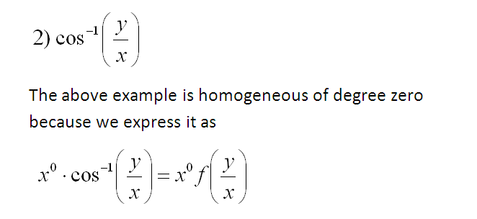

Slide 5
Euler’s Theorem

Slide 9
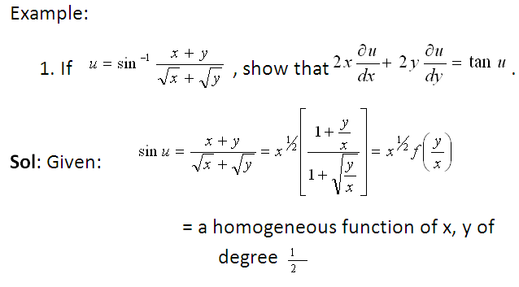

Slide 11
Suvarna Rohit Bhagwat
Mb.No.-9552385097
Email Id.-suvarnab@isquareit.edu.in

Slide 13
Suvarna Bhagwat
Assistant Professor
Department of Engineering Sciences
International Institute of Information Technology (I²IT), Pune
suvarnab@isquareit.edu.in

