Slide 1
Engineering Graphics I Unit-1 Projections of a Point & Line
By,
Prof. Priyanka Narwade

Slide 2
Learning objectives: Projections of a Point
To Study concept of Principle Planes
To Understand theory of Projections
Analysis of a point in various quadrants
Analysis of a point in 1st quadrant, its different cases
Theory of projections by auxiliary plane method: AVP & AIP

Slide 3
2nd Quadrant
VP
2nd Quad.
1ST Quad.
F.V.
1st Quadrant
Y
Observer
X Y
HP
X
3rdQuadrant
Observer
3rd Quad.
4th Quad.
4th Quadrant

Slide 4
POINT A IN
2ND QUADRANT
VP
POINT A IN
1ST QUADRANT
VP
a’
A
A
a’
a
HP
OBSERVER
HP
OBSERVER
a
a
HP
HP
OBSERVER
OBSERVER
a
a’
A
a’
POINT A IN
3RD QUADRANT
A
POINT A IN
4TH QUADRANT
VP
VP

Slide 5
PROJECTIONS OF A POINT IN FIRST QUADRANT.
POINT A ABOVE HP
& INFRONT OF VP
POINT A ABOVE HP
& IN VP
POINT A IN HP
& INFRONT OF VP
For Tv
For Tv
PICTORIAL
PRESENTATION
PICTORIAL
PRESENTATION
For Tv
a’
a’
A
A
For Fv
Y
Y
Y
For Fv
a
a’
X
a
a
X
X
A
For Fv
ORTHOGRAPHIC PRESENTATIONS
OF ALL ABOVE CASES.
Fv above xy,
Tv below xy.
Fv above xy,
Tv on xy.
Fv on xy,
Tv below xy.
VP
VP
VP
a’
a’
X
Y
X
Y
X
a’
Y
a
a
a
HP
HP
HP

Slide 6
Theory of Projections by Auxiliary Plane Method
Auxiliary Vertical Plane [AVP]
AVP is always perpendicular to HP, inclined to VP and hinged to HP (X₁Y₁).
AVP is used to find Auxiliary (New) FV which will lie on a line drawn from TV, perpendicular to New Reference Line (X₁Y₁), drawn at an angle of AVP to XY, and lies at a distance of its previous FV from its own XY.

Slide 7
Theory of Projections by Auxiliary Plane Method
Auxiliary Inclined Plane [AIP]
AIP is always perpendicular to VP, inclined to HP and hinged to VP (X₁Y₁).
AIP is used to find Auxiliary (New) TV which will lie on a line drawn from FV, perpendicular to New Reference Line (X₁Y₁), drawn at an angle of AIP to XY, and lies at a distance of its previous TV from its own XY.

Slide 8
Learning objectives: Projections of a Line
To study the Concept of Line
To understand fundamentals of projections of a line
Analysis of a line in 1st quadrant, different cases
Traces of a line: HT & VT
Summarization of concepts & observations of a oblique line

Slide 9
Projections of Line
Line:
The shortest distance between two points
A locus of infinite number of points.
A segment of an arc with infinite radius
A one dimensional object
True Length:
Every line has only & only one True Length (TL).
TL of a line in FV, TV, SV remains the same.
Concept:
If any line is parallel to any one reference plane, then view obtained in that reference plane is always True Length.
When any one view of a line represents TL, then its correspondence view is always parallel to XY & is apparent length.
For example: If FV is a TL, then its corresponding view is TV as Plan Length (PL).
For example: If TV is a TL, then its corresponding view is FV as Elevation Length (EPL).

Slide 10
For Tv
Orthographic Pattern
(Pictorial Presentation)
V.P.
a’
Note:
Fv is a vertical line
Showing True Length
&
Tv is a point.
a’
1.
V.P.
A
Fv
FV
A Line
perpendicular
to Hp
&
// to Vp
b’
b’
Y
X
Y
B
For Fv
TV
a b
X
Tv
a b
H.P.
Orthographic Pattern
(Pictorial Presentation)
Note:
Fv & Tv both are
// to xy
&
both show T. L.
V.P.
For Tv
2.
a’
Fv
b’
V.P.
b’
A Line
// to Hp
&
// to Vp
F.V.
B
a’
A
Y
X
Y
For Fv
b
a
b
T.V.
Tv
X
a
H.P.

Slide 11
Fv inclined to xy
Tv parallel to xy.
V.P.
3.
V.P.
b’
b’
A Line inclined to Hp
and
parallel to Vp
(Pictorial presentation)
B
F.V.
F.V.
a’
θ
θ
Y
X
Y
a’
θ
A
b
a
T.V.
b
X
T.V.
a
H.P.
Orthographic Projections
Tv inclined to xy
Fv parallel to xy.
V.P.
4.
V.P.
Fv
A Line inclined to Vp
and
parallel to Hp
(Pictorial presentation)
F.V.
b’
a’
b’
a’
A
Ø
B
X
Y
a
Ø
a
Ø
b
Tv
T.V.
b
H.P.

Slide 12
For Tv
For Tv
5.
A Line inclined to both
Hp and Vp
(Pictorial presentation)
b’
b’
V.P.
V.P.
B
F.V.
B
F.V.
α
α
Y
Y
a’
a’
For Fv
For Fv
A
A
β
X
β
X
a
T.V.
b
a
T.V.
b
V.P.
b’
FV
a’
α
X
Y
a
β
TV
H.P.
b

Slide 13
Orthographic Projections
Means Fv & Tv of Line AB
are shown below,
with their apparent Inclinations
α & β
Note the procedure
When Fv & Tv known,
How to find True Length.
(Views are rotated to determine
True Length & it’s inclinations
with Hp & Vp).
Note the procedure
When True Length is known,
How to locate FV & TV.
(Component a’b₂’ of TL is drawn
which is further rotated
to determine FV)
V.P.
V.P.
V.P.
b’
b’
b₁’
b’
b₁’
FV
FV
Fv
TL
a’
α
TL
a’
θ
α
b₂’
a’
θ
X
Y
X
Y
X
Y
b₁
a
β
a
β
b₁
a
Ø
TV
β
TV
TV
Tv
TL
H.P.
b
H.P.
b
H.P.
b
b₂
Here TV (ab) is not // to XY line
Hence it’s corresponding FV
a’ b’ is not showing
True Length &
True Inclination with Hp.
In this sketch, TV is rotated
and made // to XY line.
Hence it’s corresponding
FV a’ b₁’ Is showing
True Length
&
True Inclination with Hp.
Here a’b₁’ is component
of TL ab₁ gives length of FV.
Hence it is brought Up to
Locus of a’ and further rotated
to get point b’. a’ b’ will be Fv.
Similarly drawing component
of other TL(a’b₁‘) TV can be drawn.

Slide 14
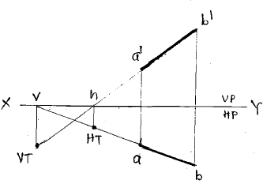
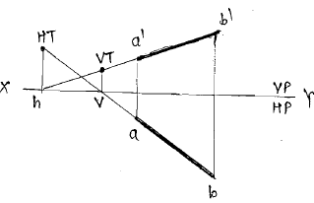
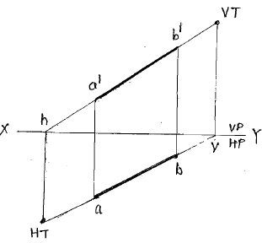
Traces of Line
Trace: Extension of apparent line intersecting to reference plane.
Horizontal Trace (HT): Extend EL to intersect XY at ‘h’, through ‘h’ draw the projector which will cut extension of PL to give HT.
Vertical Trace (VT): Extend PL to intersect XY at ‘v’, through ‘v’ draw the projector which will cut extension of EL to give VT.
Remember: EL (a’, b’), h, VT are collinear & lie on ‘α’ line.
PL (a, b), v, HT are collinear & lie on ‘β’ line, while ‘h’ & ‘v’ are always lie on XY.

Slide 15
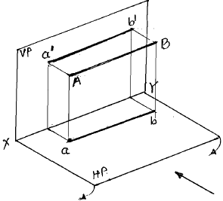
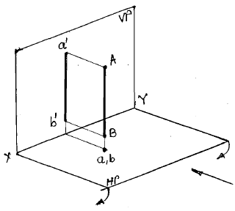
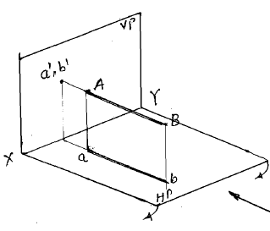
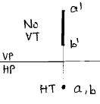
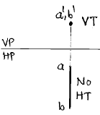
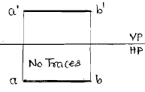
Traces of Line
Line Parallel to VP &
Perpendicular to HP
Line Parallel to HP &
Perpendicular to VP
Line Parallel to HP & VP

Slide 16
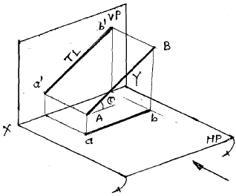
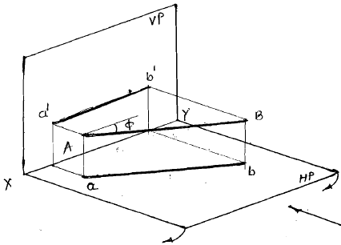
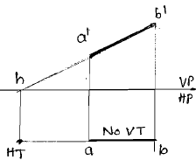
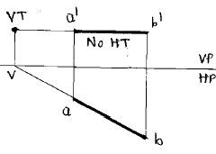
Traces of Line
Line Parallel to VP &
inclined to HP
Line Parallel to HP &
inclined to VP

Slide 17
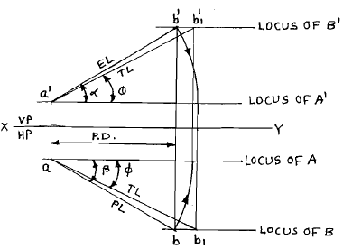
Projections of Line
a’ Point above HP
a Point in front of VP
b‘ Point above HP
b Point in front of VP
a’b’ Elevation or FV length, EL
ab Plan or TV length, PL
TL True length = a‘b’₁ = ab₁
α Apparent angle made by EL
Β Apparent angle made by PL
Θ True inclination with HP by TL
Φ True inclination with VP by TL
PD Projector distance parallel to XY
a‘a Lies on the same Projector
b‘b Lies on the same Projector
HT Horizontal trace
VT Vertical trace
a’, b’, h, VT are collinear & lies on EL
a, b, v, HT are collinear & lies on PL
h & v are always on XY
A Line inclined to both HP & VP

Slide 18
Hints to solve the problems
Line is inclined to HP or XY represents ‘θ’ while to VP or XY represents ‘Φ’.
FV makes, FV line is inclined, Elevation makes - represents ‘α’, while TV makes, TV line is inclined, Plan makes - represents ‘β’.
If apparent lengths & apparent angles are known, then rotate them upto the locus through the point of rotation and make it parallel to XY. Then project it to the corresponding view to find its TL (e.g. EL & ‘α’ are known, then rotate EL, make it parallel to XY & project it into TV to find corresponding TL & ‘Φ’.).
If true length & true inclinations are known, then project them into corresponding view & rotate it to find the EL or PL. [Reverse of above procedure].

Slide 19
Marking Scheme
Locating given data – 2M
Drawing complete Front View – 4M
Drawing complete Top View – 4M
Locating traces – 2M
Total: 12 Marks

Slide 20
Points to remember while solving problems
The point of a line which you rotate, project it on the locus of the same point in corresponding view.
Never extend true line to intersect XY to find out the traces of a line.
Projections of any point on EL or PL are always lying on the same projector.
Draw only EL & PL as visible lines, TL & XY as thin lines while all the projectors, projections, rotations etc. should be as faint as possible.
When EL or PL is rotated, then show the direction of rotation by arrow.
Put the given data in the drawing while write separate answers for the findings with the corresponding units.
Use all capital letters for any write up on the sheet.

Slide 21
Thank You!

