Slide 1
LEX & YACC
Ms.Ashwini Jarali
Department of Computer Science
International Institute of Information Technology, I²IT
www.isquareit.edu.in

Slide 2
LEX & YACC
What is Lex?
Lex is officially known as a "Lexical Analyser".
It's main job is to break up an input stream into more usable elements.
in, other words, to identify the "interesting bits" in a text file.
For example, if you are writing a compiler for the C programming language, the symbols { } ( ) ; all have significance on their own. The letter a usually appears as part of a keyword or variable name, and is not interesting on it's own. Instead, we are interested in the whole word. Spaces and newlines are completely uninteresting, and we want to ignore them completely, unless they appear within quotes "like this“
All of these things are handled by the Lexical Analyser.

Slide 3
What is Yacc?
Yacc is officially known as a "parser".
YACC stands for "Yet Another Compiler Compiler". This is because this kind of analysis of text files is normally associated with writing compilers.
For example, a C program may contain something like:
{
int int; int = 33;
printf("int: %d\n",int);
}

Slide 4
In this case, the lexical analyser would have broken the input stream into a series of "tokens", like this:
{ int
int
;
int
=
33 ;
Printf ( "int: %d\n" , int )
;
}
Note that the lexical analyser has already determined that where the keyword int appears within quotes, it is really just part of a litteral string.
It is up to the parser to decide if the token int is being used as a keyword or variable. Or it may choose to reject the use of the name int as a variable name. The parser also ensures that each statement ends with a ; and that the brackets balance.

Slide 5
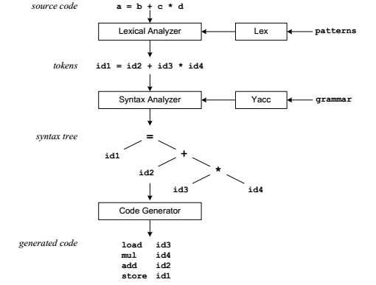
Compilation Sequence

Slide 6
The patterns in the above diagram is a file you create with a text editor. Lex will read your patterns and generate C code for a lexical analyzer or scanner.
The lexical analyzer matches strings in the input, based on your patterns, and converts the strings to tokens.
Tokens are numerical representations of strings, and simplify processing.
When the lexical analyzer finds identifiers in the input stream it enters them in a symbol table.
The grammar in the above diagram is a text file you create with a text editor. Yacc will read your grammar and generate C code for a syntax analyzer or parser.
The syntax analyzer uses grammar rules that allow it to analyze tokens from the lexical analyzer and create a syntax tree.
The syntax tree imposes a hierarchical structure to the tokens.

Slide 7
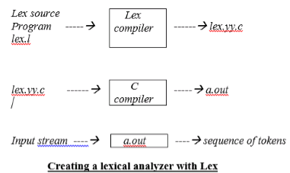
Lex specifications:
A Lex program (the .l file) consists of three parts:
declarations
%%
translation rules
%%
Definition(User Subroutines)

Slide 8
auxiliary procedures
The declarations section includes declarations of variables, manifest constants and regular definitions.
The translation rules of a Lex program are statements of the form :
p1 {action 1}
p2 {action 2}
…
Where each p is a regular expression and each action is a program fragment describing what action the lexical analyzer should take when a pattern p matches a lexeme. In Lex the actions are written in C.
The third section holds whatever auxiliary procedures are needed by the actions. Alternatively these procedures can be compiled separately and loaded with the lexical analyzer.

Slide 9
Sample Lex program implementation to count the number of words.
/*lex program to count number of words*/
%{ /*Declaration section*/
#include<stdio.h>
#include<string.h>
int i = 0;
%}
/* Rules Section*/
%%
([a-zA-Z0-9])* {i++;} /* Rule for counting number of words*/
"\n" {printf("%d\n", i); i = 0;}
%%
int yywrap(void){}
int main()
{ // The function that starts the analysis
yylex(); return 0; }

Slide 10
/*lex program to count number of words, lines and characters */
%{ //declaration int nchar, nword, nline; %}
//rules %%
\n { nline++; nchar++; } [^ \t\n]+ { nword++, nchar += yyleng; } . { nchar++; }
%%
//defination
int main(void) { yylex(); printf("%d\t%d\t%d\n", nchar, nword, nline); return 0; }

Slide 11
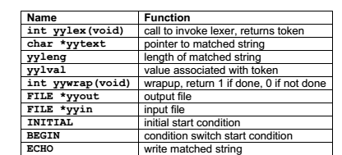
Lex Predefined Variables

Slide 12
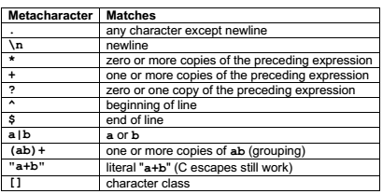
Pattern Matching Primitives
Pattern Matching Primitives

Slide 13
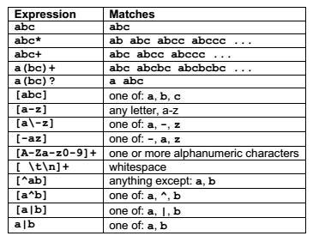
Pattern Matching Examples
Pattern Matching Primitives

Slide 14
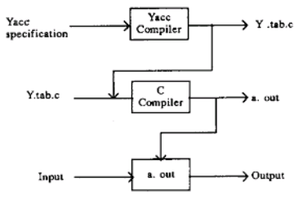
YACC
Pattern Matching Primitives

Slide 15
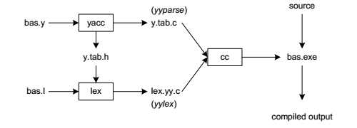
Building a Compiler with Lex/Yacc
assume our goal is to write a BASIC compiler. First, we need to specify all pattern matching rules for lex (bas.l) and grammar rules for yacc (bas.y).
Commands to create our compiler, bas.exe, are listed below: yacc –d bas.y # create y.tab.h, y.tab.c
lex bas.l # create lex.yy.c cc lex.yy.c y.tab.c –o bas.exe # compile/link

Slide 16
Yacc reads the grammar descriptions in bas.y and generates a syntax analyzer (parser), that includes function yyparse, in file y.tab.c. Included in file bas.y are token declarations.
The –d option causes yacc to generate definitions for tokens and place them in file y.tab.h.
Lex reads the pattern descriptions in bas.l, includes file y.tab.h, and generates a lexical analyzer, that includes function yylex, in file lex.yy.c.
Finally, the lexer and parser are compiled and linked together to create executable bas.exe.
From main we call yyparse to run the compiler.
Function yyparse automatically calls yylex to obtain each token.

Slide 17
YACC full specification file looks like:
declarations
%%
rules
%%
programs
The declaration section may be empty
The rules section is made up of one or more grammar rules. A grammar rule has the BNF form:
A : BODY ;
Where A represents a nonterminal name, and BODY represents a sequence of zero or more names and literals.
The colon and the semicolon are Yacc punctuation.

Slide 18
If there are several grammar rules with the same left hand side, the vertical bar ``|'' can be used to avoid rewriting the left hand side. Thus the grammar rules
A : B C D ;
A : E F ;
A : G ;
can be given to Yacc as
A : B C D
| E F
| G ;
If a nonterminal symbol matches the empty string, this can be indicated in the obvious way:
empty : ;

Slide 19
Names representing tokens must be declared ;
this is most simply done by writing in the declarations section.
%token name1 name2 . . .
Every name not defined in the declarations section is assumed to represent a nonterminal symbol.
Every nonterminal symbol must appear on the left side of at least one rule.
For recursive execution ,the grammar rule is :
A : Z|A Z;
Z:B C D
| E F
| G ;

Slide 20
Sample YACC program which accept strings that starts and ends with 0 or 1
Lexical Analyzer Source Code (abc.l)
%{ /* Definition section */
extern int yylval;
%}
/* Rule Section */
%%
0 {yylval = 0; return ZERO;}
1 {yylval = 1; return ONE;}
.|\n {yylval = 2; return 0;}
%%
/*Definition Section*/
#no need of Definition section here as it is input to Yacc program

Slide 21
Parser Source Code : (abc.y)
%{ /* Definition section */
#include<stdio.h>
#include <stdlib.h>
void yyerror(const char *str)
{ printf("\nSequence Rejected\n");
}
%}
%token ZERO ONE
/* Rule Section */
%%
r : s {printf("\nSequence Accepted\n\n");}
;
s : n
| ZERO a
| ONE b
;

Slide 22
Parser Source Code :(abc.y)
a : n a //Recursive
| ZERO
;
b : n b //Recursive
| ONE
;
n : ZERO
| ONE
;
%%
#include"lex.yy.c“ //driver code
int main()
{ printf("\nEnter Sequence of Zeros and Ones : ");
yyparse(); printf("\n");
return 0; }

Slide 23
Steps to execute Yacc Program
yacc –d abc.y # create y.tab.h, y.tab.c
lex abc.l # create lex.yy.c
cc lex.yy.c y.tab.c –o abc.exe # compile/link
./abc.exe #Execute
Output
01110 //Accepted
//Accepted
10000 //Rejected

Slide 24
Difference between LEX and YACC
Lex is used to split the text into a list of tokens, what text become token can be specified using regular expression in lex file.
Yacc is used to give some structure to those tokens. For example in Programming languages, we have assignment statements like int a = 1 + 2; and i want to make sure that the left hand side of '=' be an identifier and the right side be an expression [it could be more complex than this]. This can be coded using a CFG rule and this is what you specify in yacc file and this you cannot do using lex (lex cannot handle recursive languages).
A typical application of lex and yacc is for implementing programming languages.
Lex tokenizes the input, breaking it up into keywords, constants, punctuation, etc.

Slide 25
Yacc then implements the actual computer language; recognizing a for statement, for instance, or a function definition.
Lex and yacc are normally used together. This is how you usually construct an application using both:
Input Stream (characters) -> Lex (tokens) -> Yacc (Abstract Syntax Tree) -> Your Application

Slide 26
References:
https://luv.asn.au/overheads/lex_yacc/index.html
https://www.ques10.com/p/9881/lex-and-yacc-1/
https://www.cs.utexas.edu/users/novak/yaccpaper.htm
https://www.geeksforgeeks.org/yacc-program-which-accept-strings-that-starts-and-ends-with-0-or-1/
LEX & YACC TUTORIAL by Tom Niemann

