Slide 1
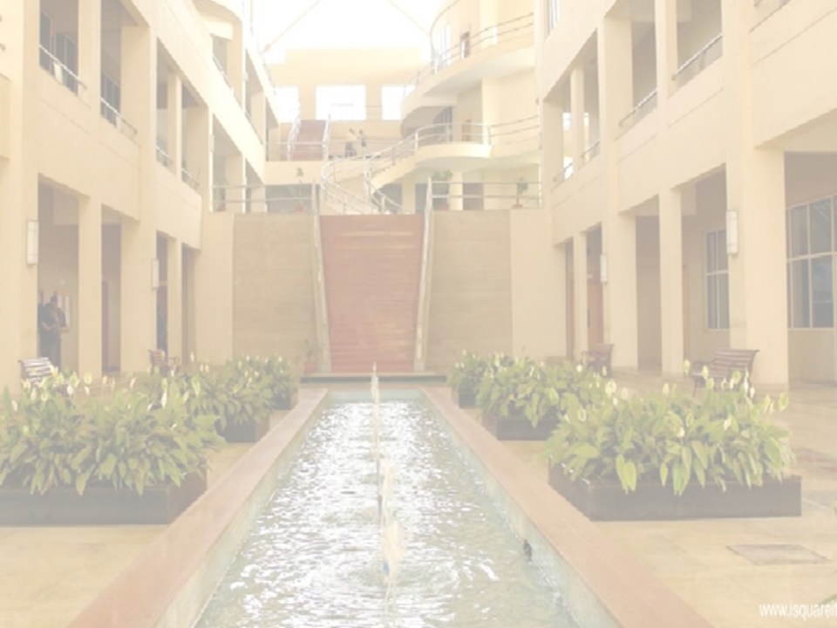

Water treatment: Boiler Problems
Dr.Smita Kavalgikar
Engineering Sciences
International Institute of Information Technology, I²IT
www.isquareit.edu.in

Slide 2






Slide 3
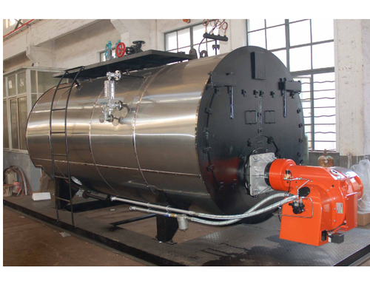
BOILER
A boiler is a device for generating steam
The furnace, which provides heat, usually by burning a fuel, and the boiler proper, a device in which the heat changes water into steam.
The steam Applications :water heating, central heating, boiler-based power generation, cooking, and sanitation.
Proper treatment of boiler feed water is an important part of operating and maintaining a boiler system. As steam is produced, dissolved solids become concentrated and form deposits inside the boiler.
This leads to poor heat transfer and reduces the efficiency of the boiler.

Slide 4
BOILER FEED WATER
Feedwater is water that undergoes purification or preheating and is then supplied to boilers for hot water and steam production, or it can remain still. It is typicallyfound in thermal power plants where it is stored and conditioned in tanks, known as boiler feed water
It should have the following composition:
Its hardness should be below 0.2 ppm.
Its caustic alkalinity(due to OH⁻)
Its soda alkalinity(due to Na₂CO₃) should be 0.45-1ppm.
Types of boiler | Permitted hardness in feed water
Low Pressure | 40-80 ppm
Medium Pressure | 10-40 ppm
High Pressure | 0-3 ppm

Slide 5
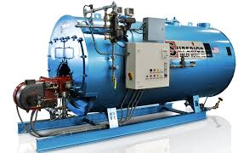
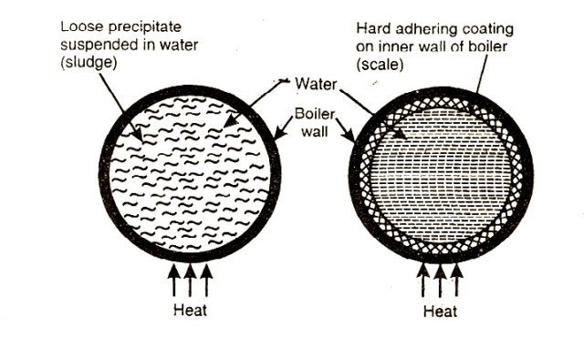
Scale & sludge formation
Water in boiler is continuously heated causes the increase in the concentration of dissolved and suspended solids.
The precipitation in the form of soft loose and slimy deposits (sludge)
The precipitation in the form of hard deposits, which are sticky on the walls
of boilers (scale)
sludge & Scale formation process

Slide 6
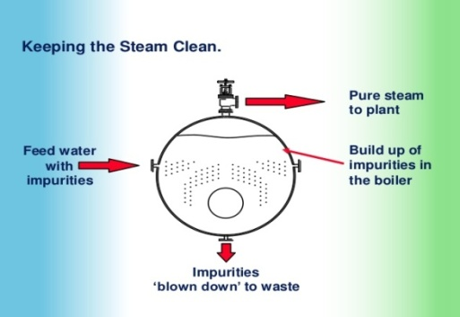
Disadvantages of sludge
Sludge:
The muddy solid at the bottom of the boiler (or) the loose, slimy and soft deposits in the boiler are called sludge.
Occurs in colder areas ,collected in area where flow rate is slow or at bends of pipes
Causes of the sludge:-
The sludge is caused by MgCO₃, MgCl₂,CaCl₂ which have more solubility in hot water
Sludges are bad conductors of heat and results in wastage of heat and fuel
Sludges entrapped in the scale get deposited as scale causes more loss of efficiency of boiler
Excessive sludge formation leads to setting of sludge in slow circulation. Areas such as pipe connections leading to chocking (or) blockage of the pipes an disturb the working of boilers
Prevention
By using soft water which is free from dissolved salts like
MgCO_{3,} MgCl₂, CaCl₂ & MgSO_{4.}
Blow down operation can prevent sludge formation

Slide 7
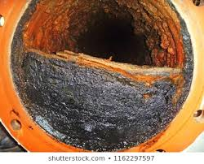
Scale: -
Scales are hard sticky deposits on the inner walls of boiler.
The scales are very difficult to remove
Main boiler trouble
Causes of the sludge:
Due to the decomposition of Ca(HCO₃)₂ at high temperature & pressure present in boiler, It forms caco₃ insoluble salt settles as ppt in the boiler.
Ca(HCO₃)₂ → CaCO_{3↓} + CO_{2↑} + H₂O
CaSO₄ highly soluble in cold water and less soluble in hot water. So the CaSO₄ in boiler water is precipitates out as hard scale if the temp of boiler increases.
The dissolved Mgcl₂ present in water is precipitates as Mg (OH) ₂ at high temperature, deposits as scale.
MgCl₂ +2H₂O→ Mg (OH)_{2↓} + 2HCl
Sio₂ present in water deposits as calcium silicate or magnesium Silicate. The deposits are very hard.

Slide 8
Disadvantages of Scale: -
Wastage of Fuel:
As the scale is hardly sticky on the walls of the boiler and it is very bad conductor of heat or have low thermal conductivity. Heat transfer from wall of boiler to water is decreased.
To get a steady supply of heat over heating is done. So there is loss of heat and fuel.
Depends upon thickness of scale
Lowering of boiler safety:
Due to the scale formation we have to heat the boiler to high temperatures this causes the weakening of boiler material.
Distortion of boiler tubes makes boiler unsafe to bear pressure of the steam (especially in high pressure boiler)
Decease in efficiency:
Due to scale deposits the chocking of boiler is observed.
Danger of explosion:
Due to uneven heat there may be developing of cracks in Scale.
Due to uneven expansion crack in scale may increases.
Whenever the water passes through this crack comes to contact with boiler plate and generates sudden steam and high pressure results explosion of boiler.

Slide 9
Removal of Scales:
If the scale is soft. It can be removed by scrapping, by piece of wood or wire.
If the scale is brittle. By giving thermal shocks done by heating to higher temperature and suddenly cooling.
If scale is hard and adherent. The CaCO₃ scale is removed by the washing with 5-10% HCl Solution and CaSO₄ scale in removed washing with EDTA solution.
If the scale is loosely bound. Blow down operation also removes Scale
Prevention of scale formation:
Internal treatment :
1} Precipitate out scale forming impurities form of sludge which will be blown down.
2} Impurities can be converted into compounds which are dissolved form in water so wont harm.

Slide 10
Important Internal treatment methods
1}Colloidal conditioning:
In low pressure boilers, by adding organic substances e.g. kerosene, tanin ,agar-agar
These will coat on the scale and yield non-sticky and loose deposits as like sludge
which will be removed by blown down operation
2}Phosphate conditioning:
In high pressure boilers, by adding sodium phosphate
3CaCl₂ + 2Na₃Po₄→ Ca₃(PO₄)₂↓ + 6NaCl
↑ Non-adherent, easy to remove
NaH₂PO₄
Na₂HPO₄
Na₃PO₄
Alkalinity of water is too high
Alkalinity of water is adequate
Alkalinity of water is low
Acidic
Slightly alkaline
Alkaline

Slide 11
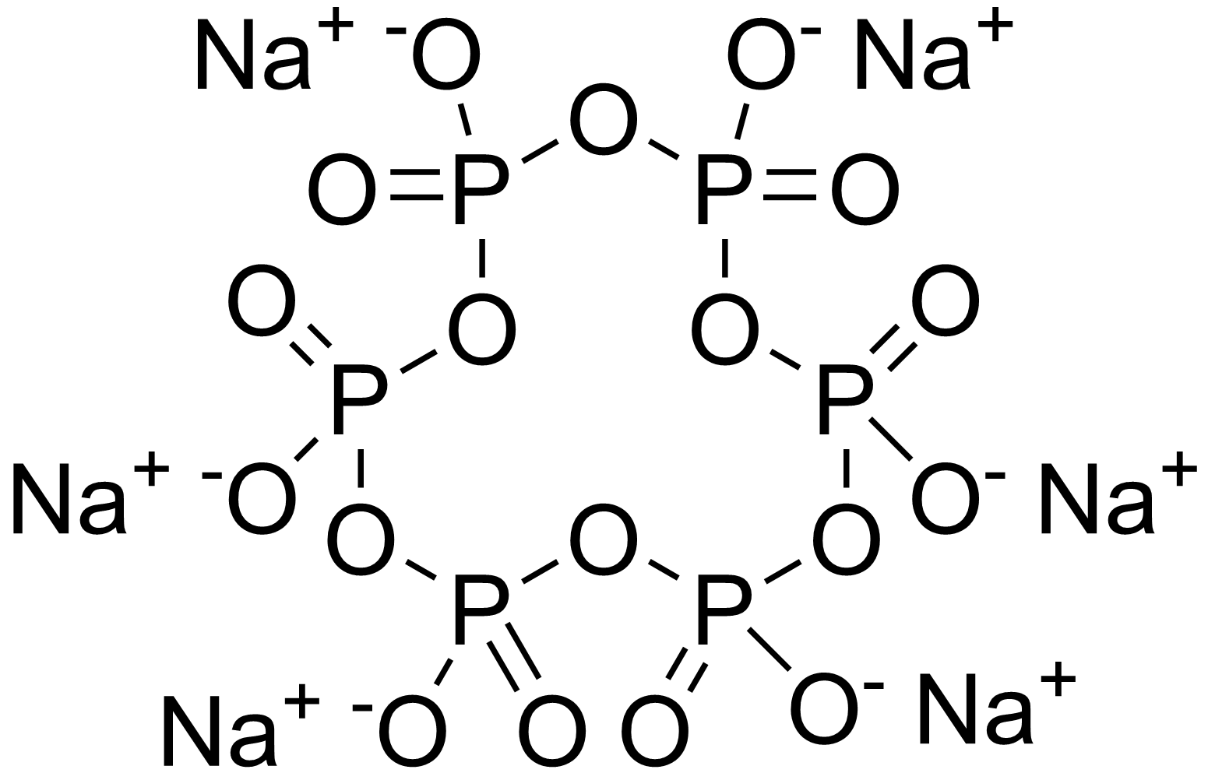
3} Carbonate conditioning:
By adding Na₂CO₃ to boiler
CaSO₄ + Na₂CO₃ →CaCO₃↓ + Na₂SO₄
↑ removed by blow down operations
4} Treatment with sodium aluminate(NaAlO₂)
By addition of NaAlO₂ hydrolysis occur gives gelatinous ppt
NaOH reacts with the magnesium salt to form sludge
entraps the colloidal impurity (oil, silica)
removed by blow down operation
5} Calogen conditioning
Sodium hexametaphosphate Na₂[Na₄(PO₃)₆] is forming soluble complex.
NaAlO₂ + H₂O NaOH + Al(OH)₃
NaOH + MgCl₂ Mg(OH)₂↓+2NaCl
Na₂[Na₄(PO₃)₆] 2Na⁺ + [Na₄P₆O₁₈]² ⁻
Na₂[Na₄P₆O₁₈] + 2CaSO₄ Na₂[Ca₂P₆O₁₈] + 2Na₂SO₄

Slide 12
Dr. Smita Kavalgikar
Mob. No: 9011079483
Email ID: smitan@isquareit.edu.in

