Slide 1
Introduction
to
TCP/IP protocol Suite
Hope Foundation’s International Institute of Information Technology, I²IT, P-14 Rajiv Gandhi Infotech Park, Hinjawadi, Pune - 411 057
Tel - +91 20 22933441 / 2 / 3 | Website - www.isquareit.edu.in ; Email - info@isquareit.edu.in

Slide 2
Protocol Layering
In data communication and networking, a Protocol defines the rules that both the sender and receiver and all intermediate devices need to follow to be able to communicate effectively.
When communication is simple, we may need only one simple protocol.
When communication is complex, we may need to divide the task between different layers, in which case we need a protocol at each layer, or Protocol Layering.
Source: Data Communications and Networking 5E, Forouzan
Hope Foundation’s International Institute of Information Technology, I²IT, P-14 Rajiv Gandhi Infotech Park, Hinjawadi, Pune - 411 057
Tel - +91 20 22933441 / 2 / 3 | Website - www.isquareit.edu.in ; Email - info@isquareit.edu.in

Slide 3
A Single Layer protocol
Greet eachother when they meet
Confine the vocabulary to the level of friendship
Refrain from speaking if one is speaking
Opportunity to talk both on an issue (dialog / monolog)
Exchange nice words when departing
Source: Data Communications and Networking 5E, Forouzan
Hope Foundation’s International Institute of Information Technology, I²IT, P-14 Rajiv Gandhi Infotech Park, Hinjawadi, Pune - 411 057
Tel - +91 20 22933441 / 2 / 3 | Website - www.isquareit.edu.in ; Email - info@isquareit.edu.in

Slide 4
A three-Layer Protocol
Source: Data Communications and Networking 5E, Forouzan
Hope Foundation’s International Institute of Information Technology, I²IT, P-14 Rajiv Gandhi Infotech Park, Hinjawadi, Pune - 411 057
Tel - +91 20 22933441 / 2 / 3 | Website - www.isquareit.edu.in ; Email - info@isquareit.edu.in

Slide 5
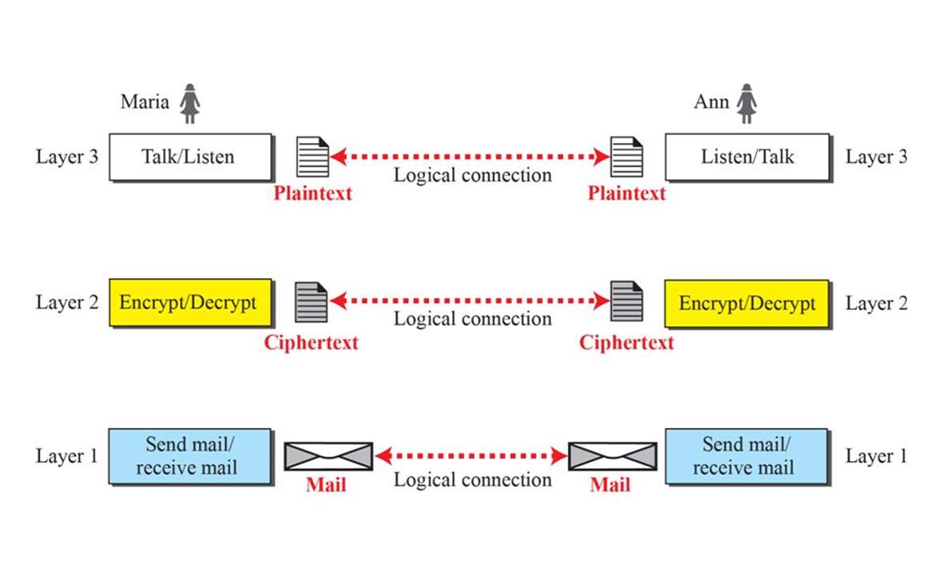
Principles of Protocol layering
First principle: If we want bidirectional communications, we need to make each layer so that it is able to perform two opposite tasks, one in each direction.
Second Principle: Two objects under each layer at both side should be identical.
Logical connection between peer layers
Source: Data Communications and Networking 5E, Forouzan
Hope Foundation’s International Institute of Information Technology, I²IT, P-14 Rajiv Gandhi Infotech Park, Hinjawadi, Pune - 411 057
Tel - +91 20 22933441 / 2 / 3 | Website - www.isquareit.edu.in ; Email - info@isquareit.edu.in

Slide 6
Introduction
TCP/IP is a protocol suite used in the Internet today. It’s a hierarchical protocol made up of interactive modules, each of which provides a specific functionality.
Image Source: Weblink https://www.google.com/url?sa=i&source=images&cd=&ved=2ahUKEwjspoq34s7fAhVJbn0KHaFSBdMQjRx6BAgBEAU&url=https%3A%2F%2Fwww.youtube.com%2Fwatch%3Fv%3DS9NhTS0WssI&psig=AOvVaw2rl2F6guAkQrGI6I02i1PW&ust=1546507202644930
Hope Foundation’s International Institute of Information Technology, I²IT, P-14 Rajiv Gandhi Infotech Park, Hinjawadi, Pune - 411 057
Tel - +91 20 22933441 / 2 / 3 | Website - www.isquareit.edu.in ; Email - info@isquareit.edu.in

Slide 7
Communication through an internet
Source: Data Communications and Networking 5E, Forouzan
Hope Foundation’s International Institute of Information Technology, I²IT, P-14 Rajiv Gandhi Infotech Park, Hinjawadi, Pune - 411 057
Tel - +91 20 22933441 / 2 / 3 | Website - www.isquareit.edu.in ; Email - info@isquareit.edu.in

Slide 8
Layers in the TCP/Ip protocol suite
Source: Data Communications and Networking 5E, Forouzan
Hope Foundation’s International Institute of Information Technology, I²IT, P-14 Rajiv Gandhi Infotech Park, Hinjawadi, Pune - 411 057
Tel - +91 20 22933441 / 2 / 3 | Website - www.isquareit.edu.in ; Email - info@isquareit.edu.in

Slide 9
Identical objects in the TCp/ip protocol suite
Source: Data Communications and Networking 5E, Forouzan
Hope Foundation’s International Institute of Information Technology, I²IT, P-14 Rajiv Gandhi Infotech Park, Hinjawadi, Pune - 411 057
Tel - +91 20 22933441 / 2 / 3 | Website - www.isquareit.edu.in ; Email - info@isquareit.edu.in

Slide 10
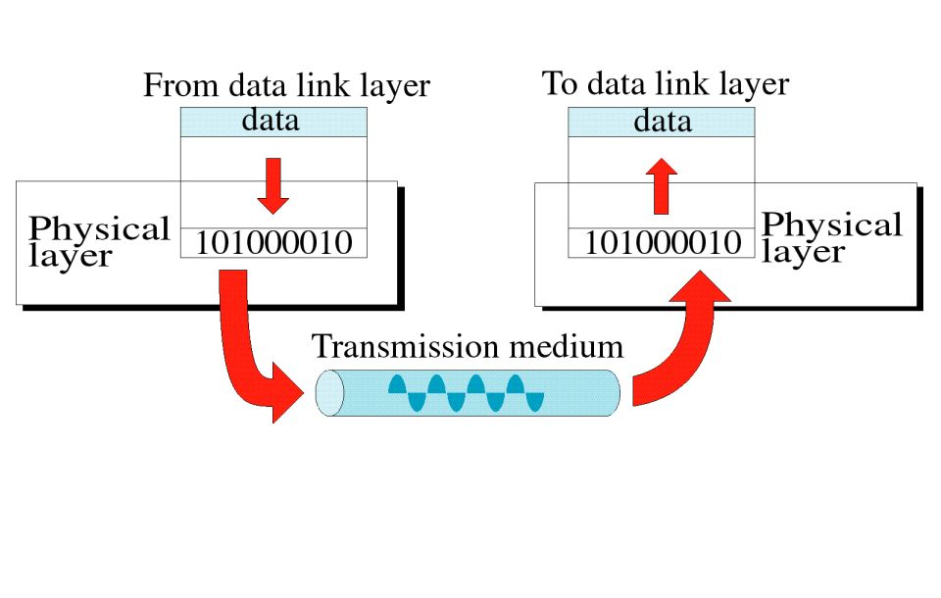
Physical Layer
Physical layer is responsible for movements of bits from one hop(node) to the next
1. Physical Characteristics of Interface and medium : Type of Transmission medium
2. Representation of Bits : Encoding Techniques ; Conversion of Bits to Electrical/Optical signals
3. Data rate: bits/sec
4. Synchronization: Clock Synchronization at Sender & receiver
5. Physical Topology: Star, Bus, Mesh, Ring etc
6. Line Configuration : Point to Point, Multipoint Configurations
7. Transmission Mode : Simplex , Half-Duplex, Full-Duplex
Image Source: https://slideplayer.com/slide/9415506/
Source: Data Communications and Networking 5E, Forouzan
Hope Foundation’s International Institute of Information Technology, I²IT, P-14 Rajiv Gandhi Infotech Park, Hinjawadi, Pune - 411 057
Tel - +91 20 22933441 / 2 / 3 | Website - www.isquareit.edu.in ; Email - info@isquareit.edu.in

Slide 11
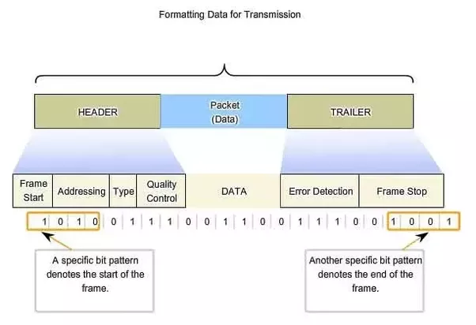
Data Link Layer
Data link layer is responsible for moving frames from one hop(node) to the next
Image Source: http://www.highteck.net/EN/DataLink/Data_Link_Layer.html
1. Framing
2. Physical Addressing
3.Flow control
4. Error Control: Detection & Correction
5. Access Control
e.g., ARP, IEEE 802.3 and IEEE 802.11
Source: Data Communications and Networking 5E, Forouzan
Hope Foundation’s International Institute of Information Technology, I²IT, P-14 Rajiv Gandhi Infotech Park, Hinjawadi, Pune - 411 057
Tel - +91 20 22933441 / 2 / 3 | Website - www.isquareit.edu.in ; Email - info@isquareit.edu.in

Slide 12
Network Layer
Network layer is responsible for delivery of individual packets from source host to destination host
1. Logical Addressing: IPv4, IPv6
2. Routing: Routing algorithms & table (traffic routing & control)
e.g., IP, ICMP, IGMP, DHCP
Image Source: Weblink
https://fossbytes.com/network-layer-osi-model/
Source: Data Communications and Networking 5E, Forouzan
Hope Foundation’s International Institute of Information Technology, I²IT, P-14 Rajiv Gandhi Infotech Park, Hinjawadi, Pune - 411 057
Tel - +91 20 22933441 / 2 / 3 | Website - www.isquareit.edu.in ; Email - info@isquareit.edu.in

Slide 13
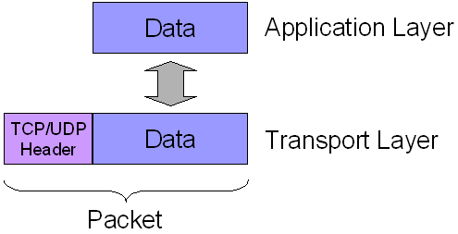
Transport Layer
Transport layer is responsible for the delivery of the message from one process to another
1. Service point addressing: Port Address
2. Segmentation : Divided into transmittable segments with sequence numbers
3. Connection Control
4. Flow Control
5. Session Multiplexing
6. Error Detection & Correction (resends)
7. Message reordering (reassembly)
e.g., TCP, UDP
Source: Data Communications and Networking 5E, Forouzan
Hope Foundation’s International Institute of Information Technology, I²IT, P-14 Rajiv Gandhi Infotech Park, Hinjawadi, Pune - 411 057
Tel - +91 20 22933441 / 2 / 3 | Website - www.isquareit.edu.in ; Email - info@isquareit.edu.in

Slide 14
Application Layer
Application layer is responsible for providing services to the user.
1. Network virtual terminal (e.g. usgs)
2.File transfer, access and management
3.Mail services
4.Directory services
Source: Data Communications and Networking 5E, Forouzan
Image Socure: https://www.pinterest.com/pin/561050066049773076/?lp=true
Hope Foundation’s International Institute of Information Technology, I²IT, P-14 Rajiv Gandhi Infotech Park, Hinjawadi, Pune - 411 057
Tel - +91 20 22933441 / 2 / 3 | Website - www.isquareit.edu.in ; Email - info@isquareit.edu.in

Slide 15
Source: Data Communications and Networking 5E, Forouzan
Hope Foundation’s International Institute of Information Technology, I²IT, P-14 Rajiv Gandhi Infotech Park, Hinjawadi, Pune - 411 057
Tel - +91 20 22933441 / 2 / 3 | Website - www.isquareit.edu.in ; Email - info@isquareit.edu.in

Slide 16
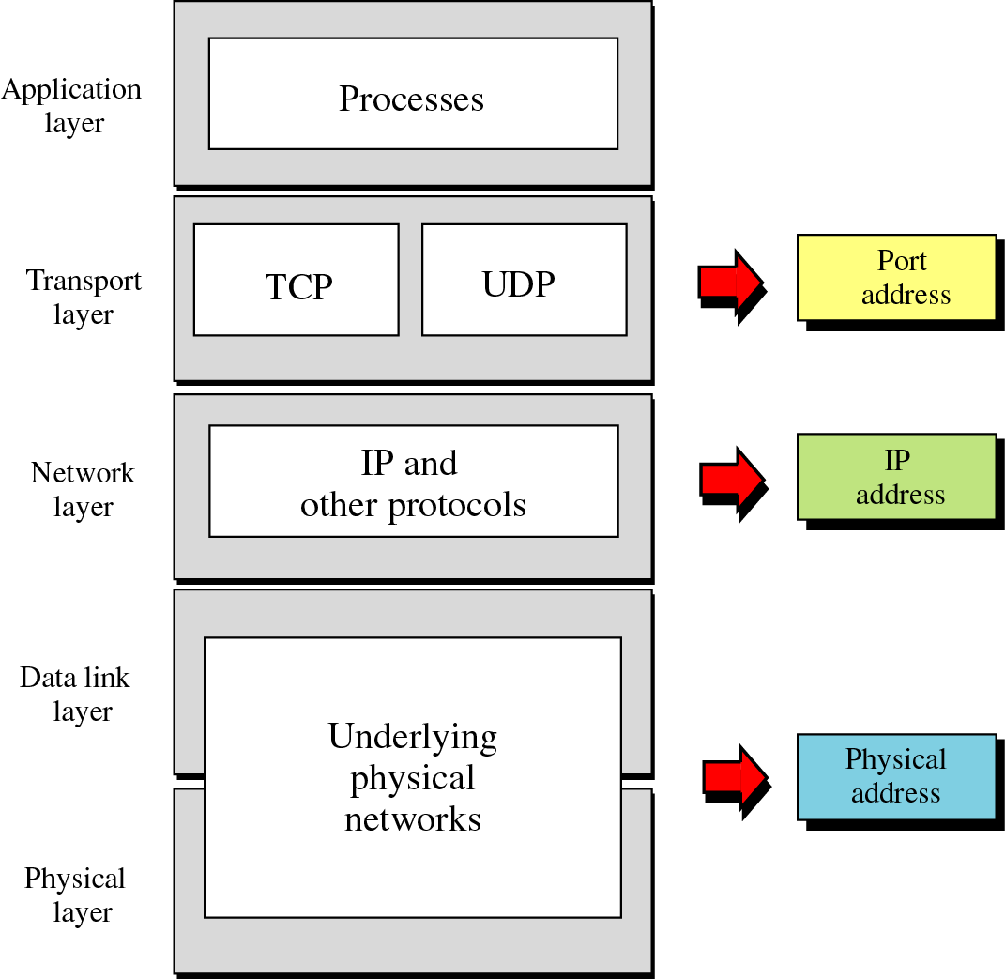
Specific Address
Relationship of layers and
Addresses in TCP/IP
Image Source : https://slideplayer.com/slide/5357044/
Hope Foundation’s International Institute of Information Technology, I²IT, P-14 Rajiv Gandhi Infotech Park, Hinjawadi, Pune - 411 057
Tel - +91 20 22933441 / 2 / 3 | Website - www.isquareit.edu.in ; Email - info@isquareit.edu.in

Slide 17
Thank you very much
Hope Foundation’s International Institute of Information Technology, I²IT, P-14 Rajiv Gandhi Infotech Park, Hinjawadi, Pune - 411 057
Tel - +91 20 22933441 / 2 / 3 | Website - www.isquareit.edu.in ; Email - info@isquareit.edu.in

