Slide 1
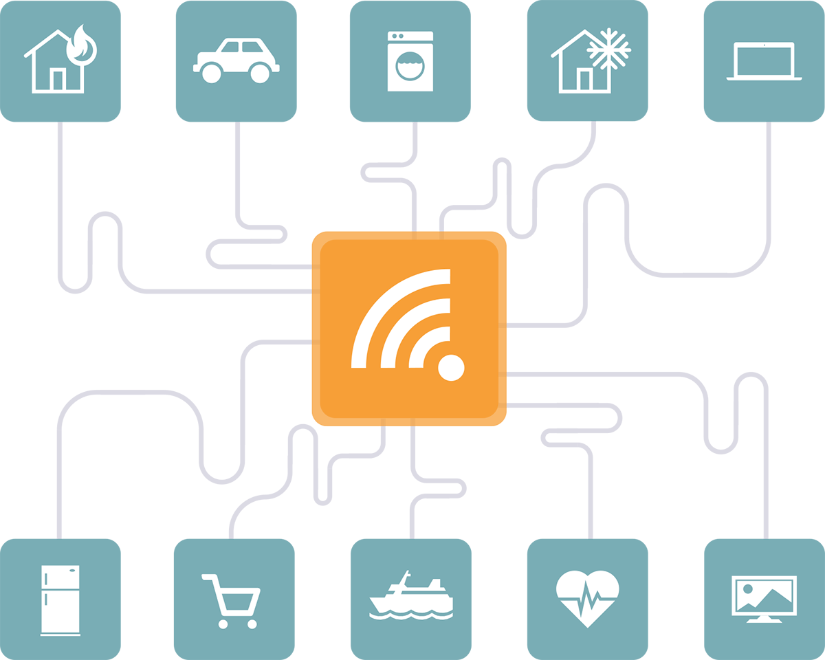
http://basho.com/use-cases/iot-sensor-device-data/
Dr. Risil Chhatrala
Dept of E&TC
I²IT, Pun
Notes:
These slides were prepared in January, 2001.

Slide 2
Introduction
Lots of data is being collected and warehoused
Web data, e-commerce
purchases at department/ grocery stores
Bank/Credit Card transactions
Social Network
Hope Foundation’s International Institute of Information Technology, I²IT
P-14, Rajiv Gandhi Infotech Park, MIDC Phase 1, Hinjawadi, Pune – 411 057
Tel +91 20 22933441/2/3 |www.isquareit.edu.in | info@isquareit.edu.in

Slide 3
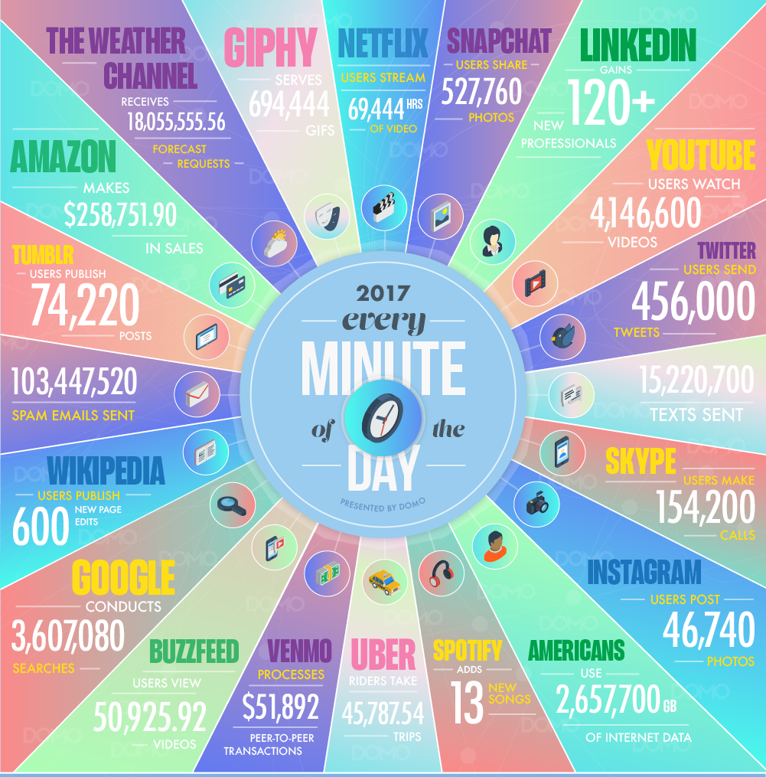
How much data?
Hope Foundation’s International Institute of Information Technology, I²IT
P-14, Rajiv Gandhi Infotech Park, MIDC Phase 1, Hinjawadi, Pune – 411 057
Tel +91 20 22933441/2/3 |www.isquareit.edu.in | info@isquareit.edu.in

Slide 4
How much data?
Google processes
20 PB a day (2008)
69480 searches per second today
http://www.internetlivestats.com/one-second/#google-band
Facebook has 30+ PB of user data + 100 TB/day
These are numbers generated every minute of the day:
Snapchat users share 527,760 photos
More than 120 professionals join LinkedIn
Users watch 4,146,600 YouTube videos
456,000 tweets are sent on Twitter
Instagram users post 46,740 photos
Hope Foundation’s International Institute of Information Technology, I²IT
P-14, Rajiv Gandhi Infotech Park, MIDC Phase 1, Hinjawadi, Pune – 411 057
Tel +91 20 22933441/2/3 |www.isquareit.edu.in | info@isquareit.edu.in

Slide 5
The Rapid Growth of Unstructured Data
YouTube users upload 300 hours of new video every minute of the day
571 new websites are created every minute of the day
Brands and organizations on Facebook receive 34,722 Likes every minute of the day
Hope Foundation’s International Institute of Information Technology, I²IT
P-14, Rajiv Gandhi Infotech Park, MIDC Phase 1, Hinjawadi, Pune – 411 057
Tel +91 20 22933441/2/3 |www.isquareit.edu.in | info@isquareit.edu.in

Slide 6
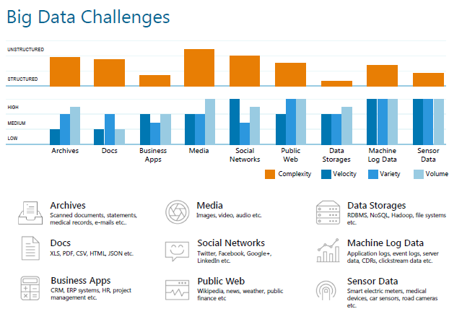
Hope Foundation’s International Institute of Information Technology, I²IT
P-14, Rajiv Gandhi Infotech Park, MIDC Phase 1, Hinjawadi, Pune – 411 057
Tel +91 20 22933441/2/3 |www.isquareit.edu.in | info@isquareit.edu.in

Slide 7
What is “big data”?
"Big Data are high-volume, high-velocity, and/or high-variety information assets that require new forms of processing to enable enhanced decision making, insight discovery and process optimization” (Gartner 2012)
Complicated (intelligent) analysis of data may make a small data “appear” to be “big”
Bottom line: Any data that exceeds our current capability of processing can be regarded as “big”
Hope Foundation’s International Institute of Information Technology, I²IT
P-14, Rajiv Gandhi Infotech Park, MIDC Phase 1, Hinjawadi, Pune – 411 057
Tel +91 20 22933441/2/3 |www.isquareit.edu.in | info@isquareit.edu.in

Slide 8
Type of Data
Relational Data (Tables/Transaction/Legacy Data)
Text Data (Web)
Semi-structured Data (XML)
Graph Data
Social Network, Semantic Web (RDF), …
Streaming Data
You can only scan the data once
Hope Foundation’s International Institute of Information Technology, I²IT
P-14, Rajiv Gandhi Infotech Park, MIDC Phase 1, Hinjawadi, Pune – 411 057
Tel +91 20 22933441/2/3 |www.isquareit.edu.in | info@isquareit.edu.in

Slide 9
What to do with these data?
Aggregation and Statistics
Data warehouse and OLAP
Indexing, Searching, and Querying
Keyword based search
Pattern matching (XML/RDF)
Knowledge discovery
Data Mining
Statistical Modeling
Hope Foundation’s International Institute of Information Technology, I²IT
P-14, Rajiv Gandhi Infotech Park, MIDC Phase 1, Hinjawadi, Pune – 411 057
Tel +91 20 22933441/2/3 |www.isquareit.edu.in | info@isquareit.edu.in

Slide 10
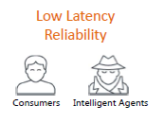
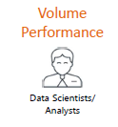
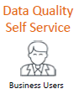
Big Data Analytics
Real Time
Intelligence
Data
Discovery
Business
Reporting
Hope Foundation’s International Institute of Information Technology, I²IT
P-14, Rajiv Gandhi Infotech Park, MIDC Phase 1, Hinjawadi, Pune – 411 057
Tel +91 20 22933441/2/3 |www.isquareit.edu.in | info@isquareit.edu.in

Slide 11
Big Data Analytics
 | Traditional Analytics (BI) | Big Data Analytics
Focus on | Descriptive analytics Diagnosis analytics | Predictive analytics Data Science
Data Sets | Limited data sets Cleansed data Simple models | Large scale data sets More types of data Raw data Complex data models
Supports | Causation: what happened, and why? | Correlation: new insight More accurate answers
Hope Foundation’s International Institute of Information Technology, I²IT
P-14, Rajiv Gandhi Infotech Park, MIDC Phase 1, Hinjawadi, Pune – 411 057
Tel +91 20 22933441/2/3 |www.isquareit.edu.in | info@isquareit.edu.in

Slide 12
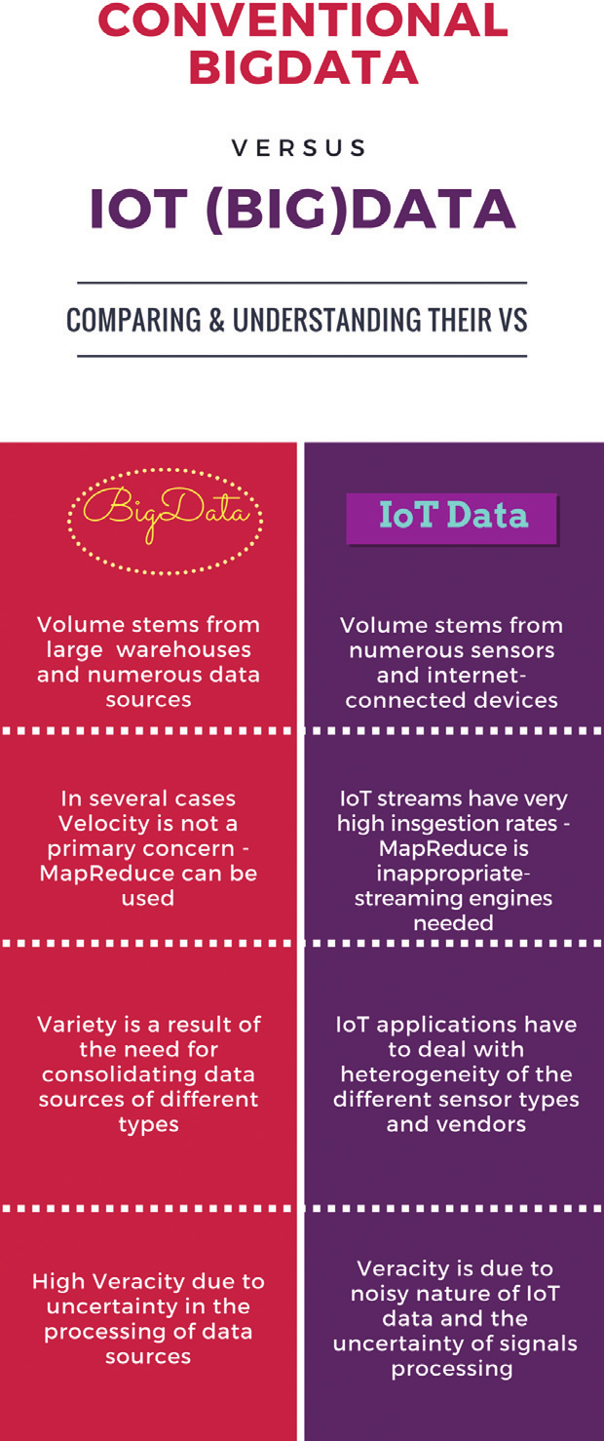
Conventional Big Data Vs IoT Big Data
Volume:
Velocity:
Variety:
Veracity:
Variability
Visualization
Value
Hope Foundation’s International Institute of Information Technology, I²IT
P-14, Rajiv Gandhi Infotech Park, MIDC Phase 1, Hinjawadi, Pune – 411 057
Tel +91 20 22933441/2/3 |www.isquareit.edu.in | info@isquareit.edu.in

Slide 13
Challenges of IoT Analytics Applications
The heterogeneity of IoT data streams
The varying data quality:
The real-time nature of IoT datasets
The time and location dependencies of IoT streams:
Privacy and security sensitivity:
Data bias:
Hope Foundation’s International Institute of Information Technology, I²IT
P-14, Rajiv Gandhi Infotech Park, MIDC Phase 1, Hinjawadi, Pune – 411 057
Tel +91 20 22933441/2/3 |www.isquareit.edu.in | info@isquareit.edu.in

Slide 14
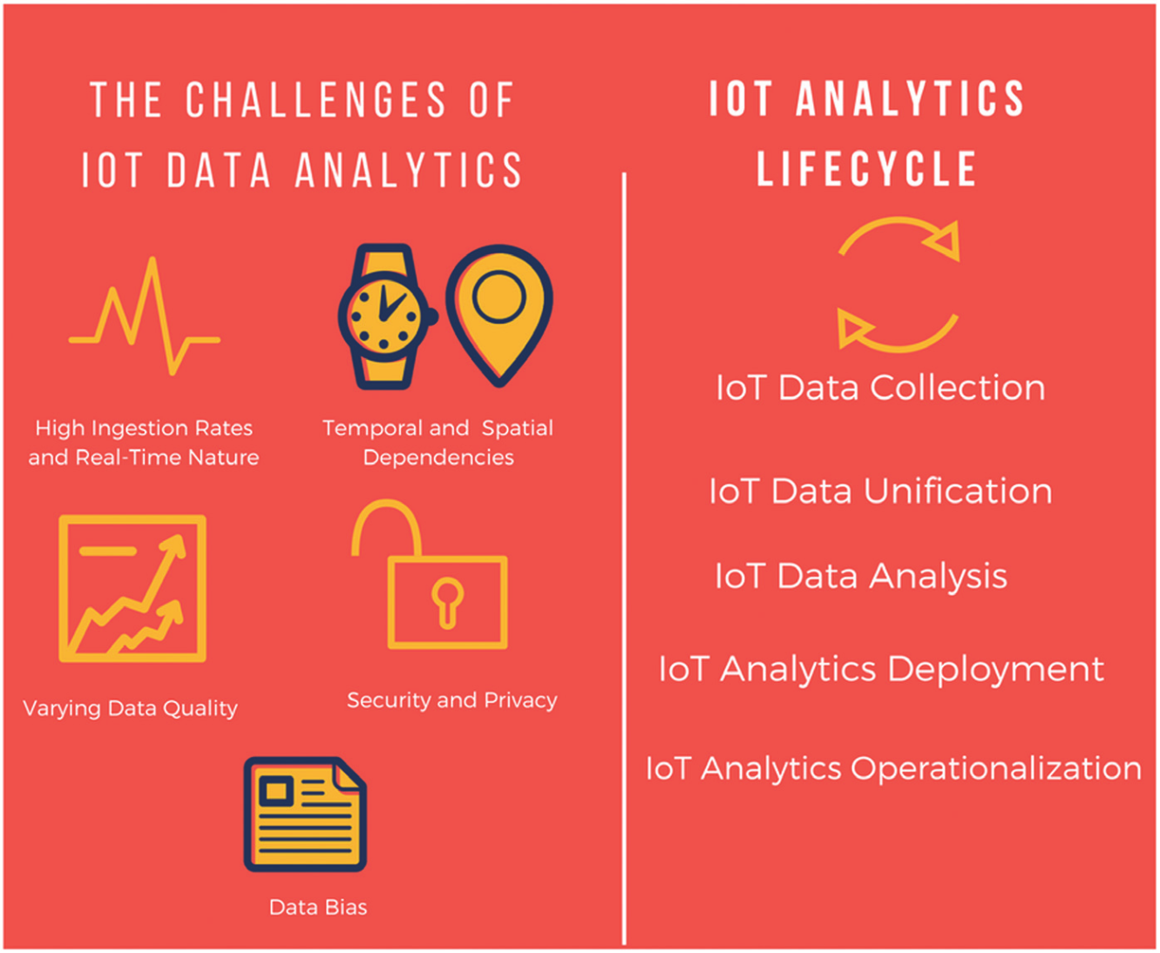
Hope Foundation’s International Institute of Information Technology, I²IT
P-14, Rajiv Gandhi Infotech Park, MIDC Phase 1, Hinjawadi, Pune – 411 057
Tel +91 20 22933441/2/3 |www.isquareit.edu.in | info@isquareit.edu.in

Slide 15
Data Management and Analysis Disciplines
IoT middleware and interoperability technologies,
Statistics
Machine learning
Data mining and Knowledge Discovery,
Database management systems,
Hope Foundation’s International Institute of Information Technology, I²IT
P-14, Rajiv Gandhi Infotech Park, MIDC Phase 1, Hinjawadi, Pune – 411 057
Tel +91 20 22933441/2/3 |www.isquareit.edu.in | info@isquareit.edu.in

Slide 16
Data Handling Technologies
Data Handling at data centre
Storing, managing and organizing data
Estimates and provides necessary processing capacity
Provides sufficient network infrastructure
Effectively manages energy consumption
Replicate data to keep backup
Develop business oriented strategic solution
Helps business personnel to analyze existing data
Discovers problems in business operations
Hope Foundation’s International Institute of Information Technology, I²IT
P-14, Rajiv Gandhi Infotech Park, MIDC Phase 1, Hinjawadi, Pune – 411 057
Tel +91 20 22933441/2/3 |www.isquareit.edu.in | info@isquareit.edu.in

Slide 17
Hope Foundation’s International Institute of Information Technology, I²IT
P-14, Rajiv Gandhi Infotech Park, MIDC Phase 1, Hinjawadi, Pune – 411 057
Tel +91 20 22933441/2/3 |www.isquareit.edu.in | info@isquareit.edu.in

Slide 18
Data Acquisition
Data Collection
Log files or record files that are automatically generated by data sources to record activities for further analysis
Sensory data such as sound waves, voice, vibration, automobile, chemical, current weather, pressure, temperature.
Complex and variety of data collection through mobile devices. Eg. Geographical location, 2D bar codes, pictures, videos etc..
Hope Foundation’s International Institute of Information Technology, I²IT
P-14, Rajiv Gandhi Infotech Park, MIDC Phase 1, Hinjawadi, Pune – 411 057
Tel +91 20 22933441/2/3 |www.isquareit.edu.in | info@isquareit.edu.in

Slide 19
Data Acquisition
Data Transmission
InterDCN transmission
Intra DCN transmission
Data Preprocessing
Collected datasets suffer from noise, redundancy, inconsistency etc..
Integration: Combining data from various sources and provides uniform view of data
Cleaning: Identifying inaccurate, incomplete, or unreasonable data and then modifying or deleting
Redundancy mitigation : Eliminating data repetition through detection, filtering and compression
Hope Foundation’s International Institute of Information Technology, I²IT
P-14, Rajiv Gandhi Infotech Park, MIDC Phase 1, Hinjawadi, Pune – 411 057
Tel +91 20 22933441/2/3 |www.isquareit.edu.in | info@isquareit.edu.in

Slide 20
Data Storage
File System
Distributed file system that store massive data and ensure- consistency, availability and fault tolerance of data
GFS
HDFS
Databases
Emergence of non traditional relational databases (NoSQL) in order to deal with characteristics that big data possess.
Three main NoSQL databases: Key value databases, Column oriented databases and document oriented databases
Hope Foundation’s International Institute of Information Technology, I²IT
P-14, Rajiv Gandhi Infotech Park, MIDC Phase 1, Hinjawadi, Pune – 411 057
Tel +91 20 22933441/2/3 |www.isquareit.edu.in | info@isquareit.edu.in

Slide 21
Requirements of IoT BigData Analytics Platform
Intelligent and Dynamic
Distributed
Scalable
Real-Time
Programmable
Interoperable
Secure
Hope Foundation’s International Institute of Information Technology, I²IT
P-14, Rajiv Gandhi Infotech Park, MIDC Phase 1, Hinjawadi, Pune – 411 057
Tel +91 20 22933441/2/3 |www.isquareit.edu.in | info@isquareit.edu.in

Slide 22
Hadoop
Hadoop is software framework for distributed processing of large datasets across large clusters of computers.
Hadoop is open source implementation of Google’s GFS and MapReduce.
Apache Hadoop’s Map Reduce and Hadoop distributed file system(HDFS) components originally derived respectively from Google’s MapReduce and Google File System.
Hope Foundation’s International Institute of Information Technology, I²IT
P-14, Rajiv Gandhi Infotech Park, MIDC Phase 1, Hinjawadi, Pune – 411 057
Tel +91 20 22933441/2/3 |www.isquareit.edu.in | info@isquareit.edu.in

Slide 23
Building Blocks of Hadoop
Hadoop Common
A module containing utilities that support other hadoop components.
Hadoop Distributed File System (HDFS)
Provides reliable data storage and access across the nodes
MapReduce
Framework for applications that process large amount of datasets in parallel
Yet Another Resource Negotiator(YARN)
Next generation MapReduce, which assigns CPU, memory and storage to applications running on Hadoop Cluster
Hope Foundation’s International Institute of Information Technology, I²IT
P-14, Rajiv Gandhi Infotech Park, MIDC Phase 1, Hinjawadi, Pune – 411 057
Tel +91 20 22933441/2/3 |www.isquareit.edu.in | info@isquareit.edu.in

Slide 24
HDFS
Hope Foundation’s International Institute of Information Technology, I²IT
P-14, Rajiv Gandhi Infotech Park, MIDC Phase 1, Hinjawadi, Pune – 411 057
Tel +91 20 22933441/2/3 |www.isquareit.edu.in | info@isquareit.edu.in

Slide 25
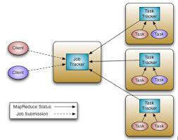
Jobs and Task trackers
Job Tracker
Runs with the name node
Receives the use’s job
Decide on how many task
will run (Number of Mappers)
Decide on where to run each
Mapper (Concept of locality)
Task Tracker
Runs on data node
Receives task from job tracker
Always in communication with the job tracker reporting progress
Hope Foundation’s International Institute of Information Technology, I²IT
P-14, Rajiv Gandhi Infotech Park, MIDC Phase 1, Hinjawadi, Pune – 411 057
Tel +91 20 22933441/2/3 |www.isquareit.edu.in | info@isquareit.edu.in

Slide 26
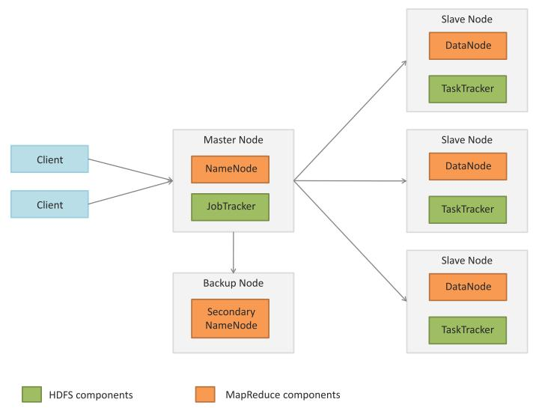
Master Slave Architecture
Hope Foundation’s International Institute of Information Technology, I²IT
P-14, Rajiv Gandhi Infotech Park, MIDC Phase 1, Hinjawadi, Pune – 411 057
Tel +91 20 22933441/2/3 |www.isquareit.edu.in | info@isquareit.edu.in

Slide 27
Master Slave Architecture
Master:
Executes operations like opening, closing, and remaining files and directories
Determines the mapping of blocks to Datanodes
Slave
Serves read and write requests from the file system’s client
Perform block creation, deletion and replication as instructed by the Namenode
Hope Foundation’s International Institute of Information Technology, I²IT
P-14, Rajiv Gandhi Infotech Park, MIDC Phase 1, Hinjawadi, Pune – 411 057
Tel +91 20 22933441/2/3 |www.isquareit.edu.in | info@isquareit.edu.in

Slide 28
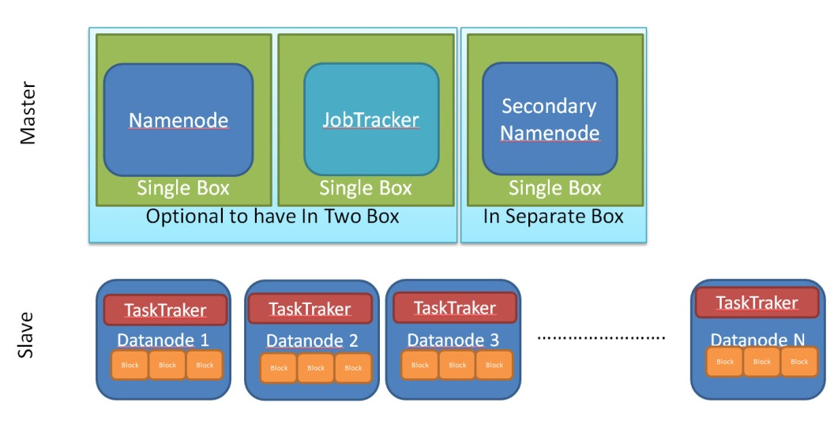
Hope Foundation’s International Institute of Information Technology, I²IT
P-14, Rajiv Gandhi Infotech Park, MIDC Phase 1, Hinjawadi, Pune – 411 057
Tel +91 20 22933441/2/3 |www.isquareit.edu.in | info@isquareit.edu.in

Slide 29
MapReduce
Map:
In the Map phase, data is read from a distributed file system and partitioned among a set of computing nodes in the cluster. The data is sent to the nodes as a set of key-value pairs. The Map tasks process the input records independently of each other and produce intermediate results as key-value pairs. The intermediate results are stored on the local disk of the node running the Map task.
Reduce:
When all the Map tasks are completed, the Reduce phase begins in which the intermediate data with the same key is aggregated.
Hope Foundation’s International Institute of Information Technology, I²IT
P-14, Rajiv Gandhi Infotech Park, MIDC Phase 1, Hinjawadi, Pune – 411 057
Tel +91 20 22933441/2/3 |www.isquareit.edu.in | info@isquareit.edu.in

Slide 30
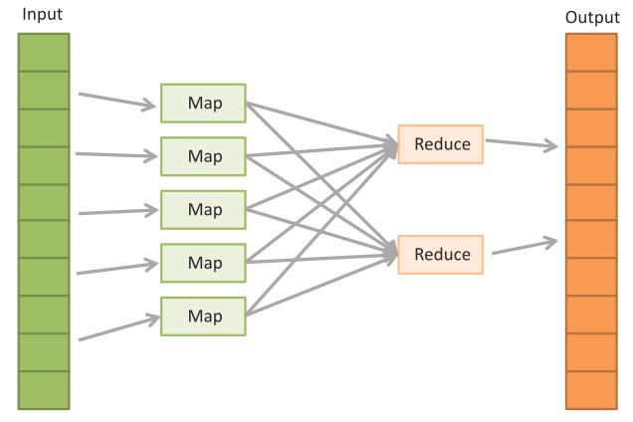
Hope Foundation’s International Institute of Information Technology, I²IT
P-14, Rajiv Gandhi Infotech Park, MIDC Phase 1, Hinjawadi, Pune – 411 057
Tel +91 20 22933441/2/3 |www.isquareit.edu.in | info@isquareit.edu.in

Slide 31
Data Analytics
Data Analytics is process of examining data sets in order to draw conclusions about the information they contain, increasingly with the aid of specialized systems and software. Data Analytics techniques and technologies are widely used in commercial industries to enable organizations to make more informed business decisions and by scientist and researchers to verify or disprove scientific models, theories and hypothesis
Hope Foundation’s International Institute of Information Technology, I²IT
P-14, Rajiv Gandhi Infotech Park, MIDC Phase 1, Hinjawadi, Pune – 411 057
Tel +91 20 22933441/2/3 |www.isquareit.edu.in | info@isquareit.edu.in

Slide 32
Qualitative Analysis
Analysis of data that are categorical in nature
Quantitative Analysis
Analysis of data that are numerical in nature
Hope Foundation’s International Institute of Information Technology, I²IT
P-14, Rajiv Gandhi Infotech Park, MIDC Phase 1, Hinjawadi, Pune – 411 057
Tel +91 20 22933441/2/3 |www.isquareit.edu.in | info@isquareit.edu.in

Slide 33
Qualitative Analysis
data is not described through numerical values,
Described by some sort of descriptive contexts such as text
data can be gathered by many methods such as from interviews, from videos, from audio recordings, field notes etc..
data needs to be interpreted and group in to identifiable themes
Summarize: Notice the things, collect the things and think about it.
Hope Foundation’s International Institute of Information Technology, I²IT
P-14, Rajiv Gandhi Infotech Park, MIDC Phase 1, Hinjawadi, Pune – 411 057
Tel +91 20 22933441/2/3 |www.isquareit.edu.in | info@isquareit.edu.in

Slide 34
Quantitative Analysis
Process by which numerical data is analysed
Involves descriptive statistics
Following are involved in Quantitative Analysis
Statistical Model
Analysis of Variable
Correlation analysis
Regression Analysis
Hope Foundation’s International Institute of Information Technology, I²IT
P-14, Rajiv Gandhi Infotech Park, MIDC Phase 1, Hinjawadi, Pune – 411 057
Tel +91 20 22933441/2/3 |www.isquareit.edu.in | info@isquareit.edu.in

Slide 35
Qualitative Vs Quantitative Analysis
Qualitative Data | Quantitative Data
Data is observed | Data is measured
Involves description | Involves numbers
Emphasis is on quality | Emphasis is on quantity
Eg. Color, smell, taste etc.. | Eg. Volume, weight
Hope Foundation’s International Institute of Information Technology, I²IT
P-14, Rajiv Gandhi Infotech Park, MIDC Phase 1, Hinjawadi, Pune – 411 057
Tel +91 20 22933441/2/3 |www.isquareit.edu.in | info@isquareit.edu.in

Slide 36
Advantages of data analytics
Allows for the identification of important trends,
It helps the businesses identify performance problems that we require some sort of action
Some prediction can be performed
Can be viewed in visual manner and that can help in faster and better decision making
Analytics can provide a company with an edge over their competitors
Hope Foundation’s International Institute of Information Technology, I²IT
P-14, Rajiv Gandhi Infotech Park, MIDC Phase 1, Hinjawadi, Pune – 411 057
Tel +91 20 22933441/2/3 |www.isquareit.edu.in | info@isquareit.edu.in

Slide 37
References
https://nptel.ac.in/courses/106105166/
https://onlinecourses.nptel.ac.in/noc17_cs22/course
John Soldatos, “Building Blocks for IoT Analytics Internet-of-Things Analytics”, CRC Press
Hadoop MapReduce Tutorial: Available online
Akhil Arora & Shrey Mehrotra, “Introduction to hadoop and hdfs”.

Slide 38
THANK YOU
For further information, please feel free to contact
Dr. Risil Chhatrala
Department of Electronics & Telecommunication
Hope Foundation’s
International Institute of Information Technology, I²IT
P-14, Rajiv Gandhi Infotech Park, MIDC Phase I
Hinjawadi, Pune – 411 057
Tel +91 20 22933441/2/3 |www.isquareit.edu.in | info@isquareit.edu.in | risilc@isquareit.edu.in

