Slide 1
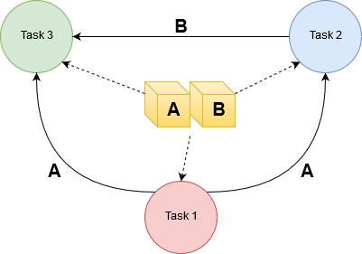
Transaction Serializability
Prof. Deptii Chaudhari

Slide 2
HOPE FOUNDATION’S
INTERNATIONAL INSTITUTE OF INFORMATION TECHNOLOGY, (I²IT)
www.isquareit.edu.in
+91 20 22933441 / 2

Slide 3
Transaction Serializability
Basic Assumption – Each transaction preserves database consistency.
Thus serial execution of a set of transactions preserves database consistency.
A (possibly concurrent) schedule is serializable if it is equivalent to a serial schedule.
Different forms of schedule equivalence give rise to the notions of:
1. Conflict serializability
2. View serializability

Slide 4
Conflicting Instructions
Instructions l_{i} and l_{j} of transactions T_{i} and T_{j} respectively, conflict if and only if there exists some item Q accessed by both l_{i} and l_{j}, and at least one of these instructions wrote Q.
1. l_{i} = read(Q), l_{j} = read(Q). l_{i} and l_{j} don’t conflict. 2. l_{i} = read(Q), l_{j} = write(Q). They conflict. 3. l_{i} = write(Q),l_{j} = read(Q). They conflict 4. l_{i} = write(Q),l_{j} = write(Q). They conflict
Intuitively, a conflict between l_{i} and l_{j} forces a (logical) temporal order between them.
If l_{i} and l_{j} are consecutive in a schedule and they do not conflict, their results would remain the same even if they had been interchanged in the schedule.

Slide 5
Conflict Serializability
If a schedule S can be transformed into a schedule S´ by a series of swaps of non-conflicting instructions, we say that S and S´ are conflict equivalent.
We say that a schedule S is conflict serializable if it is conflict equivalent to a serial schedule.

Slide 6
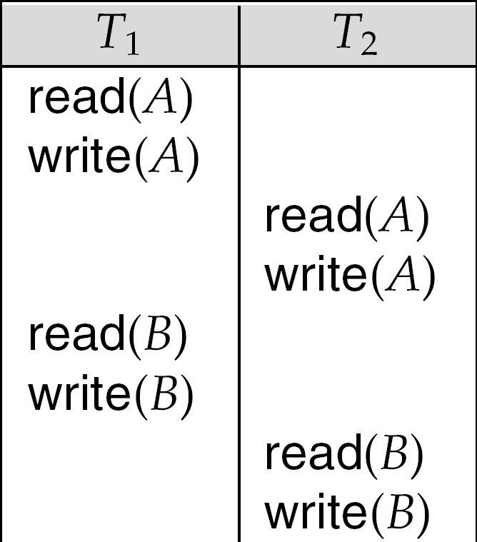
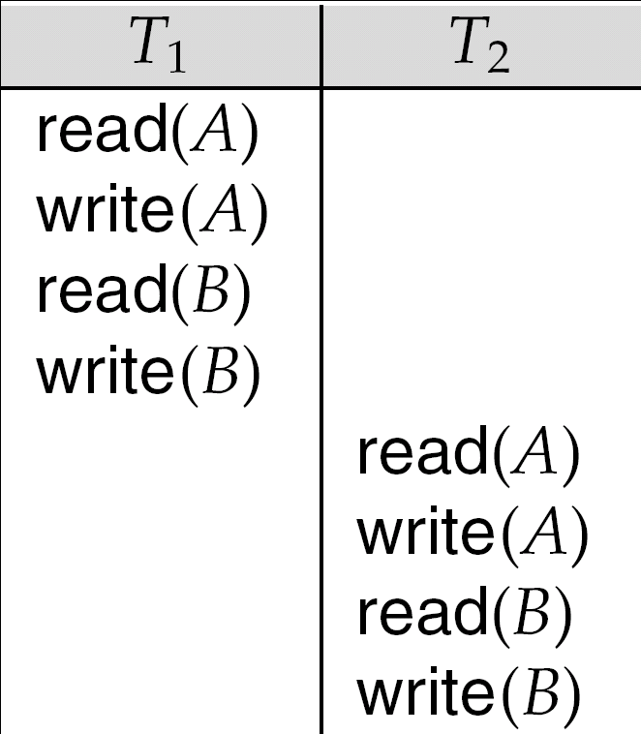
Conflict Serializability
Schedule 1 can be transformed into Schedule 2, a serial schedule where T₂ follows T₁, by series of swaps of non-conflicting instructions.
Therefore Schedule 1 is conflict serializable.
Schedule 1
Schedule 2

Slide 7
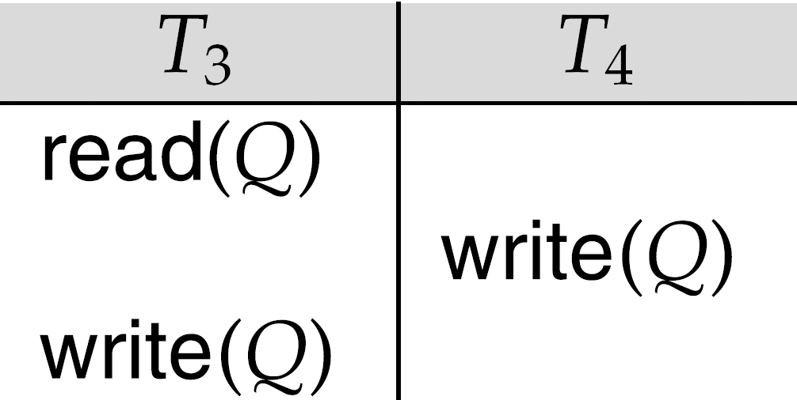
Example of a schedule that is not conflict serializable:
We are unable to swap instructions in the above schedule to obtain either the serial schedule < T₃, T₄ >, or the serial schedule < T₄, T₃ >.

Slide 8
Testing for Serializability
Consider some schedule of a set of transactions T₁, T₂, ..., T_{n}
Precedence graph — a direct graph where the vertices are the transactions (names).
We draw an arc from T_{i} to T_{j} if the two transaction conflict, and T_{i} accessed the data item on which the conflict arose earlier.
We may label the arc by the item that was accessed.

Slide 9
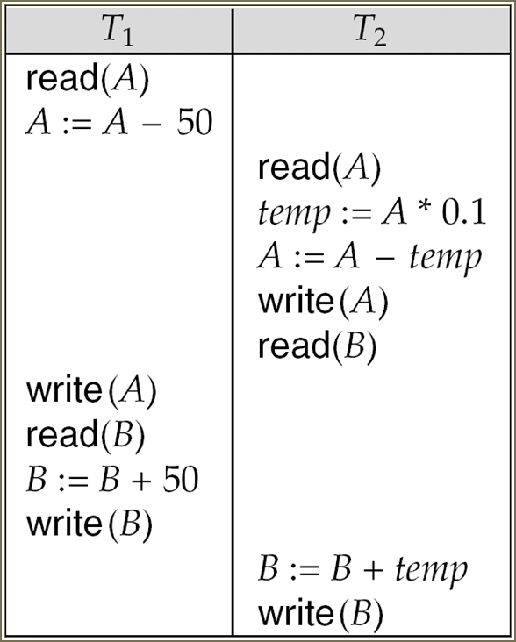
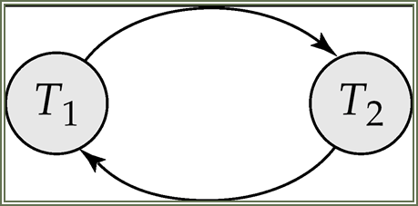
Example

Slide 10
How to check for Conflict serializability?
Consider the schedule
T1 | R1(X) R1(X)
T2 | R2(Y) R2(Y) W2(X)
T3 | W3(Y)
Step #1 : Check for the conflicting actions.
Two or more actions are said to be in conflict if:
1. The actions belong to different transactions. 2. At least one of the actions is a write operation. 3. The actions access the same object (read or write).
The following set of actions is conflicting:
T1:R(X), T2:W(X), T1:R(X)

Slide 11
While the following sets of actions are not:
T1:R(X), T2:R(Y), T3:R(X) T1:R(X), T2:W(Y), T3:R(X)
For our example, we have a conflict on X (T1 reads it and T2 writes it). We also have a conflict on Y (T2 reads it and T3 writes it).
So it has a conflict property but is it serializable?
Step #2 : Check for a cycle in the Precedence Graph.
First, draw all the Transactions (Tx):
Initial Graph
T1
T2
T3

Slide 12
Check if there is a Tx that reads an item after a different Tx writes it.
We have T1 that reads X after T2 writes it, so draw arrow from T2 -> T1
Check if there is a Tx that writes an item after a different Tx reads it.
We have T2 that writes X after T1 reads it, so draw arrow from T1 -> T2
We also have T3 that writes Y after T2 reads it, so draw arrow from T2 -> T3
Check if there is a Tx that writes an item after a different TX writes it.

Slide 13
Final Graph
T1
T2
T3
We can see that there is a cycle between T1 and T2, so the graph is cyclic, and therefore it is not conflict serializable.

Slide 14
VIEW SERIALIZABILITY
Consider two schedules S1 and S2, where the same set of transactions participates in both schedules. The schedules S1 and S2 are said to be view equivalent if three conditions are met:
1. If Ti reads initial value of A in S1, then Ti also reads initial value of A in S2
2. If Ti reads value of A written by Tj in S1, then Ti also reads value of A written by Tj in S2
3. If Ti writes final value of A in S1, then Ti also writes final value of A in S2

Slide 15
The concept of view equivalence leads to the concept of view serializability.
We say that a schedule S is view serializable if it is view equivalent to a serial schedule.

Slide 16
View Equivalent Schedule
Consider two schedules S1 and S2, they are said to be view equivalent if following conditions are true :
Initial read must be same.
S1 : T1 reads A from Database. S2 : T1 reads A from T2. ∴ S1 ≠ S2.
T1 | T2
R(A)
 | W(A)
T1 | T2
 | W(A)
R(A)
S1
S2

Slide 17
There are two transactions say Ti and Tj, The schedule S1 and S2 are view equivalent if in schedule S1, Ti reads A that has been updated by Tj, and in schedule S2, Ti must read A from Tj. i.e. write-read(WR) sequence must be same between S1 and S2.
T1 | T2 | T3
W(A)
 | W(A)
 |  | R(A)
 | S1
T1 | T2 | T3
 | W(A)
W(A)
 |  | R(A)
 | S2
S1 : T3 reads value of A from T2.
S2 : T3 reads value of A from T1.
∴ S1 ≠ S2.
i.e. write-read sequence is not same between S1 and S2.

Slide 18
Final write operations should be same between S1 and S2.
T1 | T2 | T3
 | W2(A)
 |  | W3(A)
 | R2(A)
W1(A)
 | S2
T1 | T2 | T3
W1(A)
 | R2(A)
 |  | W3(A)
 | S1
S1 : A is finally updated by T3. S2 : A is finally updated by T1. ∴ S1 ≠ S2.

Slide 19
Check whether the schedule is view serializable or not?
S : R2(B); R2(A); R1(A); R3(A); W1(B); W2(B); W3(B)
Solution: With 3 transactions, total number of schedules possible = 3! = 6
<T1 T2 T3>
<T1 T3 T2>
<T2 T3 T1>
<T2 T1 T3>
<T3 T1 T2>
<T3 T2 T1>
Step 1 : Final Updation (Write) on data items
A : -
B : T1 T2 T3

Slide 20
Since the final updation on B is made by T3, so the transaction T3 must execute before transactions T1 and T2.
Therefore, (T1,T2) → T3
Now, Removing those schedules in which T3 is not executing at last.
Remaining Schedules : <T1 T2 T3> and <T2 T1 T3>
Step 2 : Initial Read + Which transaction updates after read?
A : T2 T1 T3
B : T2 T1
The transaction T2 reads B initially which is updated by T1. So T2 must execute before T1.
Hence, T2 → T1
Now, Removing those schedules in which T2 is not executing before T1.
Remaining Schedules : <T2 T1 T3>

Slide 21
Step 3 : Write Read Sequence (WR) :
No need to check here.
Hence, view equivalent serial schedule is :
T2 → T1 → T3

Slide 22
Check whether the schedules is View serializable or not ?
R2(A); R1(A); W1(C); R3(C); W1(B); R4(B); W3(A); R4(C); W2(D); R2(B); W4(A); W4(B)
Solution
The data items on which operations are occurring are A,B,C,D.
Step 1 : Check for Final Updation (Write) on data items
A : T3 T4
B : T1 T4
C : T1
D : T2

Slide 23
Since the final updation on A is made by T4, so the transaction T4 must execute after T3 transaction.
Since the final updation on B is made by T4, so the transaction T1 must execute before T3 transaction.
Dependency 1 : (T1 T3) → T4 ..... (1)
Step 2 : Initial Read
Initial Read + Which transaction updates after read?
A : T2 T1 T3
The transaction T2 and T1 reads A initially from DB which is updated by T3. So T3 must execute after T1 and T2.
Dependency 2 : (T2 T1) → T3 ..... (2)
From (1) and (2) dependencies, another dependency can be concluded as :
Dependency 3 : (T1 T2) → T3 → T4 ..... (3)

Slide 24
Step 3 : Write Read Sequence (WR) :
WR Seq. : Dependencies :
W1(C) R3(C) T1 → T3
W1(C) R4(C) T1 → T4
W1(B) R4(B) T1 → T4
W1(B) R2(B) T1 → T2
⇒ T1 → (T2 T3 T4) ....(4)
From (3) and (4) dependencies, We conclude the view equivalent serial schedule is :
T1 → T2 → T3 → T4.

Slide 25
Check whether given schedule is view serializable. Justify your answer.
Step 1 : Check for Final Updation (Write) on data item Q
(T4, T3 ) -> T5
DEPENDENCY : (T4 ,T3)→ T5 ……(1)

Slide 26
Step 2 : Initial Read
Initial Read + Which transaction updates after read?
T3 T4, T5
The transaction T3 reads Q initially from DB which is updated by T4 & T5. So T3 must execute before T4 and T5.
Dependency 2 : T3 → (T4, T5) ..... (2)
Step 3 : Write Read Sequence (WR)
No need to check here.
From dependency (1) T4 must happen before T3 & from dependency 2 T3 must happen before T4. This results in cyclic dependency which cannot be resolved.
Hence the given schedule is not view serializable.

Slide 27
References
Silberschatz A., Korth H., Sudarshan S., "Database System Concepts", McGraw Hill

Slide 28
THANK YOU !!
For further information please contact
Prof. Deptii Chaudhari
Department of Computer Engineering
Hope Foundation’s International Institute of Information Technology, I²IT
Hinjawadi, Pune – 411 057
Phone - +91 20 22933441
www.isquareit.edu.in | deptiic@isquareit.edu.in

