Slide 1

Introduction to Microwave
By. Bhagyashri Thorat
Assistant Professor
Department of Electronics & Telecommunication
Hope Foundation’s International Institute of Information Technology
Hope Foundation’s International Institute of Information Technology, I²IT, P-14 Rajiv Gandhi Infotech Park, Hinjawadi, Pune - 411 057
Tel - +91 20 22933441 / 2 / 3 | Website - www.isquareit.edu.in ; Email - info@isquareit.edu.in

Slide 2
Electromagnetic Spectrum & spectrum meaning
a band of colours, as seen in a rainbow, produced by separation of the components of light by their different degrees of refraction according to wavelength.
the entire range of wavelengths of electromagnetic radiation.
noun: the spectrum
a characteristic series of frequencies of electromagnetic radiation emitted or absorbed by a substance.
the components of a sound or other phenomenon arranged according to such characteristics as frequency, charge, and energy.
used to classify something in terms of its position on a scale between two extreme points.
Hope Foundation’s International Institute of Information Technology, I²IT, P-14 Rajiv Gandhi Infotech Park, Hinjawadi, Pune - 411 057
Tel - +91 20 22933441 / 2 / 3 | Website - www.isquareit.edu.in ; Email - info@isquareit.edu.in

Slide 3
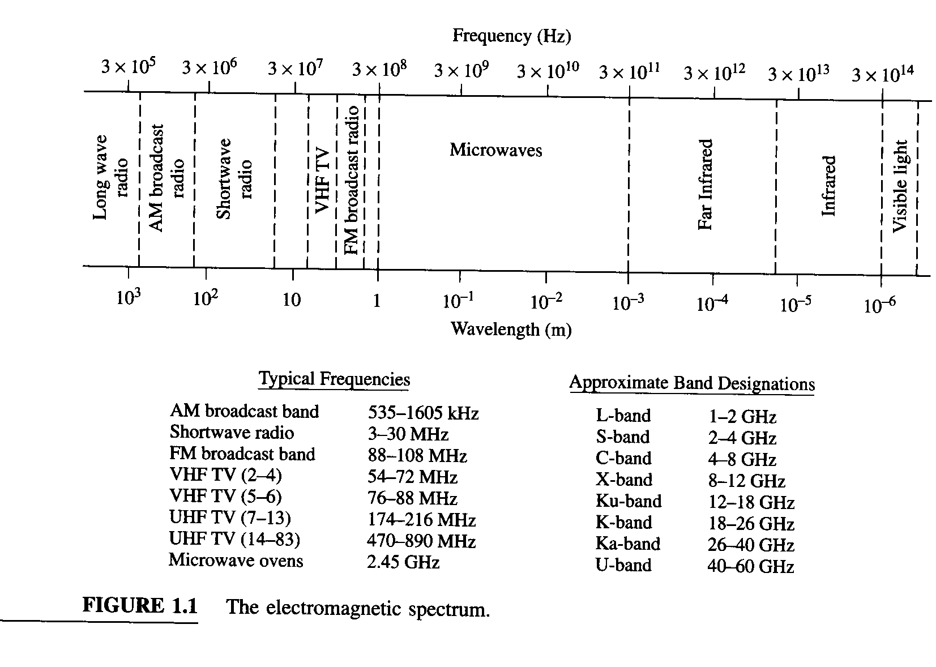
Electromagnetic Spectrum
Hope Foundation’s International Institute of Information Technology, I²IT, P-14 Rajiv Gandhi Infotech Park, Hinjawadi, Pune - 411 057
Tel - +91 20 22933441 / 2 / 3 | Website - www.isquareit.edu.in ; Email - info@isquareit.edu.in

Slide 4
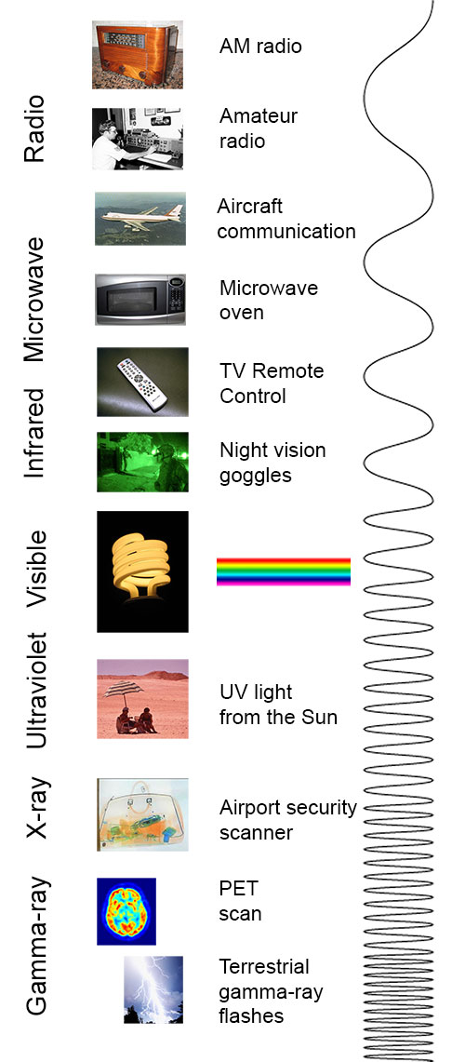
Hope Foundation’s International Institute of Information Technology, I²IT, P-14 Rajiv Gandhi Infotech Park, Hinjawadi, Pune - 411 057
Tel - +91 20 22933441 / 2 / 3 | Website - www.isquareit.edu.in ; Email - info@isquareit.edu.in

Slide 5
Brief Microwave History
Maxwell (1864-73)
integrated electricity and magnetism
set of 4 coherent and self-consistent equations
predicted electromagnetic wave propagation
Hertz (1886-88)
experimentally confirmed Maxwell’s equations
oscillating electric spark to induce similar oscillations in a distant wire loop (λ=10 cm)
Hope Foundation’s International Institute of Information Technology, I²IT, P-14 Rajiv Gandhi Infotech Park, Hinjawadi, Pune - 411 057
Tel - +91 20 22933441 / 2 / 3 | Website - www.isquareit.edu.in ; Email - info@isquareit.edu.in

Slide 6
Brief Microwave History
Marconi (early 20th century)
parabolic antenna to demonstrate wireless telegraphic communications
tried to commercialize radio at low frequency
Lord Rayleigh (1897)
showed mathematically that EM wave propagation possible in waveguides
George Southworth (1930)
showed waveguides capable of small bandwidth transmission for high powers
Hope Foundation’s International Institute of Information Technology, I²IT, P-14 Rajiv Gandhi Infotech Park, Hinjawadi, Pune - 411 057
Tel - +91 20 22933441 / 2 / 3 | Website - www.isquareit.edu.in ; Email - info@isquareit.edu.in

Slide 7
Brief Microwave History
R.H. and S.F. Varian (1937)
development of the klystron
MIT Radiation Laboratory (WWII)
radiation lab series - classic writings
Development of transistor (1950’s)
Development of Microwave Integrated Circuits
microwave circuit on a chip
microstrip lines
Satellites, wireless communications, ...
Hope Foundation’s International Institute of Information Technology, I²IT, P-14 Rajiv Gandhi Infotech Park, Hinjawadi, Pune - 411 057
Tel - +91 20 22933441 / 2 / 3 | Website - www.isquareit.edu.in ; Email - info@isquareit.edu.in

Slide 8
Advantages of Microwaves
Increased bandwidth availability
More bandwidth can be realized at higher frequencies. Bandwidth is critically important because available frequency bands in the electromagnetic spectrum are being rapidly depleted.
Microwave signals travel by line of sight are not bent by the ionosphere as are lower frequency signals and thus satellite and terrestrial communication links with very high capacities are possible.
Effective reflection area (radar cross section) of a radar target is proportional to the target’s electrical size. Thus generally microwave frequencies are preferred for radar systems.
Hope Foundation’s International Institute of Information Technology, I²IT, P-14 Rajiv Gandhi Infotech Park, Hinjawadi, Pune - 411 057
Tel - +91 20 22933441 / 2 / 3 | Website - www.isquareit.edu.in ; Email - info@isquareit.edu.in

Slide 9

Advantages of microwaves
Hope Foundation’s International Institute of Information Technology, I²IT, P-14 Rajiv Gandhi Infotech Park, Hinjawadi, Pune - 411 057
Tel - +91 20 22933441 / 2 / 3 | Website - www.isquareit.edu.in ; Email - info@isquareit.edu.in

Slide 10
Advantages of microwaves
Power Requirments:
Transmitters/Receivers power requirments are pretty low at microwave frequencies compared to short wave band
Transparency property of microwaves:
Microwave frequency band ranging from 300 MHz -10 GHz are capable of freely propagating through the ionized layers surrounding the earth as well as through the atmosphere.
Hope Foundation’s International Institute of Information Technology, I²IT, P-14 Rajiv Gandhi Infotech Park, Hinjawadi, Pune - 411 057
Tel - +91 20 22933441 / 2 / 3 | Website - www.isquareit.edu.in ; Email - info@isquareit.edu.in

Slide 11
Application of microwave
Various molecular, atomic, and nuclear resonances occur at microwave frequencies, creating a variety of unique applications in the areas of basic science, remote sensing, medical diagnostics and treatment, and heating methods.
Today, the majority of applications of microwaves are related to radar and communication systems. Radar systems are used for detecting and locating targets and for air traffic control systems, missile tracking radars, automobile collision avoidance systems, weather prediction, motion detectors, and a wide variety of remote sensing systems.
Microwave communication systems handle a large fraction of the world’s international and other long haul telephone, data and television transmissions.
Most of the currently developing wireless telecommunications systems, such as direct broadcast satellite (DBS) television, personal communication systems (PCSs), wireless local area networks (WLANS), cellular video (CV) systems, and global positioning satellite (GPS) systems rely heavily on microwave technology.
Hope Foundation’s International Institute of Information Technology, I²IT, P-14 Rajiv Gandhi Infotech Park, Hinjawadi, Pune - 411 057
Tel - +91 20 22933441 / 2 / 3 | Website - www.isquareit.edu.in ; Email - info@isquareit.edu.in

Slide 12
Thank You
For further details please feel free to contact
Bhagyashri Thorat
Department of Electronics & Telecommunication
Hope Foundation’s
International Institute of Information Technology, I²IT
P-14, Rajiv Gandhi Infotech Park, MIDC Phase 1,
Hinjawadi, Pune – 411 057
Tel +91 20 22933441 / 2 /3
www.isquareit.edu.in
bhagyashrit@isquareit.edu.in | info@isquareit.edu.in

