Slide 1
Cloud Computing
Prof. Sachindra Chavan
Assistant Professor
Department of Information Technology
Hope Foundation’s
International Institute of Information Technology, I²IT
www.isquareit.edu.in

Slide 2
What is Cloud Computing?
Hope Foundation’s International Institute of Information Technology, I²IT P-14,Rajiv Gandhi Infotech Park
MIDC Phase 1, Hinjawadi, Pune – 411057 Tel - +91 20 22933441/2/3 | www.isquareit.edu.in | info@isquareit.edu.in

Slide 3
Cloud Computing
Virtualized distributed processing, storage, and software resources and a service.
Delivering computing as a on-demand, pay-as-you-go service.
"clouds are a large pool of easily usable and accessible virtualized resources (such as hardware, development platforms and/or services). These resources can be dynamically reconfigured to adjust to a variable load (scale), allowing also for an optimum resource utilization. This pool of resources is typically exploited by a pay-per-use model in which guarantees are offered by the Infrastructure Provider by means of customized Service Level Agreements." Vaquero et al.
Hope Foundation’s International Institute of Information Technology, I²IT P-14,Rajiv Gandhi Infotech Park
MIDC Phase 1, Hinjawadi, Pune – 411057 Tel - +91 20 22933441/2/3 | www.isquareit.edu.in | info@isquareit.edu.in

Slide 4
Characteristics of a Cloud
Pay-per-use
Elastic capacity
Illusion of Infinite Resources
Self-Service interface
Resources that are abstracted or virtualized
Provide API and Development tools for developers to build scalable applications on their services.
Hope Foundation’s International Institute of Information Technology, I²IT P-14,Rajiv Gandhi Infotech Park
MIDC Phase 1, Hinjawadi, Pune – 411057 Tel - +91 20 22933441/2/3 | www.isquareit.edu.in | info@isquareit.edu.in

Slide 5
Why go Cloud?
Dynamically Scalable
Device independent
Instant
Cost-efficient
Task-Centrism
Private Server Cost
Hope Foundation’s International Institute of Information Technology, I²IT P-14,Rajiv Gandhi Infotech Park
MIDC Phase 1, Hinjawadi, Pune – 411057 Tel - +91 20 22933441/2/3 | www.isquareit.edu.in | info@isquareit.edu.in

Slide 6
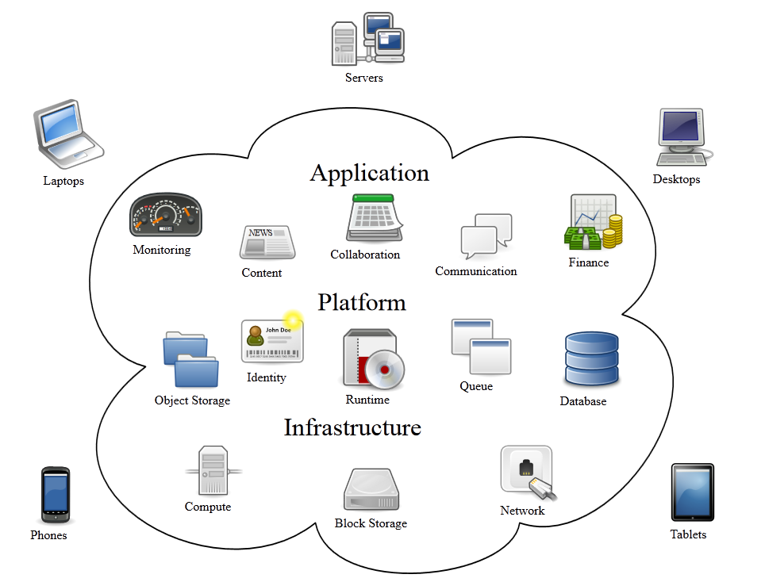
Models of Cloud Computing
Hope Foundation’s International Institute of Information Technology, I²IT P-14,Rajiv Gandhi Infotech Park
MIDC Phase 1, Hinjawadi, Pune – 411057 Tel - +91 20 22933441/2/3 | www.isquareit.edu.in | info@isquareit.edu.in

Slide 7
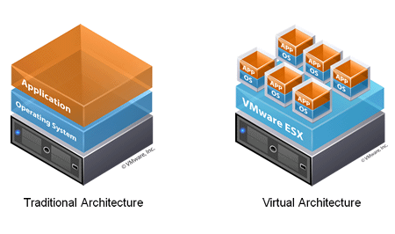
Virtualization
Under-utilization of resource
Dividing up the resources
Maintenance required
Controlling job flow
Hope Foundation’s International Institute of Information Technology, I²IT P-14,Rajiv Gandhi Infotech Park
MIDC Phase 1, Hinjawadi, Pune – 411057 Tel - +91 20 22933441/2/3 | www.isquareit.edu.in | info@isquareit.edu.in

Slide 8
Deployment Models of a Cloud
Private/Enterprise
Dedicated
Hybrid/Mixed
Cloud/Public
Hope Foundation’s International Institute of Information Technology, I²IT P-14,Rajiv Gandhi Infotech Park
MIDC Phase 1, Hinjawadi, Pune – 411057 Tel - +91 20 22933441/2/3 | www.isquareit.edu.in | info@isquareit.edu.in

Slide 9
Software as a Service (SaaS)
Provides off-the-shelf applications offered over the internet
Examples:
Google Docs
Aviary
Pixlr
Microsoft Office Web App
Hope Foundation’s International Institute of Information Technology, I²IT P-14,Rajiv Gandhi Infotech Park
MIDC Phase 1, Hinjawadi, Pune – 411057 Tel - +91 20 22933441/2/3 | www.isquareit.edu.in | info@isquareit.edu.in

Slide 10
Software as a Service cont.
Flexibility vs Power tradeoff
Pros
Accessible from any computer or devices
Software available facilitates collaborative working.
Cons
Off shelf products non-flexible
Cannot provide add-ons or customize them
Hope Foundation’s International Institute of Information Technology, I²IT P-14,Rajiv Gandhi Infotech Park
MIDC Phase 1, Hinjawadi, Pune – 411057 Tel - +91 20 22933441/2/3 | www.isquareit.edu.in | info@isquareit.edu.in

Slide 11
Platform as a Service (PaaS)
Provides all infrastructure needed for a consumer to run applications over the internet.
PaaS is a Cloud Computing service that offers a computing platform and solution stack for users.
Language
OS
Database
Middleware
Other applications
Hope Foundation’s International Institute of Information Technology, I²IT P-14,Rajiv Gandhi Infotech Park
MIDC Phase 1, Hinjawadi, Pune – 411057 Tel - +91 20 22933441/2/3 | www.isquareit.edu.in | info@isquareit.edu.in

Slide 12
Features to look for
Programming Languages
Python
Java
.Net Languages
Ruby
Programming Frameworks
Ruby on Rails
Spring
Java EE
.Net
Persistence Options
Hope Foundation’s International Institute of Information Technology, I²IT P-14,Rajiv Gandhi Infotech Park
MIDC Phase 1, Hinjawadi, Pune – 411057 Tel - +91 20 22933441/2/3 | www.isquareit.edu.in | info@isquareit.edu.in

Slide 13
Programming Models
A PaaS Cloud should be able to support various programming models for different types of Programming.
Programming large datasets in clusters of computers (MapReduce)
Development of request-based web services and applications
Orchestration of a business process in the form of workflows (WorkFlow Model)
High-performance distributed execution of tasks.
Hope Foundation’s International Institute of Information Technology, I²IT P-14,Rajiv Gandhi Infotech Park
MIDC Phase 1, Hinjawadi, Pune – 411057 Tel - +91 20 22933441/2/3 | www.isquareit.edu.in | info@isquareit.edu.in

Slide 14
Platform as a Service (cont.)
Examples:
Google Apps Engine
Windows Azure Platform
Force.com
Pros:
Rapid Deployment
Low Cost
Private or Public Deployment
Cons:
Not much freedom
Choices of tools are limited
Vendor Lock-in
Hope Foundation’s International Institute of Information Technology, I²IT P-14,Rajiv Gandhi Infotech Park
MIDC Phase 1, Hinjawadi, Pune – 411057 Tel - +91 20 22933441/2/3 | www.isquareit.edu.in | info@isquareit.edu.in

Slide 15
PaaS Service Providers
Hope Foundation’s International Institute of Information Technology, I²IT P-14,Rajiv Gandhi Infotech Park
MIDC Phase 1, Hinjawadi, Pune – 411057 Tel - +91 20 22933441/2/3 | www.isquareit.edu.in | info@isquareit.edu.in

Slide 16
Infrastructure as a Service (IaaS)
Cloud service that allows existing applications to run on its hardware.
Rents out resources dynamically wherever they are needed.
Services:
Compute Servers
Data Storage
Firewall
Load Balancer
Hope Foundation’s International Institute of Information Technology, I²IT P-14,Rajiv Gandhi Infotech Park
MIDC Phase 1, Hinjawadi, Pune – 411057 Tel - +91 20 22933441/2/3 | www.isquareit.edu.in | info@isquareit.edu.in

Slide 17
Distinguishable features of IaaS
Geographical Presence
Responsiveness
Availability
User Interfaces and Access to Servers
Providing means of accessing their Cloud
Gui
CLI
Web Services
Hope Foundation’s International Institute of Information Technology, I²IT P-14,Rajiv Gandhi Infotech Park
MIDC Phase 1, Hinjawadi, Pune – 411057 Tel - +91 20 22933441/2/3 | www.isquareit.edu.in | info@isquareit.edu.in

Slide 18
Distinguishable features of IaaS (Cont.)
Advance Reservation of Capacity
Time-Frame reservations
Automatic Scaling and Load Balancing
Elasticity of the service
One of the most desirable features of an IaaS Cloud
Traffic distribution
Hope Foundation’s International Institute of Information Technology, I²IT P-14,Rajiv Gandhi Infotech Park
MIDC Phase 1, Hinjawadi, Pune – 411057 Tel - +91 20 22933441/2/3 | www.isquareit.edu.in | info@isquareit.edu.in

Slide 19
Distinguishable features of IaaS (Cont.)
Service-Level Agreement
As with all services, parties much sign an agreement
Metrics
Uptime, Performance measures
Penalties
Amazon
Hypervisor and Operating System Choice
Xen
VMWare, vCloud, Citric Cloud Center
Hope Foundation’s International Institute of Information Technology, I²IT P-14,Rajiv Gandhi Infotech Park
MIDC Phase 1, Hinjawadi, Pune – 411057 Tel - +91 20 22933441/2/3 | www.isquareit.edu.in | info@isquareit.edu.in

Slide 20
IaaS Service Providers
Hope Foundation’s International Institute of Information Technology, I²IT P-14,Rajiv Gandhi Infotech Park
MIDC Phase 1, Hinjawadi, Pune – 411057 Tel - +91 20 22933441/2/3 | www.isquareit.edu.in | info@isquareit.edu.in

Slide 21
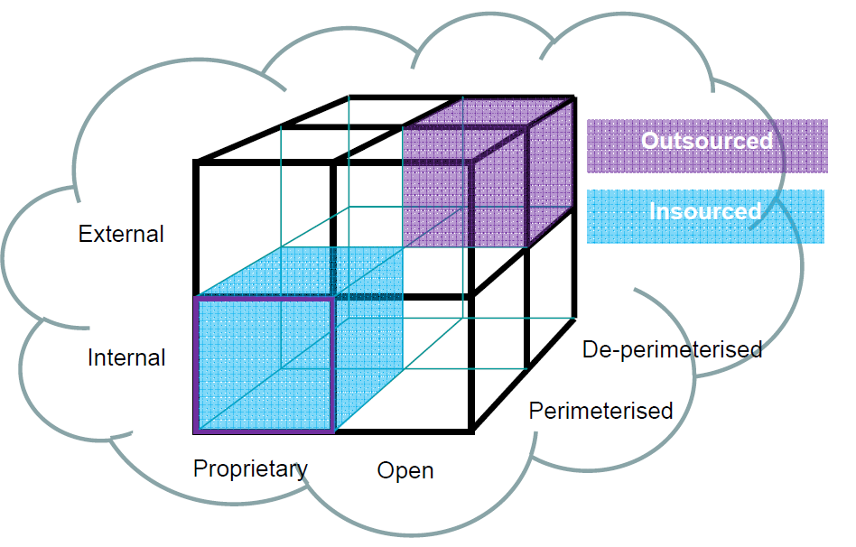
Cloud Cube Model
Hope Foundation’s International Institute of Information Technology, I²IT P-14,Rajiv Gandhi Infotech Park
MIDC Phase 1, Hinjawadi, Pune – 411057 Tel - +91 20 22933441/2/3 | www.isquareit.edu.in | info@isquareit.edu.in

Slide 22
Virtual Infrastructure Managers (VIMs)
The Operating System of the Cloud
Responsible for the Allocation of resources in a cloud
Aggregates resources from multiple sources
Also called Cloud Operating System, Infrastructure Sharing Software, and Virtual Infrastructure Engines
Hope Foundation’s International Institute of Information Technology, I²IT P-14,Rajiv Gandhi Infotech Park
MIDC Phase 1, Hinjawadi, Pune – 411057 Tel - +91 20 22933441/2/3 | www.isquareit.edu.in | info@isquareit.edu.in

Slide 23
Features of a VI Manager
Virtualization Support
Backbone
Cpu, Memory, Storage
Sizing and resizing
Self-Service, On-Demand Resource Provisioning
Directly obtain services from cloud
Creation of Servers
Tailoring Software
Configurations
Security Policies
Eliminates going through a system admin
Hope Foundation’s International Institute of Information Technology, I²IT P-14,Rajiv Gandhi Infotech Park
MIDC Phase 1, Hinjawadi, Pune – 411057 Tel - +91 20 22933441/2/3 | www.isquareit.edu.in | info@isquareit.edu.in

Slide 24
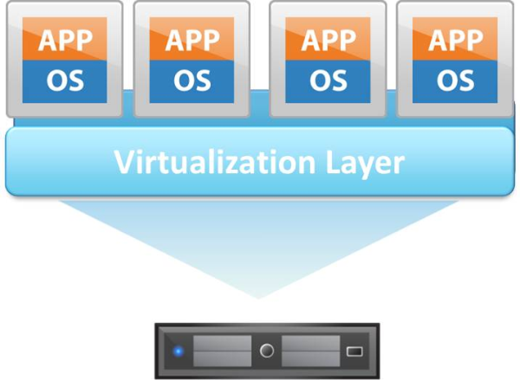
Features of a VI Manager (Cont.)
Multiple Backend Hypervisors
Drawbacks of virtualization models
Uniform Management of Virtualization
Storage Virtualization
Abstracting Logical Storage from Physical Storage
Creation of Virtual disk independent from device and location
Storage Area Networks (SAN)
Fibre Channel, iSCSI, NFS
Hope Foundation’s International Institute of Information Technology, I²IT P-14,Rajiv Gandhi Infotech Park
MIDC Phase 1, Hinjawadi, Pune – 411057 Tel - +91 20 22933441/2/3 | www.isquareit.edu.in | info@isquareit.edu.in

Slide 25
Features of a VI Manager (Cont.)
Interface to Public Clouds
Overloading requires borrowing
During spikes, VIMs can obtain resources from external sources
Virtual Networking
Isolated Virtual Networks on top of a Physical Infrastructure
Allows VMs to be grouped in same broad cast domain
Allows VM’s in one group to block messages from another.
Hope Foundation’s International Institute of Information Technology, I²IT P-14,Rajiv Gandhi Infotech Park
MIDC Phase 1, Hinjawadi, Pune – 411057 Tel - +91 20 22933441/2/3 | www.isquareit.edu.in | info@isquareit.edu.in

Slide 26
Features of a VI Manager (Cont.)
Dynamic Resource Allocation
Resources need to allocated and deallocated when needed.
Demand prediction is difficult to calculate
Machine not in use will be put into a low-powered state
Moving loads around to reduce overheating
Monitor resource utilization and reallocated accordingly
Virtual Clusters
Holistically managing interconnected groups of Virtual Machines
Hope Foundation’s International Institute of Information Technology, I²IT P-14,Rajiv Gandhi Infotech Park
MIDC Phase 1, Hinjawadi, Pune – 411057 Tel - +91 20 22933441/2/3 | www.isquareit.edu.in | info@isquareit.edu.in

Slide 27
Features of a VI Manager (Cont.)
Reservation and Negotiation Mechanism
Requesting Computational Resources to be available for them at a specific time (AR)
Those that allow AR will be better than those without
Having advance reservations using complex attributes is useful to satisfy priorities
Reservations should also be able to be negotiated and renegotiated when required.
Hope Foundation’s International Institute of Information Technology, I²IT P-14,Rajiv Gandhi Infotech Park
MIDC Phase 1, Hinjawadi, Pune – 411057 Tel - +91 20 22933441/2/3 | www.isquareit.edu.in | info@isquareit.edu.in

Slide 28
Features of a VI Manager (Cont.)
High Availability and Data Recovery
Must have little downtime
VIMs must have a High Availability (HA) feature used to minimize downtime and prevent business disruptions
Detects physical/virtual server failure
Restarts VM on a healthy server
If not enough VIMs will run redundant VMs and Synchronize them
If one fails, users can be moved to a healthy one
VI Managers must handle backups of a large number of VMs
Must not interfere with performance too much
Hope Foundation’s International Institute of Information Technology, I²IT P-14,Rajiv Gandhi Infotech Park
MIDC Phase 1, Hinjawadi, Pune – 411057 Tel - +91 20 22933441/2/3 | www.isquareit.edu.in | info@isquareit.edu.in

Slide 29
Virtual Infrastructure Managers
Hope Foundation’s International Institute of Information Technology, I²IT P-14,Rajiv Gandhi Infotech Park
MIDC Phase 1, Hinjawadi, Pune – 411057 Tel - +91 20 22933441/2/3 | www.isquareit.edu.in | info@isquareit.edu.in

Slide 30
Disadvantages of the Cloud
Security
Reliant on Cloud Provider
Flaws
Requires an Internet Access
Hope Foundation’s International Institute of Information Technology, I²IT P-14,Rajiv Gandhi Infotech Park
MIDC Phase 1, Hinjawadi, Pune – 411057 Tel - +91 20 22933441/2/3 | www.isquareit.edu.in | info@isquareit.edu.in

Slide 31
Summary
Cloud Computing
Software as a Service
Platform as a Service
Infrastructure as a Service
Virtual Infrastructure Management
Hope Foundation’s International Institute of Information Technology, I²IT P-14,Rajiv Gandhi Infotech Park
MIDC Phase 1, Hinjawadi, Pune – 411057 Tel - +91 20 22933441/2/3 | www.isquareit.edu.in | info@isquareit.edu.in

Slide 32
Works Cited
Cloud Computing: Principles and Paradigms. Buyya et al.
ExplainingComputers.com
http://www.securityweek.com/addressing-cloud-security-concerns-key-issues-and-recommendations
Hope Foundation’s International Institute of Information Technology, I²IT P-14,Rajiv Gandhi Infotech Park
MIDC Phase 1, Hinjawadi, Pune – 411057 Tel - +91 20 22933441/2/3 | www.isquareit.edu.in | info@isquareit.edu.in

Slide 33
THANK YOU
For further details, please contact
Sachindra Chavan
sachindrac@isquareit.edu.in
Department of Information Technology
Hope Foundation’s
International Institute of Information Technology, I²IT
P-14,Rajiv Gandhi Infotech Park
MIDC Phase 1, Hinjawadi, Pune – 411057
Tel - +91 20 22933441/2/3
www.isquareit.edu.in | info@isquareit.edu.in

