Slide 1

Corporate / Business Etiquette Prepared by Vaidehi Banerjee Department of Applied Sciences & Engineering
Good manners and etiquette will open doors that even best education cannot..
- Clarence Thomas

Slide 2
Business Etiquette
Introductions
Colleagues
Dress
Dinning
Events
Telephone
Travelling
Writing
Hope Foundation’s International Institute of Information Technology, I²IT
P-14, Rajiv Gandhi Infotech Park, MIDC Phase I, Hinjawadi, Pune – 411 057 Tel +91 20 22933441/2/3 | www.isquareit.edu.in | info@isquareit.edu.in

Slide 3
Introduction Etiquette
Old
Young
Higher Rank
Lesser Rank
Articles
News Letters
Brochures
Website
Guest
Family
Woman
Man
Hope Foundation’s International Institute of Information Technology, I²IT
P-14, Rajiv Gandhi Infotech Park, MIDC Phase I, Hinjawadi, Pune – 411 057 Tel +91 20 22933441/2/3 | www.isquareit.edu.in | info@isquareit.edu.in

Slide 4
Etiquette with Colleagues
Always ask before borrowing
Thank You & Please
Don’t interrupt others
Refrain from being loud
Respect Others Privacy
Considerate towards saving energy
Do not indulge in gossip
Courteous towards others
Hope Foundation’s International Institute of Information Technology, I²IT
P-14, Rajiv Gandhi Infotech Park, MIDC Phase I, Hinjawadi, Pune – 411 057 Tel +91 20 22933441/2/3 | www.isquareit.edu.in | info@isquareit.edu.in

Slide 5
Dress Etiquette
Women
Sarees
Western
Men
Suits
Light shirt / Dark Trousers
Accessories
Footwear
Friday Dressing
Accessories / Footwear
Hope Foundation’s International Institute of Information Technology, I²IT
P-14, Rajiv Gandhi Infotech Park, MIDC Phase I, Hinjawadi, Pune – 411 057 Tel +91 20 22933441/2/3 | www.isquareit.edu.in | info@isquareit.edu.in

Slide 6
Formal Dress Etiquette - Women
DOs | DON’Ts
Dress to suit your body structure and complexion | Revealing or ill-fitted clothes
Use light make up during the day and little bright in the evening | Over use lipstick / eye make up (on camera it is needed not for the naked eye)
Wear dainty jewellery for formals | Mangalsutra, Patlya, Choodas, glass & metal bangles
Shoes that are comfortable | Heels that click / keds / dirty weathered ones
Well-groomed | Ignore the physical appearance
Invest in cotton & silks and both styles | Use synthetic / terry-cot / etc
Hope Foundation’s International Institute of Information Technology, I²IT
P-14, Rajiv Gandhi Infotech Park, MIDC Phase I, Hinjawadi, Pune – 411 057 Tel +91 20 22933441/2/3 | www.isquareit.edu.in | info@isquareit.edu.in

Slide 7
Formal Dress Etiquette - Men
DOs | DON’Ts
Dress to suit your body structure and complexion | Bold or ill-fitted clothes
Well-groomed | Ignore facial / body abrasions /
Formal watches and eye wear | Bold watches / bracelets / tattoos / religious tags
Shoes that are comfortable | Pointed, faux leather, synthetic material
Cleanliness | Ignore your body odour
Invest in suit / formal shirts & trousers | Use synthetic / terry-cot / etc
Hope Foundation’s International Institute of Information Technology, I²IT
P-14, Rajiv Gandhi Infotech Park, MIDC Phase I, Hinjawadi, Pune – 411 057 Tel +91 20 22933441/2/3 | www.isquareit.edu.in | info@isquareit.edu.in

Slide 8
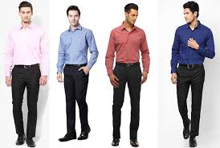
Dress to Impress
Light Shirt
Dark Trousers
Shoes
Belt
https://www.quora.com/What-is-the-dress-code-for-interview
Hope Foundation’s International Institute of Information Technology, I²IT
P-14, Rajiv Gandhi Infotech Park, MIDC Phase I, Hinjawadi, Pune – 411 057 Tel +91 20 22933441/2/3 | www.isquareit.edu.in | info@isquareit.edu.in

Slide 9
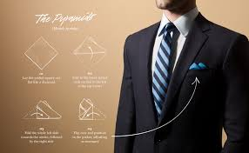
Dress to Impress
Dark Suits
Tie Contrast
Pocket Square
https://www.pinterest.com/pin/536069161871703175/
Hope Foundation’s International Institute of Information Technology, I²IT
P-14, Rajiv Gandhi Infotech Park, MIDC Phase I, Hinjawadi, Pune – 411 057 Tel +91 20 22933441/2/3 | www.isquareit.edu.in | info@isquareit.edu.in

Slide 10
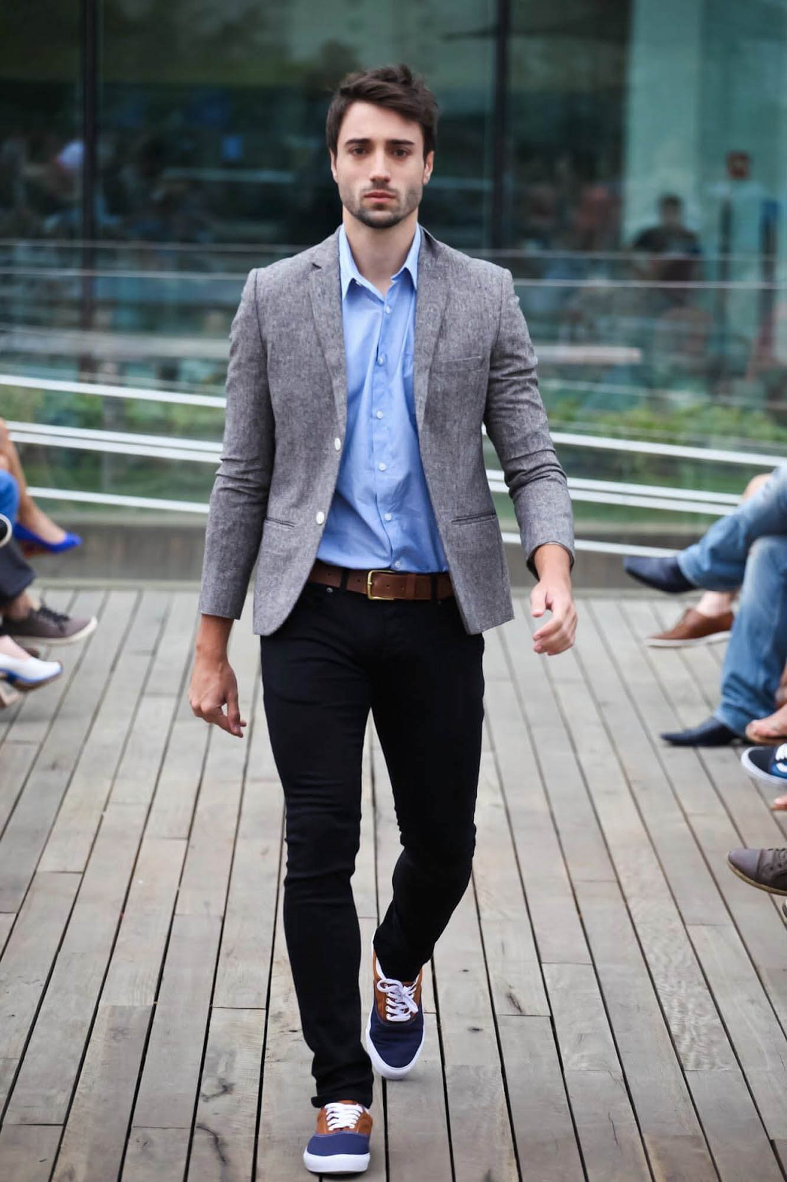
Dress to Impress
Friday Dressing
Chinos
Semi Casual
https://www.gentlemansgazette.com/business-casual-men-attire/
Hope Foundation’s International Institute of Information Technology, I²IT
P-14, Rajiv Gandhi Infotech Park, MIDC Phase I, Hinjawadi, Pune – 411 057 Tel +91 20 22933441/2/3 | www.isquareit.edu.in | info@isquareit.edu.in

Slide 11
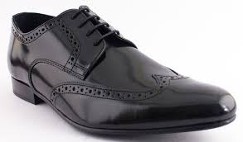
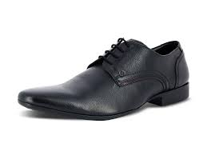
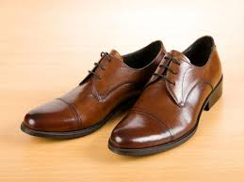
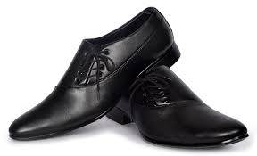
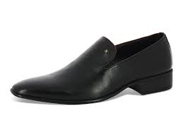
Dress to Impress
Hope Foundation’s International Institute of Information Technology, I²IT
P-14, Rajiv Gandhi Infotech Park, MIDC Phase I, Hinjawadi, Pune – 411 057 Tel +91 20 22933441/2/3 | www.isquareit.edu.in | info@isquareit.edu.in

Slide 12
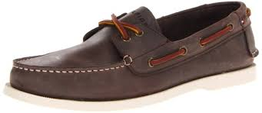
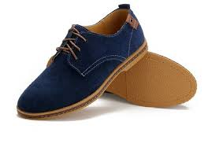
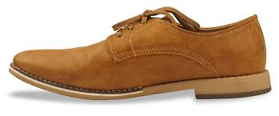
Dress to Impress
Hope Foundation’s International Institute of Information Technology, I²IT
P-14, Rajiv Gandhi Infotech Park, MIDC Phase I, Hinjawadi, Pune – 411 057 Tel +91 20 22933441/2/3 | www.isquareit.edu.in | info@isquareit.edu.in

Slide 13

Dress to Impress
Dark Suits
Knee Length
Stockings
https://www.tutorialspoint.com/business_dress_code/dress_code_for_women.htm
Hope Foundation’s International Institute of Information Technology, I²IT
P-14, Rajiv Gandhi Infotech Park, MIDC Phase I, Hinjawadi, Pune – 411 057 Tel +91 20 22933441/2/3 | www.isquareit.edu.in | info@isquareit.edu.in

Slide 14
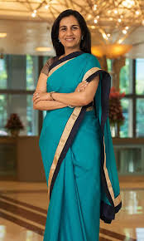
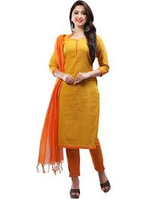
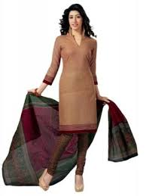
Dress to Impress
http://www.pdhotspot.com/what-to-wear-for-an-interview-in-india-women/
Hope Foundation’s International Institute of Information Technology, I²IT
P-14, Rajiv Gandhi Infotech Park, MIDC Phase I, Hinjawadi, Pune – 411 057 Tel +91 20 22933441/2/3 | www.isquareit.edu.in | info@isquareit.edu.in

Slide 15
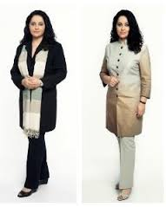
Dress to Impress
https://www.pinterest.com/pin/86694361547905443/
Hope Foundation’s International Institute of Information Technology, I²IT
P-14, Rajiv Gandhi Infotech Park, MIDC Phase I, Hinjawadi, Pune – 411 057 Tel +91 20 22933441/2/3 | www.isquareit.edu.in | info@isquareit.edu.in

Slide 16
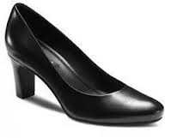
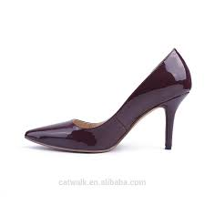
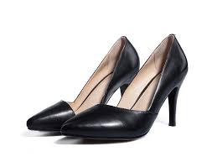
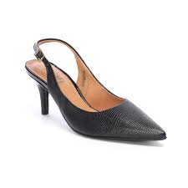
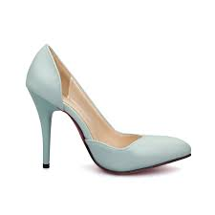
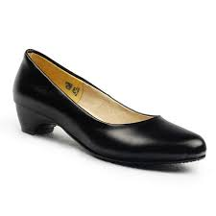
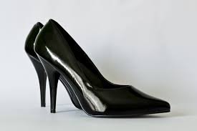
Dress to Impress
Hope Foundation’s International Institute of Information Technology, I²IT
P-14, Rajiv Gandhi Infotech Park, MIDC Phase I, Hinjawadi, Pune – 411 057 Tel +91 20 22933441/2/3 | www.isquareit.edu.in | info@isquareit.edu.in

Slide 17
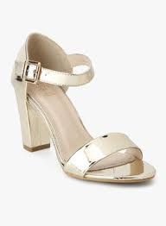
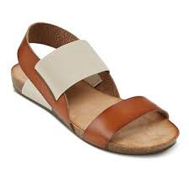
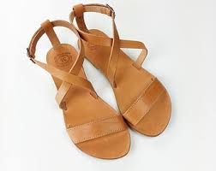
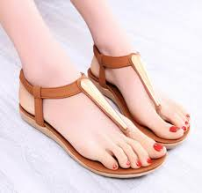
Dress to Impress
Hope Foundation’s International Institute of Information Technology, I²IT
P-14, Rajiv Gandhi Infotech Park, MIDC Phase I, Hinjawadi, Pune – 411 057 Tel +91 20 22933441/2/3 | www.isquareit.edu.in | info@isquareit.edu.in

Slide 18
Dinning Etiquette
Wait until everyone is served
Bring food to your mouth
Do not talk with your mouthful
Do not chew with mouth open
Normally pass food to the right
Rest the fork, knife and spoon when not in use
Don’t rest elbows on the table
Mute Cell Phones
Sit up straight
Hope Foundation’s International Institute of Information Technology, I²IT
P-14, Rajiv Gandhi Infotech Park, MIDC Phase I, Hinjawadi, Pune – 411 057 Tel +91 20 22933441/2/3 | www.isquareit.edu.in | info@isquareit.edu.in

Slide 19
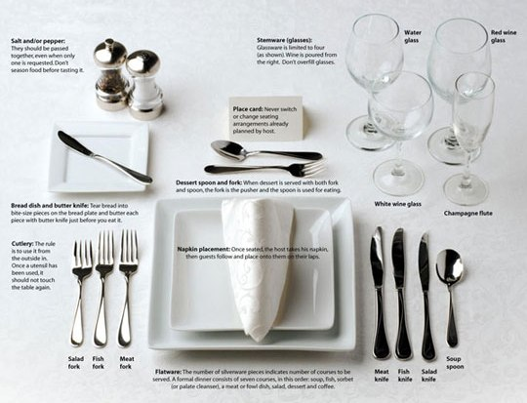
Dinning Etiquette
https://fisher.osu.edu/blogs/gradlife/tag/etiquette-dinner/
Hope Foundation’s International Institute of Information Technology, I²IT
P-14, Rajiv Gandhi Infotech Park, MIDC Phase I, Hinjawadi, Pune – 411 057 Tel +91 20 22933441/2/3 | www.isquareit.edu.in | info@isquareit.edu.in

Slide 20
Events Etiquette
Mark your calendar
R S V P
Inform about food preference
Be Punctual
Carry gift for host
Dress Code
Introduce all guests
Be an active listener
Do not complain at social events
Appropriate Topics of Discussion
Hope Foundation’s International Institute of Information Technology, I²IT
P-14, Rajiv Gandhi Infotech Park, MIDC Phase I, Hinjawadi, Pune – 411 057 Tel +91 20 22933441/2/3 | www.isquareit.edu.in | info@isquareit.edu.in

Slide 21
Telephone Etiquette
Identify yourself at the beginning
Mind the tone of your voice
Plan what to say before you make the call
No interruptions while speaking
Speak slowly and clearly - to a machine
Turn off ringer when entering meeting
Speak into the receiver – low and even tone
Hope Foundation’s International Institute of Information Technology, I²IT
P-14, Rajiv Gandhi Infotech Park, MIDC Phase I, Hinjawadi, Pune – 411 057 Tel +91 20 22933441/2/3 | www.isquareit.edu.in | info@isquareit.edu.in

Slide 22
Travelling Etiquette
When travelling in group – reach on time
Don’t hog the boarding area
Check before you recline
Let people in front of you get off first
Middle seats get the armrests
Keep the volume down
Walk on the left. Stand on the right.
Hope Foundation’s International Institute of Information Technology, I²IT
P-14, Rajiv Gandhi Infotech Park, MIDC Phase I, Hinjawadi, Pune – 411 057 Tel +91 20 22933441/2/3 | www.isquareit.edu.in | info@isquareit.edu.in

Slide 23
Travelling Etiquette
At the hotel, be calm and not push the line
Don’t’ slam the hotel door
Wait for the next elevator
Don’t trash the room
Judiciously use the electricity in the room
Tip Appropriately
Don’t criticize the culture / food / country
Hope Foundation’s International Institute of Information Technology, I²IT
P-14, Rajiv Gandhi Infotech Park, MIDC Phase I, Hinjawadi, Pune – 411 057 Tel +91 20 22933441/2/3 | www.isquareit.edu.in | info@isquareit.edu.in

Slide 24
Net Etiquette
Same standards of behaviour as in real life
Respect other people’s time & bandwidth
Don’t wash dirty linen in public
Don’t abuse your power
Don’t plagiarize. Acknowledge
Do not gossip through mails / social media
Don’t steal photos. Ask for permission
Hope Foundation’s International Institute of Information Technology, I²IT
P-14, Rajiv Gandhi Infotech Park, MIDC Phase I, Hinjawadi, Pune – 411 057 Tel +91 20 22933441/2/3 | www.isquareit.edu.in | info@isquareit.edu.in

Slide 25
Thank you For further information please contact Vaidehi Banerjee vaidehib@isquareit.edu.in Department of Applied Sciences & Engineering Hope Foundation’s International Institute of Information Technology, I²IT Pune P-14, Rajiv Gandhi Infotech Park, MIDC Phase I, Hinjawadi, Pune – 411 057 Phone - +91 20 22933441/2/3 www.isquareit.edu.in | info@isquareit.edu.in

