Slide 1
Hope Foundation’s
International Institute of Information Technology, (I²IT).
www.isquareit.edu.in
Tel - +91 20 22933441

Slide 2
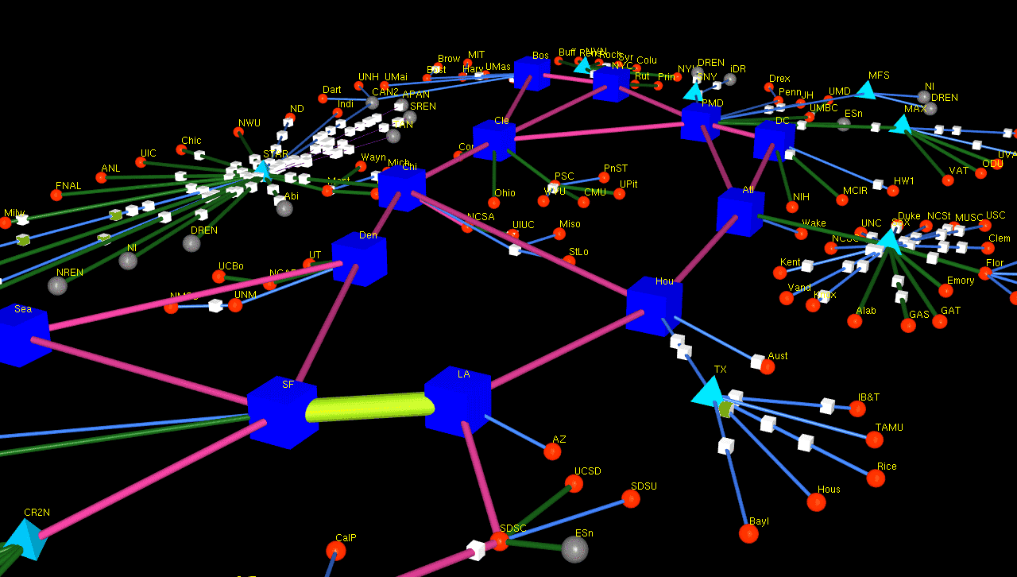
Distributed Systems
Characterization and Design
http://www.news.cs.nyu.edu/~jinyang/fa06/

Slide 3
Outline
What is a distributed system
Examples of distributed systems
Common characteristics of distributed system
Basic design issues
Challenges for distributed system

Slide 4
What Is A Distributed System?
A collection of independent computers or processors that appears to its users as a single coherent system.
Features:
No shared memory – message-based communication
Each runs its own local Operating System.
Heterogeneity
To present a single-system image:
The distributed system “looks like” a single computer rather than a collection of separate computers.

Slide 5
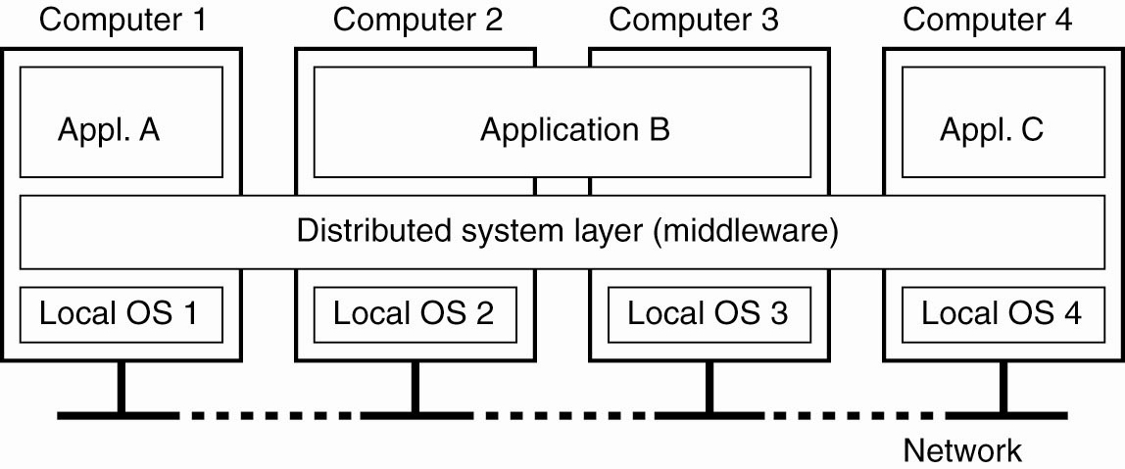
Definition of a Distributed System
Figure 1-1. A distributed system organized as middleware.

Slide 6
Examples of Distributed Systems
Local Area Network (LAN) and Intranet
Automatic Teller Machine Network
Database Management System
Mobile and Ubiquitous Computing
Internet/World-Wide Web

Slide 7
Distributed System Characteristics
Easily expandable.
To present a single-system image.
Supported by middleware.
Continuous availability.

Slide 8
Common Characteristics
Certain common characteristics can be used to assess distributed systems
Heterogeneity
Concurrency
Transparency
Scalability
Openness
Security
Failure Handling

Slide 9
Basic Design Issues
In the general software engineering principles include separation of concerns, modularity, abstraction, anticipation of change,
Specific issues for distributed systems are,
Naming
Communication
Software structure
Consistency maintenance
System architecture
Workload allocation

Slide 10
Challenges for distributed system
Security is a major test in a conveyed framework, particularly when
utilizing open systems.
Adaptation to internal failure could be intense when the dispersed
model is manufactured dependent on problematic parts.
Coordination and asset sharing can be troublesome if legitimate
conventions or on the other hand arrangements are not set up.
Distributed systems have new issues that were never experienced in single frameworks.

Slide 11
THANK YOU
For further information please contact
Prof. Prashant Gadakh
Department of Computer Engineering
Hope Foundation’s
International Institute of Information Technology, I²IT
Hinjawadi, Pune – 411 057
Phone - +91 20 22933441
www.isquareit.edu.in | prashantg@isquareit.edu.in

