Slide 1
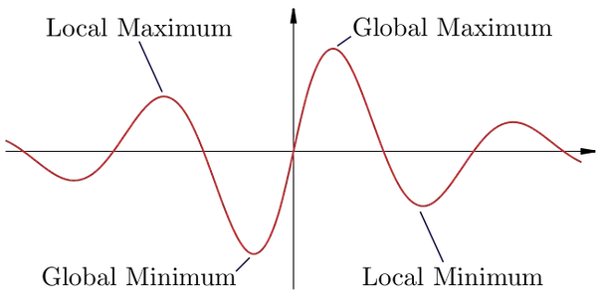
https://www.quora.com/What-is-the-difference-between-local-minima-maxima-and-absolute-minima-maxima
Hope Foundation’s International Institute of Information Technology, I²IT, P-14 Rajiv Gandhi Infotech Park, Hinjawadi, Pune - 411 057
Tel - +91 20 22933441 / 2 / 3 | Website - www.isquareit.edu.in ; Email - info@isquareit.edu.in

Slide 2
Engineering Mathematics-I
Maxima and Minima
Prepared by : Prof. Rupali Yeole
Hope Foundation’s International Institute of Information Technology, I²IT, P-14 Rajiv Gandhi Infotech Park, Hinjawadi, Pune - 411 057
Tel - +91 20 22933441 / 2 / 3 | Website - www.isquareit.edu.in ; Email - info@isquareit.edu.in

Slide 3
Maxima and Minima of Functions of Two Independent Variables
Let be a function of two independent variables and , which is continuous for all values of and in the neighborhood of i.e. be a point in its neighborhood which lies inside the region .
Hope Foundation’s International Institute of Information Technology, I²IT, P-14 Rajiv Gandhi Infotech Park, Hinjawadi, Pune - 411 057
Tel - +91 20 22933441 / 2 / 3 | Website - www.isquareit.edu.in ; Email - info@isquareit.edu.in

Slide 4
The point is called a point of relative minimum,
if for all
Then is called the relative minimum value.
The point is called a point of relative maximum,
if for all
Then is called the relative minimum value.
Hope Foundation’s International Institute of Information Technology, I²IT, P-14 Rajiv Gandhi Infotech Park, Hinjawadi, Pune - 411 057
Tel - +91 20 22933441 / 2 / 3 | Website - www.isquareit.edu.in ; Email - info@isquareit.edu.in

Slide 5
Stationary point: The point at which function is either maximum or minimum is known as stationary point.
Extreme Value: The value of the function at stationary point is known as extreme value of the function .
Hope Foundation’s International Institute of Information Technology, I²IT, P-14 Rajiv Gandhi Infotech Park, Hinjawadi, Pune - 411 057
Tel - +91 20 22933441 / 2 / 3 | Website - www.isquareit.edu.in ; Email - info@isquareit.edu.in

Slide 6
Working Rule
To determine the maxima and minima (extreme values) of a function
Step I : Solve
simultaneously for &
Step II: Obtain the values of
Hope Foundation’s International Institute of Information Technology, I²IT, P-14 Rajiv Gandhi Infotech Park, Hinjawadi, Pune - 411 057
Tel - +91 20 22933441 / 2 / 3 | Website - www.isquareit.edu.in ; Email - info@isquareit.edu.in

Slide 7
Step III:
If & at , then is maximum at & maximum value of the function is .
If & at , then is maximum at & maximum value of the function is .
If at , then is neither maximum nor minimum at .Such point is called Saddle Point.
If at , then no conclusion can be made about the extreme values of & further investigation is required.
Hope Foundation’s International Institute of Information Technology, I²IT, P-14 Rajiv Gandhi Infotech Park, Hinjawadi, Pune - 411 057
Tel - +91 20 22933441 / 2 / 3 | Website - www.isquareit.edu.in ; Email - info@isquareit.edu.in

Slide 8
Example 1
Q.1 Discuss the maxima and Minima of the function
Answer: Let
Step I: For extreme values
Hope Foundation’s International Institute of Information Technology, I²IT, P-14 Rajiv Gandhi Infotech Park, Hinjawadi, Pune - 411 057
Tel - +91 20 22933441 / 2 / 3 | Website - www.isquareit.edu.in ; Email - info@isquareit.edu.in

Slide 9
Therefore stationary point is .
Step II:
Hope Foundation’s International Institute of Information Technology, I²IT, P-14 Rajiv Gandhi Infotech Park, Hinjawadi, Pune - 411 057
Tel - +91 20 22933441 / 2 / 3 | Website - www.isquareit.edu.in ; Email - info@isquareit.edu.in

Slide 10
Step III: At
Hence is maximum at
Hope Foundation’s International Institute of Information Technology, I²IT, P-14 Rajiv Gandhi Infotech Park, Hinjawadi, Pune - 411 057
Tel - +91 20 22933441 / 2 / 3 | Website - www.isquareit.edu.in ; Email - info@isquareit.edu.in

Slide 11
THANK YOU
For further details please contact
RUPALI YEOLE
Department of Applied Sciences & Engineering
Hope Foundation’s
International Institute of Information Technology, I²IT
P-14, Rajiv Gandhi Infotech Park, MIDC Phase 1, Hinjawadi, Pune – 411 057
www.isquareit.edu.in
Phone : +91 20 22933441 / 2 / 3
rupaliy@isquareit.edu.in | info@isquareit.edu.in

