Slide 1

INTERNATIONAL INSTITUTE OF INFORMATION TECHNOLOGY, (I²IT)
www.isquareit.edu.in

Slide 2

Contents
          Pattern Recognition
          Classification
          Classifier Fusion

Slide 3
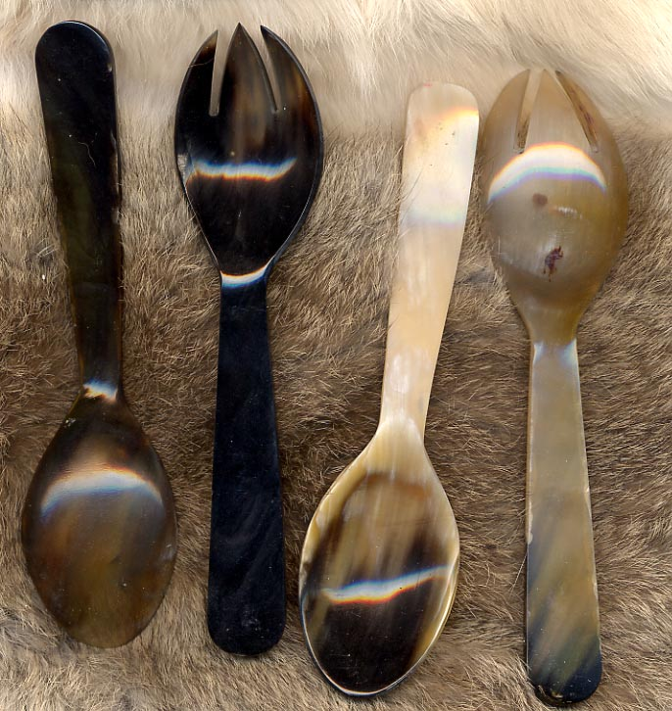
How to select an algorithm
Pattern recognition is a branch of machine learning that focuses on the recognition of patterns and regularities in data, although it is in some cases considered to be nearly synonymous with machine learning.

Slide 4

Classifier Fusion
Classifier Fusion was first proposed by Dasarathy and Sheela’s in 1979.
The main idea of fusion is to combine a set of models each of which solves the same original task in order to obtain a better model with more accuracy.

Slide 5
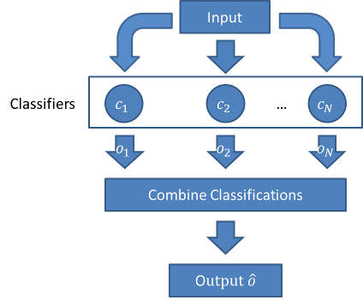
Classifier fusion consists of a set of individual classifiers i.e. a fusion/selection method to combine/select individual classifier outputs to give a final decision.
      Types of ensemble:
        Classifier Selection
        Classifier Fusion

Slide 6
Functional Aspects of Fusion
A natural move when trying to solve numerous complicated patterns.
Efficiency
        Dimension;
        Speed
Accuracy

Slide 7
Importance of Classifier Fusion
  Better classification performance than individual classifiers.
        Beside avoiding the selection of the worse classifier under particular hypothesis, fusion of multiple classifiers can improve the performance of the best individual classifiers.
        This is possible if individual classifiers make different errors.
        For linear combiners, averaging the outputs of individual classifiers with unbiased and uncorrelated errors can improve the performance of the best individual classifier.

Slide 8
Issues
Time complexity
Space Complexity
The new classifier might not be better than the single best classifier but it will distinguish or eliminate the risk of picking an inadequate single classifier.
The final decision will be wrong if the output of selected classifier is wrong.
The trained classifier may not be competent enough to handle the problem.

Slide 9
Random Selection and k- Fold Cross Validation
Data Set
n x m
Split the data set such that n=p + t
Training Data
t x m
Testing Data
p x m
Testing
MLP
2 3 ... k
. . . .
. . . .
. . . .
Bayesian Classifier
Majority Voting
SVM
Training

Slide 10
Classifiers
Classifier Fusion
Decreasing order confidence matrix
Bayesian Network
Uniform Voting
Distribution Summation
Dempster-Shafer
Entropy Weighting
Density Based Weighting
ANN
Support Vector Machine
Class Ranking
Preprocessing Techniques
Decision tree
Gene Expression Data
Principal Component Analysis
Factor Analysis
k nearest neighbor
Output
FLANN
Figure 2. Schematic representation of classifier fusion system

Slide 11
References
[1]LZhenyu chen, Jianping Li, Liwei Wei, Weixuan Xu, Yong Shi: Multiple
– kernel SVM based multiple-task oriented data mining system for
gene expression data analysis, Expert Systems with Applications, Vol-
38, pp.12151-12159 (2011).
[2] Esma Kilic, Ethem Alpaydin: Learning the areas of expertise of
classifiers in an ensemble, Procedia Computer Science,Vol-3, pp.74-82
(2011).
[3] Nicolas Garcia – Pedrajas, Bomingo Ortiz – Boyer: An empirical study
of binary classifier fusion methods for multi class classification,
Information fusion ,Vol-12, pp.111-130 (2011).
[4] Hui-Min Feng, Xue-Fei li, Jun-Fen Chen: A comparative study of four
fuzzy integrals for classifier fusion, IEEE international Conference on
Machine learning and Cybernetics, pp.332-338 (2010).
[5] Jiangtao Huange, Minghui Wang, Bo Gu, Zhixiang Chen: Multiple
classifier combination based on interval-valued fuzzy permutation,
Journal of Computational Information Systems, Vol-6, pp.1759-1768
(2010).
[1]

Slide 12
THANK YOU !!
For further information please contact
Dr. S. Mishra
Department of Computer Engineering
Hope Foundation’s International Institute of Information Technology, I²IT
Hinjawadi, Pune – 411 057
Phone - +91 20 22933441
www.isquareit.edu.in | hodce@isquareit.edu.in

