Slide 1
Heaps & Multi-way Search Trees
Prepared By Keshav Tambre

Slide 2
  Unit Objectives:
To understand basic concepts of heaps, types of heaps & applications.
To understand implementation of different heaps.
To understand various indexing techniques.
To understand difference between B trees & B+ trees.

Slide 3
Binary Heap
A priority queue data structure
A binary heap is a binary tree with two properties
  Heap Structure property
  Heap Order property

Slide 4
Structure Property
A binary heap is a complete binary tree
    Each level (except possibly the bottom most level) is completely filled
    The bottom most level may be partially filled
    (from left to right)
Height of a complete binary tree with N elements is
4

Slide 5
Heap-order Property
Heap-order property (for a “MinHeap”)
  For every node X, key(parent(X)) ≤ key(X)
  Except root node, which has no parent
Thus, minimum key always at root
  Alternatively, for a “MaxHeap”, always keep the maximum key at the root
Insert and deleteMin must maintain heap-order property

Slide 6
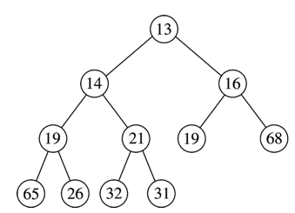
Heap Order Property
Duplicates are allowed
Minimum element
≤
≤
≤
≤
≤
≤
≤
≤
≤
≤

Slide 7
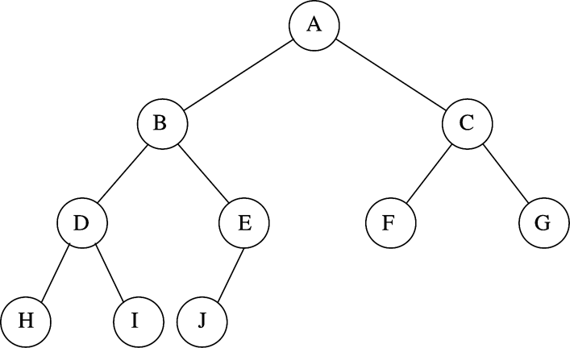
Binary Heap Example
N=10
Every level (except last) saturated
Array representation:

Slide 8
Implementing Complete Binary Trees as Arrays
Given element at position i in the array
  Left child(i) = at position 2i
  Right child(i) = at position 2i + 1
  Parent(i) = at position
i
2i
2i + 1
i/2

Slide 9
Heap Insert
Insert new element into the heap at the next available slot (“hole”)
  According to maintaining a complete binary tree
Then, “percolate” the element up the heap while heap-order property not satisfied

Slide 10
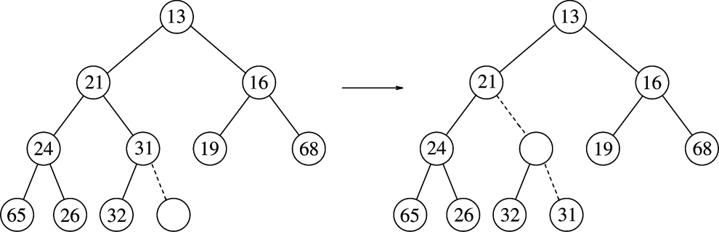
Heap Insert: Example
Percolating Up
Insert 14:
14
hole

Slide 11
Heap Insert: Example
Percolating Up
(1)
14 vs. 31
Insert 14:
14
14
hole
11

Slide 12
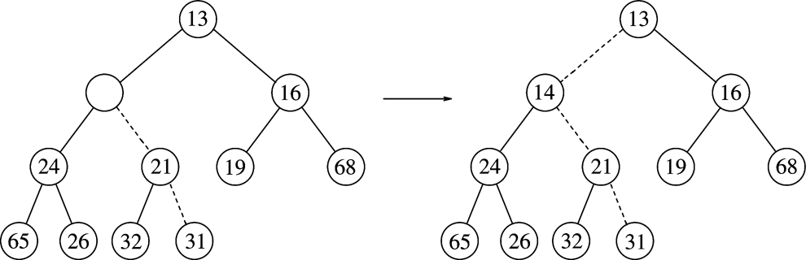
Heap Insert: Example
Percolating Up
(1)
14 vs. 31
Insert 14:
14
14
hole
(2)
14 vs. 21
14
12

Slide 13
Heap Insert: Example
Percolating Up
(1)
14 vs. 31
Insert 14:
14
hole
(2)
14 vs. 21
(3)
14 vs. 13
Heap order prop
14
Structure prop
Path of percolation up
13

Slide 14
Heap DeleteMin
Minimum element is always at the root
Heap decreases by one in size
Move last element into hole at root
Percolate down while heap-order property not satisfied

Slide 15
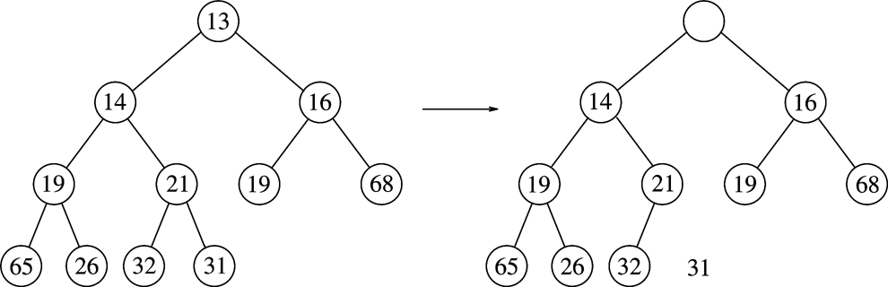
Heap DeleteMin: Example
Percolating down…
Make this position empty

Slide 16
Heap DeleteMin: Example
Percolating down…
Copy 31 temporarily
here and move it down
Make this position empty
Is 31 > min(14,16)?
Yes - swap 31 with min(14,16)
16

Slide 17
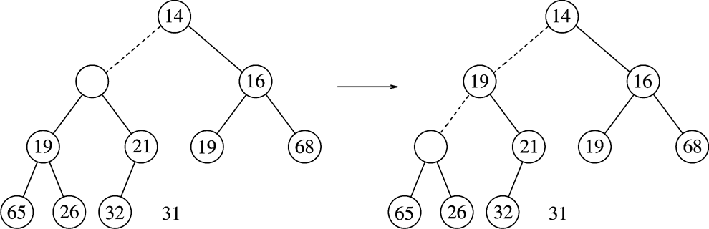
Heap DeleteMin: Example
Percolating down…
31
Is 31 > min(19,21)?
Yes - swap 31 with min(19,21)

Slide 18
Heap DeleteMin: Example
Percolating down…
31
31
Is 31 > min(19,21)?
Yes - swap 31 with min(19,21)
Is 31 > min(65,26)?
Yes - swap 31 with min(65,26)
Percolating down…
18

Slide 19
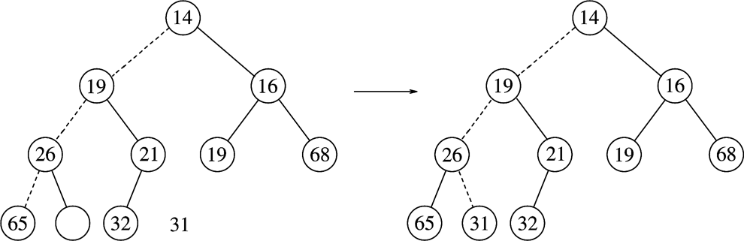
Heap DeleteMin: Example
Percolating down…
31
Percolating down…

Slide 20
Heap DeleteMin: Example
Percolating down…
31
Heap order prop
Structure prop
20

Slide 21
Building a Heap
Construct heap from initial set of N items
Method 1
  Perform N inserts
  O(N log₂ N) worst-case
Method 2 (use buildHeap())
  Randomly populate initial heap with structure property
  Perform a percolate-down from each internal node (H[size/2] to H[1])
    To take care of heap order property

Slide 22
Binary Heap
Example:
Data arrives to be heaped in the order:
54, 87, 27, 67, 19, 31, 29, 18, 32

Slide 23
Binary Heap
54, 87, 27, 67, 19, 31, 29, 18, 32
Method 1:
54
54
87
87
87
54
54
27
87
87
87
54
27
67
27
67
27
67
54
54
19

Slide 24
Binary Heap
54, 87, 27, 67, 19, 31, 29, 18, 32
87
87
67
27
67
27
54
19
19
31
54

Slide 25
Binary Heap
54, 87, 27, 67, 19, 31, 29, 18, 32
87
87
67
31
67
31
54
19
27
29
54
19
27
29
18
32

Slide 26
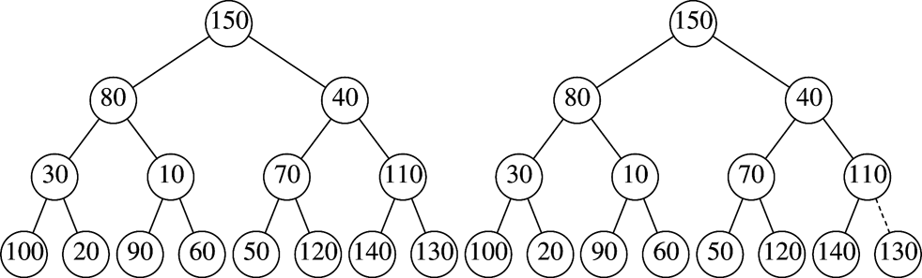
BuildHeap Example
Input: { 150, 80, 40, 30,10, 70, 110, 100, 20, 90, 60, 50, 120, 140, 130 }
Method 2:
Leaves are all valid heaps (implicitly)
So, let us look at each internal node,
from bottom to top,
and fix if necessary
Arbitrarily assign elements to heap nodes
Structure property satisfied
Heap order property violated
Leaves are all valid heaps (implicit)

Slide 27
BuildHeap Example
Swap with left child
Nothing to do
Randomly initialized heap
Structure property satisfied
Heap order property violated
Leaves are all valid heaps (implicit)
27

Slide 28
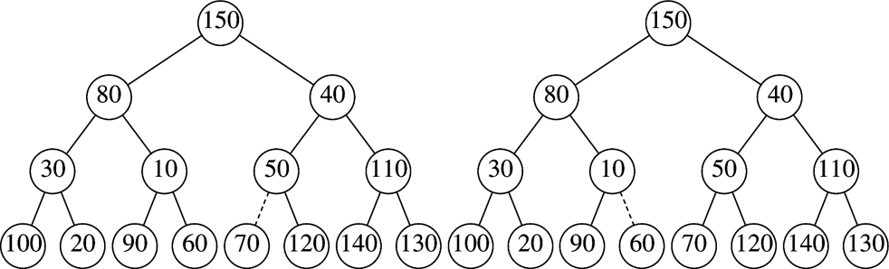
BuildHeap Example
Swap with right child
Nothing to do
Dotted lines show path of percolating down
28

Slide 29
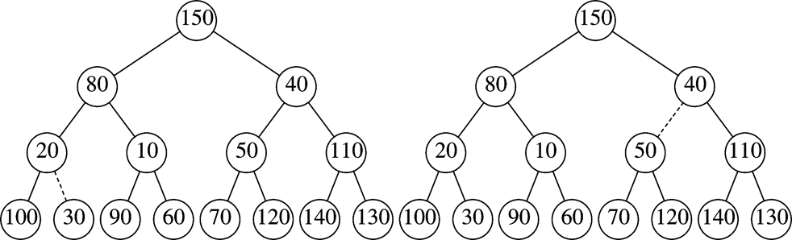
BuildHeap Example
Swap with right child
& then with 60
Nothing to do
Dotted lines show path of percolating down

Slide 30
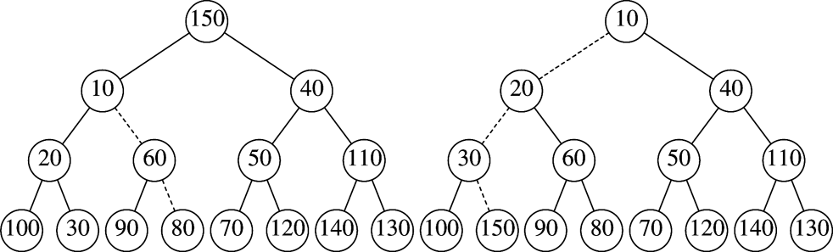
BuildHeap Example
Swap path
Final Heap
Dotted lines show path of percolating down

Slide 31
Applications of Heaps.
Operating system scheduling / Priority Queue.
  Process jobs by priority
Graph algorithms.
  Find shortest path
Selection Problem.
Heap Sort.

Slide 32
An Application:
The Selection Problem
Given a list of n elements, find the k^{th} smallest element
Algorithm 1:
  Sort the list
  Pick the k^{th} element
A better algorithm:
  Use a binary heap (minheap)

Slide 33
Selection using a MinHeap
Input: n elements
Algorithm:
  buildHeap(n)
  Perform k deleteMin() operations
  Report the k^{th} deleteMin output

Slide 34
Heapsort
(1) Build a binary heap of N elements
  the minimum element is at the top of the heap
(2) Perform N DeleteMin operations
  the elements are extracted in sorted order

Slide 35
Build Heap
Input: N elements
Output: A heap with heap-order property
Method 1: obviously, N successive insertions
Complexity: O(NlogN) worst case

Slide 36
Heapsort – Running Time Analysis
(1) Build a binary heap of N elements
  repeatedly insert N elements ⇒ O(N log N) time
(2) Perform N DeleteMin operations
  Each DeleteMin operation takes O(log N) ⇒ O(N log N)
Total time complexity: O(N log N)

Slide 37
Heapsort
Observation: after each deleteMin, the size of heap shrinks by 1
  We can use the last cell just freed up to store the element that was just deleted
  ⇒ after the last deleteMin, the array will contain the elements in decreasing sorted order
To sort the elements in the decreasing order, use a min heap
To sort the elements in the increasing order, use a max heap

Slide 38
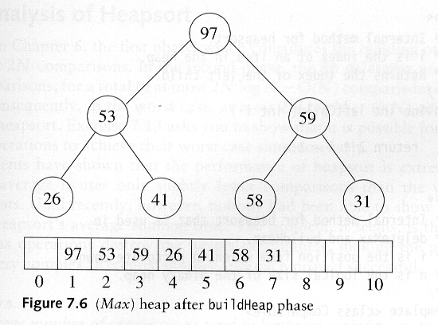
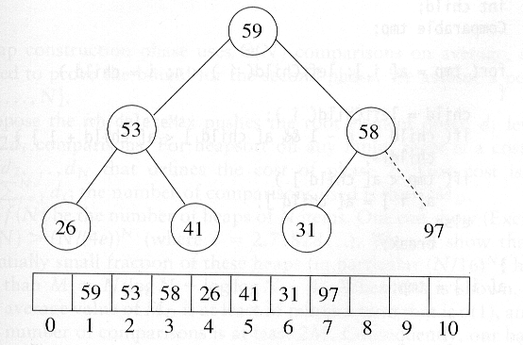
Heap-Sort Example
Sort in increasing order: use max heap
Delete 97

Slide 39
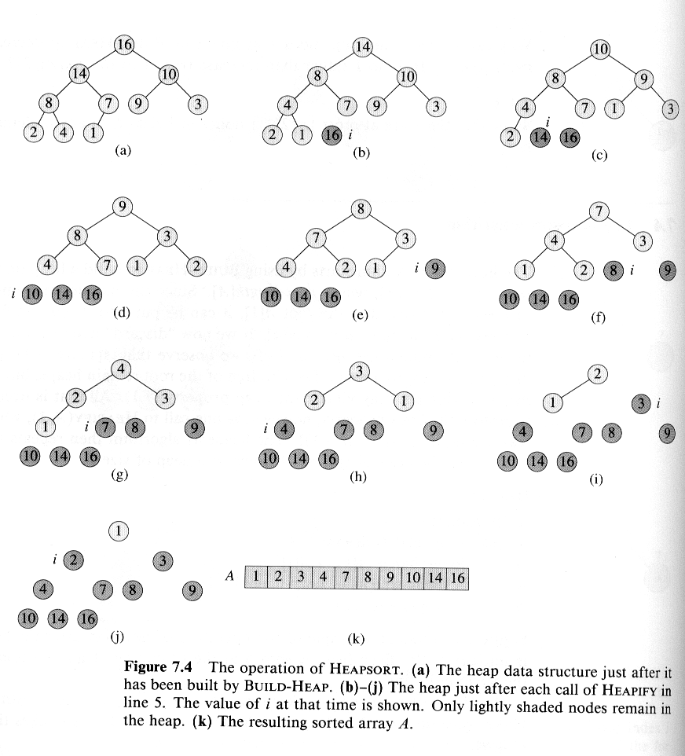
Another Heapsort Example
Delete 16
Delete 14
Delete 10
Delete 9
Delete 8

Slide 40
Example (cont’d)

Slide 41
Other Types of Heaps
Binomial Heaps
d-Heaps
Leftist Heaps
Skew Heaps
Fibonacci Heaps

Slide 42
B-Trees

Slide 43
Definition of a B-tree
A B-tree of order m is an m-way tree (i.e., a tree where each node may have up to m children) in which:
  1. the number of keys in each non-leaf node is one less than the number of its children and these keys partition the keys in the children in the fashion of a search tree
  2. all leaves are on the same level
  3. all non-leaf nodes except the root have at least ⎡m / 2⎤ children
  4. the root is either a leaf node, or it has from two to m children
  5. a leaf node contains no more than m – 1 keys
The number m should always be odd

Slide 44
An example B-Tree
26
A B-tree of order 5 containing 26 items
6
12
42
51
62
1
2
4
7
8
13
15
18
25
27
29
45
46
48
53
55
60
64
70
90
Note that all the leaves are at the same level

Slide 45
Constructing a B-tree
Suppose we start with an empty B-tree and keys arrive in the following order:1 12 8 2 25 5 14 28 17 7 52 16 48 68 3 26 29 53 55 45
We want to construct a B-tree of order 5
The first four items go into the root:
To put the fifth item in the root would violate condition 5
Therefore, when 25 arrives, pick the middle key to make a new root
1
2
8
12

Slide 46
Constructing a B-tree (contd.)
1 12 8 2 25 5 14 28 17 7 52 16 48 68 3 26 29 53 55 45
8
1
2
12
25
6, 14, 28 get added to the leaf nodes:
8
1
2
6
12
14
25
28

Slide 47
Constructing a B-tree (contd.)
1 12 8 2 25 5 14 28 17 7 52 16 48 68 3 26 29 53 55 45
Adding 17 to the right leaf node would over-fill it, so we take the middle key, promote it (to the root) and split the leaf
8
17
1
2
6
12
14
25
28
7, 52, 16, 48 get added to the leaf nodes
8
17
1
2
6
7
12
14
16
25
28
48
52

Slide 48
Constructing a B-tree (contd.)
1 12 8 2 25 5 14 28 17 7 52 16 48 68 3 26 29 53 55 45
Adding 68 causes us to split the right most leaf, promoting 48 to the root, and adding 3 causes us to split the left most leaf, promoting 3 to the root; 26, 29, 53, 55 then go into the leaves
3
8
17
48
1
2
6
7
12
14
16
25
26
28
29
52
53
55
68
Adding 45 causes a split of
25
26
28
29
and promoting 28 to the root then causes the root to split

Slide 49
Constructing a B-tree (contd.)
1 12 8 2 25 5 14 28 17 7 52 16 48 68 3 26 29 53 55 45
17
3
8
28
48
1
2
6
7
12
14
16
25
26
29
45
52
53
55
68

Slide 50
Inserting into a B-Tree
If Attempt to insert the new key into a leaf
this would result in that leaf becoming too big, split the leaf into two, promoting the middle key to the leaf’s parent
If this would result in the parent becoming too big, split the parent into two, promoting the middle key
This strategy might have to be repeated all the way to the top
If necessary, the root is split in two and the middle key is promoted to a new root, making the tree one level higher

Slide 51
Exercise in Inserting a B-Tree
Insert the following keys to a 5-way B-tree:
3, 7, 9, 23, 45, 1, 5, 14, 25, 24, 13, 11, 8, 19, 4, 31, 35, 56

Slide 52
Removal from a B-tree
During insertion, the key always goes into a leaf. For deletion we wish to remove from a leaf. There are three possible ways we can do this:
1 - If the key is already in a leaf node, and removing it doesn’t cause that leaf node to have too few keys, then simply remove the key to be deleted.
2 - If the key is not in a leaf then it is guaranteed (by the nature of a B-tree) that its predecessor or successor will be in a leaf -- in this case we can delete the key and promote the predecessor or successor key to the non-leaf deleted key’s position.

Slide 53
Removal from a B-tree (2)
If (1) or (2) lead to a leaf node containing less than the minimum number of keys then we have to look at the siblings immediately adjacent to the leaf in question:
  3: if one of them has more than the min. number of keys then we can promote one of its keys to the parent and take the parent key into our lacking leaf
  4: if neither of them has more than the min. number of keys then the lacking leaf and one of its neighbours can be combined with their shared parent (the opposite of promoting a key) and the new leaf will have the correct number of keys; if this step leave the parent with too few keys then we repeat the process up to the root itself, if required

Slide 54
Type #1: Simple leaf deletion
Assuming a 5-way
B-Tree, as before...
12
29
52
2
7
9
15
22
31
43
56
69
72
Delete 2: Since there are enough
keys in the node, just delete it
Note when printed: this slide is animated

Slide 55
Type #2: Simple non-leaf deletion
12
29
52
56
Delete 52
7
9
15
22
31
43
56
69
72
Borrow the predecessor
or (in this case) successor
Note when printed: this slide is animated

Slide 56
Type #4: Too few keys in node and its siblings
12
29
56
Join back together
Too few keys!
7
9
15
22
31
43
69
72
Delete 72
Note when printed: this slide is animated

Slide 57
Type #4: Too few keys in node and its siblings
12
29
7
9
15
22
31
43
56
69
Note when printed: this slide is animated

Slide 58
Type #3: Enough siblings
12
29
Demote root key and
promote leaf key
7
9
15
22
31
43
56
69
Delete 22
Note when printed: this slide is animated

Slide 59
Type #3: Enough siblings
12
31
7
9
15
29
43
56
69
Note when printed: this slide is animated

Slide 60
Exercise in Removal from a B-Tree
Given 5-way B-tree created by these data (last exercise):
3, 7, 9, 23, 45, 1, 5, 14, 25, 24, 13, 11, 8, 19, 4, 31, 35, 56
Add these further keys: 2, 6,12
Delete these keys: 4, 5, 7, 3, 14

