Slide 1
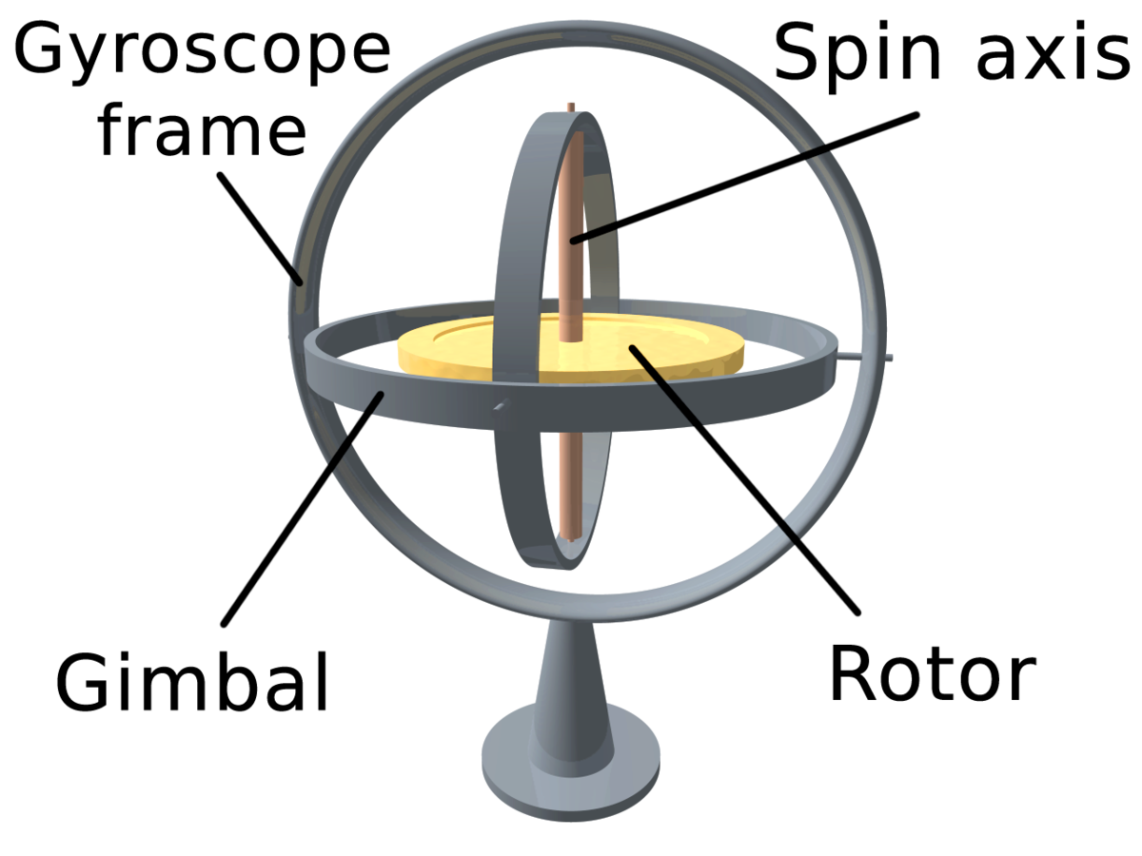
gyroscope
Prof Varsha Degaonkar
Assistant Professor
Department of Electronics and Telecommunication
Hope Foundation’s
International Institute of Information Technology, I²IT
www.isquareit.edu.in
https://en.wikipedia.org/wiki/Gyroscope

Slide 2
Introduction
Gyroscope
Used for navigation
Used for measuring angular velocity.
rotational velocity can be measured in 1, 2, or 3 directions.
3 axis gyroscopes can provide a full 6 degree-of-freedom in motion tracking system with a 3-axis accelerometer
https://en.wikipedia.org/wiki/Gyroscope
International Institute of Information Technology, I²IT, P-14 Rajiv Gandhi Infotech Park, Hinjawadi, Pune - 411 057
Tel - +91 20 22933441 / 2 / 3 | Website - www.isquareit.edu.in ; Email - info@isquareit.edu.in

Slide 3
Principle of Operation
Orientation is determined with use of Earth’s gravity
Evolved from mechanical-inertial spinning devices which consists of rotors, axles, and gimbals
Types of gyroscopes:
Rotary (classical) gyroscope
Vibrating Structure Gyroscope
Optical Gyroscope
https://en.wikipedia.org/wiki/Gyroscope

Slide 4
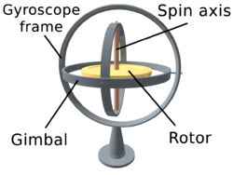
Rotary (classical) Gyroscopes
The law of conservation of angular momentum is used in the Rotary (classical) gyroscope. Which says that system will get constant angular momentum in direction and magnitude if the system has zero the resultant external torque .
It consists of : spinning disk or mass on axle, a series of gimbals
Additional degree of rotational freedom is given by gimbals.
Fig. 1 Rotary Gyroscope
https://en.wikipedia.org/wiki/Gyroscope

Slide 5
Vibrating Structure Gyroscopes
Vibrating structure gyroscopes are MEMS (Micro-machined Electro-Mechanical Systems) devices
The operation uses principle of Coriolis force.
The Coriolis force is proportional to both the angular velocity of the rotating object and the velocity of the object moving towards or away from the axis of rotation.
https://en.wikipedia.org/wiki/Gyroscope

Slide 6
Specifications
Measurement range
Number of sensing axes
Nonlinearity
Working temperature range
Shock Survivability
Bias Instability
Angular Random Walk (ARW
Bias
Bias Drift
Bandwidth

Slide 7
Selection Criteria
Nonlinearity
Noise density
Bias repeatability
Acceleration sensitivity
Sensitivity to vibration
Sensitivity to linear acceleration–or g sensitivity
Environmental Factors- Temperature
Availability
Cost

Slide 8
Thank you!!
For further details please contact
Prof. Varsha Degaonkar
varshad@isquareit.edu.in
Department of Electronics & Telecommunication
International Institute of Information Technology, I²IT
P-14, Rajiv Gandhi Infotech Park, MIDC Phase I, Hinjawadi, Pune
www.isquareit.edu.in | info@isquareit.edu.in
Ph. - +91 20 22933441

