Slide 1

Classification Using K-Nearest Neighbor
Back Ground
Prepared By
Anand Bhosale

Slide 2
Supervised Unsupervised
Labeled Data
Unlabeled Data
X1 | X2 | Class
10 | 100 | Square
2 | 4 | Root
X1 | X2
10 | 100
2 | 4

Slide 3
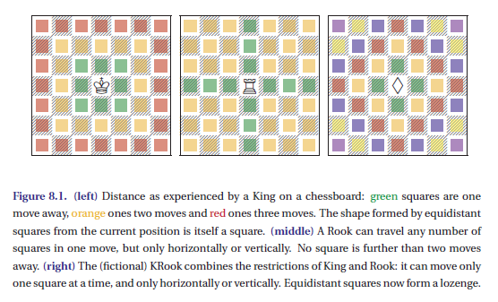
Distance

Slide 4
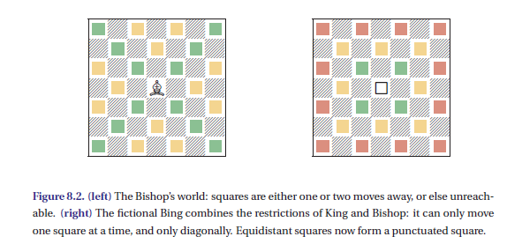
Distance

Slide 5
Distances
Distance are used to measure similarity
There are many ways to measure the distance s between two instances
Distance
Euclidean Distance
Minkowski distance
Hamming Distance
Mahalanobis Distance

Slide 6
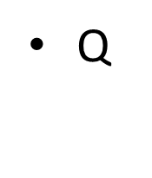
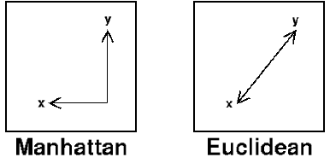

Distances
Manhattan Distance
|X1-X2| + |Y1-Y2|
Euclidean Distance
$\sqrt{\left(x1−x2\right)2}+√\left(y1−y2\right)$²

Slide 7
Properties of Distance
Dist (x,y) >= 0
Dist (x,y) = Dist (y,x) are Symmetric
Detours can not Shorten Distance
Dist(x,z) <= Dist(x,y) + Dist (y,z)
z
X
X
y
y
z

Slide 8
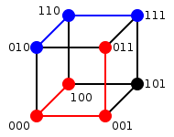
Distance
Hamming Distance

Slide 9
Distances Measure
Distance Measure – What does it mean “Similar"?
Minkowski Distance
  Norm:
  Chebyshew Distance
  Mahalanobis distance:
  d(x , y) = |x – y|^{T}S_{xy}⁻¹|x – y|

Slide 10
Nearest Neighbor and Exemplar

Slide 11
Exemplar
Arithmetic Mean
Geometric Mean
Medoid
Centroid

Slide 12
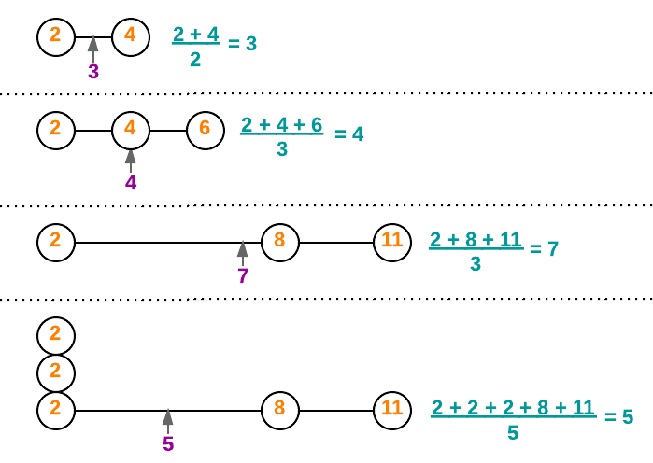
Arithmetic Mean

Slide 13
Geometric Mean
A term between two terms of a geometric sequence is the geometric mean of the two terms. Example: In the geometric sequence 4, 20, 100, ....(with a factor of 5), 20 is the geometric mean of 4 and 100.

Slide 14
Nearest Neighbor Search
Given: a set P of n points in R^{d}
Goal: a data structure, which given a query point q, finds the nearest neighbor p of q in P
p
q

Slide 15
K-NN
(K-l)-NN: Reduce complexity by having a threshold on the majority. We could restrict the associations through (K-l)-NN.

Slide 16
K-NN
(K-l)-NN: Reduce complexity by having a threshold on the majority. We could restrict the associations through (K-l)-NN.
K=5

Slide 17
K-NN
Select 5 Nearest Neighbors
as Value of K=5 by Taking their
Euclidean Disances

Slide 18
K-NN
Decide if majority of Instances over a given
value of K Here, K=5.

Slide 19
Example
Points | X1 (Acid Durability ) | X2(strength) | Y=Classification
P1 | 7 | 7 | BAD
P2 | 7 | 4 | BAD
P3 | 3 | 4 | GOOD
P4 | 1 | 4 | GOOD

Slide 20
KNN Example
Points | X1(Acid Durability) | X2(Strength) | Y(Classification)
P1 | 7 | 7 | BAD
P2 | 7 | 4 | BAD
P3 | 3 | 4 | GOOD
P4 | 1 | 4 | GOOD
P5 | 3 | 7 | ?

Slide 21
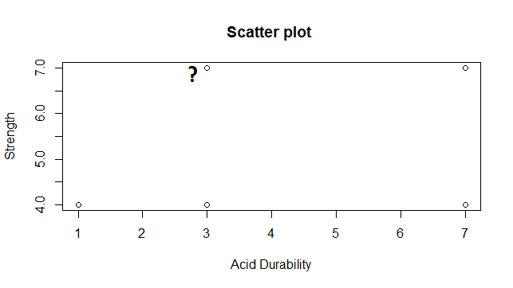
Scatter Plot

Slide 22
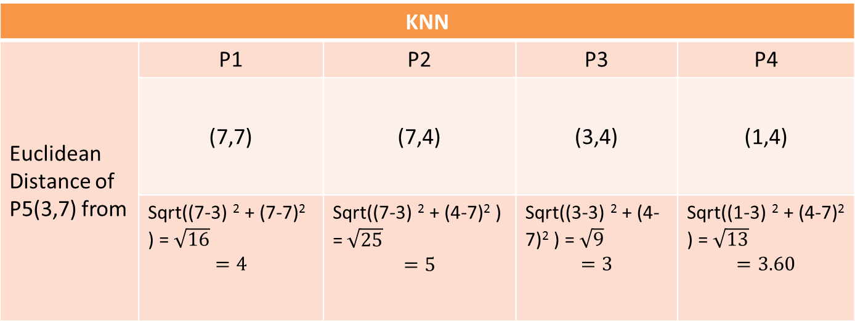
Euclidean Distance From Each Point
KNN
Euclidean Distance of P5(3,7) from | P1 | P2 | P3 | P4
 | (7,7) | (7,4) | (3,4) | (1,4)
 | Sqrt((7-3) ² + (7-7)² ) =$\sqrt{16}$ $$=4$$ | Sqrt((7-3) ² + (4-7)² ) =$\sqrt{25}$ $$=5$$ | Sqrt((3-3) ² + (4-7)² ) =$\sqrt{9}$ $$=3$$ | Sqrt((1-3) ² + (4-7)² ) =$\sqrt{13}$ $$=3.60$$

Slide 23
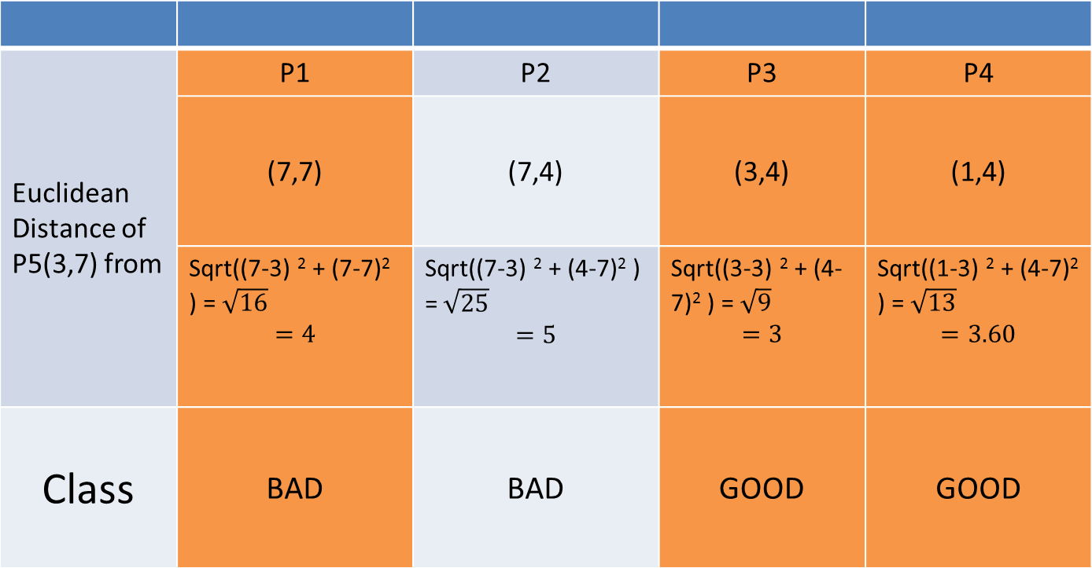
3 Nearest NeighBour
Euclidean Distance of P5(3,7) from | P1 | P2 | P3 | P4
 | (7,7) | (7,4) | (3,4) | (1,4)
 | Sqrt((7-3) ² + (7-7)² ) =$\sqrt{16}$ $$=4$$ | Sqrt((7-3) ² + (4-7)² ) =$\sqrt{25}$ $$=5$$ | Sqrt((3-3) ² + (4-7)² ) =$\sqrt{9}$ $$=3$$ | Sqrt((1-3) ² + (4-7)² ) =$\sqrt{13}$ $$=3.60$$
Class | BAD | BAD | GOOD | GOOD

Slide 24
KNN Classification
Points | X1(Durability) | X2(Strength) | Y(Classification)
P1 | 7 | 7 | BAD
P2 | 7 | 4 | BAD
P3 | 3 | 4 | GOOD
P4 | 1 | 4 | GOOD
P5 | 3 | 7 | GOOD

Slide 25
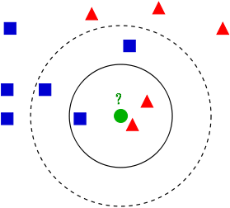
Variation In KNN

Slide 26
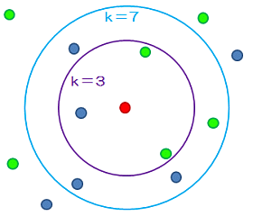
Different Values of K

Slide 27
References
Machine Learning : The Art and Science of Algorithms that Make Sense of Data By Peter Flach
A presentation on KNN Algorithm : West Virginia University , Published on May 22, 2015

Slide 28
Thanks

