Slide 1
Types of Corrosion
Dr. Swati Kolet
Assistant Professor
Department of Applied Sciences & Engineering
Hope Foundation’s
International Institute of Information Technology, Pune

Slide 2
Dry Corrosion
This type of corrosion occurs due to direct attack of atmospheric gases.
Rate of corrosion depends on:
Chemical affinity between metal and gas
Temperature
Nature of oxide film on the surface of metal
Moisture in air
Hope Foundation’s International Institute of Information Technology, I²IT P-14,Rajiv Gandhi Infotech Park
MIDC Phase 1, Hinjawadi, Pune – 411057
Tel - +91 20 22933441/2/3 | www.isquareit.edu.in | info@isquareit.edu.in

Slide 3
Mechanism of Dry Corrosion
Corrosion by oxygen:
The corrosion of metal by oxygen takes place as:
Adsorption of O₂ molecules on metal surface
Dissociation of O₂ molecules into atoms
Loss of electrons by metal atom to Oxygen atom, resulting in formation of metal ion and oxide ion.
Hope Foundation’s International Institute of Information Technology, I²IT P-14,Rajiv Gandhi Infotech Park
MIDC Phase 1, Hinjawadi, Pune – 411057
Tel - +91 20 22933441/2/3 | www.isquareit.edu.in | info@isquareit.edu.in

Slide 4
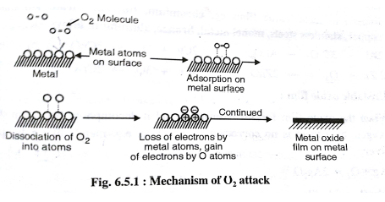
Hope Foundation’s International Institute of Information Technology, I²IT P-14,Rajiv Gandhi Infotech Park
MIDC Phase 1, Hinjawadi, Pune – 411057
Tel - +91 20 22933441/2/3 | www.isquareit.edu.in | info@isquareit.edu.in

Slide 5
Nature of oxide film
Porous film
4Na + O₂ 2Na₂O
2Fe + O₂ 2FeO
2Mg + O₂ 2MgO
Non-porous film
2Al+ 3/2O₂ 2Al₂O₃
2Mg + O₂ 2MgO
Unstable oxide film
4Ag+ O₂ → 2Ag₂O
Volatile oxide film
2Mo+ 3O₂ → 2Mo₂O₃
Hope Foundation’s International Institute of Information Technology, I²IT P-14,Rajiv Gandhi Infotech Park
MIDC Phase 1, Hinjawadi, Pune – 411057
Tel - +91 20 22933441/2/3 | www.isquareit.edu.in | info@isquareit.edu.in

Slide 6
Pilling Bedworth Rule
This gives idea about nature of oxide film.
PBR = Volume of metal oxide/ Volume of metal consumed
If 1 < PBR< 1.45 then film is non porous.
Hope Foundation’s International Institute of Information Technology, I²IT P-14,Rajiv Gandhi Infotech Park
MIDC Phase 1, Hinjawadi, Pune – 411057
Tel - +91 20 22933441/2/3 | www.isquareit.edu.in | info@isquareit.edu.in

Slide 7
Hope Foundation’s International Institute of Information Technology, I²IT P-14,Rajiv Gandhi Infotech Park
MIDC Phase 1, Hinjawadi, Pune – 411057
Tel - +91 20 22933441/2/3 | www.isquareit.edu.in | info@isquareit.edu.in

Slide 8
Electrochemical Corrosion (Immersed corrosion)
Definition: Corrosion of a metal by aqueous conducting medium with the formation of anodic and cathodic areas.
There are two types of electrochemical corrosion:
Galvanic Corrosion
Concentration/Differential Aeration
Note: Corrosion takes place only on the anodic area and the product remains dissolved or gets deposited on the cathode.
Hope Foundation’s International Institute of Information Technology, I²IT P-14,Rajiv Gandhi Infotech Park
MIDC Phase 1, Hinjawadi, Pune – 411057
Tel - +91 20 22933441/2/3 | www.isquareit.edu.in | info@isquareit.edu.in

Slide 9
1. Galvanic Corrosion
Definition: The electrochemical corrosion by attack of an aqueous medium with the formation of a galvanic cell is called galvanic corrosion.
There are three types:
Two dissimilar metals in contact
Stressed and unstressed part on the same metal
Impurities in the metal
Hope Foundation’s International Institute of Information Technology, I²IT P-14,Rajiv Gandhi Infotech Park
MIDC Phase 1, Hinjawadi, Pune – 411057
Tel - +91 20 22933441/2/3 | www.isquareit.edu.in | info@isquareit.edu.in

Slide 10
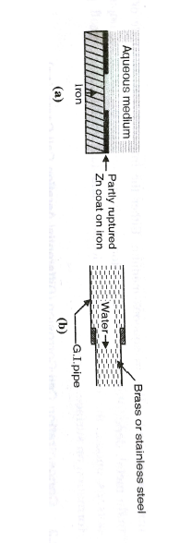
Two dissimilar metals in contact
Metals or alloys that are placed higher in the galvanic series act as anode and get corroded.
Ex: Tap of brass or stainless steel pipe.
Hope Foundation’s International Institute of Information Technology, I²IT P-14,Rajiv Gandhi Infotech Park
MIDC Phase 1, Hinjawadi, Pune – 411057
Tel - +91 20 22933441/2/3 | www.isquareit.edu.in | info@isquareit.edu.in

Slide 11
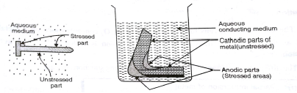
Stressed and Unstressed part on same metal
Stressed part: Working on a metal part disturbs the grain structure at the worked part i.e. stressed part.
Whenever it comes in contact with aqueous medium stresses part acts as anode and unstressed part acts as cathode.
Ex: Threaded end of a pipe or tip of a pin.
Hope Foundation’s International Institute of Information Technology, I²IT P-14,Rajiv Gandhi Infotech Park
MIDC Phase 1, Hinjawadi, Pune – 411057
Tel - +91 20 22933441/2/3 | www.isquareit.edu.in | info@isquareit.edu.in

Slide 12
Impurities in metal
A large number of tiny galvanic cells are formed on the surface of the metal or improperly made alloy when in contact with aqueous medium.
Here, either the impurity or the metal acts as anode depending on the placement in the galvanic series.
Hope Foundation’s International Institute of Information Technology, I²IT P-14,Rajiv Gandhi Infotech Park
MIDC Phase 1, Hinjawadi, Pune – 411057
Tel - +91 20 22933441/2/3 | www.isquareit.edu.in | info@isquareit.edu.in

Slide 13
2. Concentration/Differential Aeration
Definition: The concentration of cells formed due to varying O₂ concentrations on a metal are called as differential aeration cells and the corrosion is called Differential Aeration corrosion.
There are four types:
Partial immersion of metal
Partial burial in ground
Crevices
Oxide film on metal surface partially ruptured
Hope Foundation’s International Institute of Information Technology, I²IT P-14,Rajiv Gandhi Infotech Park
MIDC Phase 1, Hinjawadi, Pune – 411057
Tel - +91 20 22933441/2/3 | www.isquareit.edu.in | info@isquareit.edu.in

Slide 14
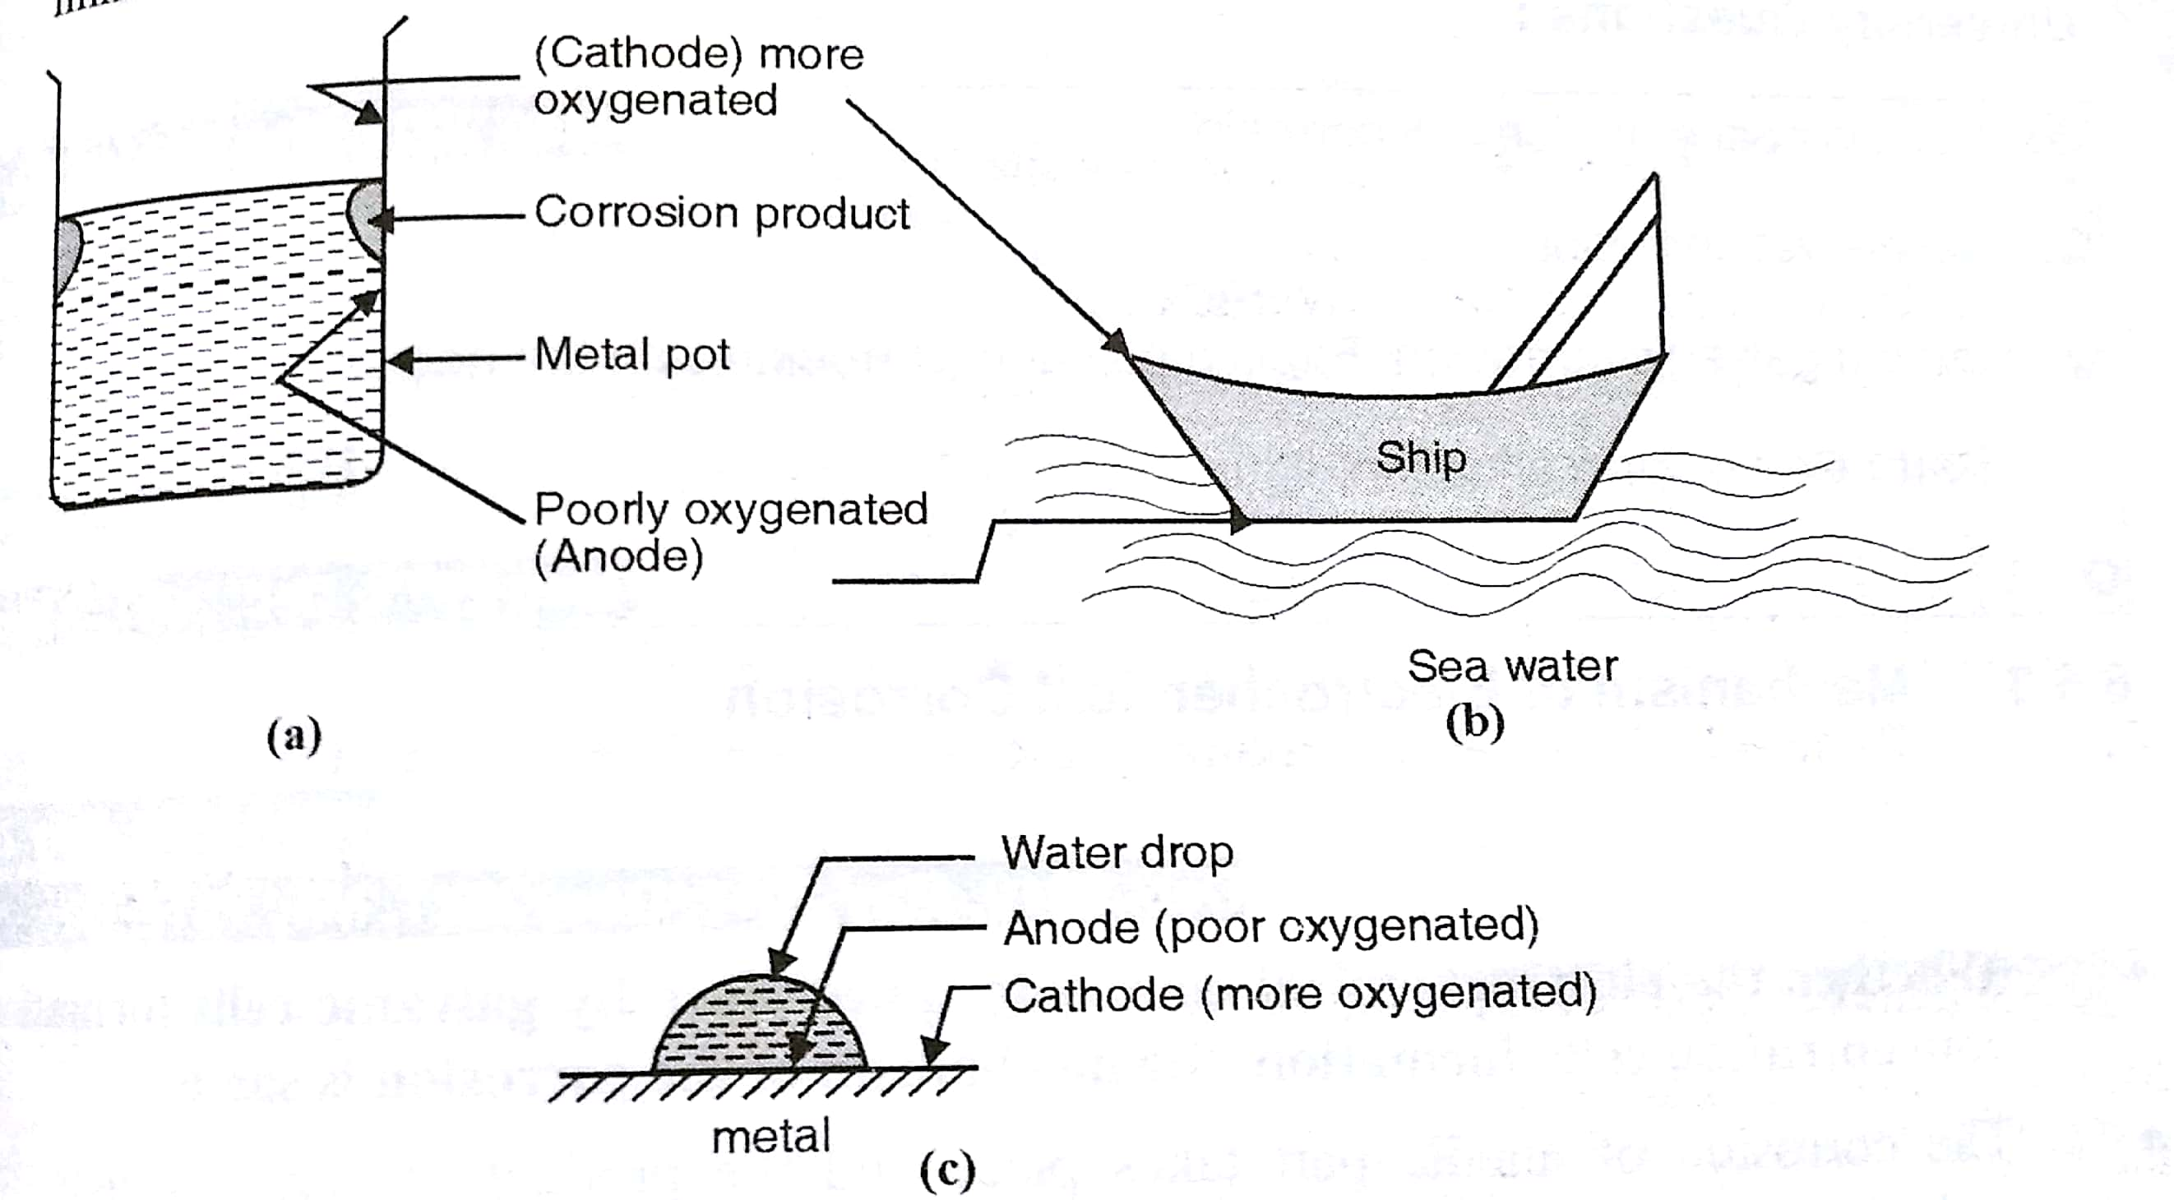
Partial immersion of metal
The immersed part of the metal is poorly oxygenated and the upper part that is exposed to higher concentration of air acts as cathode and does not get corroded.
Hope Foundation’s International Institute of Information Technology, I²IT P-14,Rajiv Gandhi Infotech Park
MIDC Phase 1, Hinjawadi, Pune – 411057
Tel - +91 20 22933441/2/3 | www.isquareit.edu.in | info@isquareit.edu.in

Slide 15
Partial burial in ground
A metal partially buried in ground has the aerial part more oxygenated(cathode) and moist part poorly oxygenated(anode).
Crevices
Two metals in contact have a crevice which is poorly oxygenated and gets corroded.
Oxide film on metal surface partially ruptured
When the non-porous oxide film is ruptured, open part is oxygenated and covered part is poorly oxygenated.
Hope Foundation’s International Institute of Information Technology, I²IT P-14,Rajiv Gandhi Infotech Park
MIDC Phase 1, Hinjawadi, Pune – 411057
Tel - +91 20 22933441/2/3 | www.isquareit.edu.in | info@isquareit.edu.in

Slide 16
Mechanism of Electrochemical Corrosion
Whether the electrochemical cells take place by galvanic cells formation or concentration cells formation ,the mechanism of corrosion is same.
Reaction on anode :
M → M^{+n} + ne⁻
Fe → Fe²⁺ + 2e⁻
Reaction on anode :
(1)H₂ liberation
(2)O₂ adsorption
Hope Foundation’s International Institute of Information Technology, I²IT P-14,Rajiv Gandhi Infotech Park
MIDC Phase 1, Hinjawadi, Pune – 411057
Tel - +91 20 22933441/2/3 | www.isquareit.edu.in | info@isquareit.edu.in

Slide 17
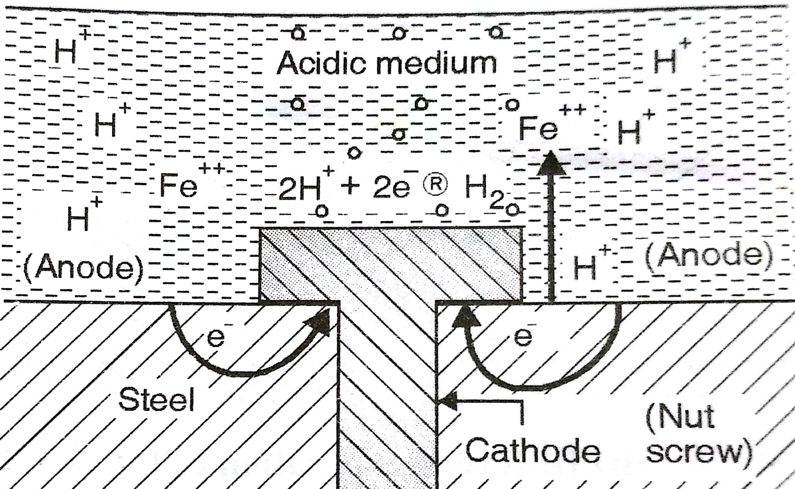
(1)H₂ liberation
If the corroding ,then the H⁺ ions from the medium catch electrons from the cathode and liberate H₂
Cathode:
2H⁺ + 2e⁻ → 2H → H₂ ↑
Fe + 2H⁺ → Fe²⁺ +H₂
Hope Foundation’s International Institute of Information Technology, I²IT P-14,Rajiv Gandhi Infotech Park
MIDC Phase 1, Hinjawadi, Pune – 411057
Tel - +91 20 22933441/2/3 | www.isquareit.edu.in | info@isquareit.edu.in

Slide 18
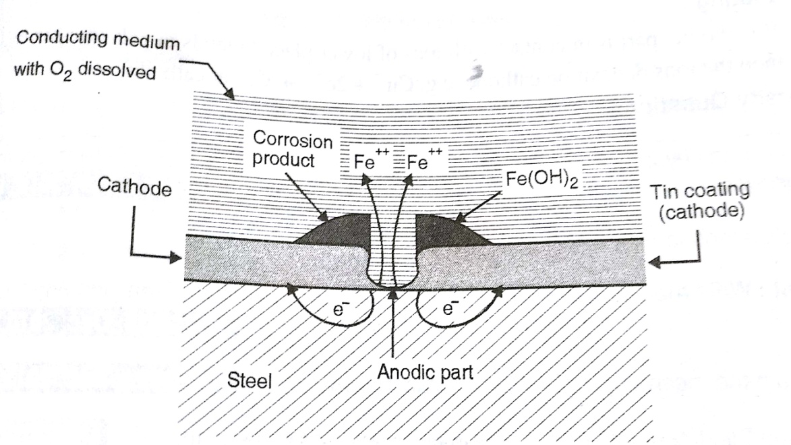
(2)O₂ adsorption
If the corroding medium is neutral or bit alkaline than some oxygen gas dissolved gets adsorbed on the cathode
Cathode:
O₂ +2H₂O → 4OH⁻
Hope Foundation’s International Institute of Information Technology, I²IT P-14,Rajiv Gandhi Infotech Park
MIDC Phase 1, Hinjawadi, Pune – 411057
Tel - +91 20 22933441/2/3 | www.isquareit.edu.in | info@isquareit.edu.in

Slide 19
THANK YOU
For further details, please contact
Dr. Swati Kolet
swatik@isquareit.edu.in
Department of Applied Sciences & Engineering
Hope Foundation’s
International Institute of Information Technology, I²IT
P-14,Rajiv Gandhi Infotech Park
MIDC Phase 1, Hinjawadi, Pune – 411057
Tel - +91 20 22933441/2/3
www.isquareit.edu.in | info@isquareit.edu.in

