Slide 1
Hope Foundation’s International Institute of Information Technology, (I²IT).
www.isquareit.edu.in
Tel - +91 20 22933441

Slide 2
Memory Organization and Segmentation in 80386 Microprocessor
An Overview

Slide 3
Outline
Introduction to Memory Organization
Model of memory organisation
Basic Design Issues
Challenges for Distributed System

Slide 4
Introduction to Memory Organization
In 80386 Microprocessor , the physical memory is organized as a sequence bytes.
A unique address range is in between zero to a maximum of 2^32-1 as shown in the following figure .
.
This can totally map 2^32 means 4 gigabytes physical address space.
0 | 1 | 2 | . | . | . | . | 2^32-1

Slide 5
80386 Programs
The 80386 programmer require no knowledge of this physical address space.
He/she can develop the 80386 programs without knowing how much physical memory is available, exactly where the 80386 program is located in the over all address space. need can be written without knowledge of how much
So the 80386 programs are independent of physical address space.

Slide 6
Model of memory organisation
System Software designers provides the model of memory organisation for the applications programmers.
Depending on the task, different models of memory organisation can be selected.
There are two end types of the model of memory organization.
Flat Model
Segmented Model

Slide 7
Flat Model
Organised as single array of 2^32 bytes ( 4 gigabytes)
Much smaller
An ordinal pointer value is from 0 to 232-1 to cover flat address space
Systems software like linkers, locators, binders, loaders relocation of separately-compiled modules

Slide 8
Segmented Model
The logical address space of 246 bytes (64 terabytes) is mapped onto the physical address space (up to 4 gigabytes).
A segment is a unit of contiguous address space.
Segment sizes may range from one byte up to a maximum of 232 bytes (4 gigabytes).

Slide 9
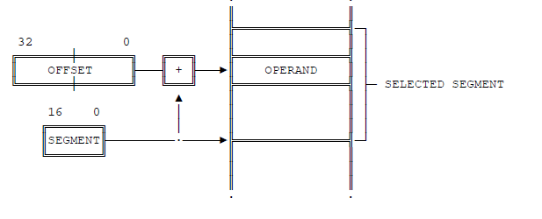
Segmented Model
A pointer in this address space has two parts as shown in the following figure. ( Source: INTEL 80386 PROGRAMMER'S REFERENCE MANUAL 1986)

Slide 10
Segmented Model
A segment selector is a 16-bit field.
It is the identifier of the segment.
3. An offset is a 32-bit ordinal number.
4. It maps to the byte in the selected segment.

Slide 11
THANK YOU
For further information please contact
Prof. Sandeep Patil
Department of Computer Engineering
Hope Foundation’s International Institute of Information Technology, I²IT
Hinjawadi, Pune – 411 057
Phone - +91 20 22933441
www.isquareit.edu.in | prashantg@isquareit.edu.in

