Slide 1
Newton’s Laws of Motion
Prepared By- Dr. Satyavathi Pentapati
I²IT, Hinjawadi, Pune - 411057

Slide 2
Newton’s First Law
Any body continues its state of rest or motion unless it is acted by some external agency of force. It describes the existence of force.
https://www.physicsclassroom.com/mmedia/newtlaws/mb.cfm

Slide 3
Newton’s Second Law
The rate of change of momentum is directly proportional to the force which caused the change and will be in the direction of the force.
Rate of change of Momentum = (mv₂-mv₁) / t
= m(v₂-v₁) / t
= ma , where, a = acceleration
Therefore, F = ma
https://i.pinimg.com/originals/bf/75/eb/bf75ebba02c81709c5060f160b46876c.gif

Slide 4
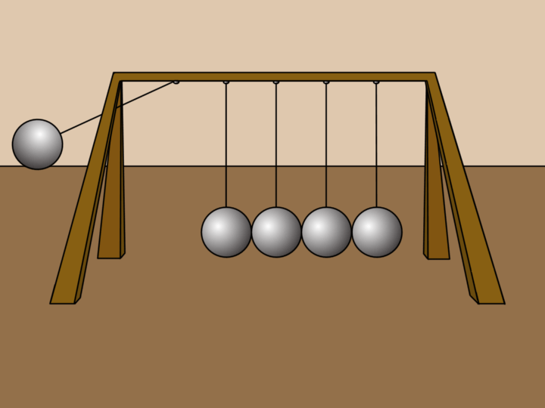
Newton’s Third Law
To every action, there is an equal and opposite reaction.
https://samandgabbyscienceproject.weebly.com/

Slide 5
THANK YOU
For any queries please contact
DR. Satyavathi Nath
Department of Applied Sciences & Engineering
Hope Foundation’s
International Institute of Information Technology, I²IT
P-14, Rajiv Gandhi Infotech Park, MIDC Phase 1,
Hinjawadi, Pune – 411 057
www.isquareit.edu.in
Phone : +91 20 22933441 / 2 / 3
satyavathin@isquareit.edu.in| info@isquareit.edu.in

