Slide 1
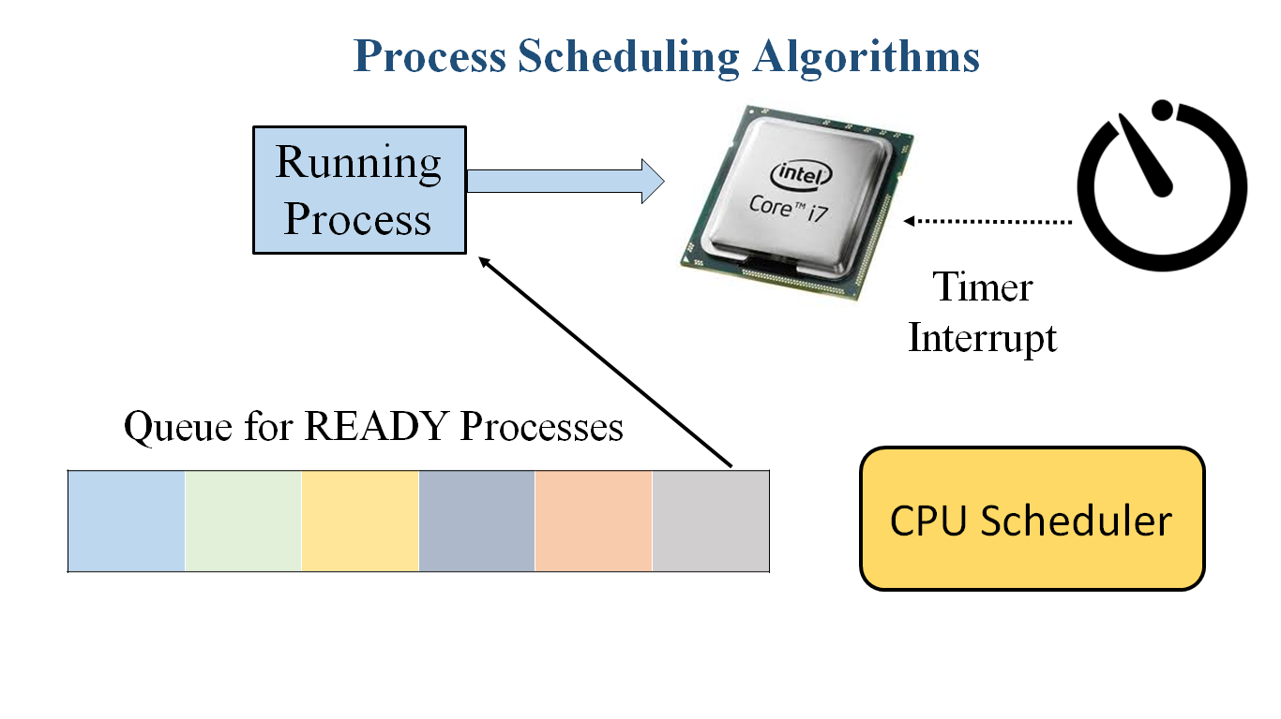
Prof. Deptii Chaudhari

Slide 2
HOPE FOUNDATION’S
INTERNATIONAL INSTITUTE OF INFORMATION TECHNOLOGY, (I²IT)
www.isquareit.edu.in
+91 20 22933441 / 2

Slide 3
Scheduling Algorithms
CPU scheduling deals with the problem of deciding which of the processes in the ready queue is to be allocated the CPU.
There are many different CPU scheduling algorithms.
First Come First Serve Scheduling (FCFS)
Shortest Job First Scheduling (SJF)
Round Robin Scheduling (RR)
Priority Based Scheduling

Slide 4
First Come First Serve Scheduling (FCFS)
By far the simplest CPU-scheduling algorithm is the first-come, first-served (FCFS) scheduling algorithm.
With this scheme, the process that requests the CPU first is allocated the CPU first.
The implementation of the FCFS policy is easily managed with a FIFO queue.
When a process enters the ready queue, its PCB is linked onto the tail of the queue. When the CPU is free, it is allocated to the process at the head of the queue.
The running process is then removed from the queue.
FCFS is non preemptive i.e.Process continues to run till the burst cycle ends

Slide 5
FCFS Example
Process | Arrival Time | Burst Time
P1 | 0 | 7
P2 | 0 | 4
P3 | 0 | 2
P4 | 0 | 5
Arrival Time: When Process enters Ready Queue
Burst Time: Time Required by the process for execution
Average Waiting Time = (0+7+11+13)/4
= 7.75
Average Response Time = (0+7+11+13)/4
= 7.75
(Same as Average Waiting Time)
Gnatt Chart : Horizontal bar chart developed by Henry Gantt, an American Engineering and social scientist in 1917 as a production control tool
Response Time = Time taken by a particular process to begin executing on CPU – Time it enters in ready queue.
P1
P2
P3
P4

Slide 6
Order of Scheduling matters
Process | Arrival Time | Burst Time
P1 | 0 | 7
P2 | 0 | 4
P3 | 0 | 2
P4 | 0 | 5
Average Waiting Time
= (0+4+6+11)/4
= 5.25
P2
P3
P4
P1

Slide 7
Convoy Effect
All processes wait for the one big process to get off the CPU
Process | Arrival Time | Burst Time
P1 | 0 | 7
P2 | 0 | 4
P3 | 0 | 2
P4 | 0 | 5
P1
P2
P3
P4

Slide 8
FCFS - Advantages & Disadvantages
Advantages
Simple
Fair ( as long as no process hogs the CPU, every process will eventually run)
Disadvantages
Waiting time depends on arrival order
Short processes stuck waiting for long process to complete

Slide 9
Shortest Job First (SJF)
A different approach to CPU scheduling is the shortest-job-first (SJF) scheduling algorithm.
This algorithm associates with each process the length of the process's next CPU burst.
When the CPU is available, it is assigned to the process that has the smallest next CPU burst.
If the next CPU bursts of two processes are the same, FCFS scheduling is used to break the tie.
No preemption : the process continues to execute until its CPU burst completes
With preemption : the process may get preempted when a new process arrives

Slide 10
SJF ( without preemption)
Process | Arrival Time | Burst Time
P1 | 0 | 7
P2 | 0 | 4
P3 | 0 | 2
P4 | 0 | 1
Average wait time
= (7+3+1+0) / 4 = 2.75
Average Response Time
= (Average wait time)
P4
P3
P2
P1
Arrival
Schedule
P3
P2
P1
P4

Slide 11
SJF ( without preemption)
Process | Arrival Time | Burst Time
P1 | 0 | 7
P2 | 2 | 4
P3 | 4 | 2
P4 | 7 | 1
Average Wait Time
= (0+8+4+0)/4
= 3
Average Response Time
= (Average Wait Time)
Arrival
P1
P2
P3
P4
Schedule
P1
P4
P3
P2

Slide 12
SJF – Advantages & Disadvantages
Advantages
Optimal : Minimum average wait time
Disadvantages
Not Practical : difficult to predict burst time (learning to predict future)
May starve long jobs

Slide 13
Round Robin (RR)
The round-robin (RR) scheduling algorithm is designed especially for timesharing systems.
It is similar to FCFS scheduling, but preemption is added to switch between processes.
A small unit of time, called a time quantum or time slice, is defined. A time quantum is generally from 10 to 100 milliseconds.
The ready queue is treated as a circular queue. The CPU scheduler goes around the ready queue, allocating the CPU to each process for a time interval of up to 1 time quantum.
To implement RR scheduling, we keep the ready queue as a FIFO queue of processes.
New processes are added to the tail of the ready queue. The CPU scheduler picks the first process from the ready queue, sets a timer to interrupt after 1 time quantum, and dispatches the process.

Slide 14
Round Robin Scheduling
Average Wait Time = (9+8+4+10)/4 =7.75
Average Response Time = (0+2+4+6)/4 =3
No of Context Switch = 7
Process | Arrival Time | Burst Time
P1 | 0 | 5
P2 | 0 | 4
P3 | 0 | 2
P4 | 0 | 3
Time Slice =2
P1 |  | P2 |  | P3 |  | P4 |  | P1 |  | P2 |  | P4 | P1
P2 P3 P4 |  | P3 P4 P1 |  | P4 P1 P2 |  | P1 P2 |  | P2 P4 |  | P4 P1 |  | P1
Schedule
FIFO

Slide 15
Round Robin Scheduling
Process | Arrival Time | Burst Time
P1 | 0 | 7
P2 | 2 | 4
P3 | 3 | 2
P4 | 9 | 1
Average Waiting Time = (7+6+3+3)/4 = 4.75
Average Response Time = (0+2+3+3)/4 = 2
No of Context Switches = 6
Arrival
P1 |  | P2 | P3 |  |  |  |  |  | P4
P1 |  | P1 |  | P2 |  | P3 |  | P1 |  | P2 |  | P4 | P1
 |  | P2 | P2 P3 | P3 P1 |  | P1 P2 |  | P2 | P2 P4 | P4 P1 |  | P1
Schedule
FIFO

Slide 16
Round Robin Scheduling
Process | Arrival Time | Burst Time
P1 | 0 | 7
P2 | 2 | 4
P3 | 3 | 2
P4 | 9 | 1
Average Waiting Time = (7+7+4+2)/4 = 5
Average Response Time = (0+1+2+2)/4 = 1.25
No of Context Switches = 11
Arrival
P1 |  | P2 | P3 |  |  |  |  |  | P4
P1 |  | P1 | P2 | P1 | P3 | P2 | P1 | P3 | P2 | P1 | P4 | P2 | P1
 |  | P2 | P1 P3 | P3 P2 | P2 P1 | P1 P3 | P3 P2 | P2 P1 | P1 P4 | P4 P1 | P2 P1 | P1
Schedule
FIFO

Slide 17
Round Robin Scheduling (Larger Timeslice)
Process | Arrival Time | Burst Time
P1 | 0 | 7
P2 | 2 | 4
P3 | 3 | 2
P4 | 9 | 1
Average Waiting Time = (5+3+9+3)/4 = 5
Average Response Time = (0+3+6+3)/4 = 3
No of Context Switches = 5
Arrival
P1 |  | P2 | P3 |  |  |  |  |  | P4
P1 |  |  |  |  | P2 |  |  |  | P3 | P1 |  | P4 | P3
 |  | P2 | P2 P3 | P2 P3 | P3P1 | P3 P1 | P3 P1 | P3 P1 | P1 P4 | P4P3 | P4 P3 | P3
Schedule
FIFO

Slide 18
Duration of Timeslice
Duration of time slice is very critical.
It affects both response time as well as number of context switches.
A short quantum timeslice
Good, because processes need not wait long before they are scheduled
Bad, because context switch overhead increases
A long quantum timeslice
Bad, because processes no longer appear to execute concurrently
May degrade system performance
Timeslice is typically kept between 10ms to 100ms

Slide 19
Round Robin – Advantages & Disadvantages
Advantages
Fair – Each process gets a fair chance to run on CPU
Low average wait time
Faster response time
Disadvantages
Increased context switching – Context switches are overhead
High average wait time, when burst times have equal lengths

Slide 20
Shortest Remaining Time First (SRTF)
Preemptive SJF scheduling is sometimes called shortest-remaining-time-first scheduling.
In SRTF scheduling, if a new process arrives with a shorter burst time than remaining of current processes then schedule new process.
It further reduces the average waiting time and average response time.

Slide 21
Shortest Remaining Time First (SRTF)
Process | Arrival Time | Burst Time
P1 | 0 | 7
P2 | 2 | 4
P3 | 4 | 2
P4 | 7 | 1
Average Wait Time
= (7+0+2+1)/4
= 2.5
Average Response Time
= (0+0+2+1)/4
=0.75
Arrival
P1
P2
P3
P4
Schedule
P1
P2
P3
P1
P2 burst time is 4,
P1 remaining burst time is 5
(Preempt P1)
P3 burst time is 2,
P2 remaining burst time is 2
(No Preemption)

Slide 22
Priority Based Scheduling
Each process is assigned a priority.
A priority is a number in a range (e.g 0 to 255)
A small number would mean high priority and larger number would mean low priority
Scheduling policy : Pick the process from the ready queue having the highest priority
Advantage: Provides relative importance to processes
Disadvantage: Could lead to starvation of low priority processes.

Slide 23
Priority Based Scheduling
Process | Priority | Burst Time
P1 | 2 | 21
P2 | 1 | 3
P3 | 4 | 6
P4 | 3 | 2
Average Waiting Time
= (0+3+24+26)/4
= 13.25
P2 | P1 | P4 | P3
0 | 3 | 24 | 26

Slide 24
Priority Based Scheduling
Average Waiting Time
= (6+0+16+18+1)
= 8.2
Process | Burst Time | Priority
P1 | 10 | 3
P2 | 1 | 1
P3 | 2 | 4
P4 | 1 | 5
P5 | 5 | 2
P2 | P5 | P1 | P3 | P4
0
1
6
16
18
19

Slide 25
Priority Based Scheduling
Priority scheduling can be either preemptive or non-preemptive.
When a process arrives at the ready queue, its priority is compared with the priority of the currently running process.
A preemptive priority scheduling algorithm will preempt the CPU if the priority of the newly arrived process is higher than the priority of the currently running process.
A non-preemptive priority scheduling algorithm will simply put the new process at the head of the ready queue.

Slide 26
Priority Scheduling – Drawbacks
A major problem with priority scheduling algorithms is indefinite blocking, or starvation.
A process that is ready to run but waiting for the CPU can be considered blocked.
A priority scheduling algorithm can leave some low priority processes waiting indefinitely.
In a heavily loaded computer system, a steady stream of higher-priority processes can prevent a low-priority process from ever getting the CPU. Generally, one of two things will happen.
Either the process will eventually be run (when the system is finally lightly loaded), or the computer system will eventually crash and lose all unfinished low-priority processes.

Slide 27
Solution to Starvation - Ageing
A solution to the problem of indefinite blockage of low-priority processes is aging.
Aging is a technique of gradually increasing the priority of processes that wait in the system for a long time.
For example, if priorities range from 127 (low) to 0 (high), we could increase the priority of a waiting process by 1 every 15 minutes.
Eventually, even a process with an initial priority of 127 would have the highest priority in the system and would be executed.

Slide 28
References
Silberschatz, Galvin, Gagne, "Operating System Principles", 9th Edition, Wiley
https://nptel.ac.in/courses/106106144/

Slide 29
THANK YOU !!
For further information please contact
Prof. Deptii Chaudhari
Department of Computer Engineering
Hope Foundation’s International Institute of Information Technology, I²IT
Hinjawadi, Pune – 411 057
Phone - +91 20 22933441
www.isquareit.edu.in | deptiic@isquareit.edu.in

