Slide 1

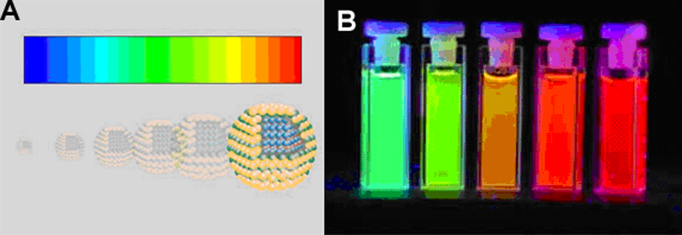
Physics of Nanoparticles
Dr. Sandeep Varpe
Assistant Professor
Department of Applied Sciences & Engineering

Slide 2
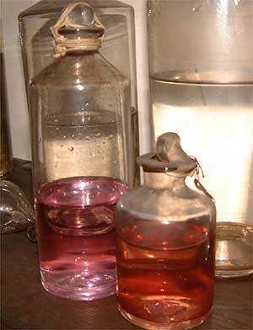
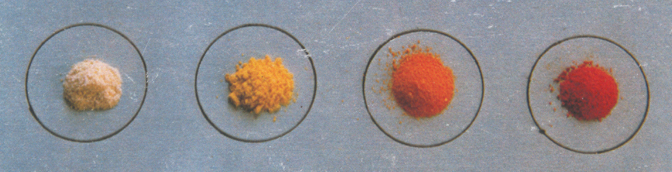
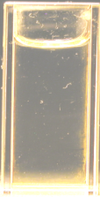
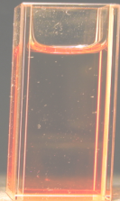
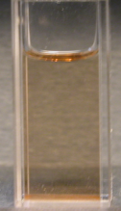
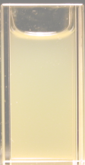
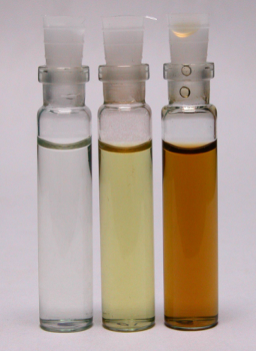

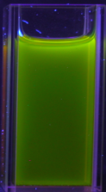
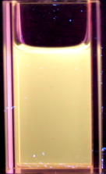
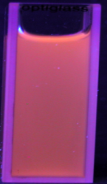
What is Special about Nanotechnology
Properties of all materials are size dependent
below ~ 100 nm!
CdS
Au
Ag
CdSe
(M. Faraday1857)!

Slide 3
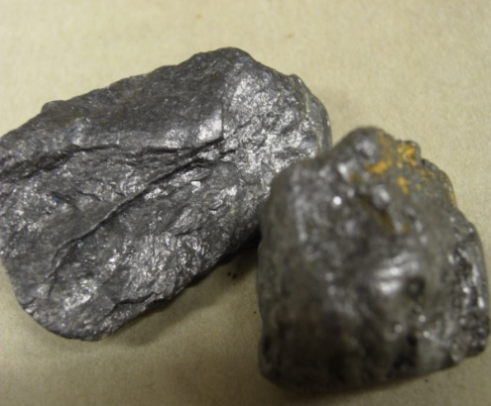
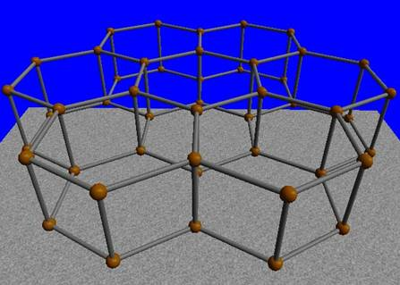

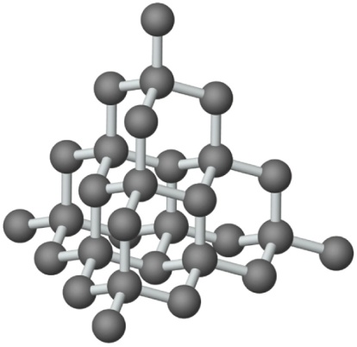
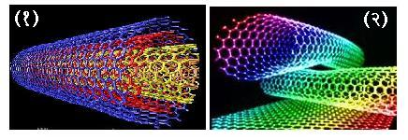
Carbon
Graphite
Diamond
Fullerenes
Carbon Naotubes
Latest is Graphene!

Slide 4
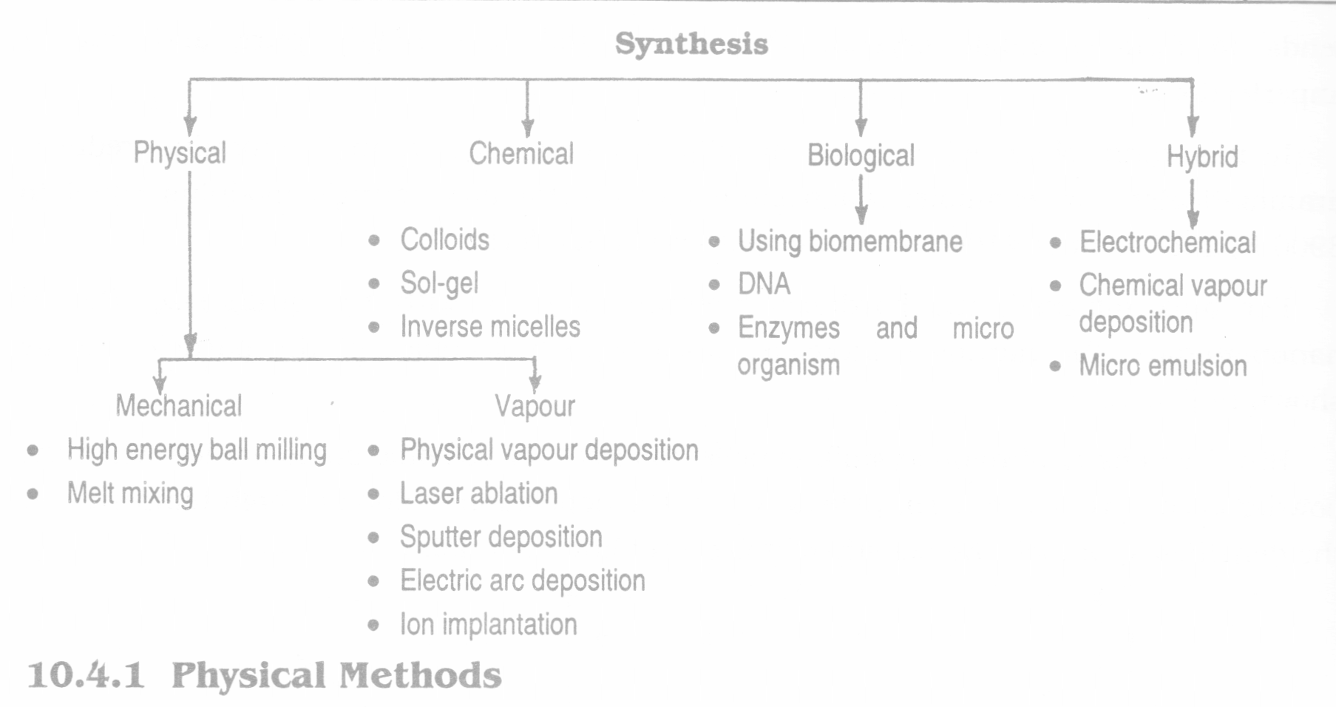

Slide 5
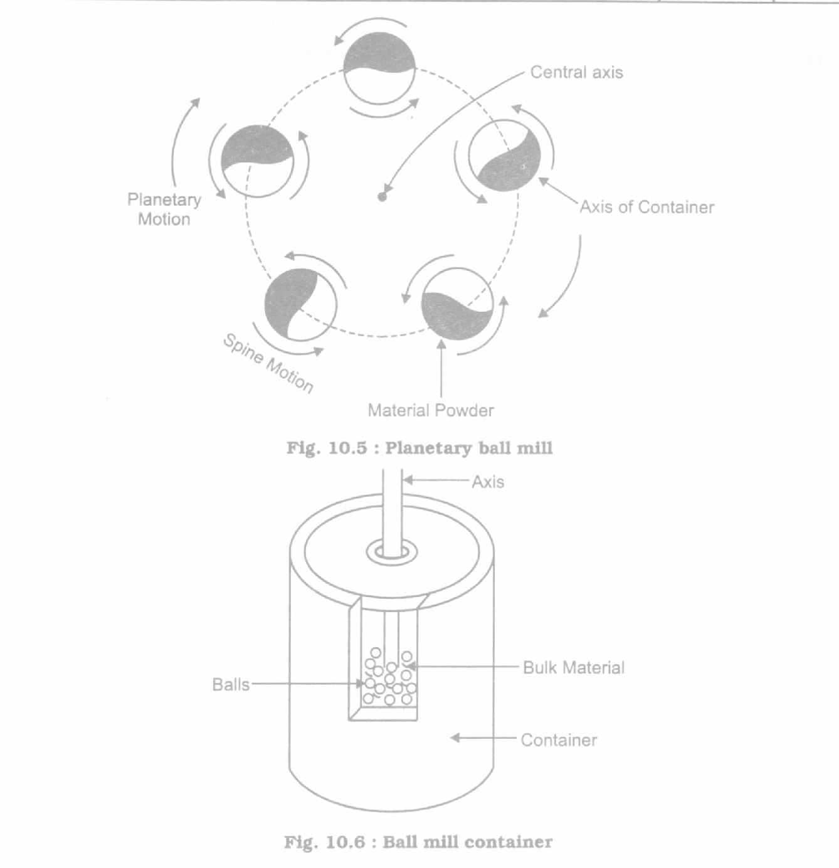
Physical Method:
Planetary ball method

Slide 6
Planetary ball method

Slide 7
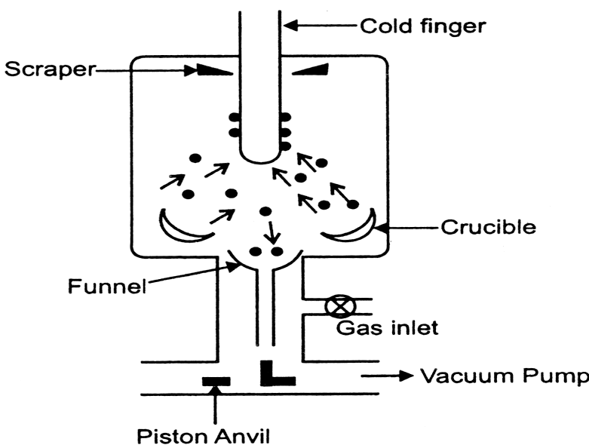
Vapor Condensation

Slide 8
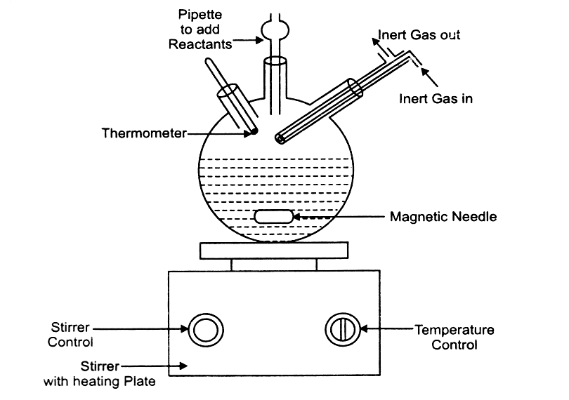
Chemical Reactor

Slide 9
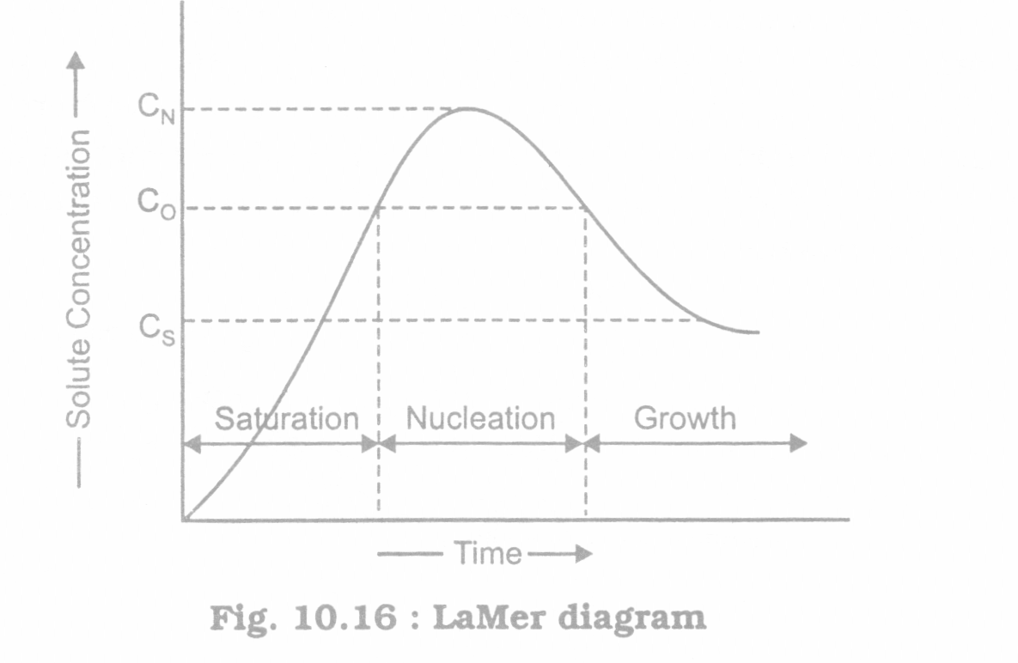

Slide 10
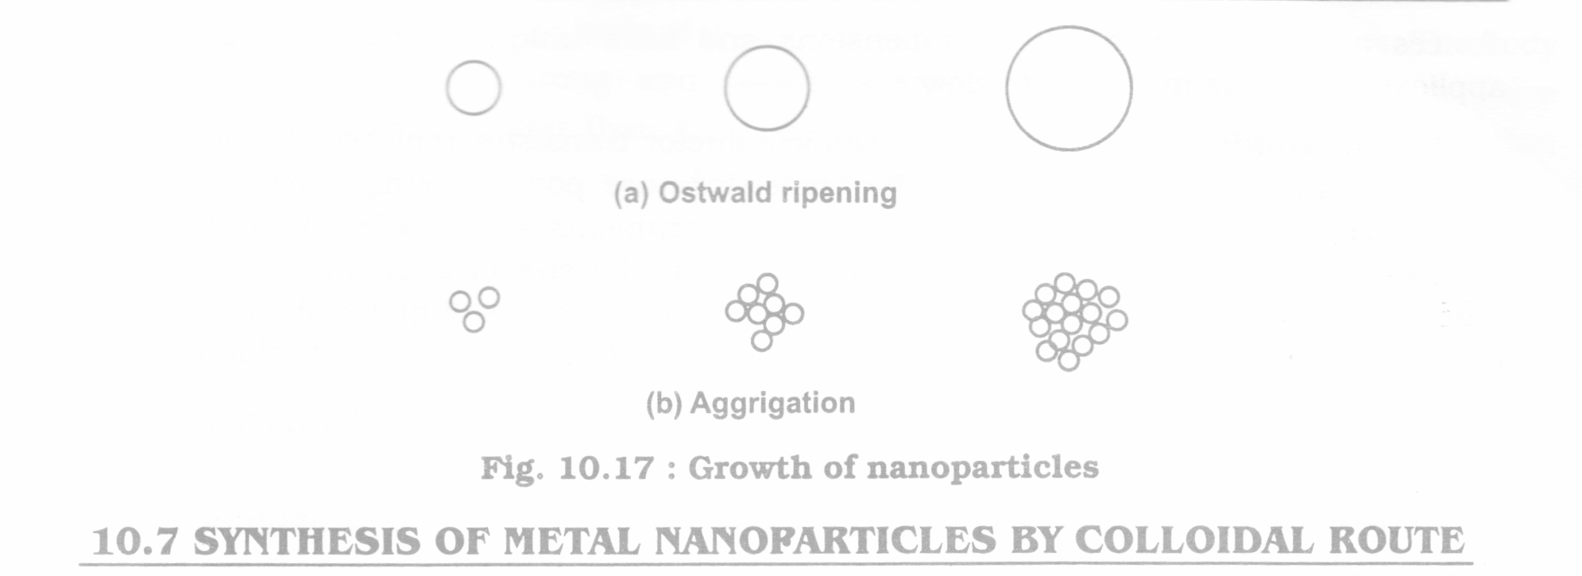

Slide 11
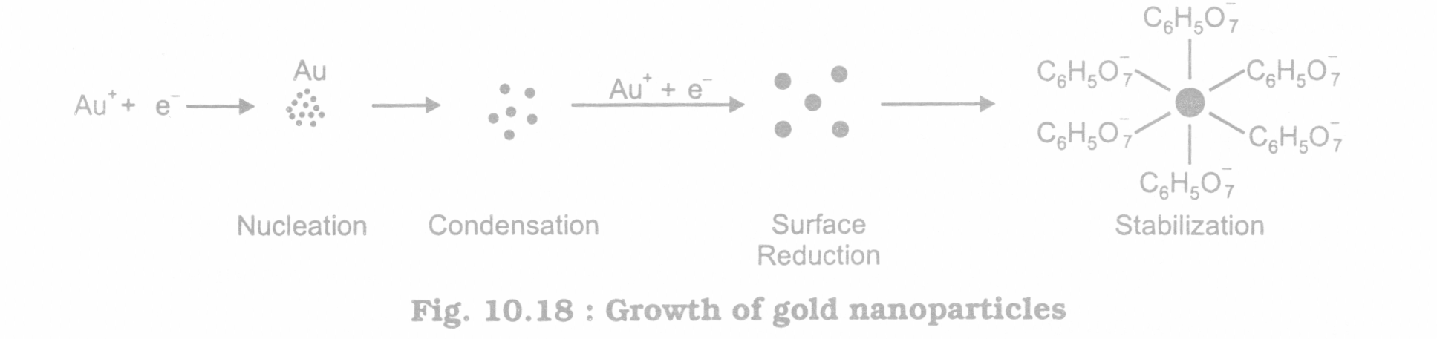

Slide 12
Sports/Toys
Electronics
Food/Agriculture
Photonics
Spintronics
Energy
Applications
Space Vehicles
Display Panels
Consumer Goods
Medical/Diagnostics

Slide 13
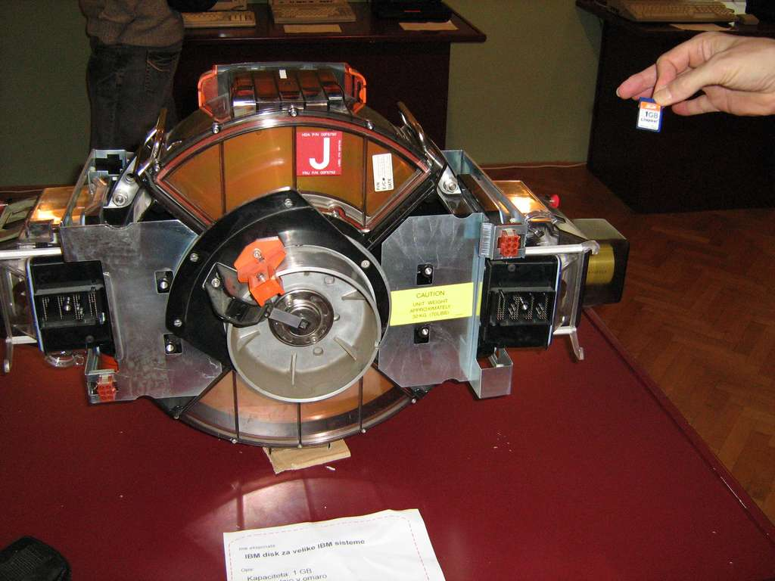
1 GB…20 yrs before an……..now

Slide 14
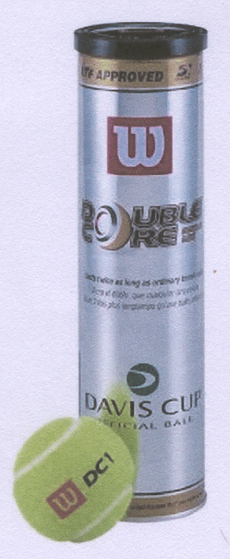

Nano-Clays

Slide 15
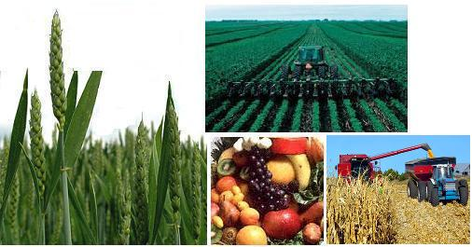
Food
Agriculture – better materials for agricultural implements, better seeds, control of fertilizers
& pesticide improved yield
Food – preservation, testing the quality

Slide 16




Cosmetics
UV protection
Wrinkle Free
Smooth...
Feel Good!

Slide 17

Nano-Textile

Slide 18
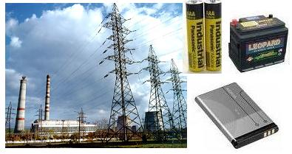
Energy

Slide 19



Communication,
Fast Computers
with Large
Data Storage Capacity

Slide 20
Thank You !
For further details, please contact
Dr. Sandeep Varpe
sandeepv@isquareit.edu.in
Department of Applied Sciences & Engineering
Hope Foundation’s
International Institute of Information Technology, I²IT
P-14,Rajiv Gandhi Infotech Park
MIDC Phase 1, Hinjawadi, Pune – 411057
Tel - +91 20 22933441/2/3
www.isquareit.edu.in | info@isquareit.edu.in

