Slide 1
Software Design Methodologies and Testing
Prof. Prashant J. Gadakh
Assistant Professor
Department of Computer Engineering
Hope Foundation’s International Institute of Information Technology, (I²IT).
www.isquareit.edu.in

Slide 2
Design Concept
Hope Foundation’s International Institute of Information Technology, I²IT P-14,Rajiv Gandhi Infotech Park
MIDC Phase 1, Hinjawadi, Pune – 411057 Tel - +91 20 22933441/2/3 | www.isquareit.edu.in | info@isquareit.edu.in

Slide 3
Introduction To Software Design
Deriving a solution which satisfies software requirements.
Software Design is a procedure of portraying, sorting out and organizing the parts of a framework.
Software Design are like set of blueprints in which various components of the system are shown.
Hope Foundation’s International Institute of Information Technology, I²IT P-14,Rajiv Gandhi Infotech Park
MIDC Phase 1, Hinjawadi, Pune – 411057 Tel - +91 20 22933441/2/3 | www.isquareit.edu.in | info@isquareit.edu.in

Slide 4
Stages of Design
Problem understanding
Problem understanding means Look at the problem from different angles to discover the design requirements in deatils.
Identify one or more solutions
Evaluate possible solutions and choose the most appropriate depending on the designer's experience and available resources.
Hope Foundation’s International Institute of Information Technology, I²IT P-14,Rajiv Gandhi Infotech Park
MIDC Phase 1, Hinjawadi, Pune – 411057 Tel - +91 20 22933441/2/3 | www.isquareit.edu.in | info@isquareit.edu.in

Slide 5
Stages of Design (Cont..)
Describe solution abstractions
Use graphical, formal or other descriptive notations by taking the help of UML to describe the components of the design.
Repeat process for each identified abstraction
Until the design is expressed in primitive terms.
Hope Foundation’s International Institute of Information Technology, I²IT P-14,Rajiv Gandhi Infotech Park
MIDC Phase 1, Hinjawadi, Pune – 411057 Tel - +91 20 22933441/2/3 | www.isquareit.edu.in | info@isquareit.edu.in

Slide 6
The Design Process
Any design may be modeled as a directed graph made up of entities with attributes which participate in relationships.
The system should be described at several different levels of abstraction.
Design takes place in overlapping stages. It is artificial to separate it into distinct phases but some separation is usually necessary.
Hope Foundation’s International Institute of Information Technology, I²IT P-14,Rajiv Gandhi Infotech Park
MIDC Phase 1, Hinjawadi, Pune – 411057 Tel - +91 20 22933441/2/3 | www.isquareit.edu.in | info@isquareit.edu.in

Slide 7
Phases in the Design Process
Hope Foundation’s International Institute of Information Technology, I²IT P-14,Rajiv Gandhi Infotech Park
MIDC Phase 1, Hinjawadi, Pune – 411057 Tel - +91 20 22933441/2/3 | www.isquareit.edu.in | info@isquareit.edu.in

Slide 8
PROCEDURAL DESIGN METHODOLOGY
A design methodology combines a systematic set of rules for creating a program design with diagramming tools needed to represent it.
Procedural design is best used to model programs that have an undeniable stream of information from contribution to yield.
It speaks to the engineering of a program as a lot of cooperating forms that pass information starting with one then onto the next
Hope Foundation’s International Institute of Information Technology, I²IT P-14,Rajiv Gandhi Infotech Park
MIDC Phase 1, Hinjawadi, Pune – 411057 Tel - +91 20 22933441/2/3 | www.isquareit.edu.in | info@isquareit.edu.in

Slide 9
Design Tools
The two major diagramming tools used in procedural design are as follows.
Data Flow Diagrams
Structure Charts (Flow Chart).
Hope Foundation’s International Institute of Information Technology, I²IT P-14,Rajiv Gandhi Infotech Park
MIDC Phase 1, Hinjawadi, Pune – 411057 Tel - +91 20 22933441/2/3 | www.isquareit.edu.in | info@isquareit.edu.in

Slide 10
Data Flow Diagrams
A data flow diagram (or DFD) is a tool to help you discover and document the program’s major processes.
The following table shows the symbols used and what each represents.
Hope Foundation’s International Institute of Information Technology, I²IT P-14,Rajiv Gandhi Infotech Park
MIDC Phase 1, Hinjawadi, Pune – 411057 Tel - +91 20 22933441/2/3 | www.isquareit.edu.in | info@isquareit.edu.in

Slide 11
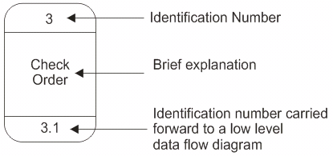
Sr. No. | Symbol Used | Meaning | Example
1 |  | Entity. A source of data or a destination for data.
2 |  | Process or task that is performed by the system.
3 |  | Data store, a place where data is held between processes.
4 |  | Data flow.
Hope Foundation’s International Institute of Information Technology, I²IT P-14,Rajiv Gandhi Infotech Park
MIDC Phase 1, Hinjawadi, Pune – 411057 Tel - +91 20 22933441/2/3 | www.isquareit.edu.in | info@isquareit.edu.in

Slide 12
Relationship and Rules
The Data Flow Diagram may be used for any level of data abstraction. DFD can be partitioned into levels. Each level has more information flow and data functional details than the previous level.
Highest level is Context Diagram. Some important points are:
1 process represents the entire system.
Data arrows show input and output.
Data Stores NOT shown. They are within the system.
Hope Foundation’s International Institute of Information Technology, I²IT P-14,Rajiv Gandhi Infotech Park
MIDC Phase 1, Hinjawadi, Pune – 411057 Tel - +91 20 22933441/2/3 | www.isquareit.edu.in | info@isquareit.edu.in

Slide 13
Hope Foundation’s International Institute of Information Technology, I²IT P-14,Rajiv Gandhi Infotech Park
MIDC Phase 1, Hinjawadi, Pune – 411057 Tel - +91 20 22933441/2/3 | www.isquareit.edu.in | info@isquareit.edu.in

Slide 14
Level 0 DFD
Next Level is Level 0 DFD. Some important points are:
Level 0 DFD must balance with the context diagram it describes.
Input going into a process are different from outputs leaving the process.
Data stores are first shown at this level.
Hope Foundation’s International Institute of Information Technology, I²IT P-14,Rajiv Gandhi Infotech Park
MIDC Phase 1, Hinjawadi, Pune – 411057 Tel - +91 20 22933441/2/3 | www.isquareit.edu.in | info@isquareit.edu.in

Slide 15
Hope Foundation’s International Institute of Information Technology, I²IT P-14,Rajiv Gandhi Infotech Park
MIDC Phase 1, Hinjawadi, Pune – 411057 Tel - +91 20 22933441/2/3 | www.isquareit.edu.in | info@isquareit.edu.in

Slide 16
Level 1 DFD
Next level is Level 1 DFD. Some important points are:
Level 1 DFD must balance with the Level 0 it describes.
Input going into a process are different from outputs leaving the process.
Continue to show data stores.
Hope Foundation’s International Institute of Information Technology, I²IT P-14,Rajiv Gandhi Infotech Park
MIDC Phase 1, Hinjawadi, Pune – 411057 Tel - +91 20 22933441/2/3 | www.isquareit.edu.in | info@isquareit.edu.in

Slide 17
From Internet
Hope Foundation’s International Institute of Information Technology, I²IT P-14,Rajiv Gandhi Infotech Park
MIDC Phase 1, Hinjawadi, Pune – 411057 Tel - +91 20 22933441/2/3 | www.isquareit.edu.in | info@isquareit.edu.in

Slide 18
Difference Between DFD & Flow Chart
A DFD may look similar to a flow chart. However, there is a significant difference with the data flow diagram. The arrows in DFDs show that there is a flow of data between the two components and not that the component is sending the data that must be executed in the following component.
A component in DFD may not continue execution when sending data and during execution of the component receiving the data. The component sending data can send multiple sets of data along several connections. In fact, a DFD node can be a component that never ends. In DFDs, all arrows must be labelled.
Hope Foundation’s International Institute of Information Technology, I²IT P-14,Rajiv Gandhi Infotech Park
MIDC Phase 1, Hinjawadi, Pune – 411057 Tel - +91 20 22933441/2/3 | www.isquareit.edu.in | info@isquareit.edu.in

Slide 19
Flow Chart
Hope Foundation’s International Institute of Information Technology, I²IT P-14,Rajiv Gandhi Infotech Park
MIDC Phase 1, Hinjawadi, Pune – 411057 Tel - +91 20 22933441/2/3 | www.isquareit.edu.in | info@isquareit.edu.in

Slide 20
Structure Chart
Structural Chart is principle tool of structure design.
Elements are ,
Module
Data
Flag
Hope Foundation’s International Institute of Information Technology, I²IT P-14,Rajiv Gandhi Infotech Park
MIDC Phase 1, Hinjawadi, Pune – 411057 Tel - +91 20 22933441/2/3 | www.isquareit.edu.in | info@isquareit.edu.in

Slide 21
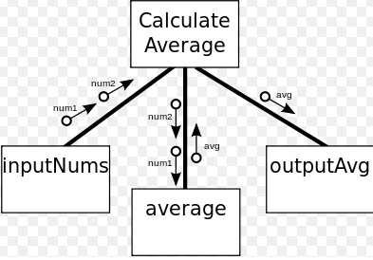
1. Flag going from caller to
called
2. Data going from caller to called
3. Data going from called to caller
Hope Foundation’s International Institute of Information Technology, I²IT P-14,Rajiv Gandhi Infotech Park
MIDC Phase 1, Hinjawadi, Pune – 411057 Tel - +91 20 22933441/2/3 | www.isquareit.edu.in | info@isquareit.edu.in

Slide 22
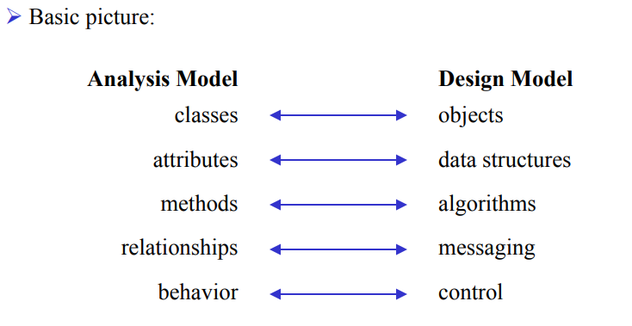
Design methods: Object-Oriented Design
Hope Foundation’s International Institute of Information Technology, I²IT P-14,Rajiv Gandhi Infotech Park
MIDC Phase 1, Hinjawadi, Pune – 411057 Tel - +91 20 22933441/2/3 | www.isquareit.edu.in | info@isquareit.edu.in

Slide 23
Unified Modeling Language Introduction
What is UML?
Hope Foundation’s International Institute of Information Technology, I²IT P-14,Rajiv Gandhi Infotech Park
MIDC Phase 1, Hinjawadi, Pune – 411057 Tel - +91 20 22933441/2/3 | www.isquareit.edu.in | info@isquareit.edu.in

Slide 24
UML
Is Unified – remaining the same at each stage of development
Applies to Modeling – process of understanding a subject (or a system).
Is a complete Language for capturing knowledge (semantics) about a subject and expressing knowledge (syntax) regarding the subject for the purpose of communication
Hope Foundation’s International Institute of Information Technology, I²IT P-14,Rajiv Gandhi Infotech Park
MIDC Phase 1, Hinjawadi, Pune – 411057 Tel - +91 20 22933441/2/3 | www.isquareit.edu.in | info@isquareit.edu.in

Slide 25
Background
1965 - The first object-oriented programming language, Simula I, was introduced
Object-oriented Analysis & Design (OOAD) by Grady Booch.
The Object Modeling Technique (OMT) by James Rumbaugh.
The Object-oriented Software Engineering method (OOSE) by Ivar Jacobson
Hope Foundation’s International Institute of Information Technology, I²IT P-14,Rajiv Gandhi Infotech Park
MIDC Phase 1, Hinjawadi, Pune – 411057 Tel - +91 20 22933441/2/3 | www.isquareit.edu.in | info@isquareit.edu.in

Slide 26
OO Analysis vs. OO Design
Analysis refers to understanding the problem.
Design refers to coming up with the solution.
REQUIREMENTS
and
ANALYSIS
DESIGN
IMPLEMENTATION
TESTING
Hope Foundation’s International Institute of Information Technology, I²IT P-14,Rajiv Gandhi Infotech Park
MIDC Phase 1, Hinjawadi, Pune – 411057 Tel - +91 20 22933441/2/3 | www.isquareit.edu.in | info@isquareit.edu.in

Slide 27
OO Analysis vs. OO Design
Jacobson (OOSE) good at high-level design
Rumbaugh (OMT) good at the middle ground
Booch (OOAD) good at low-level design
Hope Foundation’s International Institute of Information Technology, I²IT P-14,Rajiv Gandhi Infotech Park
MIDC Phase 1, Hinjawadi, Pune – 411057 Tel - +91 20 22933441/2/3 | www.isquareit.edu.in | info@isquareit.edu.in

Slide 28
Relationship Among UML Diagrams
Structural Diagram
Behaviour Diagrams
Hope Foundation’s International Institute of Information Technology, I²IT P-14,Rajiv Gandhi Infotech Park
MIDC Phase 1, Hinjawadi, Pune – 411057 Tel - +91 20 22933441/2/3 | www.isquareit.edu.in | info@isquareit.edu.in

Slide 29
Static and Dynamic Modelling
Static Modelling:-
Static Modelling is used to represent the static constituents of a Software such as :
1.Classes,
2.Objects,
3.Interfaces
4.Their relationship with each other.
Hope Foundation’s International Institute of Information Technology, I²IT P-14,Rajiv Gandhi Infotech Park
MIDC Phase 1, Hinjawadi, Pune – 411057 Tel - +91 20 22933441/2/3 | www.isquareit.edu.in | info@isquareit.edu.in

Slide 30
Static and Dynamic Modelling
Dynamic Modelling:-
Dynamic Modelling is used to represent the behaviour of the static constituents of a software ,
Dynamic Modelling Represent Following Diagrams,
Interaction Diagram:- Sequence and Collaboration Diagram.
Use Case Modelling
Activity Diagram
Hope Foundation’s International Institute of Information Technology, I²IT P-14,Rajiv Gandhi Infotech Park
MIDC Phase 1, Hinjawadi, Pune – 411057 Tel - +91 20 22933441/2/3 | www.isquareit.edu.in | info@isquareit.edu.in

Slide 31
THANK YOU
For further information please contact
Prof. Prashant Gadakh
Assistant Professor
prashantg@isquareit.edu.in
Department of Computer Engineering
Hope Foundation’s International Institute of Information Technology, I²IT
P-14, Rajiv Gandhi Infotech Park, MIDC Phase I, Hinjawadi
Pune – 411 057
Phone - +91 20 22933441
www.isquareit.edu.in | info@isquareit.edu.in

