Slide 1
Superstructure
Prof. Mahesh Waghmare
Assistant Professor
Department of Applied Sciences & Engineering
Hope Foundation’s
International Institute of Information Technology, I²IT

Slide 2
Superstructure
Part of structure above the ground surface. e.g building. Various parts like walls, roof, doors & windows, flooring etc.
It is designed for various loads acting on the structure.
Hope Foundation’s International Institute of Information Technology, I²IT P-14,Rajiv Gandhi Infotech Park
MIDC Phase 1, Hinjawadi, Pune – 411057
Tel - +91 20 22933441/2/3 | www.isquareit.edu.in | info@isquareit.edu.in

Slide 3
Various components of the superstructure
plinth
masonry
column or pillar
beam
slab or roof
lintel
Hope Foundation’s International Institute of Information Technology, I²IT P-14,Rajiv Gandhi Infotech Park
MIDC Phase 1, Hinjawadi, Pune – 411057
Tel - +91 20 22933441/2/3 | www.isquareit.edu.in | info@isquareit.edu.in

Slide 4
chajja
stairs
Types of loads:
D.L
L.L
W.L
Earthquake load
Hope Foundation’s International Institute of Information Technology, I²IT P-14,Rajiv Gandhi Infotech Park
MIDC Phase 1, Hinjawadi, Pune – 411057
Tel - +91 20 22933441/2/3 | www.isquareit.edu.in | info@isquareit.edu.in

Slide 5
These loads act simultaneously on the structure.
Intensity of W.L. & earthquake load may vary.
Always considered the worst combination of all loads for design purpose.
Hope Foundation’s International Institute of Information Technology, I²IT P-14,Rajiv Gandhi Infotech Park
MIDC Phase 1, Hinjawadi, Pune – 411057
Tel - +91 20 22933441/2/3 | www.isquareit.edu.in | info@isquareit.edu.in

Slide 6
Dead load:
Load of the materials used in the construction of buildings. i.e. self weight of different parts of the building like floor, roof, walls, plaster etc.
Is calculated by multiplying its volume by unit weight of the material.
Different unit wts. For different material.
Hope Foundation’s International Institute of Information Technology, I²IT P-14,Rajiv Gandhi Infotech Park
MIDC Phase 1, Hinjawadi, Pune – 411057
Tel - +91 20 22933441/2/3 | www.isquareit.edu.in | info@isquareit.edu.in

Slide 7
Live load:
Movable superimposed load acting on the structure.
It comprises of weight of occupants, furniture, equipment, machinery etc.
It is a udl acting on the area.
Hope Foundation’s International Institute of Information Technology, I²IT P-14,Rajiv Gandhi Infotech Park
MIDC Phase 1, Hinjawadi, Pune – 411057
Tel - +91 20 22933441/2/3 | www.isquareit.edu.in | info@isquareit.edu.in

Slide 8
Consideration of L.L. for different types of buildings.
Residential – 2
Office – 2.45
Bank & reading room- 3
Dining hall – 5
Hope Foundation’s International Institute of Information Technology, I²IT P-14,Rajiv Gandhi Infotech Park
MIDC Phase 1, Hinjawadi, Pune – 411057
Tel - +91 20 22933441/2/3 | www.isquareit.edu.in | info@isquareit.edu.in

Slide 9
There are reductions in the L.L. according to the storey of the building. max. reduction is 50%
Wind load:
It is effective in case of tall buildings.
Basic wind pressure is an equivalent static pressure in the direction of wind.
Hope Foundation’s International Institute of Information Technology, I²IT P-14,Rajiv Gandhi Infotech Park
MIDC Phase 1, Hinjawadi, Pune – 411057
Tel - +91 20 22933441/2/3 | www.isquareit.edu.in | info@isquareit.edu.in

Slide 10
Wind press. May be obtained P = kV²
P = wind press. In kn/ m²
k = coeff. Depending upon wind velocity, size & shape of structure & air temp.
When ht. of building is less than 3 times its eff. Width & further when adequate stiffening is made by floor slabs & beams, wind load may be neglected.
Hope Foundation’s International Institute of Information Technology, I²IT P-14,Rajiv Gandhi Infotech Park
MIDC Phase 1, Hinjawadi, Pune – 411057
Tel - +91 20 22933441/2/3 | www.isquareit.edu.in | info@isquareit.edu.in

Slide 11
Earthquake load:
Which acts in horizontal direction, is considered using acceleration due to earthquake & weight of the structure.
Hope Foundation’s International Institute of Information Technology, I²IT P-14,Rajiv Gandhi Infotech Park
MIDC Phase 1, Hinjawadi, Pune – 411057
Tel - +91 20 22933441/2/3 | www.isquareit.edu.in | info@isquareit.edu.in

Slide 12
Earthquake force = w x α/g
where α = acceleration due to earthquake.=
1/20 g to 1/10 g
w = weight of the structure.
g = gravitational accleration.
Hope Foundation’s International Institute of Information Technology, I²IT P-14,Rajiv Gandhi Infotech Park
MIDC Phase 1, Hinjawadi, Pune – 411057
Tel - +91 20 22933441/2/3 | www.isquareit.edu.in | info@isquareit.edu.in

Slide 13
Types of construction
3 different types
Load bearing structure.
Frame structure.
Composite structure
Hope Foundation’s International Institute of Information Technology, I²IT P-14,Rajiv Gandhi Infotech Park
MIDC Phase 1, Hinjawadi, Pune – 411057
Tel - +91 20 22933441/2/3 | www.isquareit.edu.in | info@isquareit.edu.in

Slide 14
Choice of method depends upon extent of constru. ( no. of storeys, area covered ), importance of constru. ( resi.,ind, temporary ), economy ( LIG, MIG & HIG)
Load bearing construction:
Roofs are directly supported on walls.
Load of stru. Is transferred to the walls.
Hope Foundation’s International Institute of Information Technology, I²IT P-14,Rajiv Gandhi Infotech Park
MIDC Phase 1, Hinjawadi, Pune – 411057
Tel - +91 20 22933441/2/3 | www.isquareit.edu.in | info@isquareit.edu.in

Slide 15
Walls transfer the load to the soil.
Suitable & economical up to 2- 4 storeys.
As the wall footings directly rest on the hard strata, this type of constru. Is adopted where hard strata is available at shallower depths.
.
Hope Foundation’s International Institute of Information Technology, I²IT P-14,Rajiv Gandhi Infotech Park
MIDC Phase 1, Hinjawadi, Pune – 411057
Tel - +91 20 22933441/2/3 | www.isquareit.edu.in | info@isquareit.edu.in

Slide 16
All old construction Like shaniwarwada, central building, coep college are the few examples of this type of constru.
These days temporary or less important stru. Are constructed in load bearing
Hope Foundation’s International Institute of Information Technology, I²IT P-14,Rajiv Gandhi Infotech Park
MIDC Phase 1, Hinjawadi, Pune – 411057
Tel - +91 20 22933441/2/3 | www.isquareit.edu.in | info@isquareit.edu.in

Slide 17
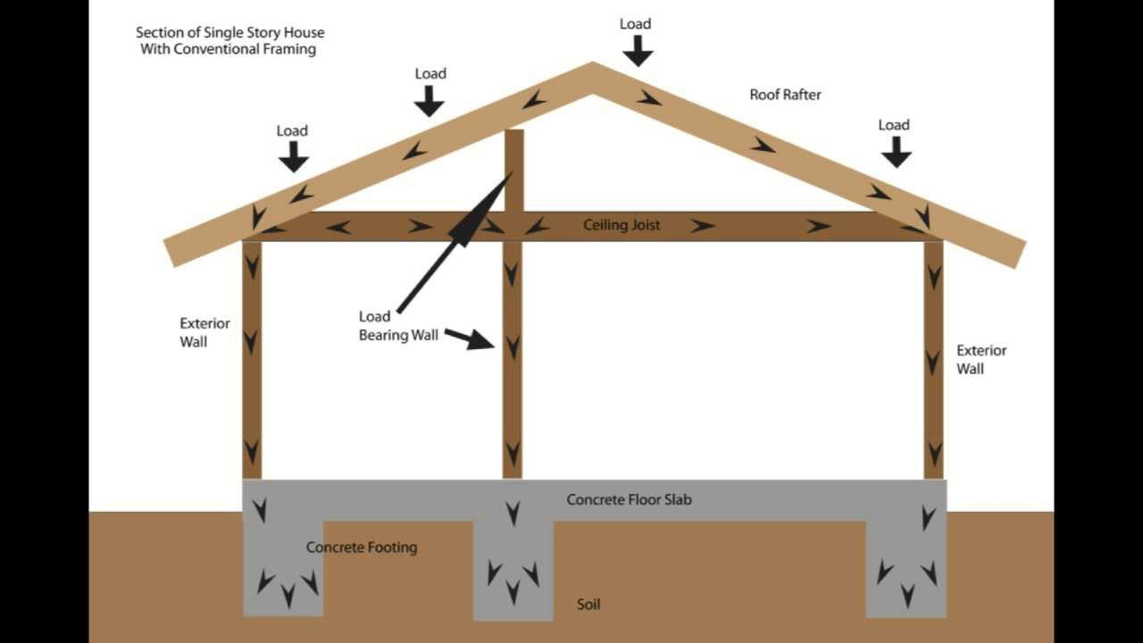
Hope Foundation’s International Institute of Information Technology, I²IT P-14,Rajiv Gandhi Infotech Park
MIDC Phase 1, Hinjawadi, Pune – 411057
Tel - +91 20 22933441/2/3 | www.isquareit.edu.in | info@isquareit.edu.in

Slide 18
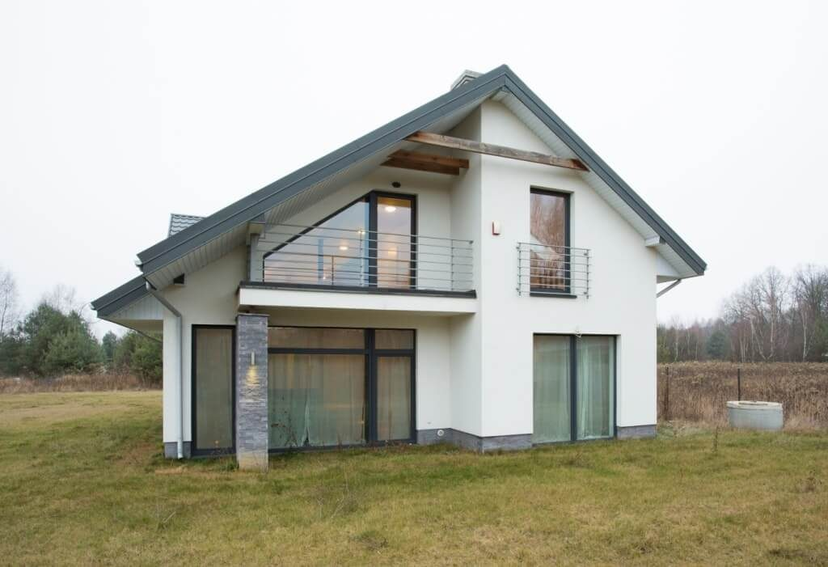
Hope Foundation’s International Institute of Information Technology, I²IT P-14,Rajiv Gandhi Infotech Park
MIDC Phase 1, Hinjawadi, Pune – 411057
Tel - +91 20 22933441/2/3 | www.isquareit.edu.in | info@isquareit.edu.in

Slide 19
Frame structure:
In this load is transfer through a frame of slab, beam, column & footing to the underlying soil.
Walls do not carry any load except their self wt.
This type of constru. May be multistoried.
Hope Foundation’s International Institute of Information Technology, I²IT P-14,Rajiv Gandhi Infotech Park
MIDC Phase 1, Hinjawadi, Pune – 411057
Tel - +91 20 22933441/2/3 | www.isquareit.edu.in | info@isquareit.edu.in

Slide 20
Frame can be constru. Using rcc stru.
The speed of constr. Is fast
Economically suitable.
If hard strata is not available pile or raft foundation can be used.
Hope Foundation’s International Institute of Information Technology, I²IT P-14,Rajiv Gandhi Infotech Park
MIDC Phase 1, Hinjawadi, Pune – 411057
Tel - +91 20 22933441/2/3 | www.isquareit.edu.in | info@isquareit.edu.in

Slide 21
Composite structure:
This is combination of load bearing & frame structure.
Outer walls can be of load bearing type & column, beam stru. Can be provided internally.
Thus floors & roofs are supported by walls as well as frame.
This type of constru. Is generally adopted for industrial sheds where spans are very large.
Hope Foundation’s International Institute of Information Technology, I²IT P-14,Rajiv Gandhi Infotech Park
MIDC Phase 1, Hinjawadi, Pune – 411057
Tel - +91 20 22933441/2/3 | www.isquareit.edu.in | info@isquareit.edu.in

Slide 22
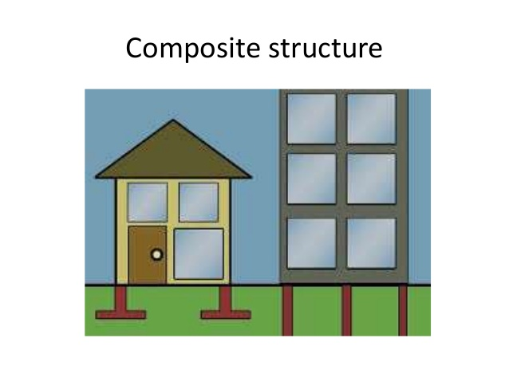
Hope Foundation’s International Institute of Information Technology, I²IT P-14,Rajiv Gandhi Infotech Park
MIDC Phase 1, Hinjawadi, Pune – 411057
Tel - +91 20 22933441/2/3 | www.isquareit.edu.in | info@isquareit.edu.in

Slide 23
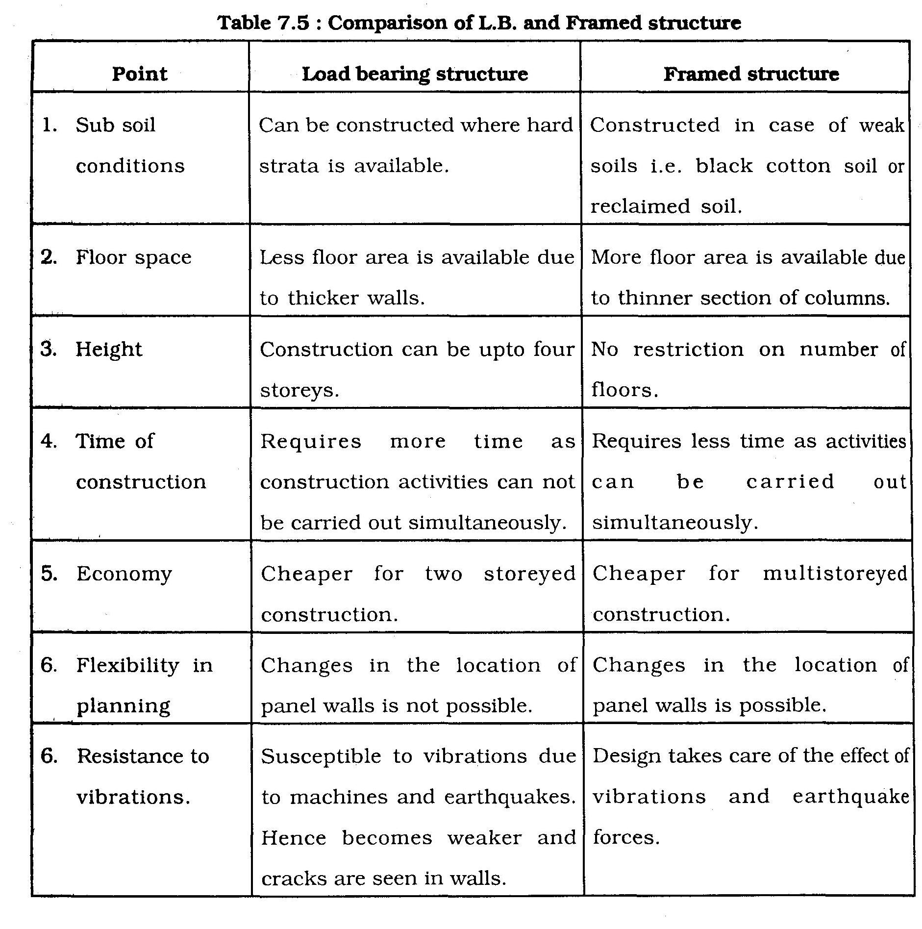
Hope Foundation’s International Institute of Information Technology, I²IT P-14,Rajiv Gandhi Infotech Park
MIDC Phase 1, Hinjawadi, Pune – 411057
Tel - +91 20 22933441/2/3 | www.isquareit.edu.in | info@isquareit.edu.in

Slide 24
Masonry
Masonry – important part of the superstru. i.e. wall
Wall divide the space into usable rooms. They also provide protection against all weather conditions, privacy & safety.
Different types- brick ,stone, concrete block masonry.
Courses of bricks or stones are arranged in various types of bonds.
To bind the bricks or stones cement mortar is used.
Hope Foundation’s International Institute of Information Technology, I²IT P-14,Rajiv Gandhi Infotech Park
MIDC Phase 1, Hinjawadi, Pune – 411057
Tel - +91 20 22933441/2/3 | www.isquareit.edu.in | info@isquareit.edu.in

Slide 25
Thickness of the walls changes according to use & position.
Load bearing walls are thicker than frame stru. Walls.
External walls are thicker than internal wall.
Hope Foundation’s International Institute of Information Technology, I²IT P-14,Rajiv Gandhi Infotech Park
MIDC Phase 1, Hinjawadi, Pune – 411057
Tel - +91 20 22933441/2/3 | www.isquareit.edu.in | info@isquareit.edu.in

Slide 26
Fundamental requirements of masonry
It should be strong to carry load of the stru.
Stones or bricks in different courses should be staggered to avoid slipping of vertical joints.
Stones ,bricks, cement to be used for masonry should be according to I.S.
Hope Foundation’s International Institute of Information Technology, I²IT P-14,Rajiv Gandhi Infotech Park
MIDC Phase 1, Hinjawadi, Pune – 411057
Tel - +91 20 22933441/2/3 | www.isquareit.edu.in | info@isquareit.edu.in

Slide 27
Curing should be proper to avoid cracks.
Proper bonds are to be maintained.
It should be in plumb & level.
Wall surface should be coated by cement plaster on either side.
Hope Foundation’s International Institute of Information Technology, I²IT P-14,Rajiv Gandhi Infotech Park
MIDC Phase 1, Hinjawadi, Pune – 411057
Tel - +91 20 22933441/2/3 | www.isquareit.edu.in | info@isquareit.edu.in

Slide 28
Floors
It is horizontal surface provided in every room for occupants to use.
Floor for ground storey is generally top of plinth whereas slab of one floor acts as floor for the upper storey.
.
Hope Foundation’s International Institute of Information Technology, I²IT P-14,Rajiv Gandhi Infotech Park
MIDC Phase 1, Hinjawadi, Pune – 411057
Tel - +91 20 22933441/2/3 | www.isquareit.edu.in | info@isquareit.edu.in

Slide 29
Floors are covered by different types of flooring material like Shahabad tiles, mosaic, granite, marble etc.
Floor should offer good resistance to wear & tear occurring due to its daily use.
It should be easy to wash & clean, fire resistant
Hope Foundation’s International Institute of Information Technology, I²IT P-14,Rajiv Gandhi Infotech Park
MIDC Phase 1, Hinjawadi, Pune – 411057
Tel - +91 20 22933441/2/3 | www.isquareit.edu.in | info@isquareit.edu.in

Slide 30
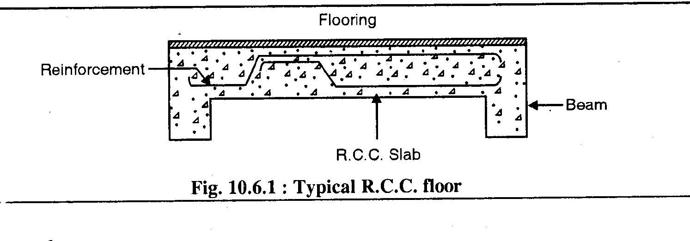
Hope Foundation’s International Institute of Information Technology, I²IT P-14,Rajiv Gandhi Infotech Park
MIDC Phase 1, Hinjawadi, Pune – 411057
Tel - +91 20 22933441/2/3 | www.isquareit.edu.in | info@isquareit.edu.in

Slide 31
Roofs
It is a covering erected over the top of a building with a view to protect the latter from the elements like rain, wind & sun.
Roof is designed & constructed to meet the requirements of different climate & materials available.
Hope Foundation’s International Institute of Information Technology, I²IT P-14,Rajiv Gandhi Infotech Park
MIDC Phase 1, Hinjawadi, Pune – 411057
Tel - +91 20 22933441/2/3 | www.isquareit.edu.in | info@isquareit.edu.in

Slide 32
E.g where rainfall is less flat roof is suitable, whereas where rainfall is more ( ghat or coastal region) pitched or sloping roof is suitable.
Types of roofs:
Pitched or sloping roof.
Flat roof.
Shells & domes.
Hope Foundation’s International Institute of Information Technology, I²IT P-14,Rajiv Gandhi Infotech Park
MIDC Phase 1, Hinjawadi, Pune – 411057
Tel - +91 20 22933441/2/3 | www.isquareit.edu.in | info@isquareit.edu.in

Slide 33
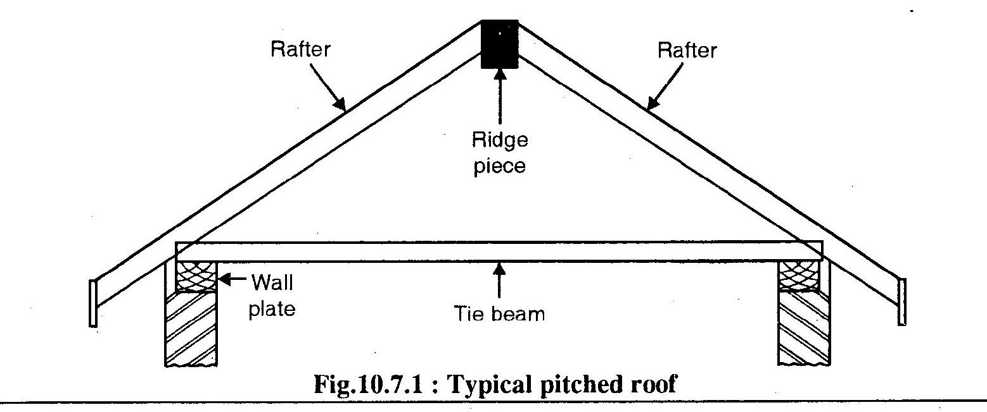
Hope Foundation’s International Institute of Information Technology, I²IT P-14,Rajiv Gandhi Infotech Park
MIDC Phase 1, Hinjawadi, Pune – 411057
Tel - +91 20 22933441/2/3 | www.isquareit.edu.in | info@isquareit.edu.in

Slide 34
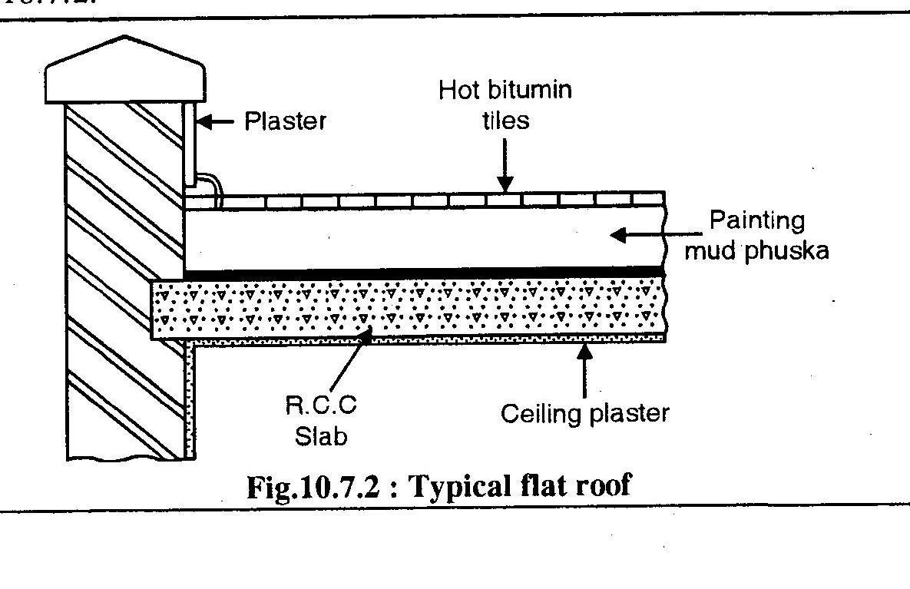
Hope Foundation’s International Institute of Information Technology, I²IT P-14,Rajiv Gandhi Infotech Park
MIDC Phase 1, Hinjawadi, Pune – 411057
Tel - +91 20 22933441/2/3 | www.isquareit.edu.in | info@isquareit.edu.in

Slide 35
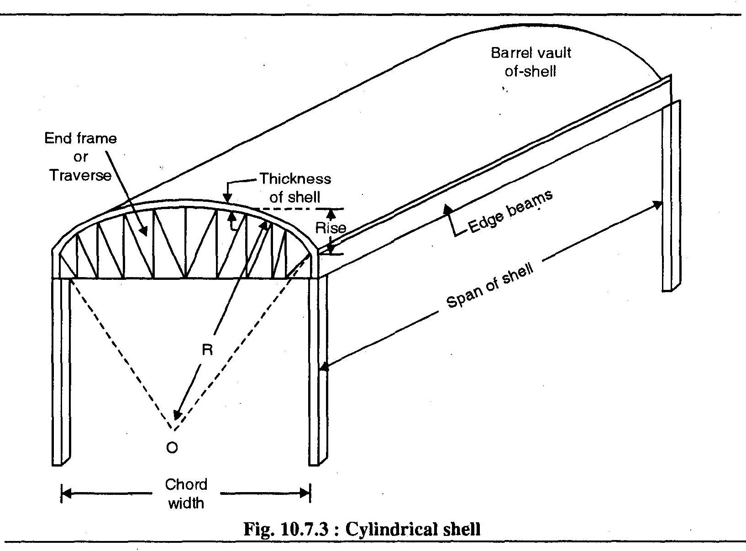
Hope Foundation’s International Institute of Information Technology, I²IT P-14,Rajiv Gandhi Infotech Park
MIDC Phase 1, Hinjawadi, Pune – 411057
Tel - +91 20 22933441/2/3 | www.isquareit.edu.in | info@isquareit.edu.in

Slide 36
Doors & windows
Necessity of doors:
Used for free movement of occupants in & out of the house
Should be minimum 1 for each room.
Outer doors are important from privacy & security point of view.
Hope Foundation’s International Institute of Information Technology, I²IT P-14,Rajiv Gandhi Infotech Park
MIDC Phase 1, Hinjawadi, Pune – 411057
Tel - +91 20 22933441/2/3 | www.isquareit.edu.in | info@isquareit.edu.in

Slide 37
Should be located near the end of the room.
Consists of two parts– frame rigidly fixed in walls & shutter fixed to frame.
Sizes may be more for outer main doors & less for bathroom & w.c.
Teak wood frame with block board shutter are the common type.
Hope Foundation’s International Institute of Information Technology, I²IT P-14,Rajiv Gandhi Infotech Park
MIDC Phase 1, Hinjawadi, Pune – 411057
Tel - +91 20 22933441/2/3 | www.isquareit.edu.in | info@isquareit.edu.in

Slide 38
Different types of doors:
Flush
Paneled
Glazed
Collapsible
Ledged & battened door.
aluminium
Hope Foundation’s International Institute of Information Technology, I²IT P-14,Rajiv Gandhi Infotech Park
MIDC Phase 1, Hinjawadi, Pune – 411057
Tel - +91 20 22933441/2/3 | www.isquareit.edu.in | info@isquareit.edu.in

Slide 39
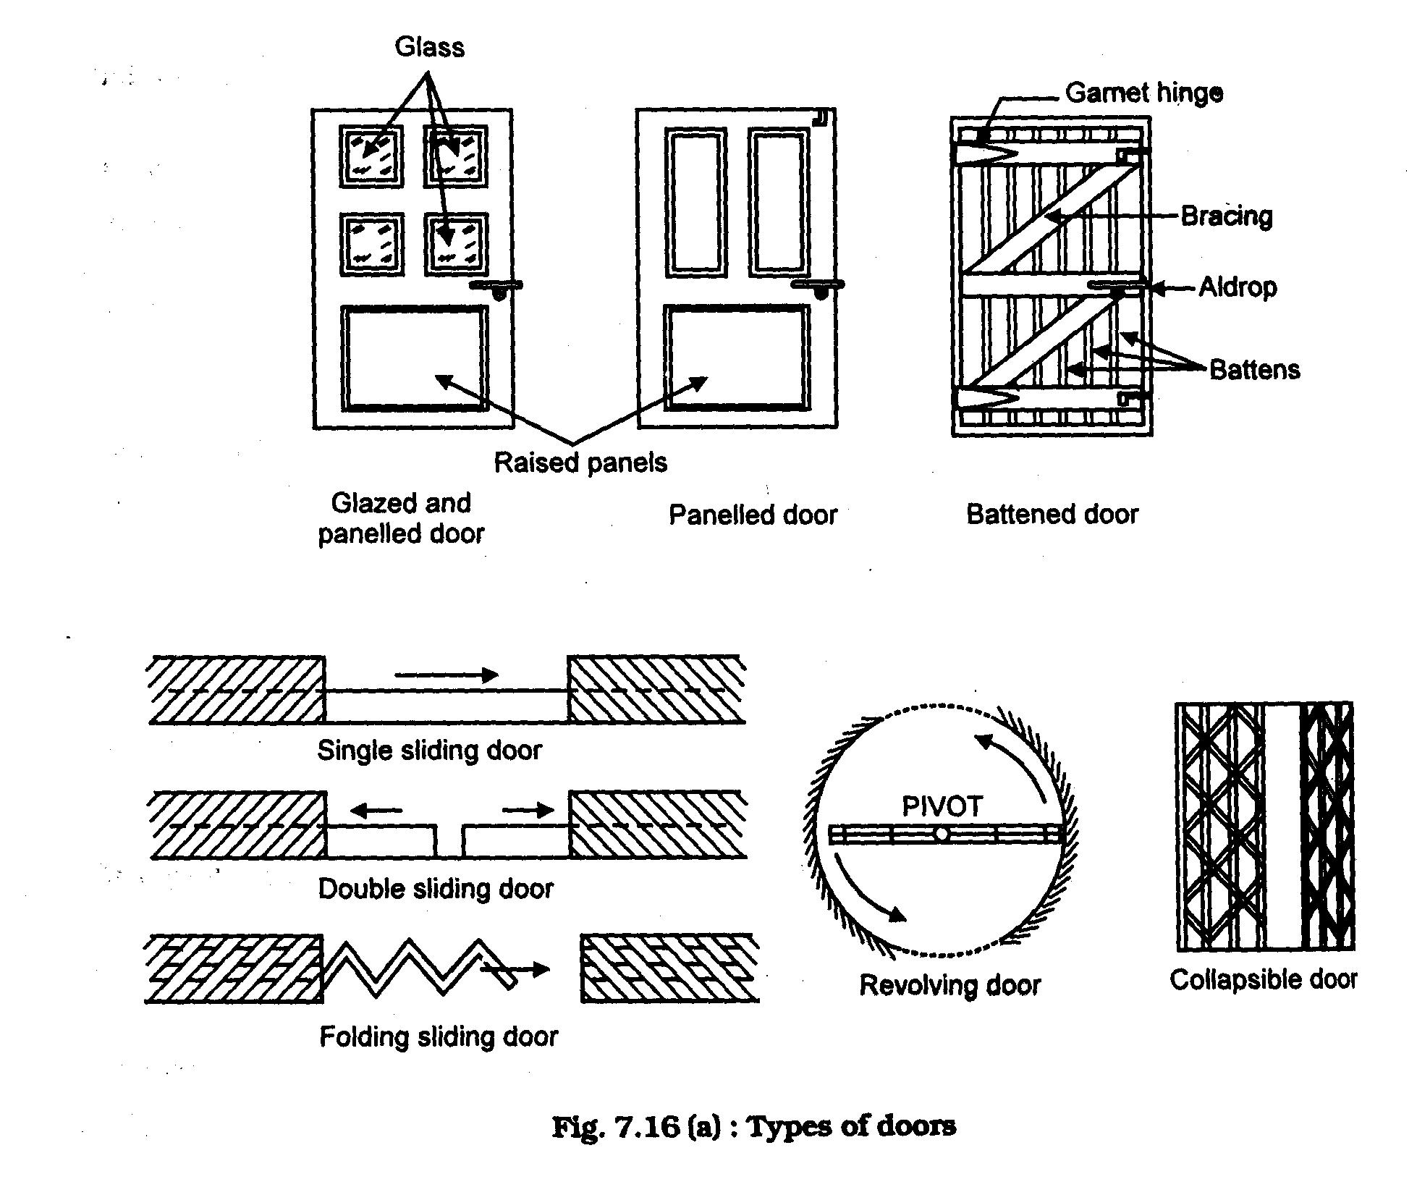
Hope Foundation’s International Institute of Information Technology, I²IT P-14,Rajiv Gandhi Infotech Park
MIDC Phase 1, Hinjawadi, Pune – 411057
Tel - +91 20 22933441/2/3 | www.isquareit.edu.in | info@isquareit.edu.in

Slide 40
Necessity of windows:
Provided for admission of light & free circulation of air into the building.
Maximum no of windows should be provided in the external wall.
Hope Foundation’s International Institute of Information Technology, I²IT P-14,Rajiv Gandhi Infotech Park
MIDC Phase 1, Hinjawadi, Pune – 411057
Tel - +91 20 22933441/2/3 | www.isquareit.edu.in | info@isquareit.edu.in

Slide 41
As per rule min. area of window shall be one tenth of the floor area of the room.
Windows are fixed such that top of window is at 2.1 m from the floor level.
Hope Foundation’s International Institute of Information Technology, I²IT P-14,Rajiv Gandhi Infotech Park
MIDC Phase 1, Hinjawadi, Pune – 411057
Tel - +91 20 22933441/2/3 | www.isquareit.edu.in | info@isquareit.edu.in

Slide 42
Vertical windows admit more light than horizontal windows.
Are provided in opposite walls for cross ventilation.
Hope Foundation’s International Institute of Information Technology, I²IT P-14,Rajiv Gandhi Infotech Park
MIDC Phase 1, Hinjawadi, Pune – 411057
Tel - +91 20 22933441/2/3 | www.isquareit.edu.in | info@isquareit.edu.in

Slide 43
Window also consist of two parts– frame fixed in the wall & hangings shutter fixed to frame.
Aluminium sliding windows which are operated on tracks.
Types of windows:
Box window
Sliding window
Bay
Louvered
Hope Foundation’s International Institute of Information Technology, I²IT P-14,Rajiv Gandhi Infotech Park
MIDC Phase 1, Hinjawadi, Pune – 411057
Tel - +91 20 22933441/2/3 | www.isquareit.edu.in | info@isquareit.edu.in

Slide 44
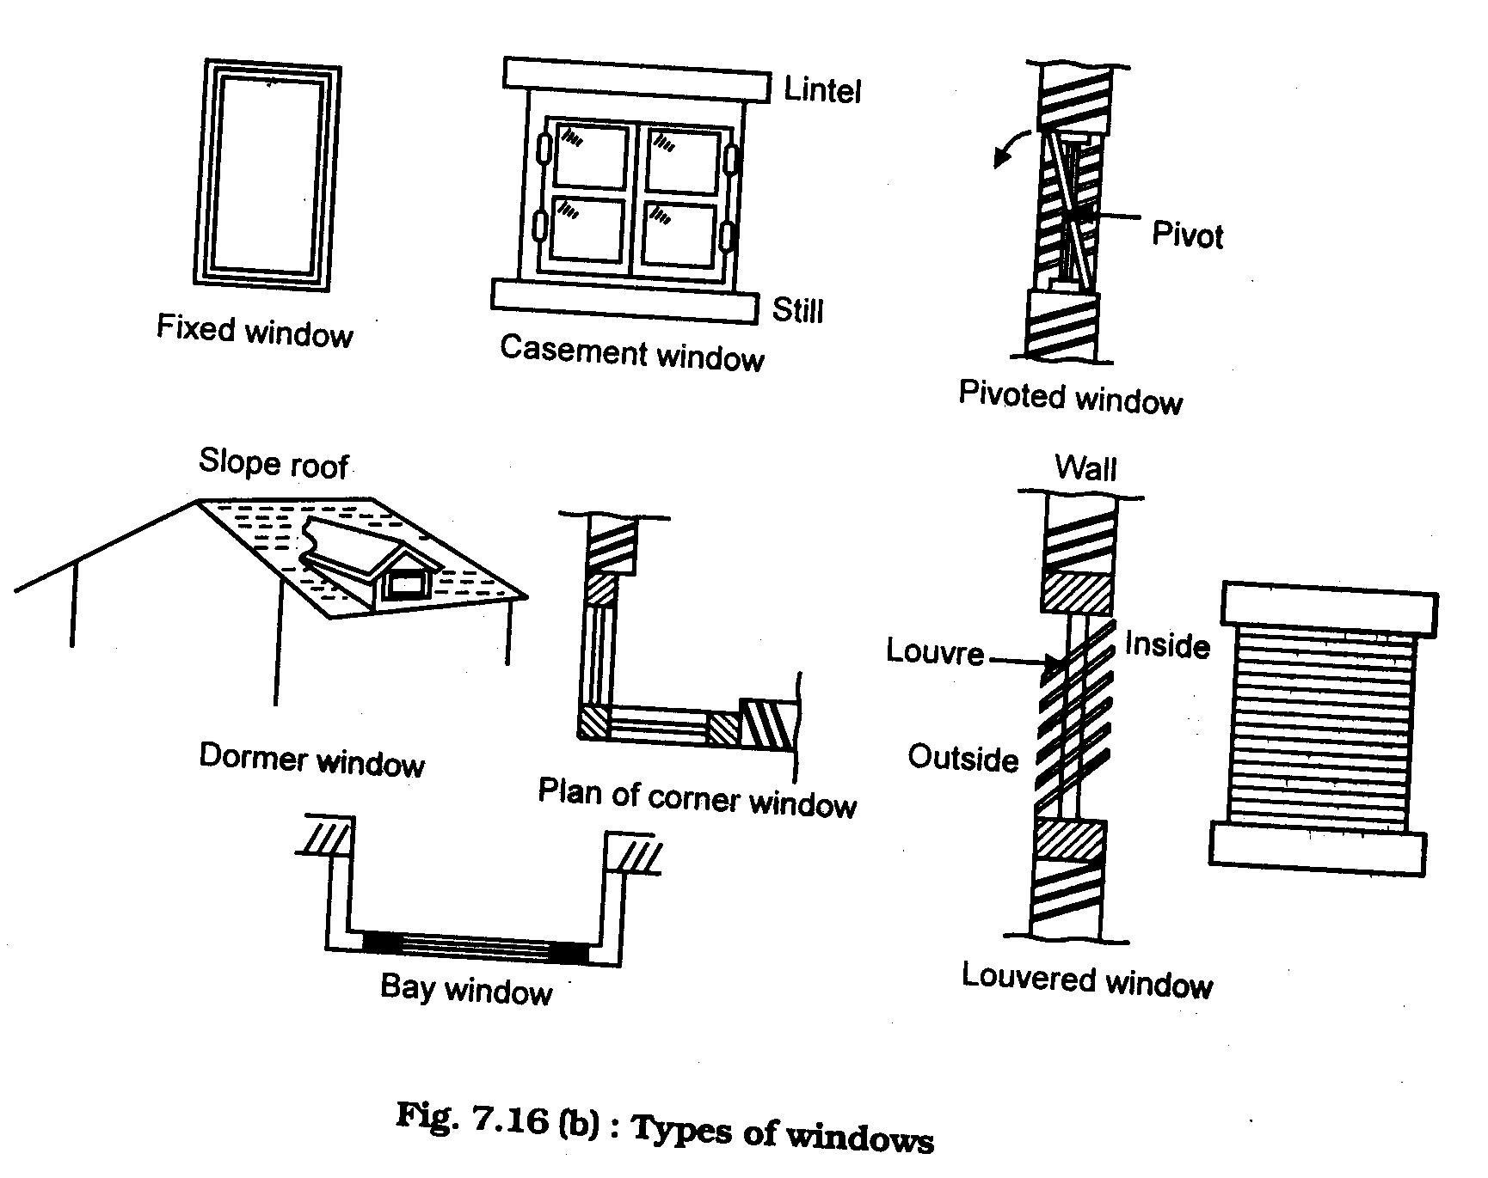
Hope Foundation’s International Institute of Information Technology, I²IT P-14,Rajiv Gandhi Infotech Park
MIDC Phase 1, Hinjawadi, Pune – 411057
Tel - +91 20 22933441/2/3 | www.isquareit.edu.in | info@isquareit.edu.in

Slide 45
Acknowledgement/References
Building Planning and built environement By Shaha, Kale, Patki,” TataMc Graw Hill
Civil Engineering Material by Dr. S.V.Deodhar, Khan Publication
Building Construction by Bhindra, Arora
Websites
https://www.google.com/imghp?hl=en

Slide 46
THANK YOU
For further details, please contact
Mahesh Waghmare
maheshw@isquareit.edu.in
Department of Applied Sciences & Engineering
Hope Foundation’s
International Institute of Information Technology, I²IT
P-14,Rajiv Gandhi Infotech Park
MIDC Phase 1, Hinjawadi, Pune – 411057
Tel - +91 20 22933441/2/3
www.isquareit.edu.in | info@isquareit.edu.in

