Slide 1
Usability Heuristics Prof. Manjusha Amritkar Assistant Professor Department of Information Technology Hope Foundation’s International Institute of Information Technology, I²IT www.isquareit.edu.in
Jakob Nielsen's 10 general principles for interaction design. They are called "heuristics" because they are broad rules of thumb and not specific usability guidelines.

Slide 2
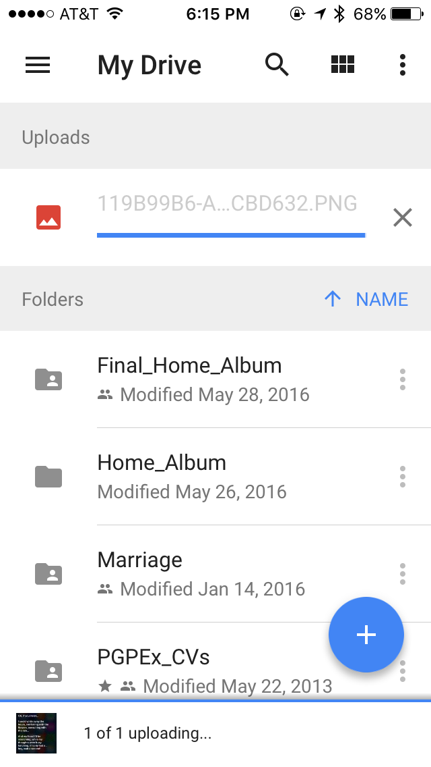
1. Visibility of System Status
This principle states that the user should know what’s going on inside the system. We need to give a feedback of his/her action within a reasonable time. This feedback is normally associated with points of action and can be provided using a color change, loader, time-left graphics, etc.
Examples:
Twitter making a swoosh sound when a tweet is being posted.
Google Drive showing the status of a document upload
Hope Foundation’s International Institute of Information Technology, I²IT P-14,Rajiv Gandhi Infotech Park
MIDC Phase 1, Hinjawadi, Pune – 411057 Tel - +91 20 22933441/2/3 | www.isquareit.edu.in | info@isquareit.edu.in

Slide 3
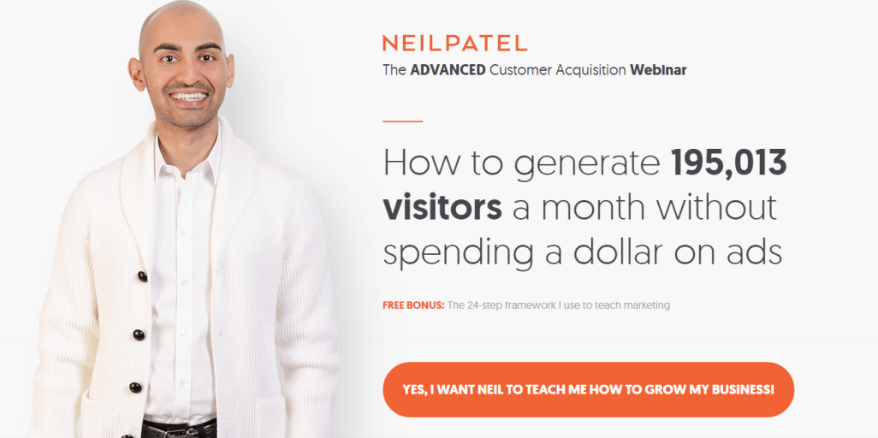
2. Match between system and the real world
Is there something on your application that a user may not understand? This is very common to miss since we get associated with the product for over a period of time. It’s also important for the application to speak the language of the target user base.
Example:
Neil Patel could very well say “Sign Up” on his landing page. Instead, he chose to say ambitiously — “Yes, I want Neil to teach me how to grow my Business!”. It sets the context and speaks the everyday language
Hope Foundation’s International Institute of Information Technology, I²IT P-14,Rajiv Gandhi Infotech Park
MIDC Phase 1, Hinjawadi, Pune – 411057 Tel - +91 20 22933441/2/3 | www.isquareit.edu.in | info@isquareit.edu.in

Slide 4
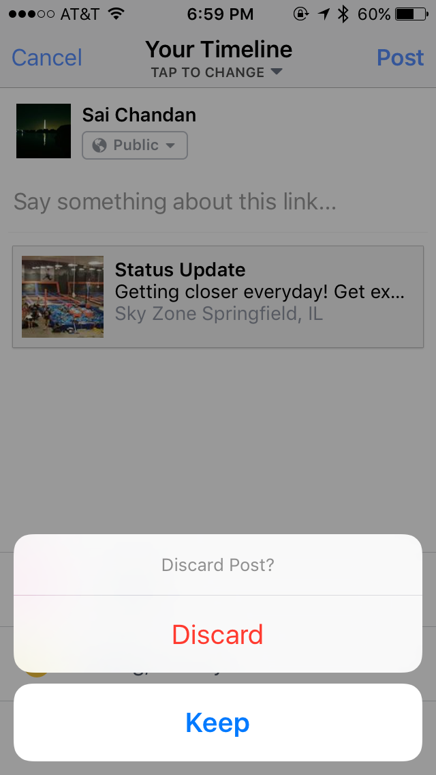
3. User Control and Freedom
This principle talks about giving the user the freedom to navigate and perform actions. The freedom to undo any accidental actions.
Examples:
Gmail’s flash message with undo action when we accidentally delete an email.
Face book checking if we tapped “Cancel” by mistake.
Hope Foundation’s International Institute of Information Technology, I²IT P-14,Rajiv Gandhi Infotech Park
MIDC Phase 1, Hinjawadi, Pune – 411057 Tel - +91 20 22933441/2/3 | www.isquareit.edu.in | info@isquareit.edu.in

Slide 5
4. Consistency and Standards
Consistency is the key. A Submit button in one page should look the same across the site on any page. If we show the data in a particular table format on one page, it should look the same the next time data is being shown in tabular format. If the header is displayed in a certain way on the public pages, it should be the same when he/she logs in.
Examples:
The Submit button in the image is consistent for label, size, style.
How the same button can transform across different pages of the same site. Note that this is not a change of state.
Hope Foundation’s International Institute of Information Technology, I²IT P-14,Rajiv Gandhi Infotech Park
MIDC Phase 1, Hinjawadi, Pune – 411057 Tel - +91 20 22933441/2/3 | www.isquareit.edu.in | info@isquareit.edu.in

Slide 6
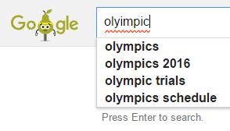
5. Error Prevention
How many times did your outlook remind you that there is no attachment in the email while you mentioned that something is attached? Outlook intuitively scans the email for such keywords and alerts the user before sending. This is Error Prevention.
Examples:
Google Search trying to correct my spelling.
If you have set some rules for the format of user password, try to validate it as the user types rather than waiting for him to click submit
Hope Foundation’s International Institute of Information Technology, I²IT P-14,Rajiv Gandhi Infotech Park
MIDC Phase 1, Hinjawadi, Pune – 411057 Tel - +91 20 22933441/2/3 | www.isquareit.edu.in | info@isquareit.edu.in

Slide 7
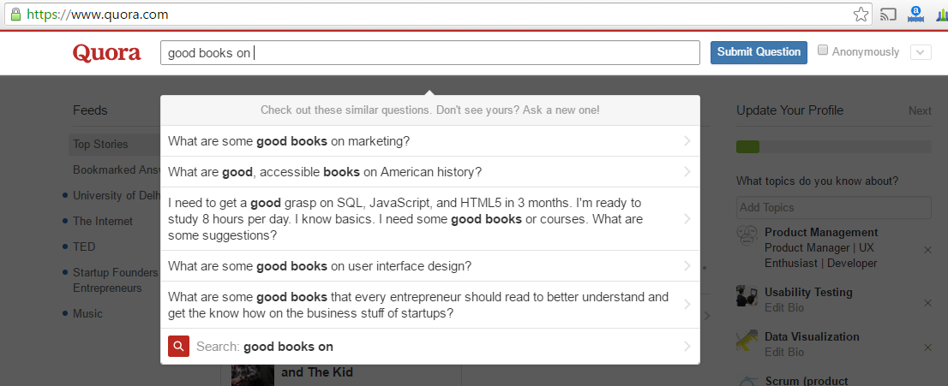
6. Recognition rather than recall
It’s always better to suggest the user a set of options than to let him remember and type the whole thing. The goal is to minimize the application of user memory.
Example:
Quora suggesting possible questions based on what I am trying to type.
Hope Foundation’s International Institute of Information Technology, I²IT P-14,Rajiv Gandhi Infotech Park
MIDC Phase 1, Hinjawadi, Pune – 411057 Tel - +91 20 22933441/2/3 | www.isquareit.edu.in | info@isquareit.edu.in

Slide 8
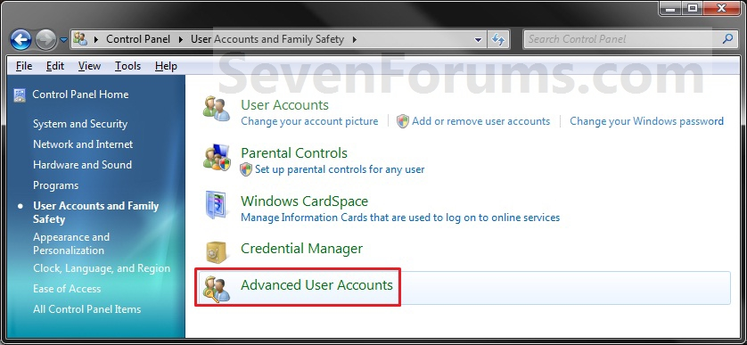
7. Flexibility and Efficiency of use
The Interface should be flexible transforming itself between a novice user and an advanced user. One frequents this option while installing a new software that asks if the user wants to go ahead with default installation or custom installation. An advanced user chooses a custom installation to cut out the unnecessary services.
Examples:
1. Control panel gives you option for user accounts and advanced user accounts
Hope Foundation’s International Institute of Information Technology, I²IT P-14,Rajiv Gandhi Infotech Park
MIDC Phase 1, Hinjawadi, Pune – 411057 Tel - +91 20 22933441/2/3 | www.isquareit.edu.in | info@isquareit.edu.in

Slide 9
8. Aesthetic and minimalist design
Interfaces need to be cleared of unnecessary elements and content that do not support the page goals and tasks.
Prioritization comes to play when this aspect is being considered. For the designer or the developer, all the information that’s being presented on the page is relevant. The product manager needs to ask the end user if it is so. Is every information displayed on interface necessary and useful?
Example:
Apple provides only the basic information of feature hiding additional information under “Learn More”. Check the same product on a retail website to understand the importance of clutter-free experience.
Hope Foundation’s International Institute of Information Technology, I²IT P-14,Rajiv Gandhi Infotech Park
MIDC Phase 1, Hinjawadi, Pune – 411057 Tel - +91 20 22933441/2/3 | www.isquareit.edu.in | info@isquareit.edu.in

Slide 10
8. Aesthetic and minimalist design
Hope Foundation’s International Institute of Information Technology, I²IT P-14,Rajiv Gandhi Infotech Park
MIDC Phase 1, Hinjawadi, Pune – 411057 Tel - +91 20 22933441/2/3 | www.isquareit.edu.in | info@isquareit.edu.in

Slide 11
9. Help users recognize, diagnose, and recover from errors
Errors are inadvertent in the user journey. A check needs to be made if those errors are being explained to the user in understandable language.
A check needs to be done if exception handling is done across the application so that relevant messages can be shown to the user.
Example:
In many cases for login, I have entered a fictitious username and password and the error message I got is “either the username or the password is incorrect”. Here we are not informing the user if the username is invalid or if the password is wrong.
Hope Foundation’s International Institute of Information Technology, I²IT P-14,Rajiv Gandhi Infotech Park
MIDC Phase 1, Hinjawadi, Pune – 411057 Tel - +91 20 22933441/2/3 | www.isquareit.edu.in | info@isquareit.edu.in

Slide 12
9. Help users recognize, diagnose, and recover from errors
Hope Foundation’s International Institute of Information Technology, I²IT P-14,Rajiv Gandhi Infotech Park
MIDC Phase 1, Hinjawadi, Pune – 411057 Tel - +91 20 22933441/2/3 | www.isquareit.edu.in | info@isquareit.edu.in

Slide 13
10. Help and Documentation
If a user has reached this step, something is not right with the interface. A great user interface lets the user navigate through it;s features without any documentation or training. But if there is any user who could not make it out, adequate help should be provided within the product.
Example:
GoDaddy’s Help page.
While there is a search field, there are main categories and frequently asked queries on the same page
Hope Foundation’s International Institute of Information Technology, I²IT P-14,Rajiv Gandhi Infotech Park
MIDC Phase 1, Hinjawadi, Pune – 411057 Tel - +91 20 22933441/2/3 | www.isquareit.edu.in | info@isquareit.edu.in

Slide 14
10. Help and Documentation
Hope Foundation’s International Institute of Information Technology, I²IT P-14,Rajiv Gandhi Infotech Park
MIDC Phase 1, Hinjawadi, Pune – 411057 Tel - +91 20 22933441/2/3 | www.isquareit.edu.in | info@isquareit.edu.in

Slide 15
References
All contents are referred from following web resource
https://blog.prototypr.io/10-usability-heuristics-with-examples-4a81ada920c

Slide 16
THANK YOU
For further details, please contact
Manjusha Amritkar
manjushaa@isquareit.edu.in
Department of Information Technology
Hope Foundation’s
International Institute of Information Technology, I²IT
P-14,Rajiv Gandhi Infotech Park
MIDC Phase 1, Hinjawadi, Pune – 411057
Tel - +91 20 22933441/2/3
www.isquareit.edu.in | info@isquareit.edu.in

