Slide 1
DESIGN PATTERNS : State Pattern
By
RAVI P. PATKI
Associate Professor (IT)
Hope Foundation’s
International Institute of Information Technology

Slide 2
Agenda
Introduction
Problem in Software Design /code
Definition of State Pattern
Solution to Problem in terms of Strategy Pattern
Advantages
Implementation of State Pattern
Applications
Hope Foundation’s International Institute of Information Technology, I²IT, P-14 Rajiv Gandhi Infotech Park, Hinjawadi, Pune - 411 057
Tel - +91 20 22933441 / 2 / 3 | Website - www.isquareit.edu.in ; Email - info@isquareit.edu.in

Slide 3
Introduction
State pattern is one of the behavioral design pattern.
State design pattern is used when an Object change it’s behavior based on it’s internal state.
The state pattern is a behavioral software design pattern that implements a state machine in an object-oriented way.
With the state pattern, a state machine is implemented by implementing each individual state as a derived class of the state pattern interface, and implementing state transitions by invoking methods defined by the pattern's super class.
Hope Foundation’s International Institute of Information Technology, I²IT, P-14 Rajiv Gandhi Infotech Park, Hinjawadi, Pune - 411 057
Tel - +91 20 22933441 / 2 / 3 | Website - www.isquareit.edu.in ; Email - info@isquareit.edu.in

Slide 4
Introduction
This pattern is used in computer programming to encapsulate varying behavior for the same object based on its internal state.
This can be a cleaner way for an object to change its behavior at runtime without resorting to large monolithic /huge conditional statements and thus improve maintainability.
Hope Foundation’s International Institute of Information Technology, I²IT, P-14 Rajiv Gandhi Infotech Park, Hinjawadi, Pune - 411 057
Tel - +91 20 22933441 / 2 / 3 | Website - www.isquareit.edu.in ; Email - info@isquareit.edu.in

Slide 5
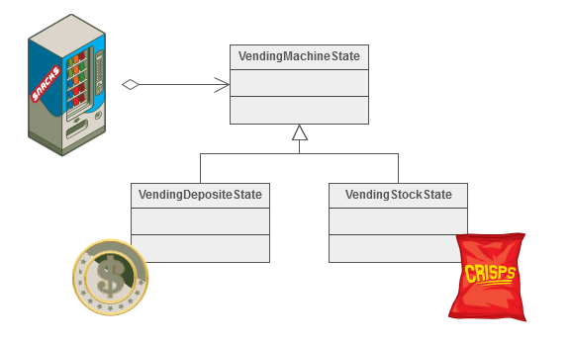
Example
The State pattern allows an object to change its behavior when its internal state changes. This pattern can be observed in a vending machine.
Vending machines have states based on the inventory, amount of currency deposited, the ability to make change, the item selected, etc.
When currency is deposited and a selection is made, a vending machine will either
deliver a product and no change,
deliver a product and change,
deliver no product due to insufficient currency on deposit, or
deliver no product due to inventory depletion.
Hope Foundation’s International Institute of Information Technology, I²IT, P-14 Rajiv Gandhi Infotech Park, Hinjawadi, Pune - 411 057
Tel - +91 20 22933441 / 2 / 3 | Website - www.isquareit.edu.in ; Email - info@isquareit.edu.in

Slide 6
Problem in Software Design
Tired of conditionals?
When writing code, our classes often go through a series of transformations.
What starts out as a simple class will grow as behavior is added.
if you didn’t take the necessary precautions, your code will become difficult to understand and maintain.
Too often, the state of an object is kept by creating multiple Boolean attributes and deciding how to behave based on the values.
This can become cumbersome and difficult to maintain when the complexity of your class starts to increase.
This is a common problem on most projects.
Hope Foundation’s International Institute of Information Technology, I²IT, P-14 Rajiv Gandhi Infotech Park, Hinjawadi, Pune - 411 057
Tel - +91 20 22933441 / 2 / 3 | Website - www.isquareit.edu.in ; Email - info@isquareit.edu.in

Slide 7
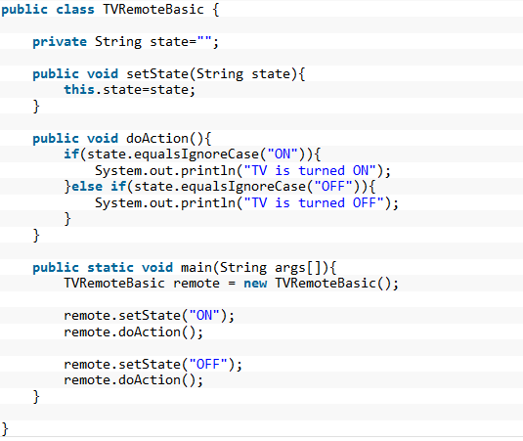
Problem in Software Design
Suppose we want to implement a TV Remote object with a simple button to perform action, if the State is ON, it will turn on the TV and if state is OFF, it will turn off the TV. We can implement it using if-else condition like below;
Hope Foundation’s International Institute of Information Technology, I²IT, P-14 Rajiv Gandhi Infotech Park, Hinjawadi, Pune - 411 057
Tel - +91 20 22933441 / 2 / 3 | Website - www.isquareit.edu.in ; Email - info@isquareit.edu.in

Slide 8
Problem in Software Design
What are the problems with above design?
Notice that
client code should know the specific values to use for setting the state of remote,
further more if number of states increase then the tight coupling between implementation and the client code will be very hard to maintain and extend.
How can we avoid this?
Design / Code will become more cleaner by using Enums and Switches or multiple if then else (Similar to our SavingAccount object in Assignment no.3)
Here in this solutions Instead of a bunch of flags, we will just have one state_ field. We also flip the order of our branching.
But again code become monolithic or as single block.
This is a common problem on most projects, and it is wise to model it with a Finite State Machine.
In fact, there is a design pattern called State that address this very well, so you can find hundreds of gems implementing this pattern.
Hope Foundation’s International Institute of Information Technology, I²IT, P-14 Rajiv Gandhi Infotech Park, Hinjawadi, Pune - 411 057
Tel - +91 20 22933441 / 2 / 3 | Website - www.isquareit.edu.in ; Email - info@isquareit.edu.in

Slide 9
Definition : State Pattern
The State pattern is known as a behavioural pattern - it's used to manage algorithms, relationships and responsibilities between objects.
In State pattern a class behavior changes based on its state. This type of design pattern comes under behavior pattern.
In State pattern, we create objects which represent various states and a context object whose behavior varies as its state object changes.
The definition of State provided in the original Gang of Four book on Design Patterns states:
“Allows an object to alter its behaviour when its internal state changes. The object will appear to change its class.”
Hope Foundation’s International Institute of Information Technology, I²IT, P-14 Rajiv Gandhi Infotech Park, Hinjawadi, Pune - 411 057
Tel - +91 20 22933441 / 2 / 3 | Website - www.isquareit.edu.in ; Email - info@isquareit.edu.in

Slide 10
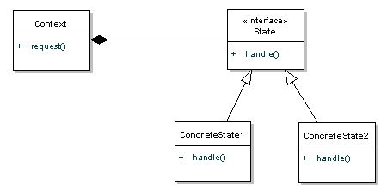
Definition : State Pattern
Let's take a look at the diagram definition
The Context can have a number of internal States, whenever the request() method is called on the Context, the message is delegated to the State to handle.
The State interface defines a common interface for all concrete states, encapsulating all behaviour associated with a particular state.
The ConcreteState implements it's own implementation for the request.
When a Context changes state, what really happens is that we have a different ConcreteState associated with it.
Hope Foundation’s International Institute of Information Technology, I²IT, P-14 Rajiv Gandhi Infotech Park, Hinjawadi, Pune - 411 057
Tel - +91 20 22933441 / 2 / 3 | Website - www.isquareit.edu.in ; Email - info@isquareit.edu.in

Slide 11
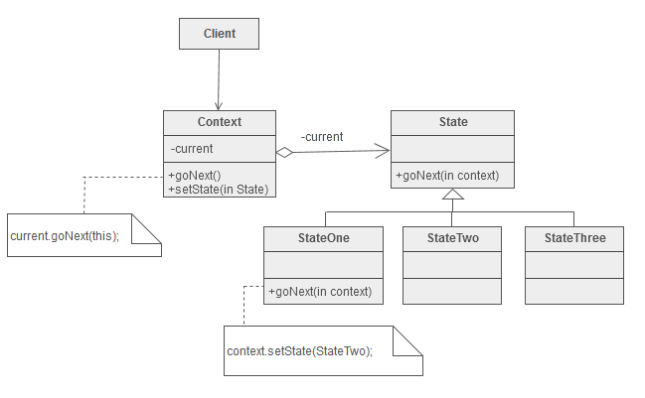
Definition : State Pattern
Hope Foundation’s International Institute of Information Technology, I²IT, P-14 Rajiv Gandhi Infotech Park, Hinjawadi, Pune - 411 057
Tel - +91 20 22933441 / 2 / 3 | Website - www.isquareit.edu.in ; Email - info@isquareit.edu.in

Slide 12
Solution to Problem in Terms of State
State Interface
First of all we will create State interface that will define the method that should be implemented by different concrete states and context class.
Hope Foundation’s International Institute of Information Technology, I²IT, P-14 Rajiv Gandhi Infotech Park, Hinjawadi, Pune - 411 057
Tel - +91 20 22933441 / 2 / 3 | Website - www.isquareit.edu.in ; Email - info@isquareit.edu.in

Slide 13
Solution to Problem in Terms of State
Concrete State Implementations
In our example, we can have two states – one for turning TV on and another to turn it off. So we will create two concrete state implementations for these behaviors.
Hope Foundation’s International Institute of Information Technology, I²IT, P-14 Rajiv Gandhi Infotech Park, Hinjawadi, Pune - 411 057
Tel - +91 20 22933441 / 2 / 3 | Website - www.isquareit.edu.in ; Email - info@isquareit.edu.in

Slide 14
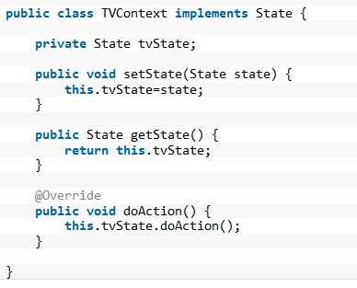
Solution to Problem in Terms of State
Now we are ready to implement our Context object that will change it’s behavior based on it’s internal state.
Context Implementation
Hope Foundation’s International Institute of Information Technology, I²IT, P-14 Rajiv Gandhi Infotech Park, Hinjawadi, Pune - 411 057
Tel - +91 20 22933441 / 2 / 3 | Website - www.isquareit.edu.in ; Email - info@isquareit.edu.in

Slide 15
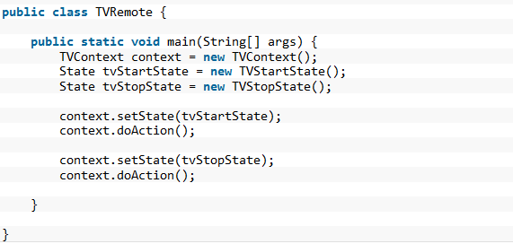
Solution to Problem in Terms of State
Test Program /Client Program
Now let’s write a simple program to test our implementation of TV Remote using State pattern.
Hope Foundation’s International Institute of Information Technology, I²IT, P-14 Rajiv Gandhi Infotech Park, Hinjawadi, Pune - 411 057
Tel - +91 20 22933441 / 2 / 3 | Website - www.isquareit.edu.in ; Email - info@isquareit.edu.in

Slide 16
Advantages
The benefits of using State pattern to implement polymorphic behavior is clearly visible,
the chances of error are less and it’s very easy to add more states for additional behavior making it more robust,
easily maintainable and flexible.
Also State pattern helped in avoiding if-else or switch-case conditional logic in this scenario.
Avoiding inconsistent states
Putting all associated behavior together in one state object
Removes monolithic if or case statements
Hope Foundation’s International Institute of Information Technology, I²IT, P-14 Rajiv Gandhi Infotech Park, Hinjawadi, Pune - 411 057
Tel - +91 20 22933441 / 2 / 3 | Website - www.isquareit.edu.in ; Email - info@isquareit.edu.in

Slide 17
Implementation
Steps to implementation
Create an interface /create our state interface
Create concrete classes implementing the same interface.
Create Context Class. /set up a context
Use the Context to see change in behaviour when State changes.
Hope Foundation’s International Institute of Information Technology, I²IT, P-14 Rajiv Gandhi Infotech Park, Hinjawadi, Pune - 411 057
Tel - +91 20 22933441 / 2 / 3 | Website - www.isquareit.edu.in ; Email - info@isquareit.edu.in

Slide 18
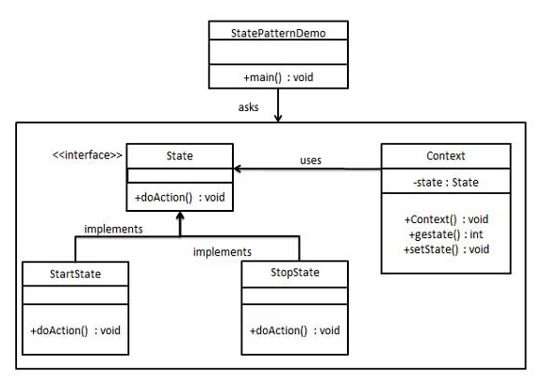
Implementation
We are going to create a State interface defining an action and concrete state classes implementing the State interface.
Context is a class which carries a State.
StatePatternDemo, our demo class, will use Context and state objects to demonstrate change in Context behavior based on type of state it is in.
Hope Foundation’s International Institute of Information Technology, I²IT, P-14 Rajiv Gandhi Infotech Park, Hinjawadi, Pune - 411 057
Tel - +91 20 22933441 / 2 / 3 | Website - www.isquareit.edu.in ; Email - info@isquareit.edu.in

Slide 19
Implementation
Step 1
Create an interface.
State.java
Hope Foundation’s International Institute of Information Technology, I²IT, P-14 Rajiv Gandhi Infotech Park, Hinjawadi, Pune - 411 057
Tel - +91 20 22933441 / 2 / 3 | Website - www.isquareit.edu.in ; Email - info@isquareit.edu.in

Slide 20
Implementation
Step 2
Create concrete classes implementing the same interface.
StartState.java
StopState.java
Hope Foundation’s International Institute of Information Technology, I²IT, P-14 Rajiv Gandhi Infotech Park, Hinjawadi, Pune - 411 057
Tel - +91 20 22933441 / 2 / 3 | Website - www.isquareit.edu.in ; Email - info@isquareit.edu.in

Slide 21
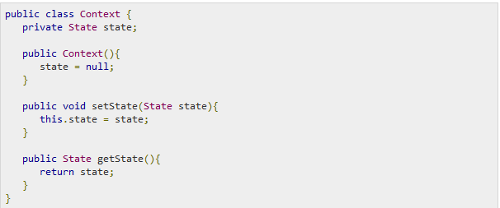
Implementation
Step 3
Create Context Class.
Context.java
Hope Foundation’s International Institute of Information Technology, I²IT, P-14 Rajiv Gandhi Infotech Park, Hinjawadi, Pune - 411 057
Tel - +91 20 22933441 / 2 / 3 | Website - www.isquareit.edu.in ; Email - info@isquareit.edu.in

Slide 22
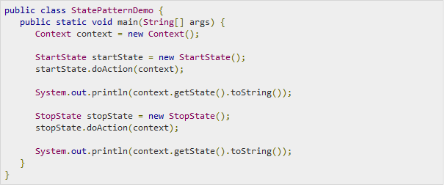
Implementation
Step 4
Use the Context to see change in behaviour when State changes.
StatePatternDemo.java
Hope Foundation’s International Institute of Information Technology, I²IT, P-14 Rajiv Gandhi Infotech Park, Hinjawadi, Pune - 411 057
Tel - +91 20 22933441 / 2 / 3 | Website - www.isquareit.edu.in ; Email - info@isquareit.edu.in

Slide 23
Implementation
Step 5
Verify the output.
Hope Foundation’s International Institute of Information Technology, I²IT, P-14 Rajiv Gandhi Infotech Park, Hinjawadi, Pune - 411 057
Tel - +91 20 22933441 / 2 / 3 | Website - www.isquareit.edu.in ; Email - info@isquareit.edu.in

Slide 24
Applications
Where Would I Use This Pattern?
You should use the State pattern when the behaviour of an object should be influenced by it's state, and when complex conditions tie object behaviour to it's state.
Hope Foundation’s International Institute of Information Technology, I²IT, P-14 Rajiv Gandhi Infotech Park, Hinjawadi, Pune - 411 057
Tel - +91 20 22933441 / 2 / 3 | Website - www.isquareit.edu.in ; Email - info@isquareit.edu.in

Slide 25
THANK YOU For further information please feel free to contact Dr. Ravi Patki ravip@isquareit.edu.in Department of Information Technology, Hope Foundation’s International Institute of Information Technology, I²IT P-14, Rajiv Gandhi Infotech Park, Hinjawadi, MIDC Phase I Pune – 411057 Tel +91 20 22933441 www.isquareit.edu.in; info@isquareit.edu.in

