Slide 1
DESIGN PATTERNS : Adapter Pattern
By
RAVI P. PATKI
(Associate Professor (IT)
Hope Foundation’s
International Institute of Information Technology

Slide 2
Agenda
Introduction
Problem in Software Design /code
Definition of Adapter Pattern
Solution to Problem in terms of Adapter Pattern
Implementation of adapter Pattern
Hope Foundation’s International Institute of Information Technology, I²IT, P-14 Rajiv Gandhi Infotech Park, Hinjawadi, Pune - 411 057
Tel - +91 20 22933441 / 2 / 3 | Website - www.isquareit.edu.in ; Email - info@isquareit.edu.in

Slide 3
Introduction
This pattern is easy to understand as the real world is full of adapters.
For example consider a USB to Ethernet adapter. We need this when we have an Ethernet interface on one end and USB on the other.
Since they are incompatible with each other. we use an adapter that converts one to other.
This example is pretty analogous to Object Oriented Adapters.
In design, adapters are used when we have a class (Client) expecting some type of object and we have an object (Adaptee) offering the same features but exposing a different interface.
Hope Foundation’s International Institute of Information Technology, I²IT, P-14 Rajiv Gandhi Infotech Park, Hinjawadi, Pune - 411 057
Tel - +91 20 22933441 / 2 / 3 | Website - www.isquareit.edu.in ; Email - info@isquareit.edu.in

Slide 4
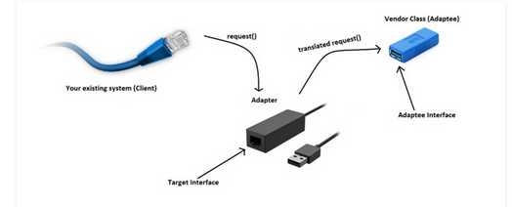
Introduction
Example
Hope Foundation’s International Institute of Information Technology, I²IT, P-14 Rajiv Gandhi Infotech Park, Hinjawadi, Pune - 411 057
Tel - +91 20 22933441 / 2 / 3 | Website - www.isquareit.edu.in ; Email - info@isquareit.edu.in

Slide 5
Introduction
Adapter pattern works as a bridge between two incompatible interfaces.
This type of design pattern comes under structural pattern as this pattern combines the capability of two independent interfaces.
This pattern involves a single class which is responsible to join functionalities of independent or incompatible interfaces.
A real life example could be a case of card reader which acts as an adapter between memory card and a laptop.
You plug-in the memory card into card reader and card reader into the laptop so that memory card can be read via laptop.
Hope Foundation’s International Institute of Information Technology, I²IT, P-14 Rajiv Gandhi Infotech Park, Hinjawadi, Pune - 411 057
Tel - +91 20 22933441 / 2 / 3 | Website - www.isquareit.edu.in ; Email - info@isquareit.edu.in

Slide 6
Implementation
We are demonstrating use of Adapter pattern via following example in which an audio player device can play mp3 files only and wants to use an advanced audio player capable of playing vlc and mp4 files.
Hope Foundation’s International Institute of Information Technology, I²IT, P-14 Rajiv Gandhi Infotech Park, Hinjawadi, Pune - 411 057
Tel - +91 20 22933441 / 2 / 3 | Website - www.isquareit.edu.in ; Email - info@isquareit.edu.in

Slide 7
Implementation
we have a MediaPlayer interface and a concrete class AudioPlayer implementing the MediaPlayer interface.
AudioPlayer can play mp3 format audio files by default.
We are having another interface AdvancedMediaPlayer and concrete classes implementing the AdvancedMediaPlayer interface.
These classes can play vlc and mp4 format files.
We want to make AudioPlayer to play other formats as well.
To attain this, we have created an adapter class MediaAdapter which implements the MediaPlayer interface and uses AdvancedMediaPlayer objects to play the required format.
AudioPlayer uses the adapter class MediaAdapter passing it the desired audio type without knowing the actual class which can play the desired format. AdapterPatternDemo, our demo class will use AudioPlayer class to play various formats.
Hope Foundation’s International Institute of Information Technology, I²IT, P-14 Rajiv Gandhi Infotech Park, Hinjawadi, Pune - 411 057
Tel - +91 20 22933441 / 2 / 3 | Website - www.isquareit.edu.in ; Email - info@isquareit.edu.in

Slide 8
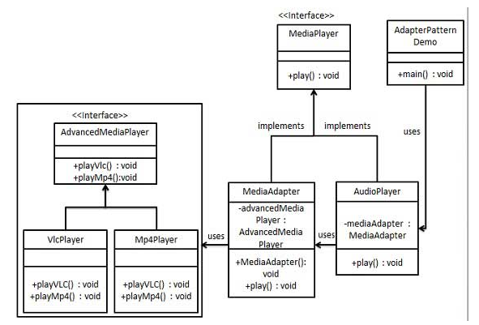
Implementation
Hope Foundation’s International Institute of Information Technology, I²IT, P-14 Rajiv Gandhi Infotech Park, Hinjawadi, Pune - 411 057
Tel - +91 20 22933441 / 2 / 3 | Website - www.isquareit.edu.in ; Email - info@isquareit.edu.in

Slide 9
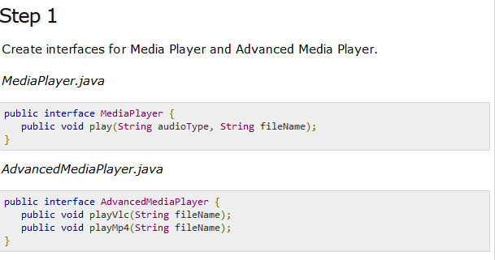
Implementation
Hope Foundation’s International Institute of Information Technology, I²IT, P-14 Rajiv Gandhi Infotech Park, Hinjawadi, Pune - 411 057
Tel - +91 20 22933441 / 2 / 3 | Website - www.isquareit.edu.in ; Email - info@isquareit.edu.in

Slide 10
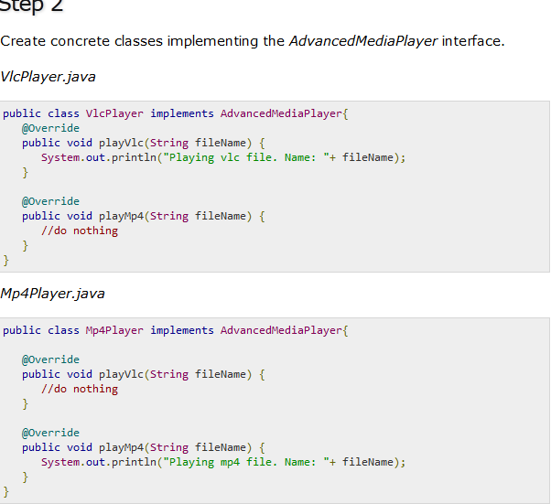
Implementation
Hope Foundation’s International Institute of Information Technology, I²IT, P-14 Rajiv Gandhi Infotech Park, Hinjawadi, Pune - 411 057
Tel - +91 20 22933441 / 2 / 3 | Website - www.isquareit.edu.in ; Email - info@isquareit.edu.in

Slide 11
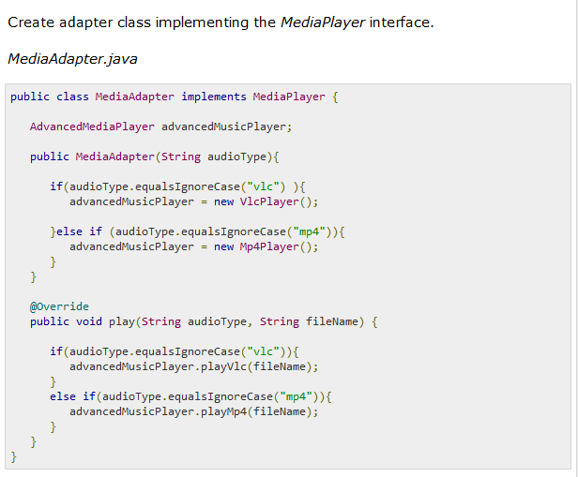
Implementation
Hope Foundation’s International Institute of Information Technology, I²IT, P-14 Rajiv Gandhi Infotech Park, Hinjawadi, Pune - 411 057
Tel - +91 20 22933441 / 2 / 3 | Website - www.isquareit.edu.in ; Email - info@isquareit.edu.in

Slide 12
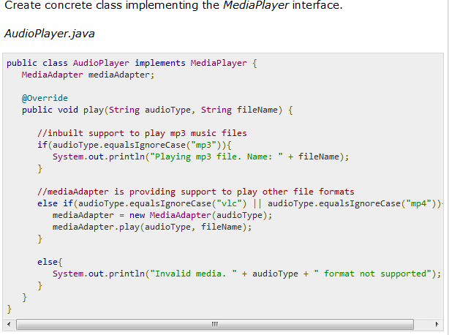
Implementation
Hope Foundation’s International Institute of Information Technology, I²IT, P-14 Rajiv Gandhi Infotech Park, Hinjawadi, Pune - 411 057
Tel - +91 20 22933441 / 2 / 3 | Website - www.isquareit.edu.in ; Email - info@isquareit.edu.in

Slide 13
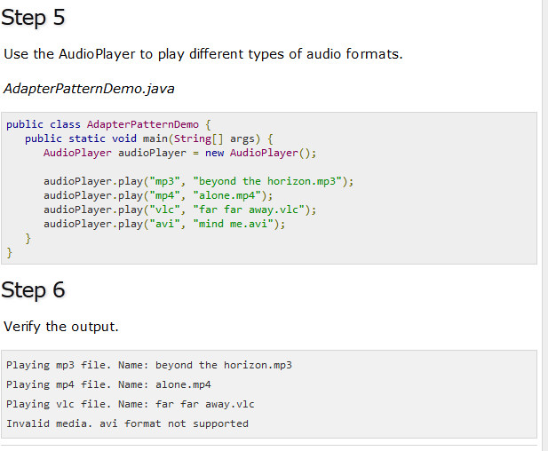
Implementation
Hope Foundation’s International Institute of Information Technology, I²IT, P-14 Rajiv Gandhi Infotech Park, Hinjawadi, Pune - 411 057
Tel - +91 20 22933441 / 2 / 3 | Website - www.isquareit.edu.in ; Email - info@isquareit.edu.in

Slide 14
THANK YOU For further information please feel free to contact Dr. Ravi Patki ravip@isquareit.edu.in Department of Information Technology, Hope Foundation’s International Institute of Information Technology, I²IT P-14, Rajiv Gandhi Infotech Park, Hinjawadi, MIDC Phase I Pune – 411057 Tel +91 20 22933441 www.isquareit.edu.in; info@isquareit.edu.in

