Slide 1
BASIC MECHANICAL ENGINEERING
Unit –I: Introduction to Mechanical Engineering
(Shaft & Keys)
Priyanka A. Narwade
Assistant Professor
Department of Applied sciences & engineering
Hope Foundation’s
International Institute of Information Technology, I²IT

Slide 2
Introduction to Machine:
Device consisting of various elements to perform the prescribed task to satisfy the human needs
E.g. Pump Set, IC Engine, Turbine etc.
INPUT
(Source of Energy)
Machine
(Arrangements of Elements)
Output
(Prescribed Task)

Slide 3
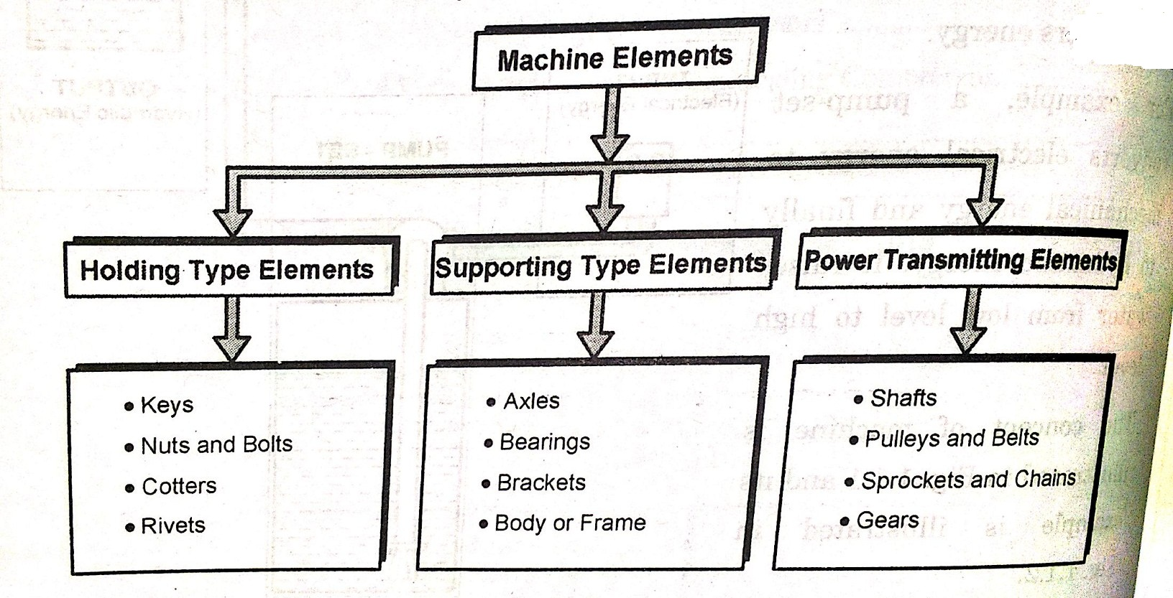
Classification of Machine Elements:

Slide 4
Shafts:
A shaft is a rotating member, circular cross-section, solid or hollow, to transmit power or motion
To transmit the power using shaft different members are used such as, Gears, Pulleys, Sprockets
Types:
A) Transmission Shaft
B) Machine Shafts

Slide 5
A) Transmission Shafts:
Transmit the power from source to the machine absorbing the power
Mountings: Gears, Pulleys etc.
Subjected to torque, BM and axial force
Types: Line Shaft and Counter Shaft

Slide 6
Difference between Line shaft & Counter Shaft:
Sr. No. | Line Shaft | Counter Shaft
1. | Directly driven by prime mover and using this power is supplied to diff. machines | Secondary shaft driven by main shaft using belt, chain or gear
2. | Directly connected to PRIME MOVER | NOT DIRECTLY CONNECTED

Slide 7
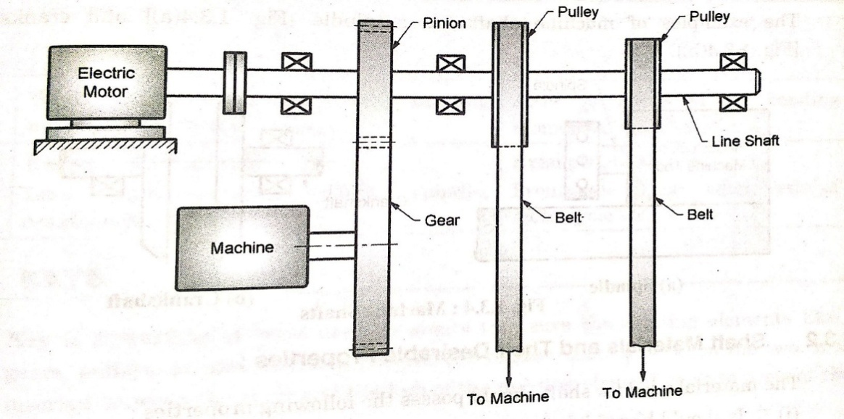
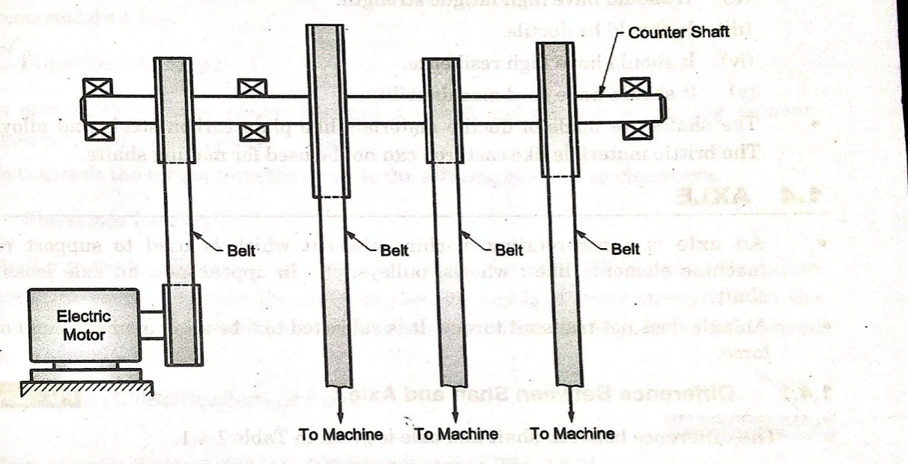
Difference between Line shaft & Counter Shaft:
Sr. No. | Line Shaft | Counter Shaft
3. | Example | Example

Slide 8
Properties of Shaft
PROPERTIES:
High Static Strength
High Fatigue Strength
Ductility
High Resilience
Good Machinability

Slide 9
Material for Shaft
Material:
Ductile material like PLAIN CARBON STEELS AND ALLOY STEELS.
BRITTLE Material like CAST IRON can not be used

Slide 10
Keys:
Key is a machine element used on the shafts to secure rotating elements and prevent relative motion between two rotating member.
Keyway is the recess provided on shaft and hub to accommodate key.
Key is also used for transmitting the torque from shaft to rotating element.

Slide 11
Keys:
Material for key is Plain Carbon Steel or Alloy Steels.
Its having lower strength than Shaft material to ensure that if at all there is failure the key should fail instead of shaft.

Slide 12
Types of Keys:
Sr. No. | Type | Feature | Application
1 | Sunk Keys | Provided half in the keyway of shaft and half in the keyway of hub | Mountings of flanges, pulleys, gears etc
a. | Rectangular Key | Rectangular tapered cross section
b. | Square key | Square tapered cross section
c. | Parallel key | Rectangular or square without taper | Used in gear boxes where axial movement is restricted
d. | Gib-headed key | Rectangular key with head at one end for easy removal of key | Used in mountings of pulleys, gears, inaccessible key seats
e. | Feather key | Special type parallel key attached to either shaft or hub to prevent the relative rotary motion but, permits relative axial movement | Clutches and gear shifting devices
f. | Woodruff key | It’s a segment from cylindrical disc | Machine tools and automobiles

Slide 13
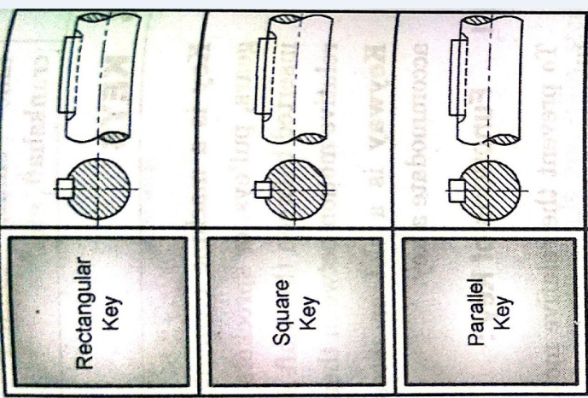
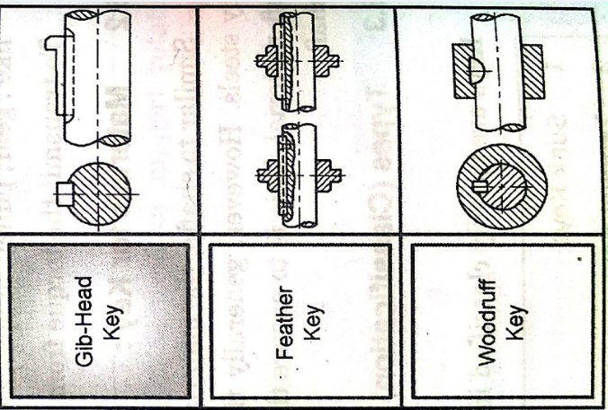
Types of sunk keys:

Slide 14
Types of keys:
Sr. No. | Type | Feature | Application
2 | Saddle Keys | Tapered key fits completely only in hub of rotating element | Light duty applications, used temporarily fastening in fixing and eccentric cams
3 | Tangent keys | Two tapered rectangular keys placed 90⁰ apart | Heavy duty industrial applications
4 | Kennedy keys | Two tapered square keys placed 90⁰ apart | Heavy duty industrial applications
5 | Round keys and taper pins | Straight pin of circular cross section | Low power drives
6 | Splines | Multiple keys which are made integral with shaft | Automobile gear box and machine tool gear boxes

Slide 15
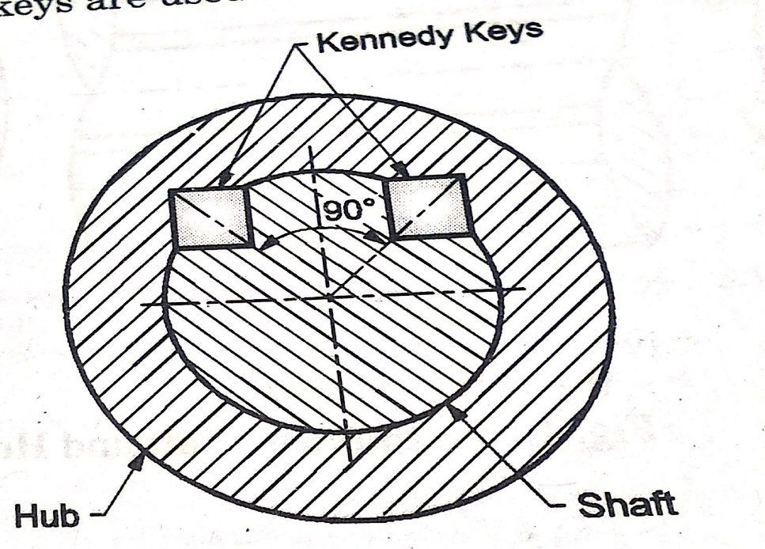
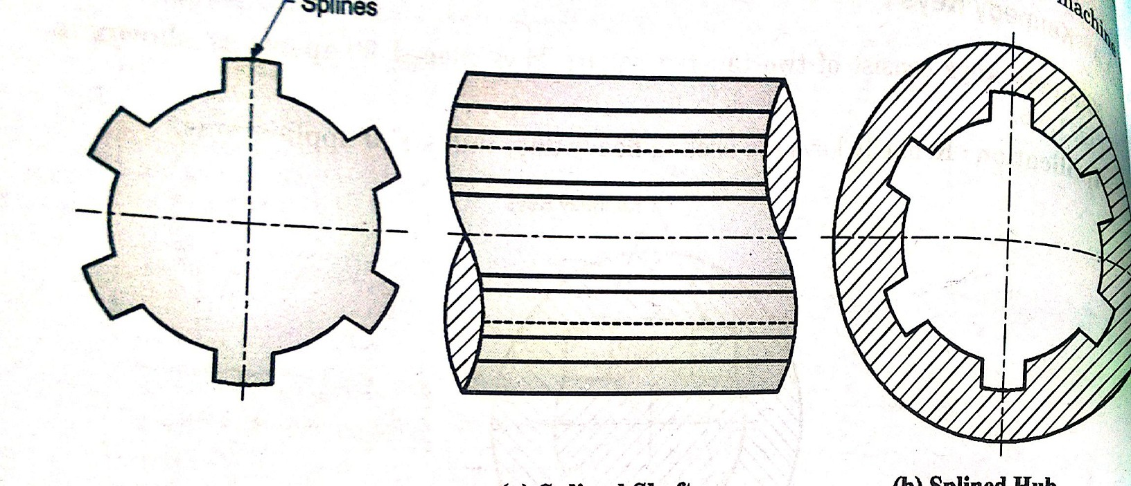
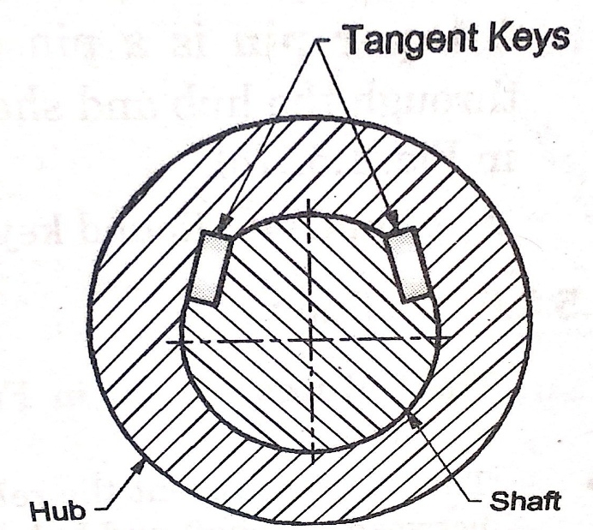

Slide 16
References
Machine Design Book by J.K. Gupta and R.S. Khurmi
Design of Machine Elements Book by V. B. Bhandari
Basic Mechanical Engineering book by R. B. Patil and Singhal

Slide 17
THANK YOU
For further details please contact
Priyanka Narwade
Department of Applied Science & Engineering
Hope Foundation’s
International Institute of Information Technology, I²IT
P-14, Rajiv Gandhi Infotech Park, MIDC Phase 1, Hinjawadi, Pune – 411 057
www.isquareit.edu.in
Phone : +91 20 22933441 / 2 / 3
priyankan@isquareit.edu.in | info@isquareit.edu.in

