Slide 1
DESIGN PATTERNS : Strategy Pattern
By
RAVI P. PATKI
Associate Professor (IT)
Hope Foundation’s
International Institute of Information Technology

Slide 2
Agenda
Introduction
Problem in Software Design
Definition of Strategy Pattern
Solution to Problem in terms of Strategy Pattern
Implementation of Strategy Pattern
Advantages
Disadvantages
Applications
Hope Foundation’s International Institute of Information Technology, I²IT, P-14 Rajiv Gandhi Infotech Park, Hinjawadi, Pune - 411 057
Tel - +91 20 22933441 / 2 / 3 | Website - www.isquareit.edu.in ; Email - info@isquareit.edu.in

Slide 3
Behavioral Patterns
In software engineering, behavioral design patterns are design patterns that identify common communication patterns between objects and realize these patterns.
By doing so, these patterns increase flexibility in carrying out this communication.
These design patterns are specifically concerned with communication between objects.
Types of Behavioral Patterns
Chain of Responsibility
Command
Interpreter
Iterator
Mediator
Memento
Multiple Dispatch
Observer
State
Strategy
Template Method
Visitor
Hope Foundation’s International Institute of Information Technology, I²IT, P-14 Rajiv Gandhi Infotech Park, Hinjawadi, Pune - 411 057
Tel - +91 20 22933441 / 2 / 3 | Website - www.isquareit.edu.in ; Email - info@isquareit.edu.in

Slide 4
Patterns Explored
We’ll explore a small subset of the given patterns in detail, going over the concept, the problem/context pair, solution, and a little about implementation
Attempt to focus on patterns that aren’t obvious or common sense
Patterns to explore
Strategy,
Observer,
State,
Adaptor.
Hope Foundation’s International Institute of Information Technology, I²IT, P-14 Rajiv Gandhi Infotech Park, Hinjawadi, Pune - 411 057
Tel - +91 20 22933441 / 2 / 3 | Website - www.isquareit.edu.in ; Email - info@isquareit.edu.in

Slide 5
Introduction
In Software Engineering, the strategy pattern (also known as the policy pattern) is a software design pattern that enables an algorithm's behavior to be selected at runtime.
The strategy pattern
defines a family of algorithms,
encapsulates each algorithm, and
makes the algorithms interchangeable within that family.
Strategy lets the algorithm vary independently from clients that use it.
Example :
For instance, a class that performs validation on incoming data may use a strategy pattern to select a validation algorithm based on the type of data, the source of the data, user choice, or other discriminating factors.
These factors are not known for each case until run-time, and may require radically different validation to be performed.
The validation strategies, encapsulated separately from the validating object, may be used by other validating objects in different areas of the system (or even different systems) without code duplication.
Hope Foundation’s International Institute of Information Technology, I²IT, P-14 Rajiv Gandhi Infotech Park, Hinjawadi, Pune - 411 057
Tel - +91 20 22933441 / 2 / 3 | Website - www.isquareit.edu.in ; Email - info@isquareit.edu.in

Slide 6
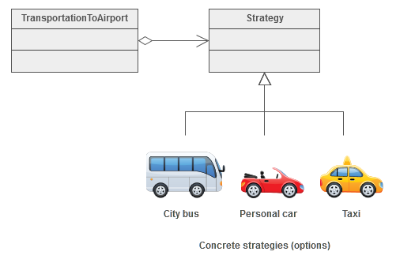
Introduction
A Strategy defines a set of algorithms that can be used interchangeably.
Example :
Modes of transportation to an airport is an example of a Strategy.
Several options exist such as driving one's own car, taking a taxi, an airport shuttle, a city bus, or a limousine service.
For some airports, subways and helicopters are also available as a mode of transportation to the airport.
Any of these modes of transportation will get a traveler to the airport, and they can be used interchangeably.
The traveler must chose the Strategy based on trade-offs between cost, convenience, and time.
Hope Foundation’s International Institute of Information Technology, I²IT, P-14 Rajiv Gandhi Infotech Park, Hinjawadi, Pune - 411 057
Tel - +91 20 22933441 / 2 / 3 | Website - www.isquareit.edu.in ; Email - info@isquareit.edu.in

Slide 7
Problem
As always we will learn this pattern by defining a problem and using strategy pattern to solve it.
Suppose we are building a game “Street Fighter”.
For simplicity assume that a character may have four moves that is kick, punch, roll and jump.
Every character has kick and punch moves, but roll and jump are optional.
How would you model your classes?
Suppose initially you use inheritance and abstract out the common features in a Fighter class and let other characters subclass Fighter class.
Hope Foundation’s International Institute of Information Technology, I²IT, P-14 Rajiv Gandhi Infotech Park, Hinjawadi, Pune - 411 057
Tel - +91 20 22933441 / 2 / 3 | Website - www.isquareit.edu.in ; Email - info@isquareit.edu.in

Slide 8
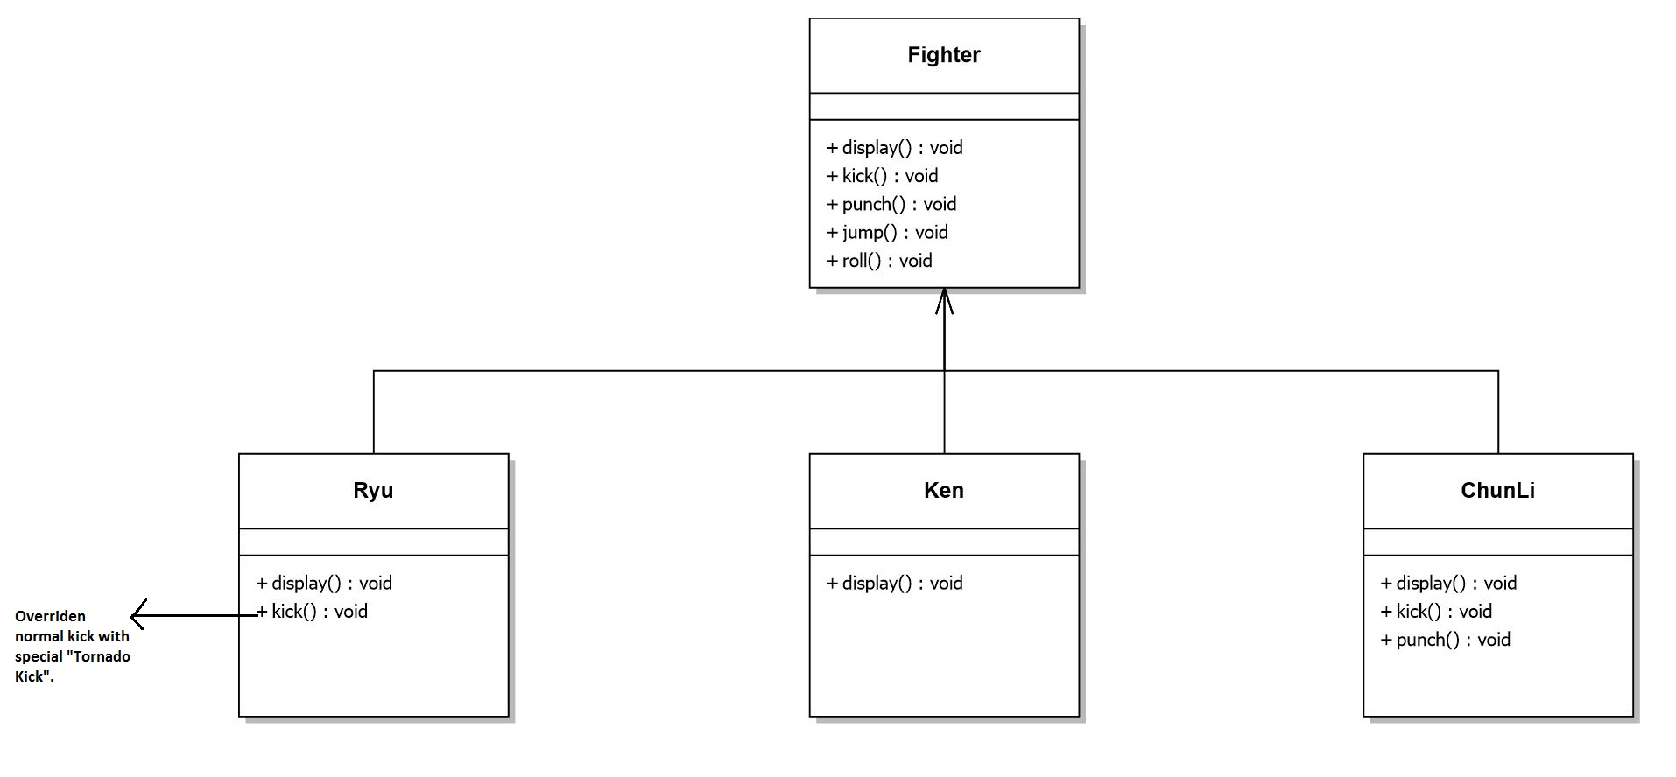
Problem
Fighter class will we have default implementation of normal actions.
Any character with specialized move can override that action in its subclass.
Class diagram would be as follows:
Hope Foundation’s International Institute of Information Technology, I²IT, P-14 Rajiv Gandhi Infotech Park, Hinjawadi, Pune - 411 057
Tel - +91 20 22933441 / 2 / 3 | Website - www.isquareit.edu.in ; Email - info@isquareit.edu.in

Slide 9
Problem
What are the problems with above design?
What if a character doesn’t perform jump move?
It still inherits the jump behavior from super class.
Although you can override jump to do nothing in that case but you may have to do so for many existing classes and take care of that for future classes too.
This would also make maintenance difficult. So we can’t use inheritance here.
this is very bad design option
Hope Foundation’s International Institute of Information Technology, I²IT, P-14 Rajiv Gandhi Infotech Park, Hinjawadi, Pune - 411 057
Tel - +91 20 22933441 / 2 / 3 | Website - www.isquareit.edu.in ; Email - info@isquareit.edu.in

Slide 10
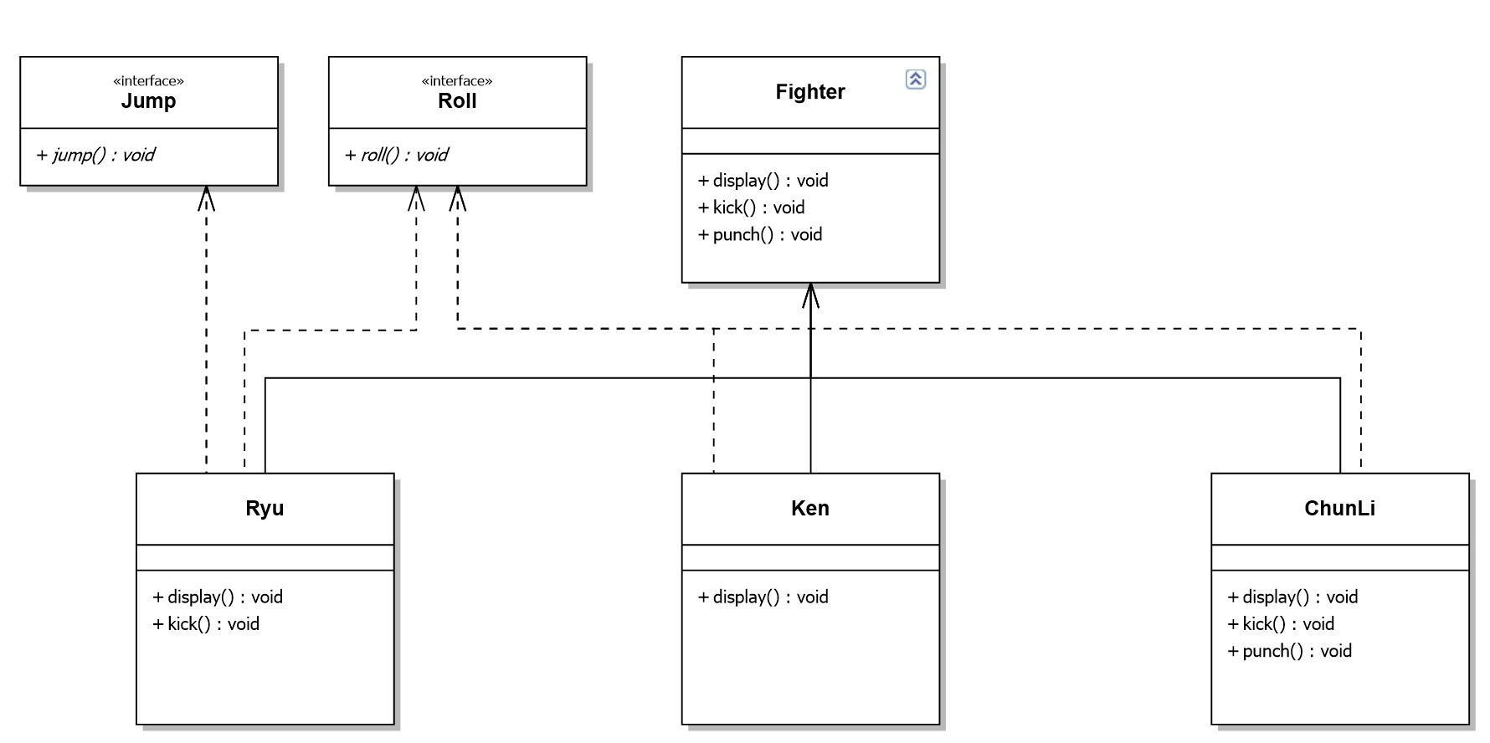
Problem
Take a look at the following design:
It’s much cleaner. We took out some actions (which some characters might not perform) out of Fighter class and made interfaces for them. That way only characters that are supposed to jump will implement the JumpBehavior.
Hope Foundation’s International Institute of Information Technology, I²IT, P-14 Rajiv Gandhi Infotech Park, Hinjawadi, Pune - 411 057
Tel - +91 20 22933441 / 2 / 3 | Website - www.isquareit.edu.in ; Email - info@isquareit.edu.in

Slide 11
Problem
What are the problems with above design?
The main problem with the above design is code reuse.
Since there is no default implementation of jump and roll behavior we may have code duplicity.
You may have to rewrite the same jump behavior over and over in many subclasses.
How can we avoid this?
What if we made JumpBehavior and RollBehavior classes instead of interface?
Well then we would have to use multiple inheritance that is not supported in many languages due to many problems associated with it.
Here strategy pattern comes to our rescue.
We will learn what the strategy pattern is and then apply it to solve our problem.
Hope Foundation’s International Institute of Information Technology, I²IT, P-14 Rajiv Gandhi Infotech Park, Hinjawadi, Pune - 411 057
Tel - +91 20 22933441 / 2 / 3 | Website - www.isquareit.edu.in ; Email - info@isquareit.edu.in

Slide 12
Definition : Strategy Pattern
“In computer programming, the strategy pattern (also known as the policy pattern) is a software design pattern that enables an algorithm’s behavior to be selected at runtime.
The strategy pattern
defines a family of algorithms,
encapsulates each algorithm, and
makes the algorithms interchangeable within that family.”
The Strategy pattern is known as a behavioural pattern - it's used to manage algorithms, relationships and responsibilities between objects.
The definition of Strategy provided in the original Gang of Four book on Design Patterns states:
“Defines a set of encapsulated algorithms that can be swapped to carry out a specific behaviour”
Hope Foundation’s International Institute of Information Technology, I²IT, P-14 Rajiv Gandhi Infotech Park, Hinjawadi, Pune - 411 057
Tel - +91 20 22933441 / 2 / 3 | Website - www.isquareit.edu.in ; Email - info@isquareit.edu.in

Slide 13
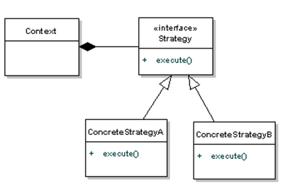
Definition : Strategy Pattern
Now, let's take a look at the diagram definition of the Strategy pattern.
Here we rely on composition instead of inheritance for reuse.
In the above diagram Context is composed of a Strategy. Instead of implementing a behavior the Context delegates it to Strategy.
The context could be anything that would require changing behaviours
The Strategy is simply implemented as an interface, so that we can swap ConcreteStrategys in and out without effecting our Context.
Hope Foundation’s International Institute of Information Technology, I²IT, P-14 Rajiv Gandhi Infotech Park, Hinjawadi, Pune - 411 057
Tel - +91 20 22933441 / 2 / 3 | Website - www.isquareit.edu.in ; Email - info@isquareit.edu.in

Slide 14
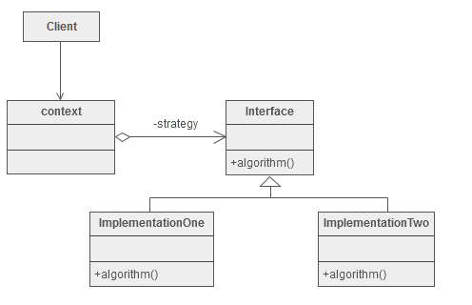
Definition : Strategy Pattern
Hope Foundation’s International Institute of Information Technology, I²IT, P-14 Rajiv Gandhi Infotech Park, Hinjawadi, Pune - 411 057
Tel - +91 20 22933441 / 2 / 3 | Website - www.isquareit.edu.in ; Email - info@isquareit.edu.in

Slide 15
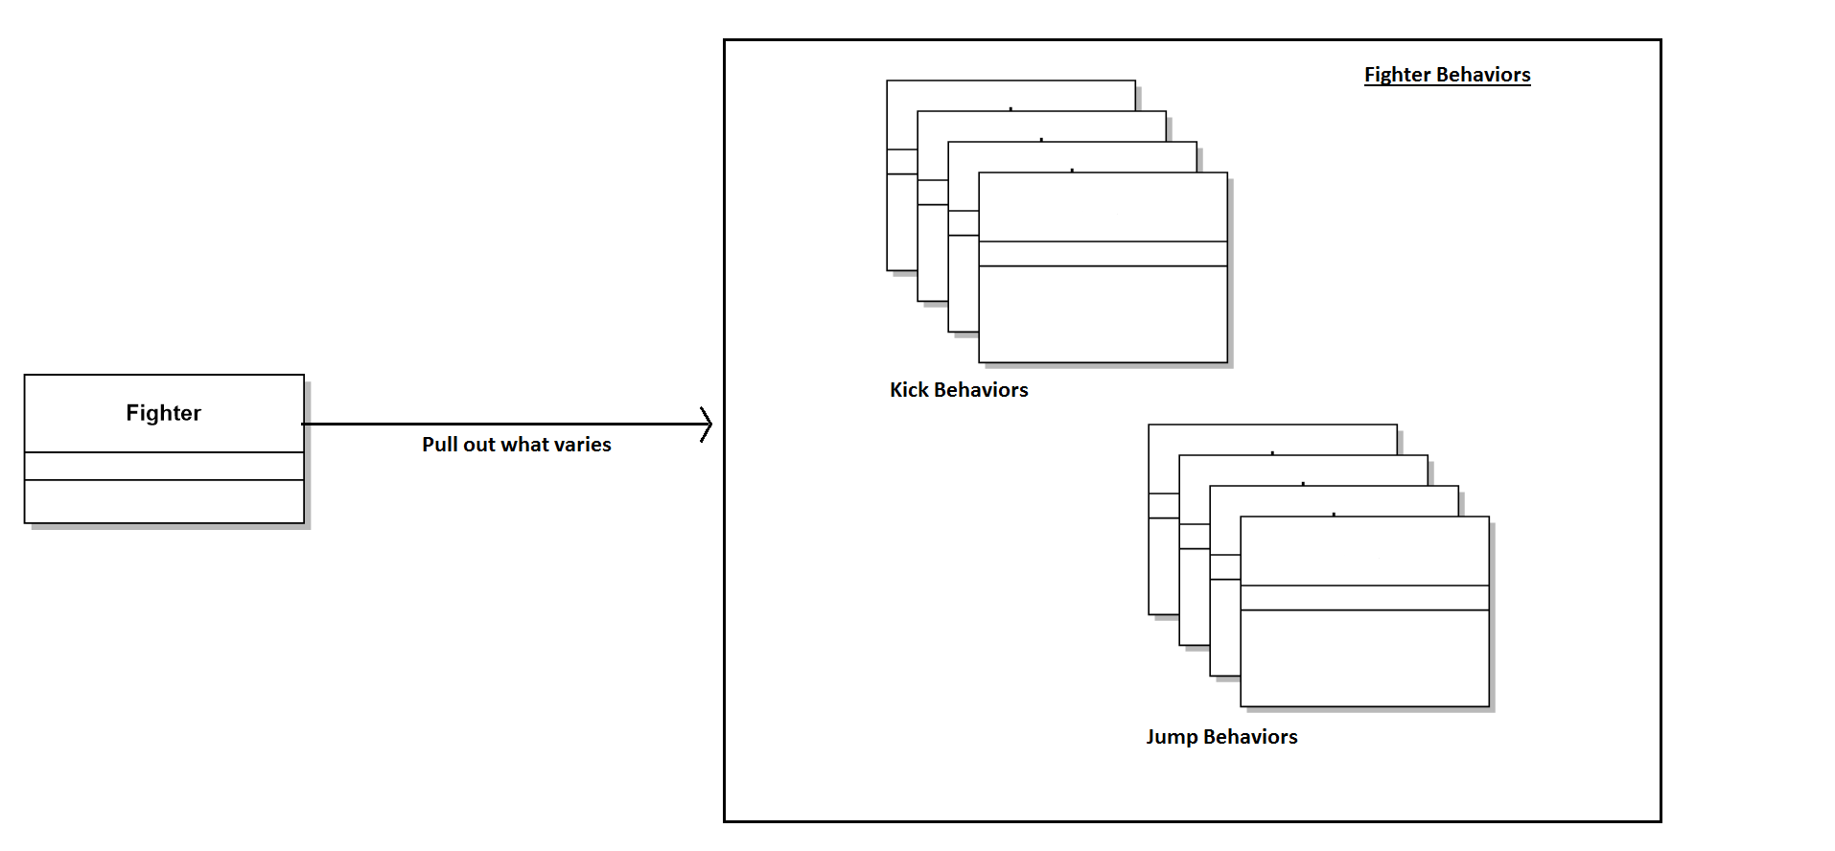
Solution
we apply Strategy Pattern to the Fighter Problem and discuss implementation.
The first step is to identify the behaviors that may vary across different classes in future and separate them from the rest.
For our example let them be kick and jump behaviors.
To separate these behaviors we will pull both methods out of Fighter class and create a new set of classes to represent each behavior.
Hope Foundation’s International Institute of Information Technology, I²IT, P-14 Rajiv Gandhi Infotech Park, Hinjawadi, Pune - 411 057
Tel - +91 20 22933441 / 2 / 3 | Website - www.isquareit.edu.in ; Email - info@isquareit.edu.in

Slide 16
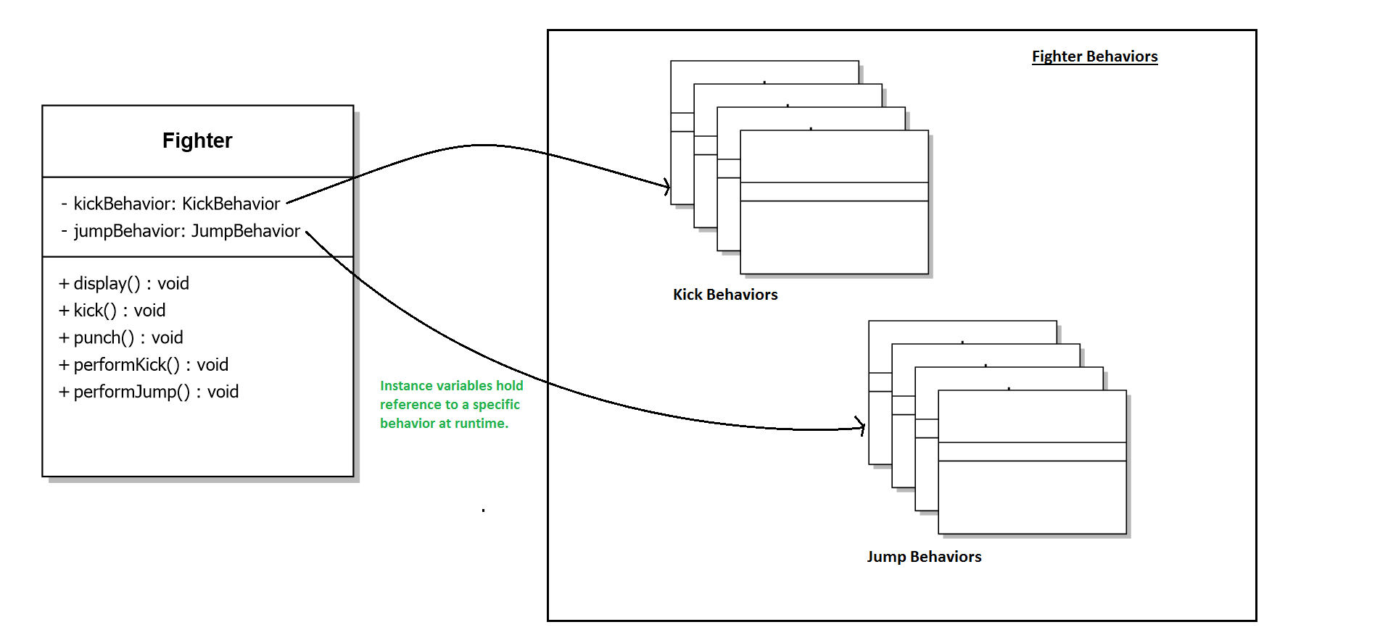
Solution
The Fighter class will now delegate its kick and jump behavior instead of using kick and jump methods defined in the Fighter class or its subclass.
Hope Foundation’s International Institute of Information Technology, I²IT, P-14 Rajiv Gandhi Infotech Park, Hinjawadi, Pune - 411 057
Tel - +91 20 22933441 / 2 / 3 | Website - www.isquareit.edu.in ; Email - info@isquareit.edu.in

Slide 17
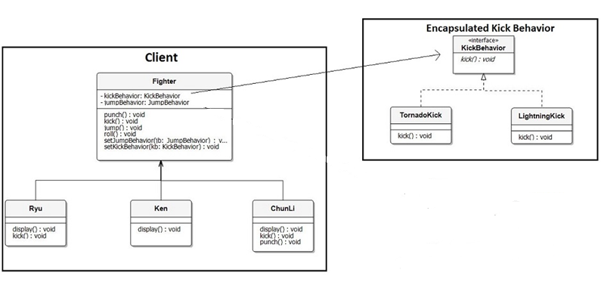
Solution
After reworking the final class diagram would be:
Hope Foundation’s International Institute of Information Technology, I²IT, P-14 Rajiv Gandhi Infotech Park, Hinjawadi, Pune - 411 057
Tel - +91 20 22933441 / 2 / 3 | Website - www.isquareit.edu.in ; Email - info@isquareit.edu.in

Slide 18
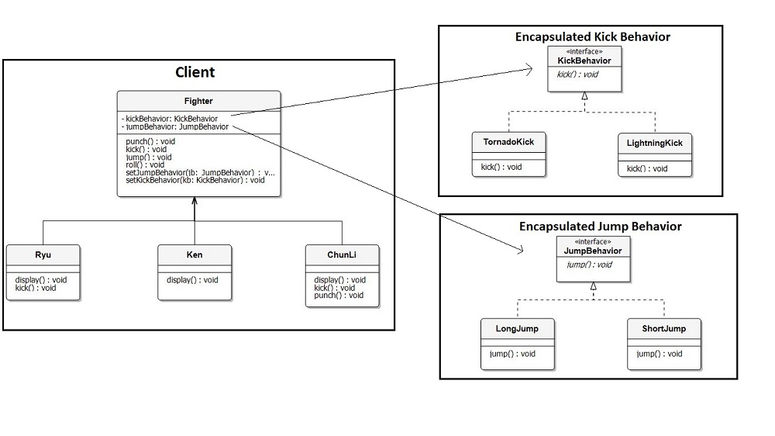
Solution
After betterly reworking the final class diagram would be:
Comparing our design to the definition of strategy pattern encapsulated kick and jump behaviors are two families of algorithms. And these algorithms are interchangeable as evident in implementation.
Hope Foundation’s International Institute of Information Technology, I²IT, P-14 Rajiv Gandhi Infotech Park, Hinjawadi, Pune - 411 057
Tel - +91 20 22933441 / 2 / 3 | Website - www.isquareit.edu.in ; Email - info@isquareit.edu.in

Slide 19
Advantages
Advantages:
A family of algorithms can be defined as a class hierarchy and can be used interchangeably to alter application behavior without changing its architecture.
By encapsulating the algorithm separately, new algorithms complying with the same interface can be easily introduced.
The application can switch strategies at run-time.
Strategy enables the clients to choose the required algorithm, without using a “switch” statement or a series of “if-else” statements.
Data structures used for implementing the algorithm are completely encapsulated in Strategy classes. Therefore, the implementation of an algorithm can be changed without affecting the Context class.
Hope Foundation’s International Institute of Information Technology, I²IT, P-14 Rajiv Gandhi Infotech Park, Hinjawadi, Pune - 411 057
Tel - +91 20 22933441 / 2 / 3 | Website - www.isquareit.edu.in ; Email - info@isquareit.edu.in

Slide 20
Disadvantages:
Disadvantages:
The application must be aware of all the strategies to select the right one for the right situation.
Context and the Strategy classes normally communicate through the interface specified by the abstract Strategy base class. Strategy base class must expose interface for all the required behaviours, which some concrete Strategy classes might not implement.
In most cases, the application configures the Context with the required Strategy object. Therefore, the application needs to create and maintain two objects in place of one.
Hope Foundation’s International Institute of Information Technology, I²IT, P-14 Rajiv Gandhi Infotech Park, Hinjawadi, Pune - 411 057
Tel - +91 20 22933441 / 2 / 3 | Website - www.isquareit.edu.in ; Email - info@isquareit.edu.in

Slide 21
Implementation
Steps to implementation
Identify an algorithm (i.e. a behavior) that the client would prefer to access through a "flex point".
Specify the signature for that algorithm in an interface.
Bury the alternative implementation details in derived classes.
Clients of the algorithm couple themselves to the interface.
Hope Foundation’s International Institute of Information Technology, I²IT, P-14 Rajiv Gandhi Infotech Park, Hinjawadi, Pune - 411 057
Tel - +91 20 22933441 / 2 / 3 | Website - www.isquareit.edu.in ; Email - info@isquareit.edu.in

Slide 22
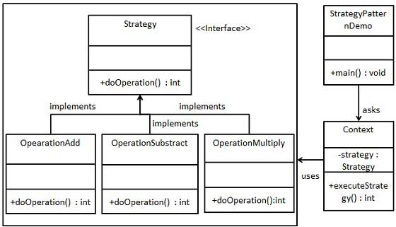
Implementation
We are going to create a Strategy interface defining an action and concrete strategy classes implementing the Strategy interface.
Context is a class which uses a Strategy.
StrategyPatternDemo, our demo class, will use Context and strategy objects to demonstrate change in Context behaviour based on strategy it deploys or uses
Hope Foundation’s International Institute of Information Technology, I²IT, P-14 Rajiv Gandhi Infotech Park, Hinjawadi, Pune - 411 057
Tel - +91 20 22933441 / 2 / 3 | Website - www.isquareit.edu.in ; Email - info@isquareit.edu.in

Slide 23
Implementation
Step 1
Create an interface.
Strategy.java
Hope Foundation’s International Institute of Information Technology, I²IT, P-14 Rajiv Gandhi Infotech Park, Hinjawadi, Pune - 411 057
Tel - +91 20 22933441 / 2 / 3 | Website - www.isquareit.edu.in ; Email - info@isquareit.edu.in

Slide 24
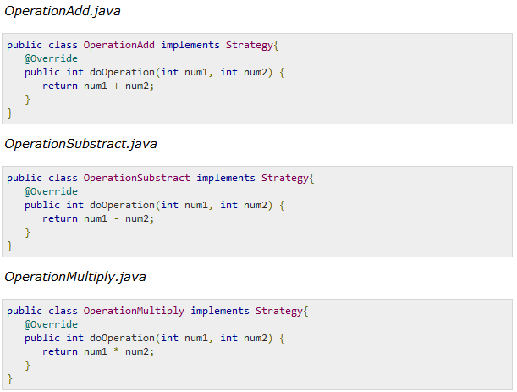
Implementation
Step 2
Create concrete classes implementing the same interface.
Hope Foundation’s International Institute of Information Technology, I²IT, P-14 Rajiv Gandhi Infotech Park, Hinjawadi, Pune - 411 057
Tel - +91 20 22933441 / 2 / 3 | Website - www.isquareit.edu.in ; Email - info@isquareit.edu.in

Slide 25
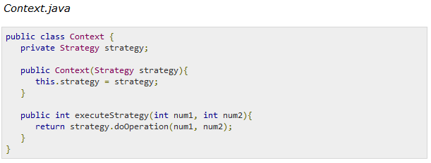
Implementation
Step 3
Create Context Class.
Hope Foundation’s International Institute of Information Technology, I²IT, P-14 Rajiv Gandhi Infotech Park, Hinjawadi, Pune - 411 057
Tel - +91 20 22933441 / 2 / 3 | Website - www.isquareit.edu.in ; Email - info@isquareit.edu.in

Slide 26
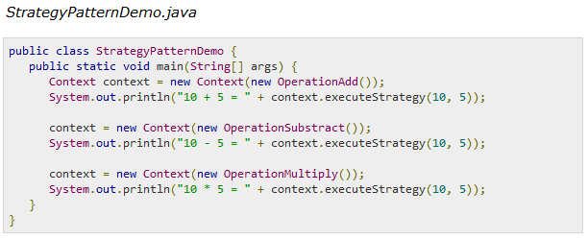
Implementation
Step 4
Use the Context to see change in behaviour when it changes its Strategy.
Hope Foundation’s International Institute of Information Technology, I²IT, P-14 Rajiv Gandhi Infotech Park, Hinjawadi, Pune - 411 057
Tel - +91 20 22933441 / 2 / 3 | Website - www.isquareit.edu.in ; Email - info@isquareit.edu.in

Slide 27
Implementation
Step 5
Verify the output.
Hope Foundation’s International Institute of Information Technology, I²IT, P-14 Rajiv Gandhi Infotech Park, Hinjawadi, Pune - 411 057
Tel - +91 20 22933441 / 2 / 3 | Website - www.isquareit.edu.in ; Email - info@isquareit.edu.in

Slide 28
Applications
Where Would I Use This Pattern?
The Strategy pattern is to be used where you want to choose the algorithm to use at runtime.
A good use of the Strategy pattern would be saving files in different formats, running various sorting algorithms, or file compression.
The Strategy pattern provides a way to define a family of algorithms, encapsulate each one as an object, and make them interchangeable.
REFERENCE : www.tutorialpoint.com
Hope Foundation’s International Institute of Information Technology, I²IT, P-14 Rajiv Gandhi Infotech Park, Hinjawadi, Pune - 411 057
Tel - +91 20 22933441 / 2 / 3 | Website - www.isquareit.edu.in ; Email - info@isquareit.edu.in

Slide 29
THANK YOU For further information please feel free to contact Dr. Ravi Patki ravip@isquareit.edu.in Department of Information Technology, Hope Foundation’s International Institute of Information Technology, I²IT P-14, Rajiv Gandhi Infotech Park, Hinjawadi, MIDC Phase I Pune – 411057 Tel +91 20 22933441 www.isquareit.edu.in; info@isquareit.edu.in

