Slide 1
INTRODUCTION TO ASSEMBLY LANGUAGE PROGRAMMING
Prof. Bhavana K.
Information Technology Department
International Institute of Information Technology, I²IT
www.isquareit.edu.in

Slide 2
Assembly Language Programming (ALP)
Structure of ALP Program
Sections in ALP program are:
Title
.model
Data declaration section
Code section

Slide 3
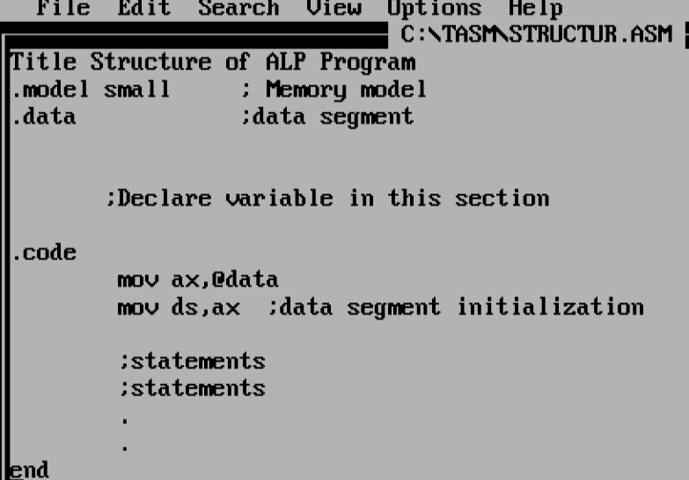
Assembly Language Programming (ALP)
Structure of ALP Program:

Slide 4
Assembly Language Programming (ALP)
Structure of ALP Program
Sections in ALP program are:
Title – This assembler directive is used to give title to a program.
.model – It initializes memory model.
Tiny | Code and Data fit into 64K
Small | All data fits in one 64K segment, all code fits in one 64K segment.
medium | All data fits in one 64K segment, but code may be greater than 64K.
compact | Data may be greater than 64K , code must be less than 64K.
large | Both data and code may be greater than 64K

Slide 5
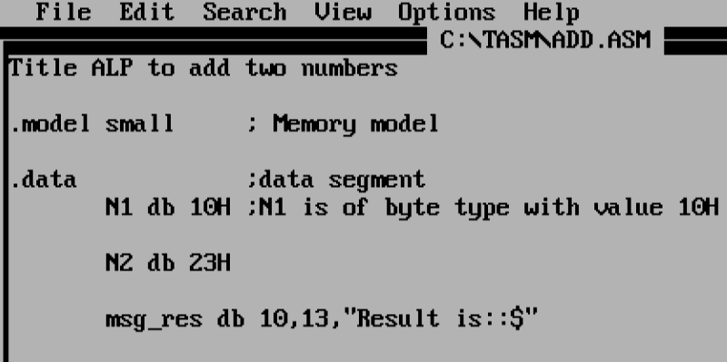
Assembly Language Programming (ALP)
Structure of ALP Program
Sections in ALP program are:
Data declaration section:

Slide 6
Sections in ALP program are:
Data declaration section:
DB (Define byte) assembler directive is used to define byte type of variable
DW (Define word) assembler directive is used to define word type of variable.
To define string
msg db 10,13,”hello$”
10– ASCII value for new line
13– ASCII value for carriage return
$ is used to indicate end of string
To define an array of 4 bytes
array db 10,11,12,13

Slide 7
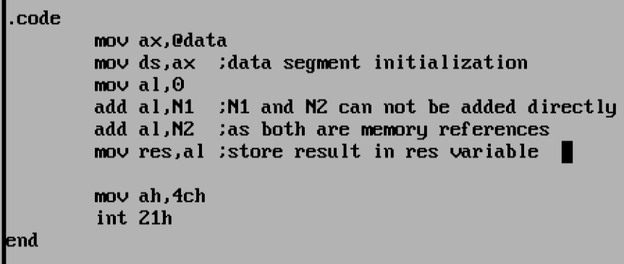
Sections in ALP program are:
Code section
Initialization of data segment
MOV AX,@DATA
MOV DS,AX
It stores upper four digits of data segment base address in DS (Data segment ) register.
The address in DS is used as a segment base address along with offset address to fetch value from data segment.

Slide 8
Sections in ALP program are:
Interrupts used in assembly language:
To accept single digit
MOV AH,01
INT 21H
Hex ASCII value of accepted digit gets stored in AL register.
To display single digit
MOV DL,HEX_ASCII_VALUE_OF_DIGIT_TO_DISPLAY
MOV AH,02
INT 21H
To terminate program
MOV AH,4CH
INT 21H

Slide 9
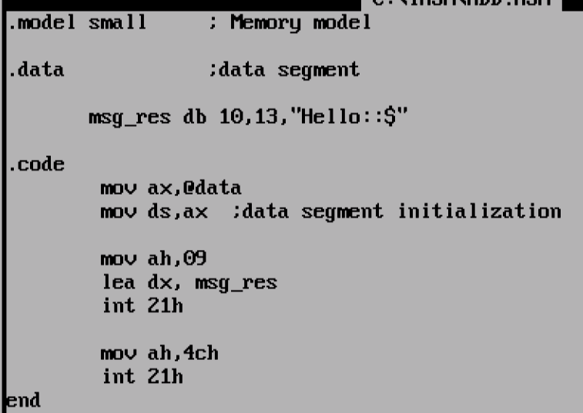
Sections in ALP program are:
Interrupts used in assembly language:
To display string
LEA DX,VARIABLE_NAME ; Offset address of string to display
MOV AH,09
INT 21H

Slide 10
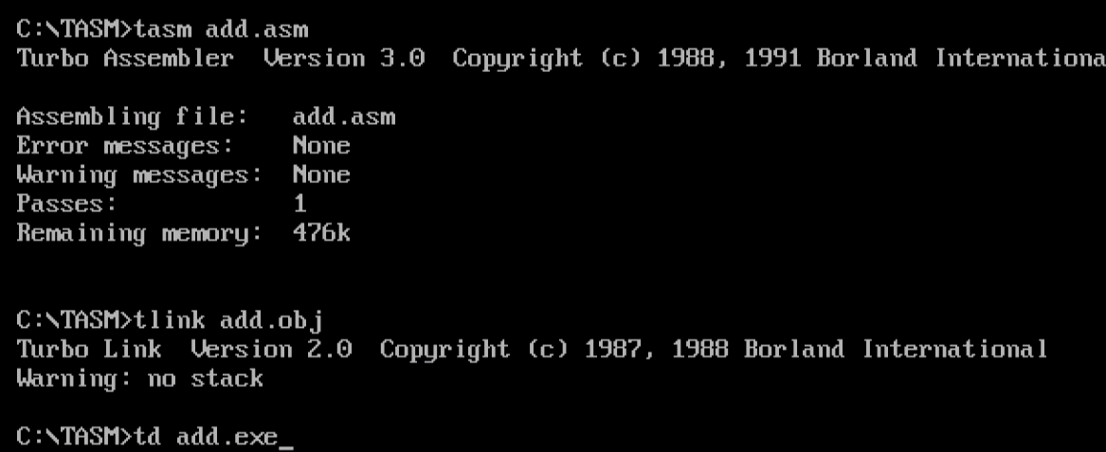
Sections in ALP program are:
Commands to execute program

Slide 11
Sections in ALP program are:
Commands to execute program
TASM FILENAME.ASM
The input to assembler is .asm file. It generates two files .obj and .lst
TLINK FILENAME.OBJ
Input to linker is .obj file. It generates two files .map and .exe
To execute program give FILENAME.EXE on command prompt.

Slide 12
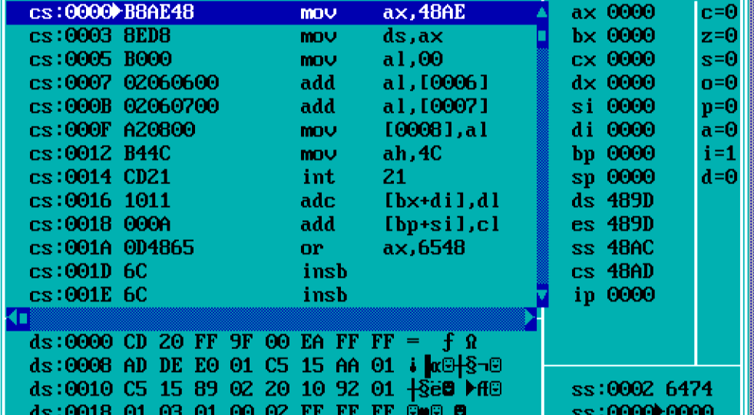
Sections in ALP program are:
To debug ALP program: To check logical errors.
TD FILENAME.EXE
flags
Code segment
registers
Data
segment
Stack segment

Slide 13
References:
Peter Abel, Niyaz Nizamuddin, "IBM PC Assembly Language and Programming", Pearson Education
Ray Duncan, "Advanced MS DOS Programming", 2nd edition, BPB Publications

Slide 14
E-mail – bhavanak@isquareit.edu.in
THANK YOU

