Slide 1
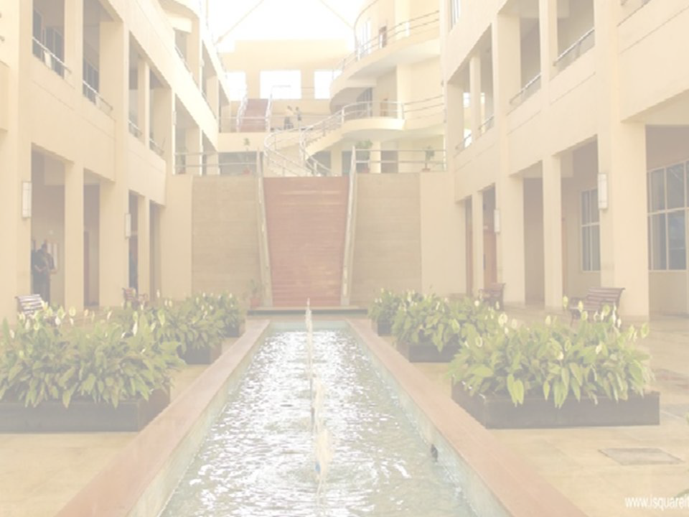
ML Model Evaluation for Binary Classification
Ajitkumar S. Shitole
Computer Engineering
International Institute of Information Technology, I²IT
www.isquareit.edu.in

Slide 2
Confusion Matrix
Total Testing Samples= 100
Total Positive samples= 70
Total Negative Samples= 30
 | Predicted Samples N P
N Actual Samples P | 25 (TN) | 05 (FP)
 | 10 (FN) | 60 (TP)
TP=True Positive, TN=True Negative, FP=False Positive, FN=False Negative

Slide 3
Confusion Matrix
Total Samples= 100, TN=25, TP=60, FP=05, FN=10
Accuracy= (TP+TN)/Total Samples = (60+25)/100=0.85
Balanced Dataset : Accuracy is a correct performance measurement technique.
Accuracy is the proportion of total samples that are correctly identified by the Machine Learning (ML) model.
Imbalanced Dataset: Accuracy mislead interpretation. Precision and Recall are preferred.
Precision= TP/(TP+FP)
Precision is the proportion of predicted positive samples that are correctly identified by the ML model.
Recall= TP/(TP+FN)
Recall is the proportion of actual positive samples that are correctly identified by the ML model.

Slide 4
Confusion Matrix
Total Samples= 100, TN=25, TP=60, FP=05, FN=10
Accuracy is also called as Recognition Rate.
Misclassification Error = 1 – Accuracy = 1 – 0.85= 0. 15
Precision = Positive Predictive Value (PPV) =TP/(TP+FP)=60/(60+05)=60/65 = 0.92
Recall = Sensitivity = True Positive Rate = TP/(TP+FN) = 60/(60+10) = 60/70 = 0.85
False Positives are also called as Type-I errors.
False Negatives are also called as Type-II errors.
Trade-off between Precision and Recall.
One may also prefer Receiver Operating Characteristic Curve (ROC) to measure the performance of the model for imbalanced datasets.

Slide 5
Ajitkumar Shitole
Department of Computer Engineering
International Institute of Information Technology
P-14, Rajiv Gandhi Infotech Park,
Hinjawadi Phase II
Pune – 411 057
www.isquareit.edu.in
info@isquareit.edu.in | admission@isquareit.edu.in
https://www.youtube.com/channel/UCtcG-111OkwGLKy8KUqJvxQ
https://twitter.com/isquareit_pune
https://www.facebook.com/I2ITPune
https://www.linkedin.com/company/i2it_2

