Slide 1
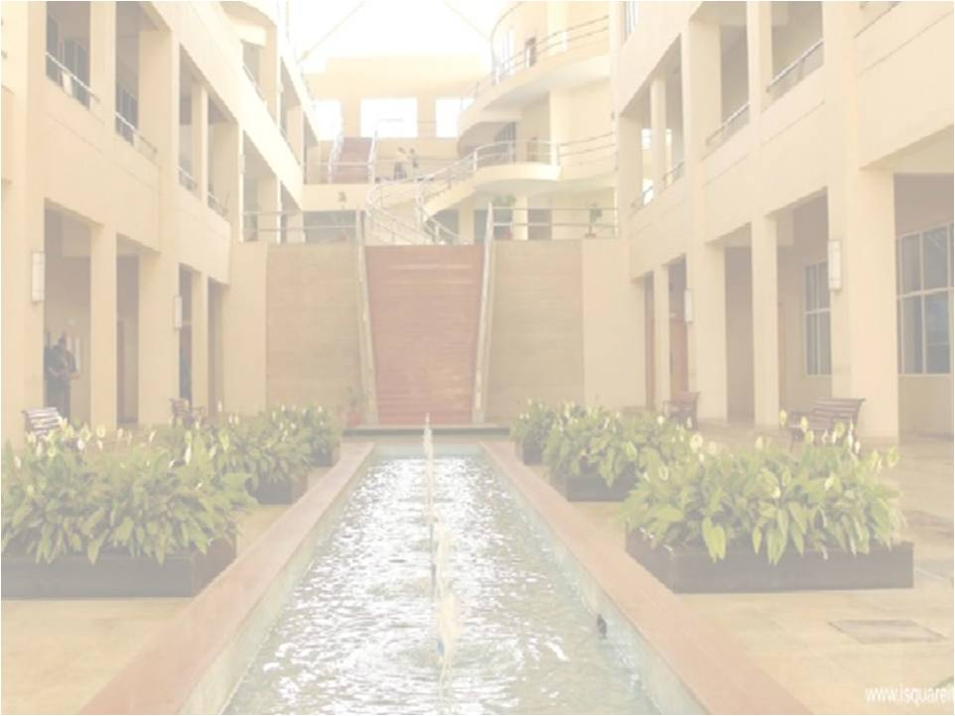
Fourier Series
Prof. Mandar Vijay Datar
Department of Engineering Sciences
International Institute of Information Technology, I²IT
www.isquareit.edu.in

Slide 2
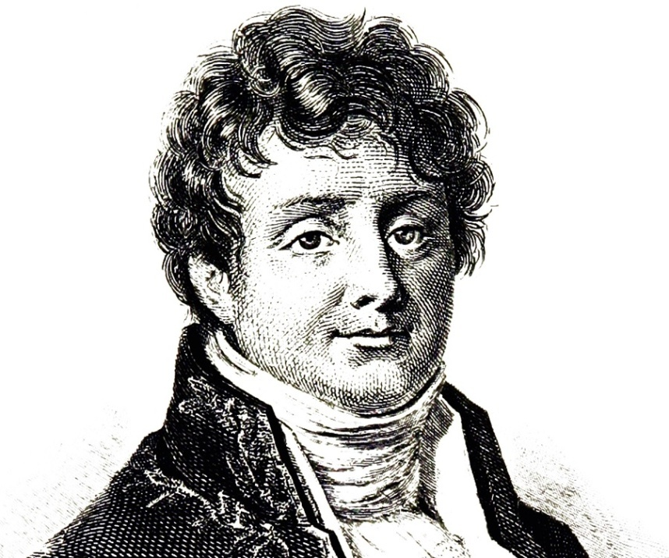
Fourier Series
Learning Objectives:-
LO1:- Periodic Functions and their expansion as Fourier Series
LO2:- Half range and Full range Fourier Series and their formulation
LO3:- Harmonic Analysis of Discrete functions
LO4:- Applications of Fourier Series
Joseph Fourier (1768-1830)

Slide 3
How it Starts
It starts with the attempt of solving Heat Conduction equation.
French mathematician Joseph Fourier (1768–1830) was trying to solve this problem
He needed to express a function as an infinite series of sine and cosine functions
Before Fourier, Bernoulli and Euler made similar attempts while solving problems of vibrating strings

Slide 4
Definition

Slide 5
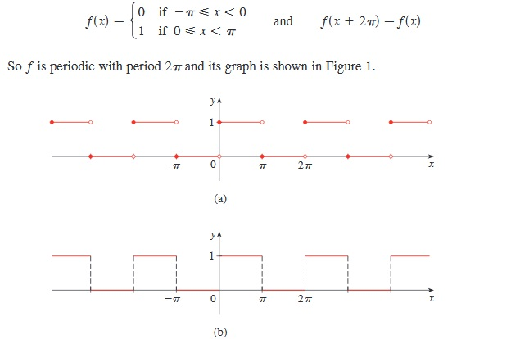
Example
Consider the following function

Slide 6
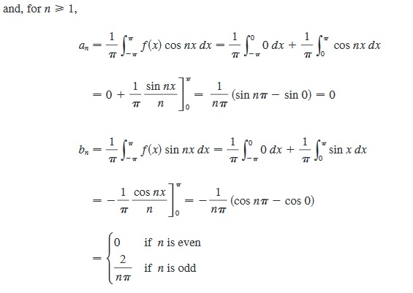
Example Continued....
We follow the steps as given in the definition of Fourier Series-

Slide 7
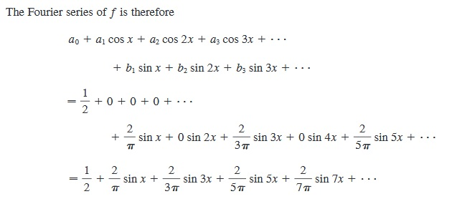
Example Continued....
Therefore the Fourier Series of given function is-

Slide 8
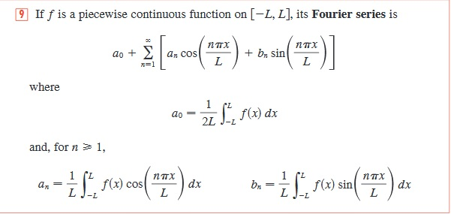
Fourier Series for Arbitrary Period

Slide 9
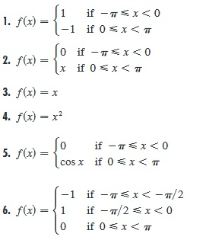
Excercise
You can Try following Problems and Find their Fourier series expansion

Slide 10
For More Details
Contact: -
Prof. Mandar Vijay Datar
mandard@isquareit.edu.in
Mob. No. 9422615876

