Slide 1
HCI- INPUT OUTPUT CHANNELS
Prof. Prajwali Korde
IT
International Institute of Information Technology, I²IT
www.isquareit.edu.in

Slide 2
Input Output Channels
Five Senses
Sight
Hearing
Touch
Taste
Smell
E.g:-personal computer (PC) with a mouse and a keyboard.

Slide 3
Vision
Two stages in vision
• Physical reception of stimulus
• Processing and interpretation of stimulus
what will and can't be perceived visually by a person's being, that successively directly affects the approach that we tend to design pc systems.

Slide 4
The Eye - physical reception
Mechanism for receiving light and transforming it into electrical energy
Light reflects from objects
The cornea and lens focus the light into a sharp image and creates that image on the back of the eye i.e. the retina.
The retina is very sensitive to light.
Retina contains two types of photoreceptor: 1. rods 2. cones.
Images are focused upside-down on retina
Retina contains rods for cones for colour vision and low light vision.

Slide 5
Rods
extremely sensitive to light
Allow to see under a low level of illumination.
The rods are active and are saturated by the impulsive light.
a hundred and twenty million rods per eye that are mainly located to the edges of the retina.
Cones
Less sensitive to light
There are three types of cone
Cones are sensitive to light having different wavelength.
around 6 million cones on concentrated on particular part of retina called as the fovea. fovea is a small area on which images are fixated.
Blind spot
Where the optic nerve enters the eye. The blind spot has no rods or cones.

Slide 6
Ganglion cells (brain!) –
X Cells – X cells are concentrated at fovea where it is responsible for the early detection of pattern.
Y-cells – These cells are distributed in the retina and responsible for the early detection of movement.

Slide 7
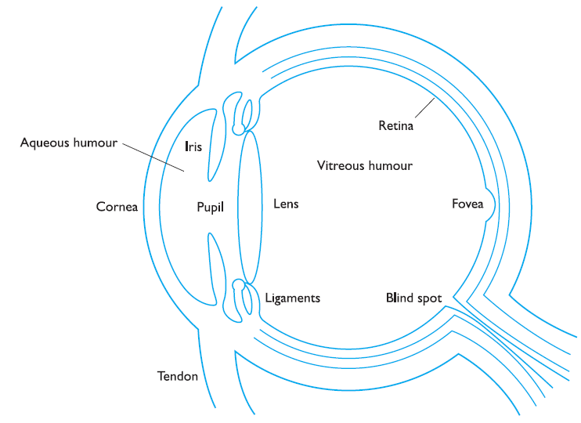

Slide 8
Interpreting the signal
Size and depth
Visual angle - It relates to distance and size from eye (indicates how much of view object occupies)
Visual acuity – It is a ability to perceive detail
If the objects are familiar object perceived as constant size , even change in visual angle doesn’t affect
Cues like overlapping help perception of depth and size

Slide 9
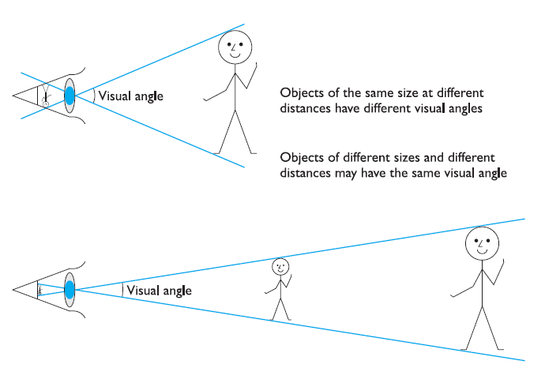
Visual Angle

Slide 10
Interpreting the signal (cont)
Brightness
Subjective reaction to levels of light
Affected by luminance of object
Measured by just noticeable difference
Visual acuity increases with luminance as does flicker
Color
Made up of hue, intensity, saturation
Hue is determined by the spectral wavelength of the light.
Intensity is the brightness of the color
Saturation is the amount of whiteness in the color.
Cones sensitive to color wavelengths(red, green blue)
Color vision is worst at the periphery where rods predominate and best in the fovea
Blue acuity is lowest
8% males and 1% females colour blind

Slide 11
Interpreting the signal (cont)
The visual system compensates for:
Movement
Changes in luminance.
Context is used to resolve ambiguity
Optical illusions sometimes occur due to over compensation

Slide 13
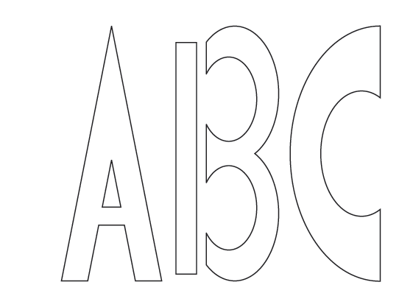

Slide 14
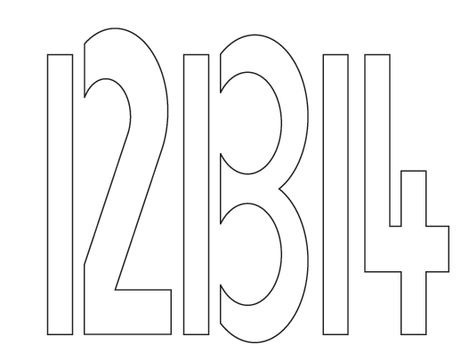

Slide 15
Optical Illusions
the Ponzo illusion
the Muller Lyer illusion

Slide 16
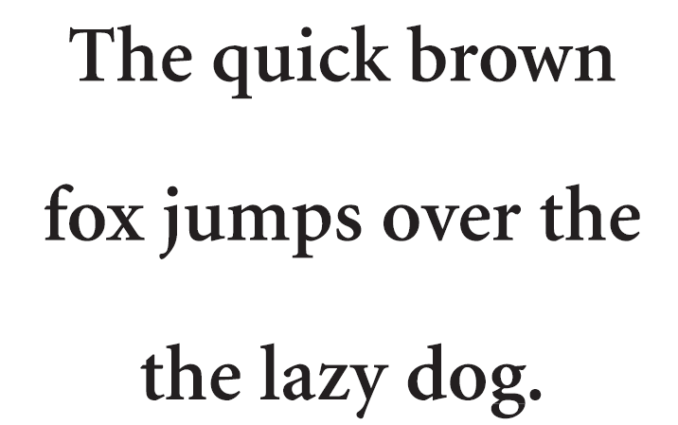

Slide 17
Thank You
Contact No: 8087348439
Email Id: prajwalik@isquareit.edu.in

