Slide 1
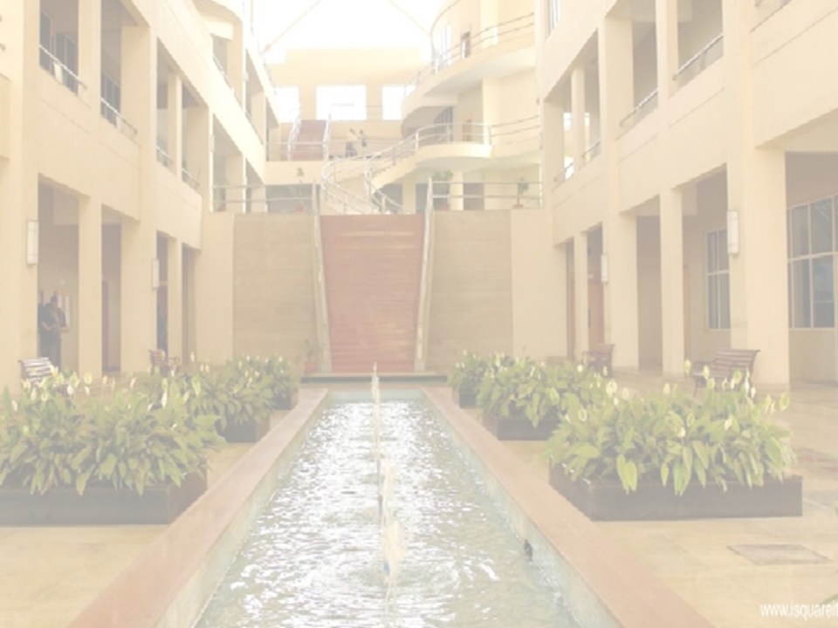

Delivery and Forwarding of
IP Packets
Prof Pranali V Deshmukh
Department
International Institute of Information Technology, I²IT
www.isquareit.edu.in

Slide 2

Delivery
The network layer supervises the handling of the packets by the underlying physical networks.
we tend to outline this handling because the delivery of a packet.
The delivery of a packet to its final destination is accomplished mistreatment 2 completely different strategies of delivery: direct and indirect

Slide 3
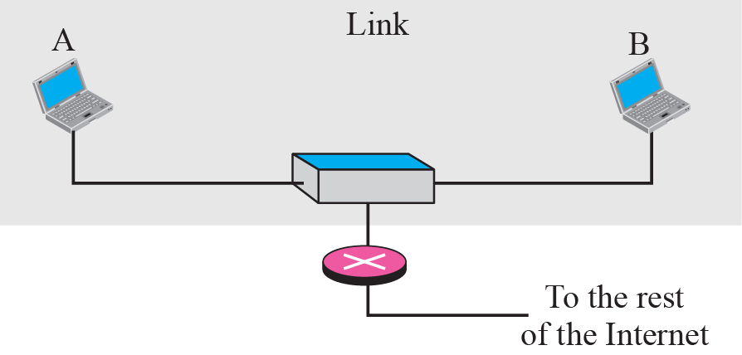
Direct Delivery

Slide 4
Indirect delivery

Slide 5
Forwarding
Forwarding suggests that to position the packet in its route to its destination.
The net nowadays is created of a mixture of links (networks), forwarding suggests that to deliver the packet to successive hop (which are often the ultimate destination or the intermediate connecting device).
Though the scientific discipline protocol was originally designed as a connectionless protocol, nowadays the tendency is to use scientific discipline as a connection-oriented protocol.

Slide 6
Topics Discussed
Forwarding Based on Destination Address
Forwarding Based on Label

Slide 7
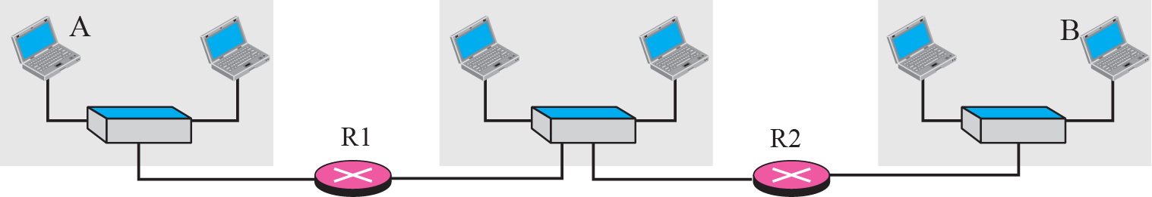
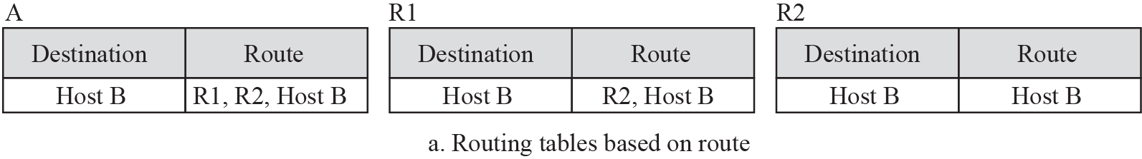
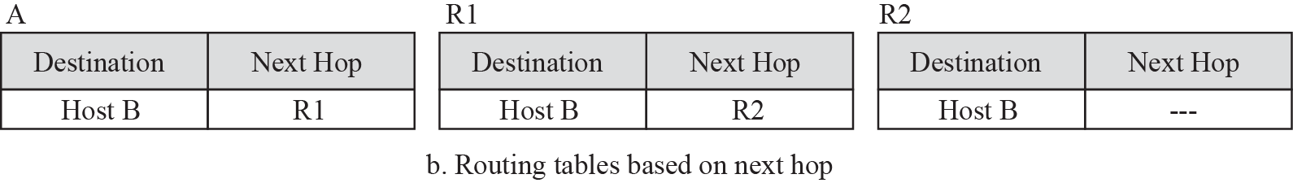
Next Hop Method

Slide 8
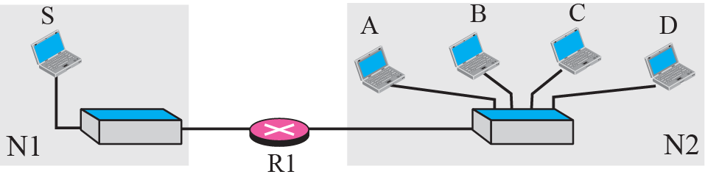
Network Specific

Slide 9
Host Specific Routing

Slide 10
Default Routing

Slide 11
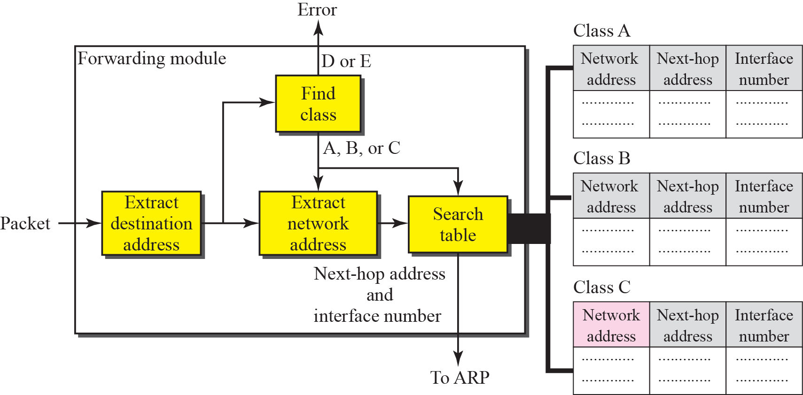
Forwarding in Classfull Addressing

Slide 12
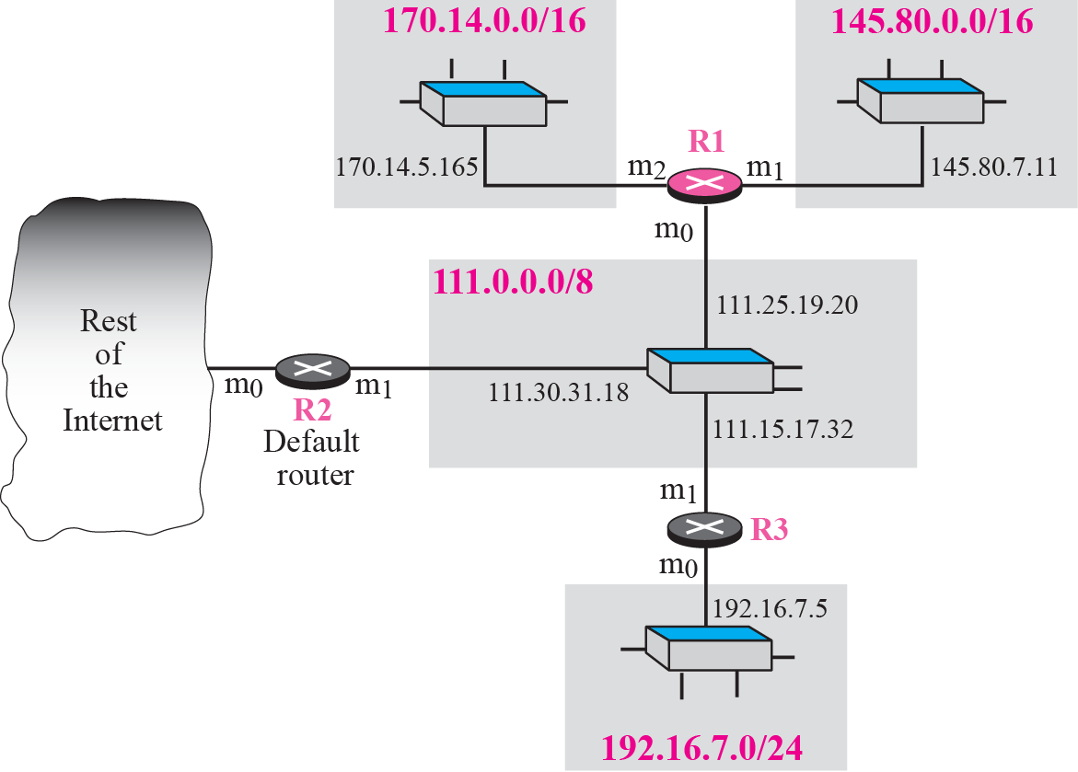
Routing Tables for R1 in Given example

Slide 13
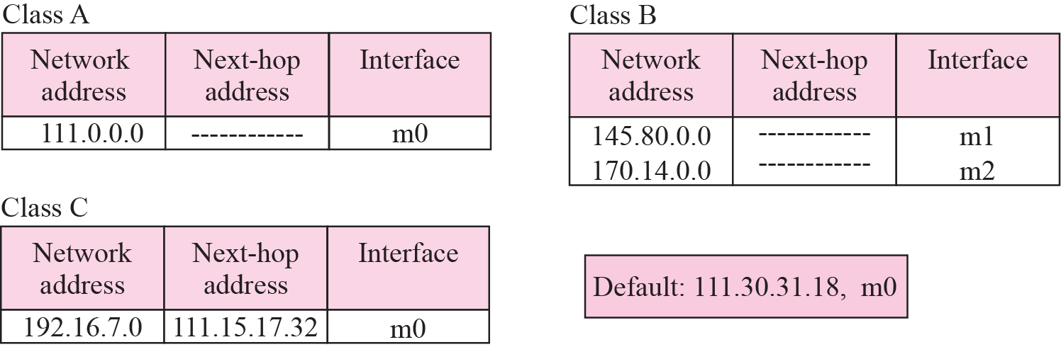

Slide 14
Router R1 receives a packet with destination address as 192.16.7.4,the packet will be forwarded as follows:
The destination address is
11000000 00010000 000001110 0001110.
A copy of the address is shifted 28 bits to the right. The result is
00000000 00000000 00000000 00001100 or 12.
The destination network is class C. The network address is extracted by masking off the leftmost 24 bits of the destination address; the result is 192.16.7.0. The table for Class C is searched. The network address is found in the first row. The next-hop address 111.15.17.32. and the interface m0 are passed to ARP

Slide 15
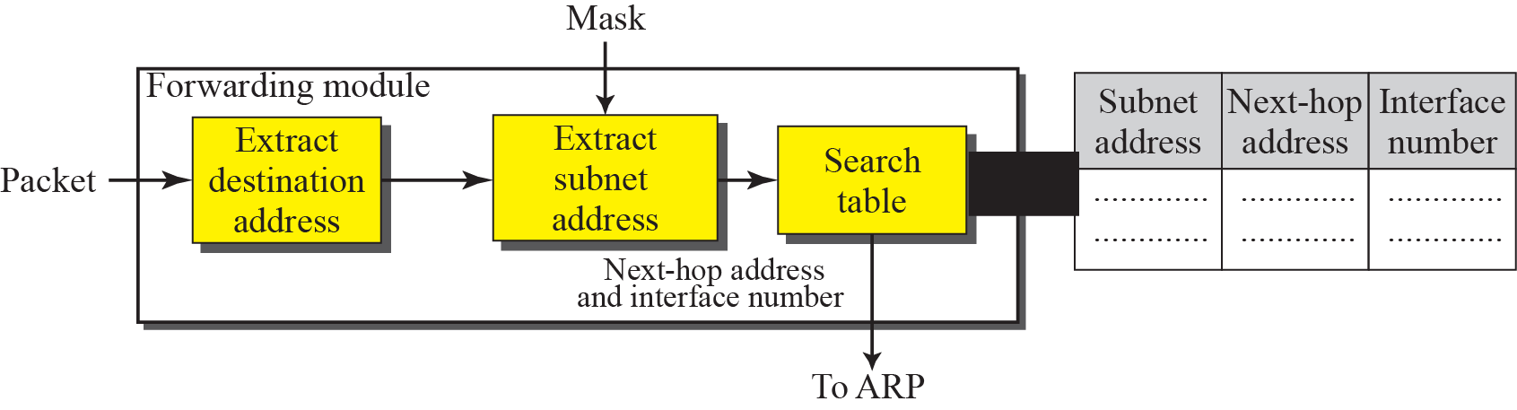
Forwarding in Classfull Addressing with Subnetting

Slide 16
Prof Pranali deshmukh
Asst. Prof (IT Dept)
8329553976
pranalid@isquareit.edu.in

