Slide 1
DATA STRUCTURE - LINKED LIST
Prof. Prashant J. Gadakh
Computer Engineering
International Institute of Information Technology, I²IT
www.isquareit.edu.in

Slide 2
Contents
Comparison of sequential and linked organizations
Primitive operations
Realization of Linked Lists
Realization of linked list using arrays
Dynamic Memory Management
Linked list using dynamic memory management
Linked List Abstract Data Type
Linked list operations
Head pointer and header node,

Slide 3
Array and Linked List
Both are linear data structure.
Linked lists and arrays are similar since they both store collections of data.
Arrays and linked lists are examples of linear lists.
Linear lists are those in which each member has a unique successor. Arrays contain consecutive memory locations whereas linked lists do not necessarily contain consecutive memory locations. These data items can be stored anywhere in the memory in a scattered manner.
Array is Sequential organization whereas linked lists is linked organization.

Slide 4
Array
An array is the data structure that contains a collection of similar type data elements and It is better and convenient way of storing the data of same data type with same size.
It allocates memory in contiguous memory locations for its elements.
Iterating the arrays using their index is faster compared to any other methods like linked list etc.
It allows to store the elements in any dimensional array - supports multidimensional array. Arrays can be used to implement matrices.

Slide 5
Sequential organization
The features of this organization are the following:
Successive elements of a list are stored a fixed distance apart.
It provides static allocation, which means, the space allocation done by a compiler once cannot be changed during execution, and the size has to be known in advance.
As individual objects are stored a fixed distance apart, we can access any element randomly.
Insertion and deletion of objects in between the list require a lot of data movement.
It is space inefficient for large objects with frequent insertions and deletions.

Slide 6
Linked organization
The features of this organization are the following:
Elements can be placed anywhere in the memory.
Dynamic allocation (size need not be known in advance), that is, space allocation as per need can be done during execution.
As objects are not placed in consecutive locations at a fixed distance apart, random access to elements is not possible.
Insertion and deletion of objects do not require any data shifting.
Linked organization needs the use of pointers and dynamic memory allocation.

Slide 7
Linked List
Advantages of Linked Lists
They are a dynamic in nature which allocates the memory when required.
Insertion and deletion operations can be easily implemented.
Stacks and queues can be easily executed.
Linked List reduces the access time.
Disadvantages of Linked Lists
The memory is wasted as pointers require extra memory for storage.
No element can be accessed randomly; it has to access each node sequentially.
Reverse Traversing is difficult in linked list.

Slide 8
Introduction of Linked List
A linked list is an ordered collection of data in which each element (node) contains a
minimum of two values, data and link(s).
In a linked list, before adding any element to the list, a memory space for that node must be allocated.
A link is made from each item to the next item in the list.
Each node of the linked list has at least the following two elements:
The data member(s) being stored in the list.
2. A pointer or link to the next element in the list.

Slide 9
Linked List Primitive Operations
Some more operations,
1. Searching a node
2. Updating a node
3. Printing the node or list
4. Counting the length of the list
5. Reversing the list
6. Sorting the list using pointer manipulation
7. Concatenating two lists
8. Merging two sorted lists into a third sorted list
Primitive operations
1. Creating an empty list
2. Inserting a node
3. Deleting a node
4. Traversing the list

Slide 10
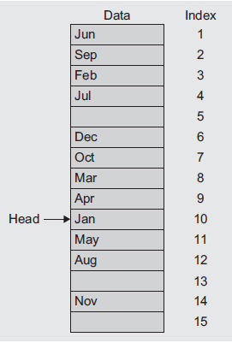
Realization of Linked List Using Arrays
We can list all the members in the sequence. The link value of the last element is set to -1 to represent the end of the list.

Slide 11
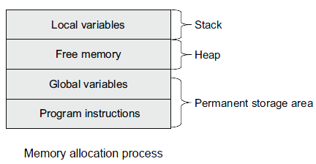
Dynamic Memory Management
The process of allocating memory at run-time is known as dynamic memory allocation.
The memory space allocated between stack and permanent storage area regions is available for dynamic allocation during the execution of the program. This free memory region is called the heap. The size of the heap keeps changing when a program is executed because of the creation and deletion of the variables that are local to the functions and blocks.

Slide 12
Dynamic Memory Management
Dynamic Memory Management in C++ with new and delete Operators. The heap is a pool of memory from which the new operator allocates memory. The memory allocated from the system heap using the new operator is de-allocated (released) using the delete operator.
New Operator
MyType *ptr;
ptr = new MyType;
These statements create a new dynamic object of the type MyType of the proper size and return a pointer of the type specified to the right of the operator new, that is, MyType *.
Syntax
Pointer_Type_Variable = new Data_Type;

Slide 13
Types of Linked List
There are different implementations of Linked List available, they are:
Singly Linked List
Doubly Linked List
Circular Linked List
Generalized Linked List

Slide 14
Single Linked List
The following terms are commonly used in discussions about linked lists:
Header node
Data Node
Tail Node
Fig. A linked list of days in a week

Slide 15
Single Linked List
head
next
next
next
next
a
b
c
d
1020 1080 020
1020
1080
2020
NULL
why we need to store the location of the next node?
Last node (Tail)
First node (Head)

Slide 16
What is Empty List?
Empty Linked list is a single pointer having the value of NULL.
head = NULL;
struct Node
{
int element;
Node *next;
};
class Node
{
public :
int data;
Node *link;
};

Slide 17
How to Create Node?
Following are the 3 steps to create the node.
1. Create node
temp= (struct Node*) malloc (sizeof (struct Node));
2. put the data temp->data = element;
3. Make next of temp node as NULL
Create the single node.
temp= (struct Node*) malloc (sizeof (struct Node));
temp->data = element;
temp->next = NULL;
P=temp;
Create more than one node.
for (i=2; i<=n; i++)
{
printf(“enter node no %d”, i);
scanf(“%d”, &element);
temp= (struct Node*) malloc (sizeof (struct Node));
temp->data = element;
temp->next = NULL;
P->next = temp;
P=P->next;
}

Slide 18
Thank You

