Slide 1
DATABASE QUERY OPTIMIZATION
Ramkrushna M.
Department of Computer Engineering
International Institute of Information Technology, I²IT
www.isquareit.edu.in

Slide 2
PROBLEM STATEMENT
Create a long running database system for processing of queries in parallel.
2. INTRODUCTION
Database
A database is simply an organized collection of related data, typically stored on disk, and accessible by possibly many concurrent users. Databases are generally separated into application areas. For example, one database may contain Human Resource (employee and payroll) data; another may contain sales data; another may contain accounting data; and so on. Databases are managed by a DBMS.

Slide 3
B. Database Management System DBMS –
A Database Management System (DBMS) is a set of programs that manages any number of databases.
A DBMS is responsible for:
accessing data, inserting, updating, and deleting data, Security, integrity, locking, logging, application-defined rules, including triggers, supporting batch and on-line programs facilitating backups and recoveries optimizing performance maximizing availability maintaining the catalog and directory of database objects managing the buffer pools acting as an interface to other systems programs supporting user interface packages, such as the popular SQL interface for relational database systems. There are 3 traditional types of database management systems: hierarchical, relational, and network.

Slide 4
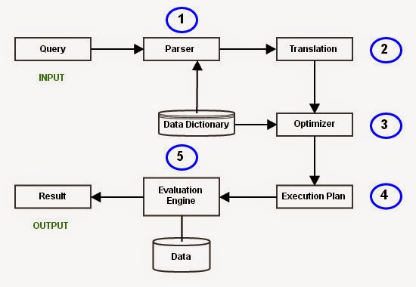
C. Query Processing in Database Systems
It is the step by step process of breaking the high level language into low level language which machine can understand and perform the requested action for user. Query processor in the DBMS performs this task.

Slide 5
D. Query Optimization
Query optimization is a function of many relational database management systems. The query optimizer attempts to determine the most efficient way to execute a given query by considering the possible query plans.
Generally, the query optimizer cannot be accessed directly by users: once queries are submitted to the database server, and parsed by the parser, they are then passed to the query optimizer where optimization occurs. However, some database engines allow guiding the query optimizer with hints.

Slide 6
E. Long running Transactions
Long-running transactions are computer database transactions that avoid locks on non-local resources, use compensation to handle failures, potentially aggregate smaller ACID transactions (also referred to as atomic transactions), and typically use a coordinator to complete or abort the transaction. In contrast to rollback in ACID transactions, compensation restores the original state, or an equivalent, and is business-specific. For example, the compensating action for making a hotel reservation is canceling that reservation, possibly with a penalty.
A number of protocols have been specified for long-running transactions using Web services within business processes. OASIS Business Transaction Processing and WS-CAF are examples. These protocols use a coordinator to mediate the successful completion or use of compensation in a long-running transaction.

Slide 7
F. Query Processing in Parallel
Parallel Query processing in databases systems means that the job of producing the results of the query gets divided between many processes which execute in parallel, thus leading to improvements in performance. The underlying concept for achieving parallelism in data processing is partitioning the dataset and processing each partition in parallel such that results produced from each partition are (usually) independent of one another and can be simply merged and presented to the user.
Typically a SQL query gets broken down into a set of sequential operations. Some or all of such steps can be executed in parallel. A typical database system figures out which operations can be parallelized and how to parallelize them. Each operation can be parallelized in various ways and appropriate method is chosen depending on your system configuration and size of data etc.
Each database system has a different architecture and thus you will find as many ways of achieving parallel query execution as the number of architectures but data partitioning and redistribution is central is all such systems.

Slide 8
3. REQUIREMENTS
A.SOFTWARE REQUIREMENTS
Windows/Linux Operating System
Spyder Python IDE
B.LIBRARIES/PACKAGES USED
Threading
Time

Slide 9
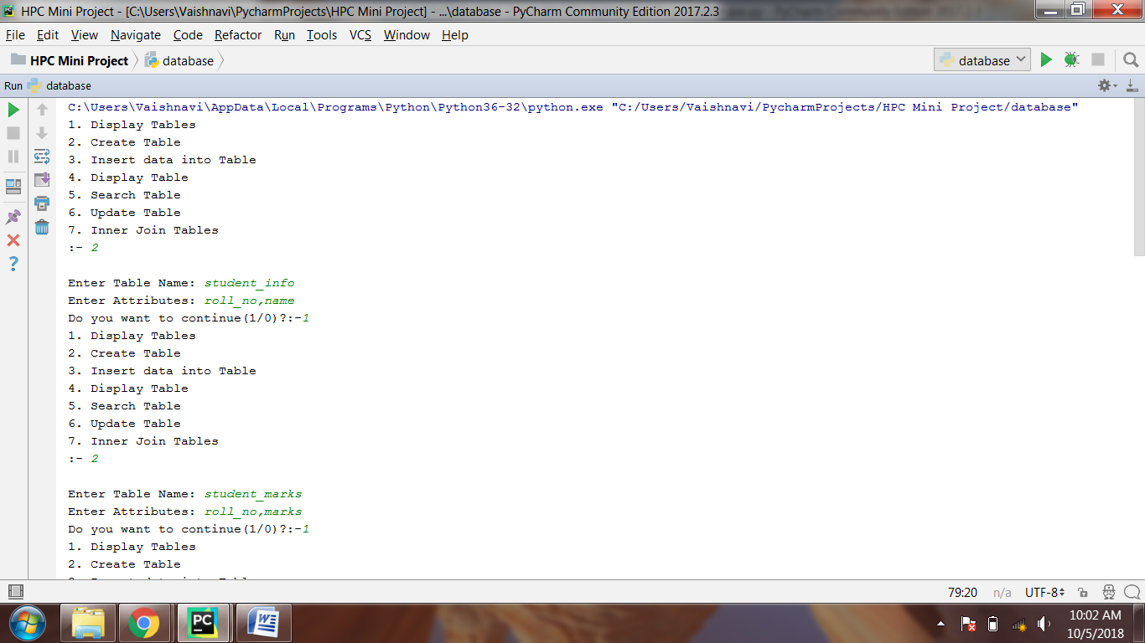
4. RESULTS

Slide 10
4. RESULTS

Slide 11
4. RESULTS

Slide 12
4. RESULTS

Slide 13
5.CONCLUSION
Thus, created a long running database system that processes the queries in parallel.

