Slide 1
Wireless Sensor Networks
Prof. Ravindra Joshi
Department of Engineering Sciences
International Institute of Information Technology, I²IT
www.isquareit.edu.in

Slide 2
Agenda
Introduction to Wireless Sensor Networks (WSN)
Wireless Sensor Networks and Mobile Ad-hoc
Networks (MANETs)
Current Research in Wireless Sensor Networks
Key Challenges

Slide 3
Wireless sensor networks
Wireless sensor network is a distributed system
consisting of a large number of low-cost wireless
sensor nodes equipped with a small processor with
limited memory, RF trans-receiver, antenna, sensing
elements and are powered with small batteries and
solar cells.
It’s a heterogeneous system, consisting of various types
of sensor nodes, actuators and operating systems.
Sensor nodes operate under constraints of memory,
size, computational power, overall cost and limited
energy sources such as batteries / solar cells.

Slide 4
Wireless sensor networks
Sink nodes
Sink nodes
Sensor fields
Sensor nodes
Main components are,
Sensor nodes
Sink nodes or base nodes
Access points connecting WSN to the wired network

Slide 5
Components of Wireless sensor networks
Sensor node is a basic component in any wireless
sensor network.
It consists of sensing, computing and communication
capabilities and also has an “on-board” power source.
After the field deployment, sensor nodes communicate with
each other with a multi-hop approach and collect information
using either continuous or event driven modes.
Location and positioning information is also exchanged with GPS
or Local positioning algorithms.
Global view of the phenomena or object is constructed after
processing the information collected from sensor nodes
Once the battery get exhausted, sensor node can’t be used any
further.

Slide 6
Components of Wireless sensor networks
Sink node (or base node) is another important
component in any wireless sensor network.
They have enhanced capabilities such as more computational
power, memory, energy, storage and communication capabilities
All sensor nodes within a sensor field communicate with this
base node periodically and to exchange the field information
The processing capability of the individual node is limited but
the aggregate processing power of the entire network is sizable.
Sink nodes are connected to wired network through access points
and act as interface between users and the sensor network.
Users can inject queries and gather information of their interest
from the base nodes.

Slide 7
Communication between sensor nodes
Help Messages
Neighbor Announcements
Messages
Data Message
Data Message
Source
Sink
Source
Sink
Source
Sink
Passive Neighbor
Active Neighbor
(a) Communication Hole
(b) Self-configuration transition
(c) Final State
The nodes can be in active or passive state:
Active nodes forward data packets (using a routing mechanism
that runs on the topology).
Passive nodes do not forward packets but might sleep or collect network measurements.
10 to 1000 nodes, 5 m to 50 m spacing between the nodes

Slide 8
Applications of wireless sensor networks
Wireless Sensor Networks find numerous applications
in various areas as mentioned below,
Environment monitoring and protection:
Monitoring of seismic activities/ data collection
Warning of earthquakes and floods
Weather monitoring and forecasting
Agricultural applications:
Monitoring of soil humidity and temperature
Detection of toxic levels in soil and water contamination
Leakage in pipelines, risk of explosions for gas/oil pipelines
Water pressure monitoring in dams and reservoirs
Understanding of soil structure

Slide 9
Applications of wireless sensor networks
Protection of buildings:
Fire alarms
Burglar alarms/ Intruder detection
Structural condition assessment of buildings, bridges
Military applications:
Soldier tracking
Battlefield tanks / vehicles tracking
Invading remote and inaccessible areas
Industrial applications:
Inventory control
Process automation

Slide 10
Applications of wireless sensor networks
Automotive Engineering:
Monitoring of engine parameters
Noise and pollution measurements
Structural condition assessment of vehicles
Medical applications:
Biomedical applications/ measurements
Monitoring of human body with embedded sensors
Space applications:
Automatic positioning
Sensing of humidity, gravitational force
Marine Engineering:
Study of marine life and water contamination

Slide 11
Information Processing in Wireless sensor networks
Collaborative Event Processing
Monitoring
Querying, Triggering
Data-centric Routing
Aggregation and Compression
Data-centric Storage
Collaborative Signal Processing
Security
Localization
Time Synchronization
Medium Access
Calibration
Operating Systems
Processor Platforms
Radios
Sensors

Slide 12
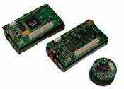
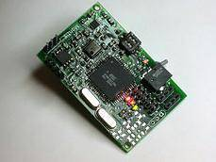
Hardware: Platforms, Radios & sensors
Processors
Atmel
StrongARM
X-Scale
Radios
Chipcon CC1000
Bluetooth
Zigbee
Sensors
Platforms
Mica-2
Stargate
iMote

Slide 13
Processor comparison
 | Atmel ATMEGA128(L) | Strong ARM SA1100 | Intel XScale
Type | Micro Controller | Microprocessor | Microprocessor
Architecture | Harvard, 8-bit RISC | Harvard 32-bit RISC | Harvard 32-bit RISC
Speed | 8MHz/16MHz | 206MHz | 200/300/400 MHz
Cache/ Memory | 128KB programming memory 4KB data memory | 16KB instruction cache 8KB data cache | 32KB instruction cache 32KB data cache
Power Draw | run mode: 16.5mW sleep mode: < 60µW | run mode: 800 mW idle mode: 210 mW sleep mode: 50µW | run mode: 400 mW idle mode: 160mW sleep mode: 50µW
Example Platforms | Mica2 mote | Compaq iPAQ3700 | Compaq iPAQ3900

Slide 14
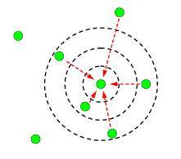
Radios
Low power, short range
Relevant criteria
Frequency
Modulation scheme
Encoding scheme
Data rates
Frequency diversity
Power considerations
Receive power
Transmit power
For short range communication, the two are comparable

Slide 15
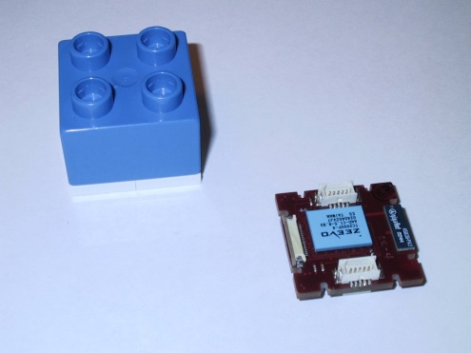
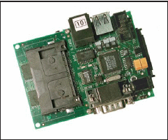
Sensors
Small (coin, matchbox size) nodes with
Processor
8-bit processors to x86 class processors
Memory
Kbytes – Mbytes range
Radio
20-100 Kbps
Battery powered
Built-in sensors

Slide 16
Operating systems
Depending the platform, various choices are available
Tiny OS
Embedded Linux
μ-OS
Tiny OS is most suitable
Developed by University of California, Berkley
Event driven execution, No polling, No blocking
Concurrency intensive operation, multi-threads based
Light weight
Easy to integrate with hardware

Slide 17
Hardware platforms using Tiny OS
 | Crossbow mica | Crossbow mica 2 | Intel Mote
CPU | ATmega128L | ATmega128L(4MHz) | ARM core(12MHz)
Program memory | 128k Flash memory | 128k Flash memory | 512k Flash memory
Data Memory | 4K SRAM | 4K SRAM | 64K SRAM
Radio | RFM TR1000 | ChipCon CC1000 | Bluetooth
Data rate | 40 Kbps | 76.8 K Baud | 1 Mbps
Frequency | 916.50 MHz | 315/433/868/915MHz | 2.4 GHz

Slide 18
Wireless sensor networks & MANETS
A mobile ad-hoc network (MANET) is a self-configuring
network of mobile routers and associated hosts connected
by wireless links.
The mobile routers are free to move randomly and organize
themselves arbitrarily, hence the network topology may
change rapidly and unpredictably.
This network may operate in stand alone manner or can
be connected to the Internet.
It has less number of nodes compared to the wireless
sensor network. E.g. communication between vehicles
and roadside equipment (VANETS)

Slide 19
Comparison of WSN & MANET
WSN
More nodes are deployed (from
10 to 1000)
- Nodes have less processing power
Nodes are miniature, low cost and
can not be easily replaced once
battery runs out, as they are
distributed over larger distances
Nodes do not require human
interaction and can remain
unattended for a longer time
- Redundant information is collected
from neighboring nodes by the sink
MANET
Less number of nodes are
deployed (from 10 to 100)
Nodes have more processing
power and have less constraints
of memory, energy resources
etc.
Nodes can be expensive
and can be replaced, if required
Nodes are spread over less distances
Redundant information is not
collected by neighboring nodes

Slide 20
Current research in wireless sensor networks
Optimization of network lifetime:
Requires less transmission power to be used
Trade-off between network lifetime and reliability
Minimize the battery consumption:
Reduce the communication related and processing power
Use of sleep/ inactive modes
Routing algorithms:
Transmission power is closely related to the route selection
Algorithms for access control:
They should consume minimum power

Slide 21
Key technical challenges faced
Scalability of network protocols:
Since the number of nodes are large
Designing simple, fast, efficient routing algorithms:
Objective is to reduce the communication related power
Optimum route selection between the available routes
Fast convergence
Less overheads
Distributed signal processing:
Mobility and security issues of the sensor nodes:

Slide 22
Key technical challenges faced
Designing simple algorithms for localization and discovery
of nodes, time synchronization.
Media Access Control (MAC) layer issues:
Collision avoidance
Topology control for higher energy efficiency
Trade-off between energy efficiency and latency, errors
Bandwidth utilization
Scalability in node density
Reduce idle listening, collisions, control overheads, overhearing
Improve physical/ radio layer performance

Slide 23
Key technical challenges faced
Fast information retrieval:
Topology adaptation and control:
Topology adaptation for higher node density, Environmental
changes, Redundant deployments
Topology control schemes such as sharing workload within
cluster, removal of redundant links, data driven schemes

Slide 24
For further queries,
Kindly contact:
Prof. Ravindra Joshi
Associate Professor, Dept. of Engg. Sciences
International Institute of Information Technology (I²IT)
Email: ravindraj@isquareit.edu.in
Cell: 9822021594

