Slide 1
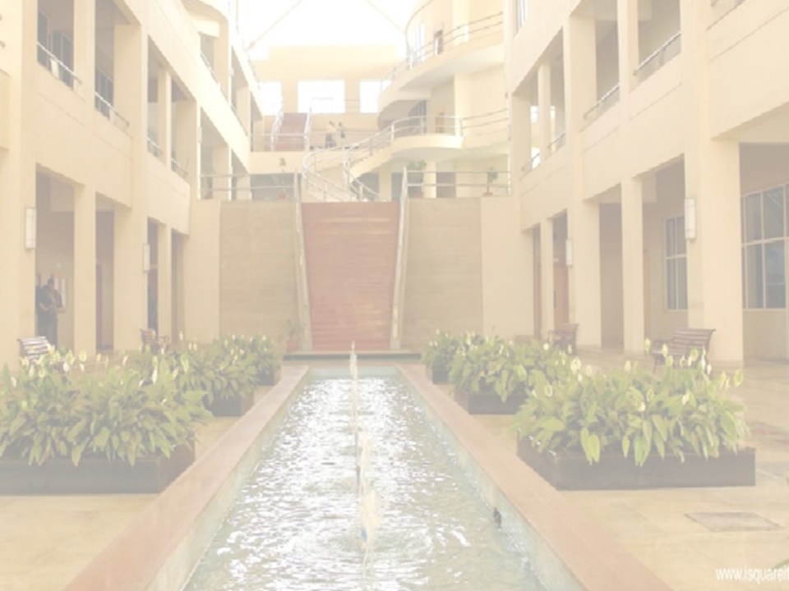

Factor Analysis
Prof. (Dr.) Risil Chhatrala
Department of Electronics and Telecommunication
International Institute of Information Technology, I²IT
www.isquareit.edu.in

Slide 2
Factor Analysis
Factor analysis is commonly used in:
  Data reduction
  Scale development
  The evaluation of the psychometric quality of a measure, and
  The assessment of the dimensionality of a set of variables.

Slide 3
Constructs : unobservable latent variables
Teaching Effectiveness.
Motivation
Love
Hate
care
Altruism
Anxiety
Worry
Stress
product quality
Physical aptitude
democracy
reliability/power.

Slide 4
construct may include several dimensions…
Factor analysis measures not directly observable constructs by measuring several of its underlying dimensions.
The identification of such underlying dimensions (factors) simplifies the understanding and description of complex constructs.

Slide 5
Factor Analysis: The Measurement Model
D₁
D₂
D₃
D₄
D₅
D₇
D₆
D₈
F₁
F₂
Notes:
D observable, F latent
\mathbf{D}_i = \boldsymbol{\Lambda}\mathbf{F}_i+\mathbf{e}_i % 42

Slide 6
Factor Analysis
Find a small number of factors z, which when combined generate x :
x_{i} – µ_{i} = v_{i1}z₁ + v_{i2}z₂ + ... + v_{ik}z_{k} + ε_{i}
where z_{j}, j =1,...,k are the latent factors with
E[ z_{j} ]=0, Var(z_{j})=1, Cov(z_{i ,}, z_{j})=0, i ≠ j ,
ε_{i} are the noise sources
E[ ε_{i} ]= ψ_{i}, Cov(ε_{i} , ε_{j}) =0, i ≠ j, Cov(ε_{i} , z_{j}) =0 ,
and v_{ij} are the factor loadings

Slide 7
Thank you!!

Slide 8
Prof. (Dr.) Risil Chhatrala
Associate Professor in
Department of Electronics and Telecommunication
International Institute of Information Technology (I²IT), Pune
risilc@isquareit.edu.in

