Slide 1
Client Side Validation using Java Script
Dr. Sashikala Mishra
Computer Engineering
International Institute of Information Technology, I²IT
www.isquareit.edu.in

Slide 2
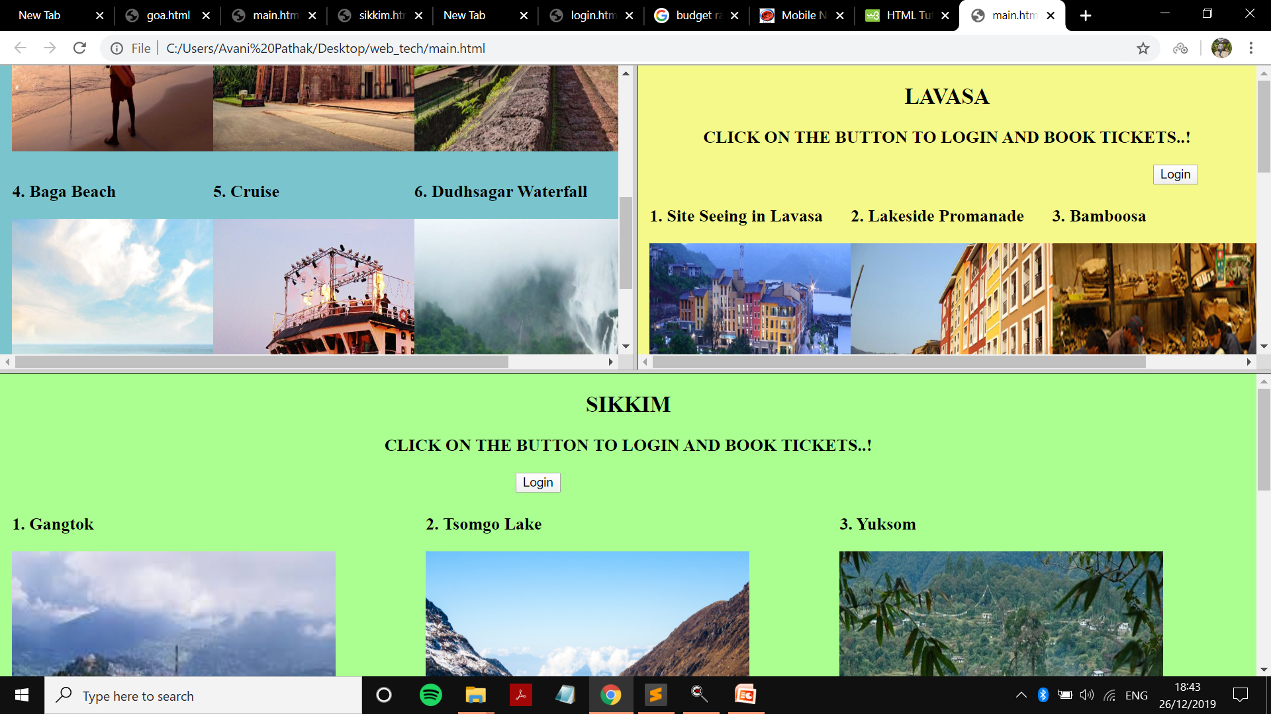
Create the webpage using Frame tag in HTML

Slide 3
Source Code for the Web Page Using Frame Tag The targeted html pages uploaded on the screen
<html>
<head>
<div><frameset rows="50%,50%"> (Total Screen divided in to two pages row wise)
<frameset cols="50%,*">
<frame name="f1" src="goa.html" scrolling="yes" noresize="noresize">
<frame name="f2" src="lavasa.html" scrolling="yes" noresize="noresize">
</frameset>
<frame name="f3" src="sikkim.html" scrolling="yes" noresize="noresize">
</frameset></frame></div>
</head>
</html>

Slide 4
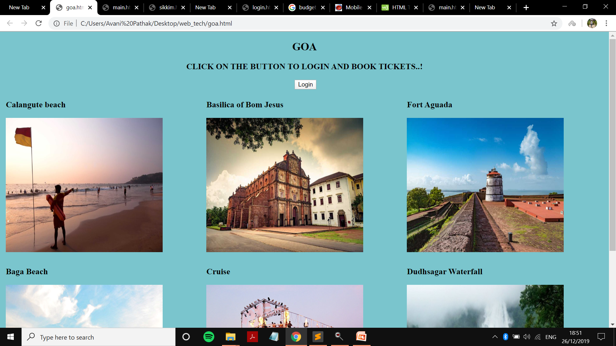
The main page included a basic html website using frames. Three frames were created of 3 places named Goa, Lavasa and Sikkim. All the three frames have 3 different websites separately operating.
A separate frame would look like this..

Slide 5
Onmouseout Onmouseover Event Handling in JS
On mouse over the image is expands. This code is written in Javascript within html
<html>
<img src="img/tsomgo.jpg" onmouseover="big(this)“ onmouseout="normal(this)" height="300" width="350"><script type="text/javascript">
function big(x){
x.style.height="500px";
x.style.width="550px";
}
function normal(x){
x.style.height="300px";
x.style.width="350px";
}
</script>

Slide 6
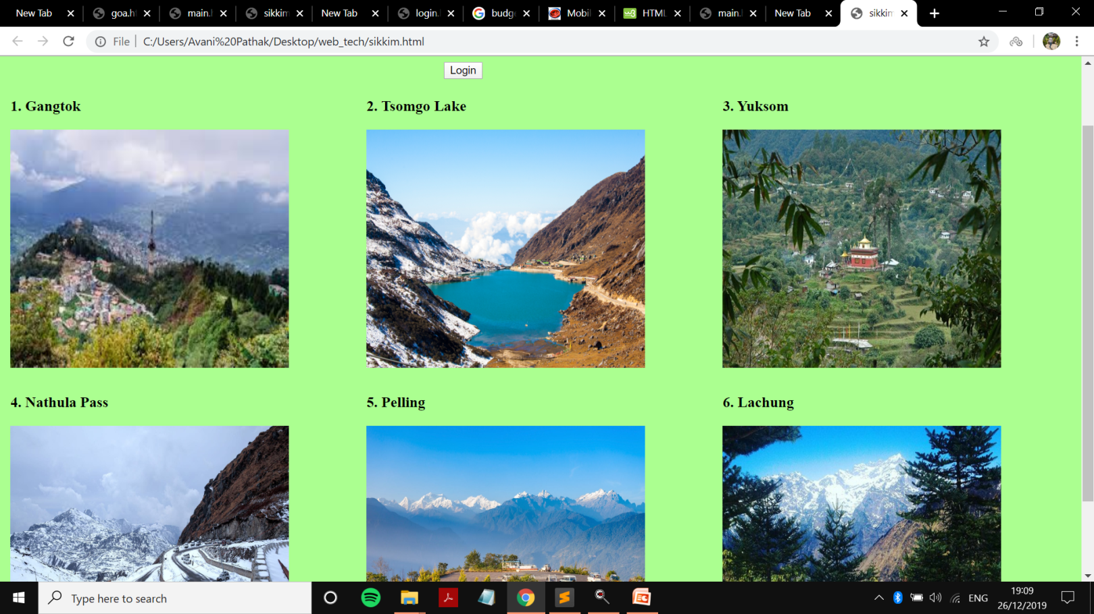
Event Handling

Slide 7
Validation
The login page is created using HTML, CSS and Javascript. Form tag is used to create the login page. Client-side validations are done using Javascript such as the Name is required if blank the alert message will be generated on clicking the submit button.
Here we are focusing on Client side validation only

Slide 8
The following form to be designed

Slide 9
The code to design the Form and to validate using javascript is as follows
<html>
<head>
<script>
function validateForm() {
var name = document.login.uname.value;
if (name == "") {
alert("Name must be filled out");
return false;
}
}
</script></head>
<body style=" background-image:url('img/bg1.jpg')">
<h2 align="center"> LOGIN </h2>
<form align="center" action="a.html" , method= "post" , name="login">
Username: <input type="text" placeholder="Username" name="uname"><br><br>

Slide 10
Validation
Email ID: <input type="text" placeholder="eg; abc@gmail.com"name="email"><br><br>
Phone No.: <input type="text" placeholder="10 digits" name="contact"><br><br>
Address: <input type="text" placeholder="Address"name="lname"><br><br>
No of travellers: <select name="no">
<option value="1">1</option>
<option value="2">2</option>
<option value="3">3</option>
<option value="4">4</option>
<option value="5">4+</option>
</select><br>
<b>Transport facility required or not: </b> <br>
Yes<input type="radio" name="trans"><br><br>
No<input type="radio" name="trans"> <br><br>
<input type="button" onclick="validateForm()" name="Submit" value="Submit"> &nbsp; &nbsp;
<input type="button" name="Clear" value="Clear"><br>

Slide 11
Web page if no mail-id provided with alert box

Slide 12
Thank You
Dr. Sashikala Mishra
HoD, Computer Engineering
I²IT
sashikalam@isquareit.edu.in

