Slide 1
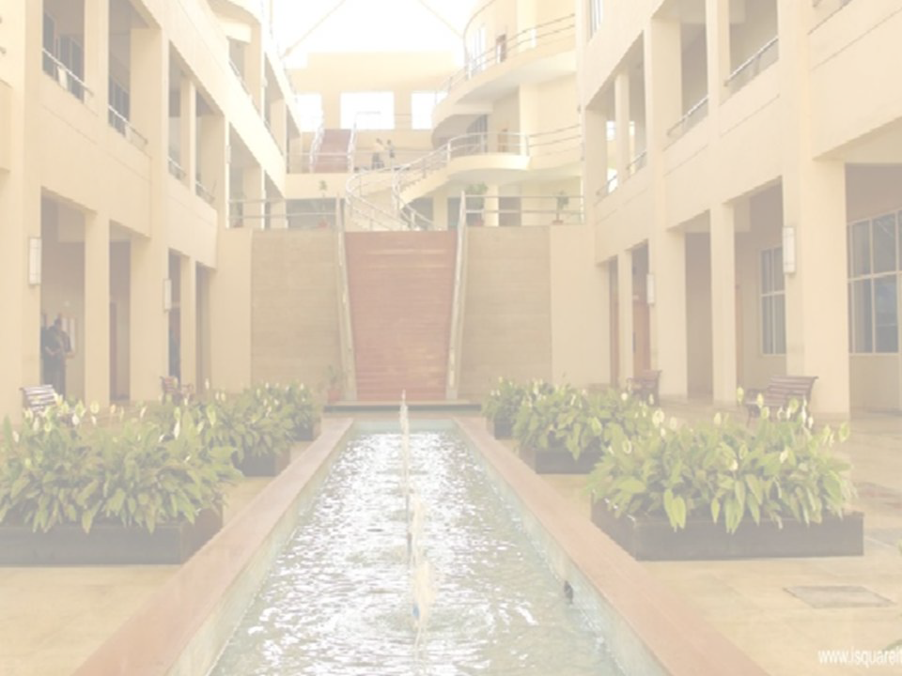
Basics of Computer Graphics
Prof. Vishal R. Chaudhary
International Institute of Information Technology, I²IT
www.isquareit.edu.in

Slide 2
Outline
What is Computer Graphics?
Advantages of Computer Graphics.
Application of Computer Graphics.
Basics of Computer Graphics.
Various display devices.

Slide 3
What is Computer Graphics?
Computer graphics is an art of drawing lines, charts, pictures, etc. using computers with the help of programming and tools.
Computer graphics image is made up of number of pixels.
Picture Element (Pixel) is the smallest addressable graphical unit represented on the computer screen.

Slide 4
Advantages of Computer Graphics
Most effective and commonly used ways of communication with computer.
It provides tools for producing
picture of “real-world” ,
synthetic objects such as mathematical surfaces in 4D and
data that have no inherent geometry such as survey result

Slide 5
Contd.
Possible to produce animations.
Can move objects as well as observes as per requirement
example walk through made by builder to show flat interior and surrounding.

Slide 6
Application of Computer Graphics
User interface
Example: App icon
Simulation and animation
Example: Cartoon films
Plotting of graphs and charts
Example: Stock exchange
Computer aided drafting and design
Example: Automobile parts designing

Slide 7
Contd.
Art and commerce
Example: Creative pictures
Cartography
Example: Geographic maps
Education and training
Example: Models of physics
Image processing
Example: Editing Photos

Slide 8
Basics of Computer Graphics
In computer graphics picture or graphics objects are presented as a collection of discrete pixels.
We can control intensity and color of pixel which decide how picture look like.
The special procedure determines which pixel will provide the best approximation to the desired picture or graphics object, this process is known as Rasterization.

Slide 9
Contd.
The process of representing continuous picture or graphics object as a collection of discrete pixels is called Scan Conversion.

Slide 10
Display Devices
Display devices are also known as output devices.
Following devices we are going to study:
Cathode ray tube (CRT)
Direct-view storage tubes (DVST)
Plasma Panels displays
Thin Film Electroluminescent Displays
Light Emitting Diode (LED)
Liquid Crystal Display (LCD)

Slide 11
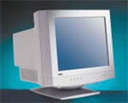
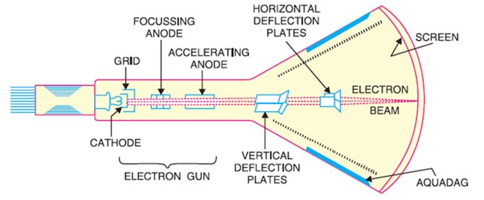
1. Cathode-Ray-Tubes

Slide 12
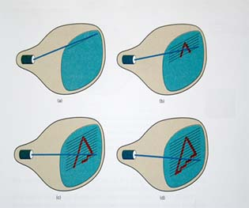
Contd.
There are two techniques used for producing images on the CRT screen:
Vector scan/Random scan display.
Raster scan display.
Vertical Retrace
Horizontal Retrace
OFF
ON

Slide 13
Architecture of a Vector Display
CPU
I/O Port
Display buffer memory
(Interaction data)
(Display command)
CRT
Display controller
Keyboard
Mouse

Slide 14
Architecture of a Raster Display
CPU
I/O Port
(Interaction data)
(Display command)
Keyboard
Display controller
Mouse
00000000000000000000001111100000000000000010000000000000000100000000000000001000000000
CRT
T
Video controller
Refresh buffer

Slide 15
Random Scan v/s Raster Scan
Base of Difference | Raster Scan System | Random Scan System
Electron Beam | The electron beam is swept across the screen, one row at a time, from top to bottom. | The electron beam is directed only to the parts of screen where a picture is to be drawn.
Resolution | Its resolution is poor. | Its resolution is good.
Picture Definition | Picture definition is stored as a set of intensity values for all screen points, called pixels in a refresh buffer area. | Picture definition is stored as a set of line drawing instructions in a display file.

Slide 16
Random Scan v/s Raster Scan
Base of Difference | Raster Scan System | Random Scan System
Realistic Display | The capability of this system to store intensity values for pixel makes it well suited for the realistic display of scenes contain shadow and color pattern. | These systems are designed for line-drawing and can’t display realistic shaded scenes.

Slide 17
Color CRT Monitors
There are two basic techniques for color display:
Beam-penetration technique
Shadow-mask technique

Slide 18
Beam-Penetration Technique
In this technique screen is coated with two colours. Outer layer with green and inner layer with red.
Slow speed electron beam strike on red layer and produce red colour.
Intermediate speed electron beam strike on red and green layer and produce two colour orange and yellow.
High speed electron beam penetrate red and strike on yellow layer and produce yellow colour.

Slide 19
Contd.
Slow Speed Electron Beam
Intermediate Speed Electron Beam
High Speed Electron Beam

Slide 20
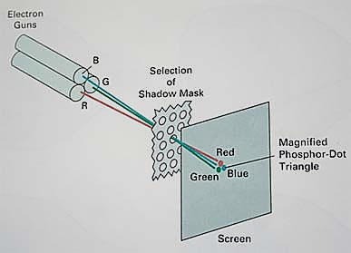
Shadow-Mask Technique

