Slide 1
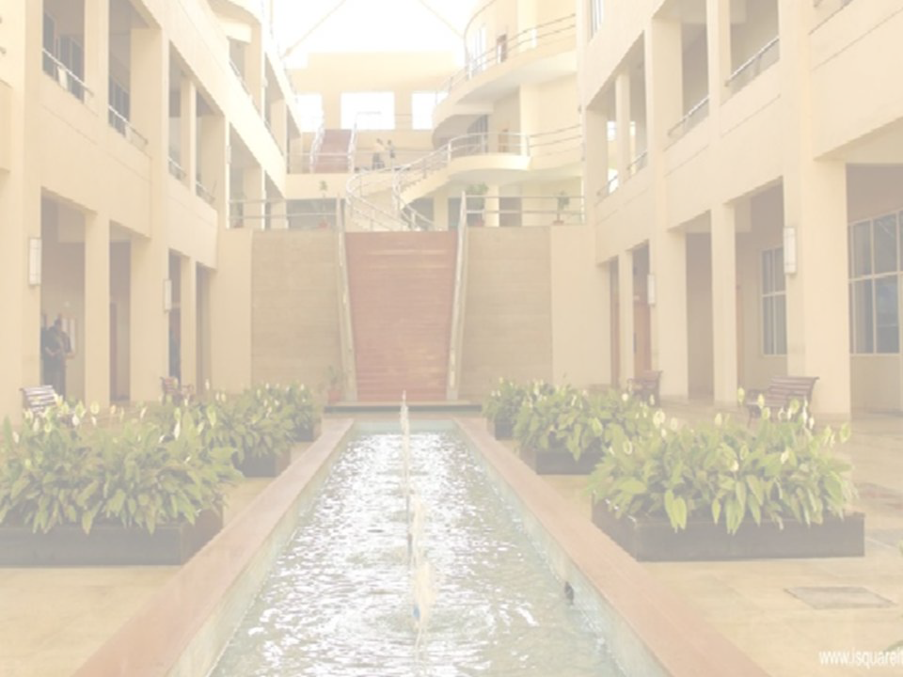
Introduction to IoT
(Internet of Things)
Yogita Narule
Department Of Computer Engineering
International Institute of Information Technology, I²IT
www.isquareit.edu.in

Slide 2
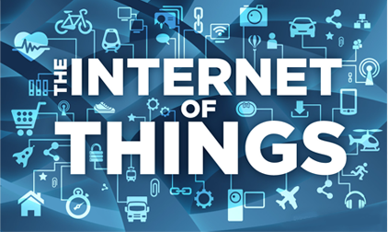

Slide 3
Contents
Introduction/Overview
The Internet of Things
Applications of IoT
Challenges and Barriers in IoT
Future of IoT

Slide 4
Internet Revolution

Slide 5
Internet Usage and Population Statistics

Slide 6
Connected World

Slide 7
Typical Views of the Internet of Things
Industrial Automation
Smart Health
Smart Home
Smart City

Slide 8
What is IoT?
The Internet of Things (IoT) is the network of physical objects or "things" embedded with electronics, software, sensors, and network connectivity, which enables these objects to collect and exchange data.
IoT allows objects to be sensed and controlled remotely across existing network infrastructure, creating opportunities for more direct integration between the physical world and computer-based systems, and resulting in improved efficiency, accuracy and economic benefit.

Slide 9
Definition Of IoT
The Internet of Things, also called The Internet of Objects, refers to a wireless network between objects, usually the network will be wireless and self-configuring, such as household appliances.
------Wikipedia

Slide 10
Internet of Things refers to the concept that the Internet is no longer just a global network for people to communicate with one another using computers, but it is also a platform for devices to communicate electronically with the world around them.
-Center for Data and Innovation

Slide 11
The term "Internet of Things" has come to describe a number of technologies and research disciplines that enable the Internet to reach out into the real world of physical objects.
------IoT 2008

Slide 12
Things having identities and virtual personalities operating in smart spaces using intelligent interfaces to connect and communicate within social, environmental, and user contexts.
-------IoT in 2020

Slide 13
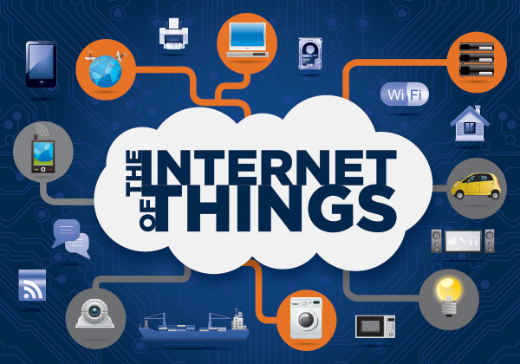
The Internet of Things
The term Internet of Things was first used by Kevin Ashton in 1999.
Refers to uniquely identifiable objects (things) and their virtual representations in an Internet-like structure

Slide 14
Characteristics
Ambient
Intelligence
Flexible
Structure
Event
Driven
Internet of Things
Semantic
Sharing
Complex Access Technologies
Notes:
AI: the autonomous and intelligent entities will act in full interoperability & will be able to auto-organize themselves depending on the context, circumstances or environment.
ED is to design the scheme depending on the need
FS means that hundreds and thousands of nodes will be disable and will be set to run.
CAT means that there’s several kinds of media such as vehicle stone that they need different access technologies.
SS is the machine can rend and send by themselves. No need to tell humanbeings

Slide 15
Enabling Technologies
RFID
Sensor
Smart Tech
Nano Tech
To identify and track the data of things
To collect and process the data to detect the changes in the physical status of things
To enhance the power of the network by devolving processing capabilities to different part of the network.
To make the smaller and smaller things have the ability to connect and interact.
Notes:
machine-to-machine interfaces and protocols of electronic communication
microcontrollers
wireless communication
RFID
Energy harvesting technologies
sensor technology
Location technology
Software
IPv6

Slide 16
The Structure of IoT
The IoT can be viewed as a gigantic network consisting of networks of devices and computers connected through a series of intermediate technologies where numerous technologies like RFIDs, wireless connections may act as enablers of this connectivity.
Tagging Things : Real-time item traceability and addressability by RFIDs.
Feeling Things : Sensors act as primary devices to collect data from the environment.
Shrinking Things : Miniaturization and Nanotechnology has provoked the ability of smaller things to interact and connect within the “things” or “smart devices.”
Thinking Things : Embedded intelligence in devices through sensors has formed the network connection to the Internet. It can make the “things” realizing the intelligent control.

Slide 17
Technical Perspective
Sensing Layer
Communication Layer
Management Layer

Slide 18
Applications of IoT
Management
Education
Retail
IoT Applications
Food
Logistics
Pharmaceuticals
Notes:
Logistics – Tagging items on a UPS truck (now they use barcodes to be scanned) but not real-time. Using the newer technology all is in realtime.

Slide 19
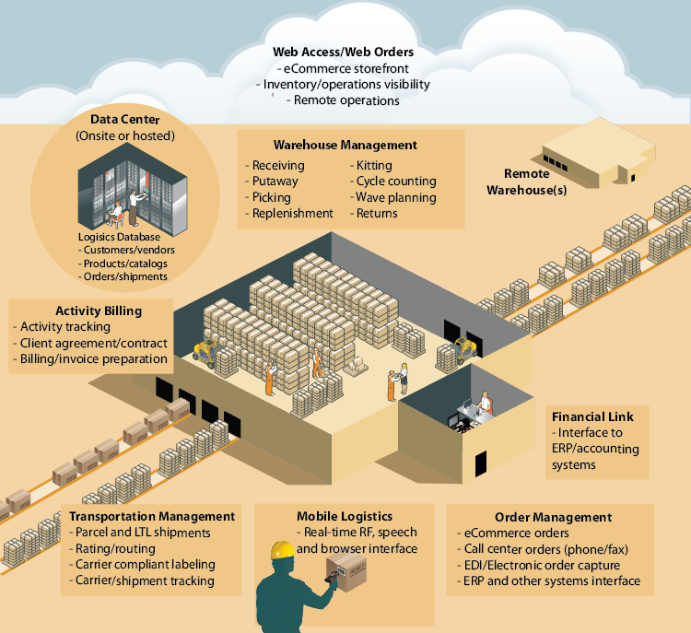
Management:
Data management
Waste management
Urban planning
Production management
...

Slide 20
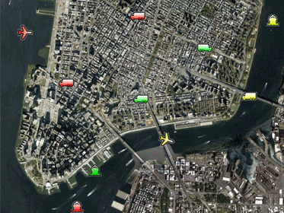
Logistics:
Warehouse, management
Inventory control
Port management
ETAs, ETDs
Ships, boats, containers, etc.
Executable code
…

Slide 21
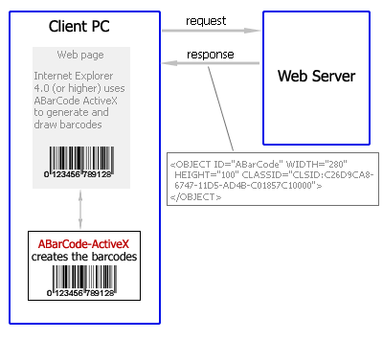
Retail:
Intelligent shopping
Bar code in retail
Electronic tags
…

Slide 22
Pharmaceuticals :
Intelligent tags for drugs
Drug usage tracking
Pharma. Product websites
--> Enable the emergency treatment to be given faster and more correct
Notes:
waste management, urban planning, sustainable urban environment, continous care, emergency response, intelligent shopping, smart product management, smart meters, home automation and smart events
Pharma. – Doctors managing patience during the day – realtime - managing heart rate, Temperature, etc.

Slide 23
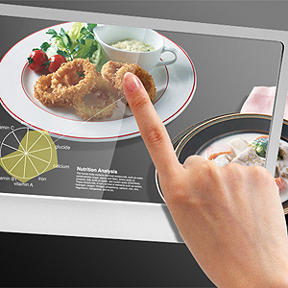
Food:
Control geographical origin
Food production management
Nutrition calculations
Prevent overproduction and shortage
Control food quality, health and safety.
Notes:
waste management, urban planning, sustainable urban environment, continous care, emergency response, intelligent shopping, smart product management, smart meters, home automation and smart events

Slide 24
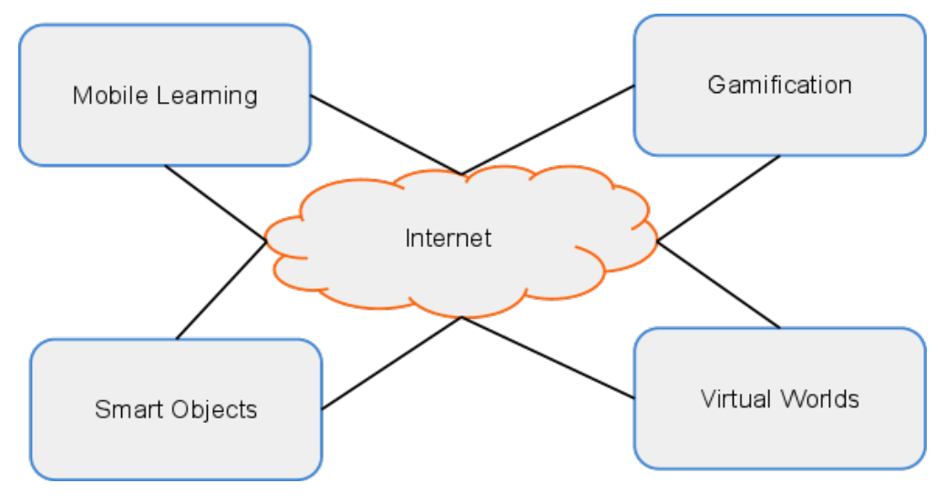
INTERNET OF THINGS
Notes:
http://blogs.princeton.edu/etc/2012/02/24/the-internet-of-things/
Education – When researching items and tagging them (Radio Frequency Identification) the data can be collected and monitored over a time period.

Slide 25
School Administration
Attendance Management
Voting System
Automatic Feedback Loops
Instructional technology
Media
Infor­ma­tion management
Foreign language learning
Notes:
Infor­ma­tion management: research data

Slide 26
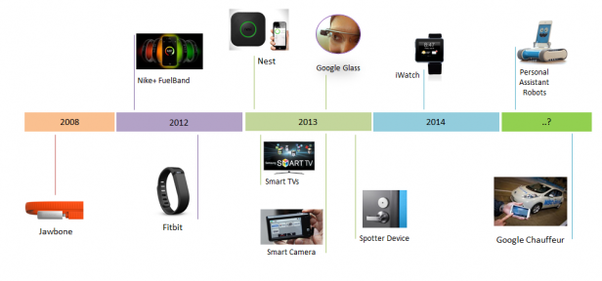
Smart Things Timeline

Slide 27
Challenges and Issues
Issues
Society: People, security, privacy
A policy for people in the Internet of Things:
Legislation
Environmental aspects
Resource efficiency
Pollution and disaster avoidance
Technological
Architecture (edge devices, servers, discovery services, security, etc.)
Governance, naming, identity, interfaces
Service openness, interoperability
Connections of real and virtual world
Standards
Notes:
Legislation: mandatory that policy keeps up with technology so that citizens gain confidence in the new technology
People’s momentarily context and roles can determine their attitudes towards new technology. An employee will resist his boss’ access to his or her mailbox while the same person may demand the same insight into the mailboxes of subordinates.

Slide 28
Challenges and Issues
IoT will inherit the drawbacks of the current internet on an infinitely larger, but more invisible scale
Privacy – will be a huge issue when implementing IoT
Identity - Online Fragmentation of Identity
Efficiency – speed - person loses identity and is an IP address
Decisions – do not delegate too much of our decision making and freedom of choice to things and machines
Balancing

Slide 29
Challenges and Issues
Transition to IPv6 – Internet protocol v6
Estalishing a common set of standards between companies, educational systems, and nations.
The same type of cabling,
The same applications or programming
The same protocol or set of rules that will apply to all
Developing energy sources for millions -even billions - of sensors.
Wind
Solar,
Hydro-electric

Slide 30
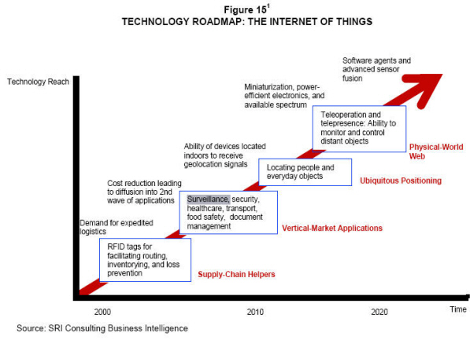
Technology Roadmap of IoT

Slide 31
Future of IoT

Slide 34
Yogita Narule
Assistant Professor
Dept. of Computer Engg.
E-mail:yogitan@isquareit.edu.in

