Slide 1


Big Data Technologies
Prof. Smita Wangikar
Information Technology Department
International Institute of Information Technology, I²IT
www.isquareit.edu.in

Slide 2

Big Data Technologies
  Characteristics of Big Data
    Volume
    Variety
    Velocity
    Veracity
    Volume
  Internal and External Data
    Data that is owned by an organization
    Data that belongs to an entity other than the organization that wishes to acquire and use it.
  Structured and Unstructured Data

Slide 3
Google File System
Design consideration
Interface
Architecture
Chunk Size
Metadata
Client operations :Write
Client operations: with Server
Decoupling and Atomic Record Appends
Master operations Logging, Where to put a chunk,Re-replication and Rebalancing
Garbage Collection
Fault Tolerance
Summary ( Benefits ,limitations)

Slide 4
GFS Design consideration
Built from cheap commodity hardware
Expect large files: 100MB to many GB
Support large streaming reads and small random reads
Support large, sequential file appends
Support producer-consumer queues for many-way merging and file atomicity
Sustain high bandwidth by writing data in bulk

Slide 5
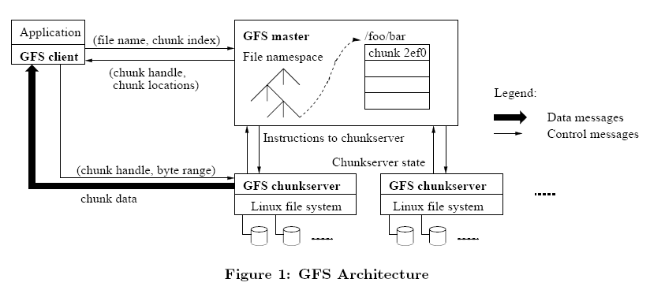
GFS … Architecture

Slide 6
GFS … ChunkSize
Interface 64MB
  Much larger than typical file system block sizes
Advantages from large chunk size
  Reduce interaction between client and master
  Client can perform many operations on a given chunk
Reduces network overhead by keeping persistent TCP connection
  Reduce size of metadata stored on the master
The metadata can reside in memory
Store three major types
  Namespaces
    File and chunk identifier
  Mapping from files to chunks
  Location of each chunk replicas

Slide 7
GFS … Client Operation…Write
Some chunkserver is primary for each chunk
  Master grants lease to primary (typically for 60 sec.)
  Leases renewed using periodic heartbeat messages between master and chunkservers
Client asks master for primary and secondary replicas for each chunk
Client sends data to replicas in daisy chain
  Pipelined: each replica forwards as it receives
  Takes advantage of full-duplex Ethernet links

Slide 8
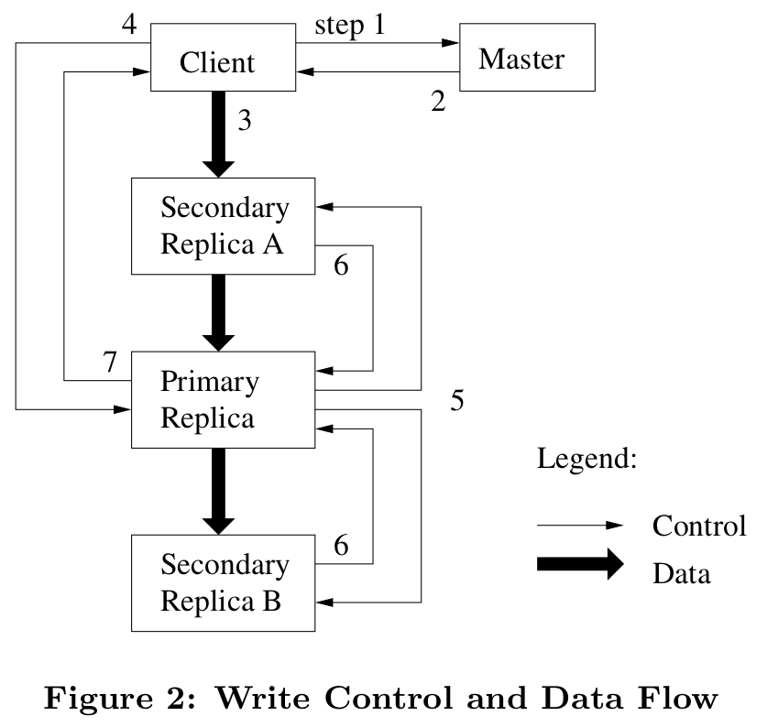
GFS … Client Operation Write

Slide 9
GFS … Client Operation…Write with
Issues control (metadata) requests to master server
Issues data requests directly to chunkservers
Caches metadata
Does no caching of data
  No consistency difficulties among clients
  Streaming reads (read once) and append writes (write once) don’t benefit much from caching at client

Slide 10
HDFS (Hadoop Distributed File System)
A distributed file system that provides high-throughput access to application data
HDFS uses a master/slave architecture in which one device (master) termed as NameNode controls one or more other devices (slaves) termed as DataNode.
It breaks Data/Files into small blocks (128 MB each block) and stores on DataNode and each block replicates on other nodes to accomplish fault tolerance.
NameNode keeps the track of blocks written to the DataNode

Slide 11
HDFS Architecture

Slide 12
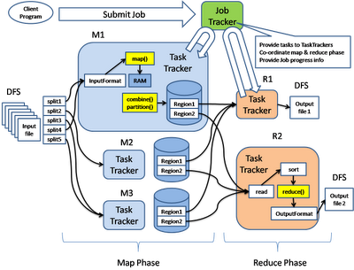
Hadoop’s Map Reduce Engine

Slide 13
How Map Reduce Works?…
A method for distributing computation across multiple nodes
Each node processes the data that is stored at that node
Consists of two main phases
  Map
  Reduce
The Mapper
  Reads data as key/value pairs
    The key is often discarded
  Outputs zero or more key/value pairs
The Shuffle and Sort
  Output from the mapper is sorted by key
  All values with the same key are guaranteed to go to the same machine
The Reducer
  Called once for each unique key
  Gets a list of all values associated with a key as input
  The reducer outputs zero or more final key/value pairs
    Usually just one output per input key

Slide 14
How Map Reduce Works?…
A method for distributing computation across multiple nodes
Each node processes the data that is stored at that node
Consists of two main phases
  Map
  Reduce
The Mapper
  Reads data as key/value pairs
    The key is often discarded
  Outputs zero or more key/value pairs
The Shffle and Sort
  Output from the mapper is sorted by key
  All values with the same key are guaranteed to go to the same machine
The Reducer
  Called once for each unique key
  Gets a list of all values associated with a key as input
  The reducer outputs zero or more final key/value pairs
    Usually just one output per input key

Slide 15
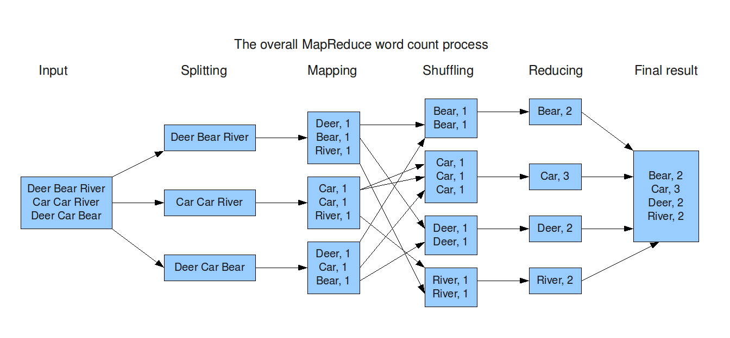
Map Reduce Example

Slide 16
Thank You
E-mail: smitaw@isquareit.edu.in

