Slide 1
DC CIRCUIT
Amit Kasar
Engineering Science Department
International Institute of Information Technology, I²IT
www.isquareit.edu.in

Slide 2
Network- A combination of circuit element (Resistance, Inductance, Capacitance) with energy sources is called as Network.
Classification of Network
Classification
Active & Passive
Network
Unilateral & Bilateral Network
Linear & Nonlinear Network
Lumped & Distrubuted Network

Slide 3
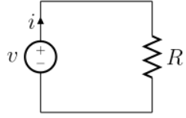
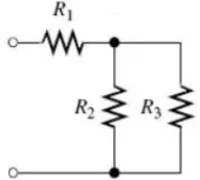
Active Network- A network which contain at least one source of Energy. (Fig. A)
Passive Network- A network without any Energy source. (Fig. B)
Fig. A Fig. B
Unilateral Network- A network whose operation is depend upon direction of current flowing through it called as unilateral network. Best example is Diode.
Bilateral Network- A network whose operation is independent upon direction of current flowing through it called as unilateral network. Best example is Resistor.

Slide 4
Continue…
Linear Network- A network whose parameters like Resistance, Inductance & Capacitance are always constant irrespective of change in voltage, time & temperature called as linear network. Ohms law can apply for such network.
Nonlinear Network- A network whose parameters like Resistance, Inductance & Capacitance are always constant with change in voltage, time & temperature called as nonlinear network. Ohms law cannot apply for such network.
Lumped Network- A network in which all circuit elements can physically separable for the analysis purpose called lumped network.
Distributed Network- A network in which all circuit elements cannot be physically separable for the analysis purpose called distrubuted network. Example is transmission line.

Slide 5
Energy Sources
Energy Sources
Voltage Source
Ideal Voltage Source
Practical Voltage Source
Current Source
Ideal Current Source
Practical Current Source

Slide 6
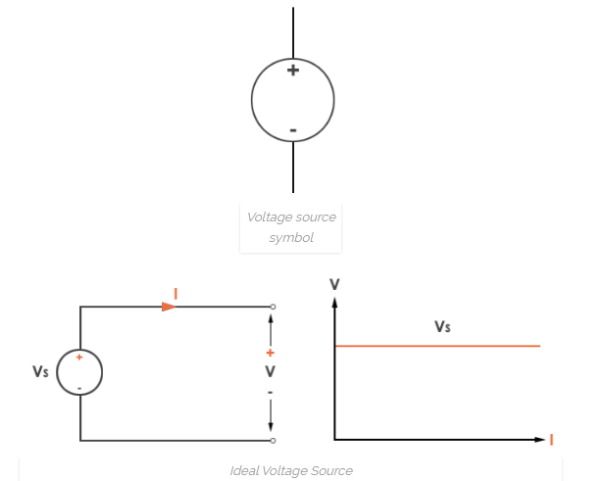
Voltage Source
Ideal Voltage Source-
A voltage source is a device which provides a constant voltage to load at any instance of time and is independent of the current drawn from it. Practically, the ideal voltage source cannot be made. It has zero internal resistance

Slide 7
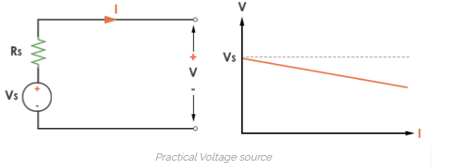
Voltage Source
Practical Voltage Source-
Practically voltage source have some internal resistance. Due to this internal resistance there is some voltage drop occurs & remaining voltage appear across the load. A practical voltage source is thus denoted by resistance in series which represents the internal resistance of source.

Slide 8
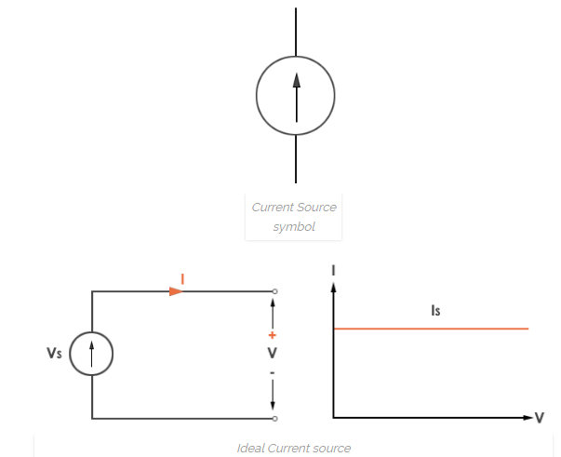
Current Source
Ideal Current Source-
A current source is a device which provides a constant current to load at any instance of time and is independent of the voltage supplied to circuit. Practically, the ideal current source not available. It has infinite resistance.

Slide 9
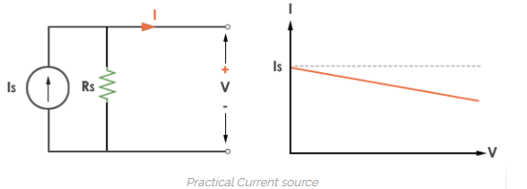
Current Source
Practical Current Source-
Practically current sources do not have infinite resistance across there but they have a finite internal resistance connected in parallel. So the current delivered by the practical current source is not constant and it is also dependent somewhat on the voltage across it.

Slide 10
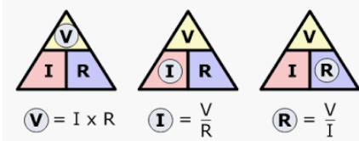
Ohm’s Law
As the physical state ( temperature)of the conductor remains constant , the current flowing through conductor is directly proportional to potential difference applied across it. But ohms law can not be applied to nonlinear resistance like diode & nonmetallic conductor like silicon carbide.

Slide 11
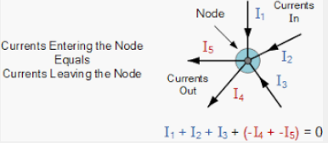
Kirchoff’s law
Kirchoff’s Current law-
The algebraic sum of currents meeting at a point or junction or nodeis equal to zero. In other words we can say that incoming currents is equal to outgoing currents. The currents are entering the node & currents are leaving the node.

Slide 12
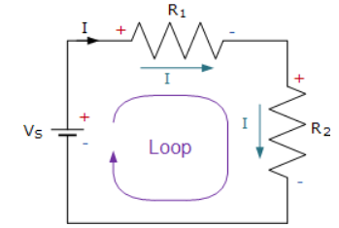
Kirchoff’s law
Kirchoff’s Voltage law-
In any closed loop network, the algebraic sum of product of current & resistance equal to the sum of all the voltage drops within the same loop” which is also equal to zero. In other words the algebraic sum of all voltages within the loop must be equal to zero.
ΣV = 0

Slide 13
References
[1] https://www.codrey.com/dc-circuits/voltage-source-and-current-source
[2] https://www.electronics-tutorials.ws/dccircuits/dcp_2.html
[3] https://www.electronics-tutorials.ws/dccircuits/dcp_4.html

