Slide 1


Fundamentals of Computer Networks
Prof. Ravindra Joshi
Dept. of Engineering Sciences
International Institute of Information Technology, I²IT
www.isquareit.edu.in

Slide 2

Fundamentals of Computer Networks
What is a Computer Network ??
It is a interconnected collection of autonomous devices (or nodes) for the purpose of resource sharing.
Interconnected:
connected by communication links (or transmission medium)
Autonomous:
each device is independent of the other
does not have master/slave relation
Node:
Any addressable device that can recognize, process or forward
data transmissions. E.g. computer, server, workstation, printer
etc.

Slide 3
Concept of Layering
In order to simplify understanding and reduce design complexity,
a network is conceptually visualized as a stack of various layers.
Various network models are available using this type of
layered architecture such as,
Internet model
OSI reference model
TCP/IP model etc.
Number of layers, names of layers, functions of layers
may differ for different network models
Modularity: Functions of each layer are distinct and layers
are independent of the others, allows for scalability (or future
expansion)

Slide 4
OSI model for computer communication
Open System Interconnection (OSI) model was invented
by International Standards Organization (ISO)
Open system is a model that,
allows two different systems to communicate regardless of
their fundamental architecture
establishes communication between different systems without requiring changes in the logic of basic hardware or software
OSI is a reference model (not a protocol)
Each layer uses and builds on the services provided by those below it
OSI reference model consists of 7-layers
Functions and services provided by each layer are clearly defined

Slide 5
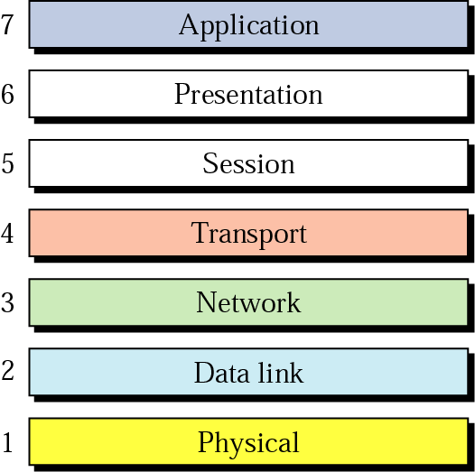
OSI model for computer communication

Slide 6
TCP/IP model for computer communication
TCP/IP is a dominant commercial protocol architecture
Since 1990 it became popular
Is a result of research conducted
On packet switched networks, Advanced Research Project Agency Network (ARPANET)
It was funded by Defense Advanced Research Project Agency (DARPA) of US Department of Defense (DOD)
It was used for Inter connection of different networks developed by different vendors
It contains only 4-layers (simplified version of OSI model)

Slide 7
TCP/IP Layers
Application Layer
Transport Layer
Internet Layer
Host-to-network Layer

Slide 8
TCP/IP Layers and services
Application Layer:
- Mail services, file transfer, remote log-in, accessing
world wide web etc.
Transport layer:
Transmission Control Protocol (TCP)
User (or Universal) Datagram Protocol (UDP)
Ensures reliable delivery, retransmission in case of error
Internet Layer:
Internet Protocol (IP)
Host-to-network Layer:
Data Link plus physical layer combined
Uses any media access Protocol (e.g. Ethernet for LAN)

Slide 9
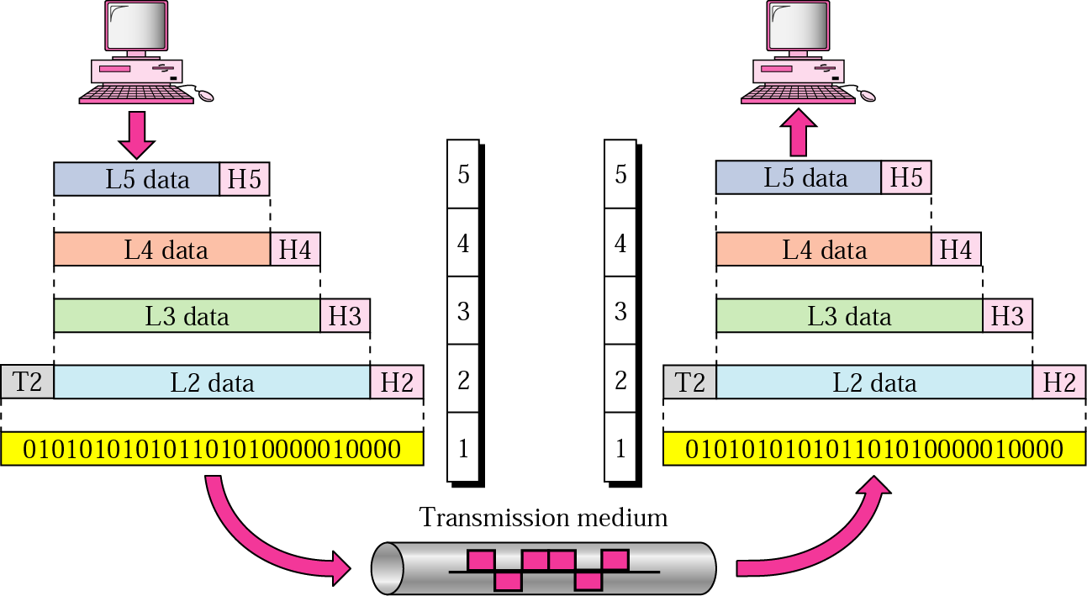
Communication between layers

Slide 10
Communication between layers
Each layer receives data and appends control information
(header & trailer) to it and passes on to the layer below
Actual transmission of data takes place through physical
layer in the form of bits (0’s and 1’s). Transmission medium
is required for the data flow.
Layers may break the message in smaller packets
Each packet is numbered and contains control information
such as destination and source address
Upon reaching the correct destination, the data packets
are forwarded to the upper layers and the corresponding
header & trailer are removed at each layer

Slide 11
Functions of Layers: physical layer
Description & functions-
Responsible for transmission of bits from one node to another over a communication channel.
Deals with mechanical, electrical, functional and
procedural specifications.
Mechanical (e.g. type of connectors)
Electrical (e.g. voltage levels, data transmission rates)
Functional (e.g. specifies functions performed by
individual pins)
Procedural (e.g. specifies sequence of events by which
bit streams are exchanged)

Slide 12
Functions of Layers: physical layer
Defines interface between devices and transmission
media (e.g. RS232C, RS-485) as well as type of
transmission media.
Representation of bits (e.g. electrical or optical signals)
Protocols used: X.21
Services provided to the data link layer:
Defines physical media characteristics, data rates,
synchronization of bits, representation of bits, sequence
of transmission etc.

Slide 13
Functions of Layers: data link layer
Description & functions-
Transforms the physical layer, a raw transmission facility
to a reliable link.
Provides error detection & correction mechanisms
Converts stream of bits into frames
Attaches specific bit patterns (such as header, trailer)
to the beginning and end of frames.
Deals with damaged, lost and duplicate frames
Provides flow control if sender and receiver speeds are
not matching.
Controls access to the shared media.

Slide 14
Functions of Layers: Network layer
Description & functions-
Responsible for delivery of packets from source to
destination across multiple networks.
Provides logical addressing (e.g. IP address) to identify
sender and receiver.
Provides routing of packets through best possible path
Congestion control in case of busy or broken routes
Protocols used: X.25

Slide 15
Functions of Layers: Transport layer
Description & functions-
Responsible for delivery of entire message from source
to destination (process-to-process delivery)
Provides establishment, data transfer and notification of
connection release
Port addressing: network layer gets the packets to the
correct computer and transport layer gets the entire
message to the correct process on that computer
Segmentation & reassembly of message
Connection control: offers connection-oriented or
connection-less service

Slide 16
Functions of Layers: Session layer
Dialogue discipline:
Control of dialogues between applications
Establishes, maintains and synchronises the interaction
Session closes with proper procedure, not abruptly
Exception handling:
Covers exceptional situations not covered by other layers
Session Recovery:
Provides checkpoint mechanism
If failure between check points-session retransmit data from the last check point
Session Release:
In case of idle time

Slide 17
Functions of Layers: Presentation layer
Responsible for presentation of data in a meaningful way to the application layer.
Defines syntax and semantics used between application entities
Data formats, Data translation, Coding/ decoding
Data compression/ decompression
Encryption/ decryption for secured data transmission
Security: Validating Login/password

Slide 18
Functions of Layers: Application layer
Enables the user to access the network using an
application software
Provides user interfaces and services such as,
Electronic mail services
File transfer and access services
Remote log-in to access network resources
Access to the World Wide Web

Slide 19
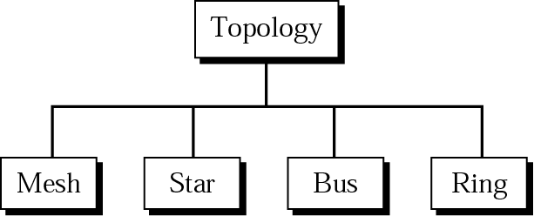
Network topologies

Slide 20
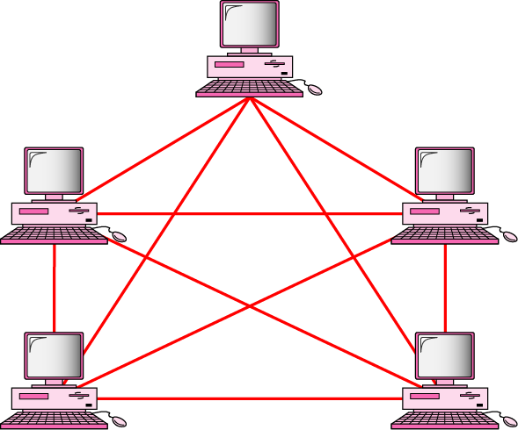
Network topologies
Mesh topology

Slide 21
Network topologies
Characteristics –
Each device is connected to every other device by
point-to-point (or dedicated) links
Number of links = n(n-1)/2
Advantages –
Robust: If one link fails, alternate route is available
Dedicated links, more security, more reliability
Data can be routed to avoid busy links
No congestion and link allocation problems
High data rates are possible (few Gbps)
Disadvantages –
High cabling cost, more I/O ports required
Extremely complex if the number of nodes are more
Installation and adding users is difficult

Slide 22
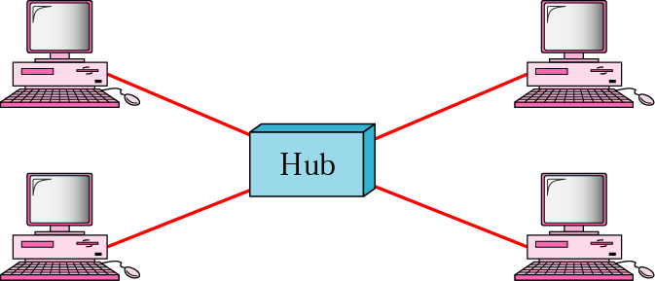
Network topologies
Star topology

Slide 23
Network topologies
Characteristics: –
Each device is connected by point-to-point links to the
central controller (and not directly)
All data traffic is routed through the central controller
Advantages –
Centralized control, Easy to locate faults
Easy to add or delete nodes
Robust: if one link fails, network will not get affected
Easy to install & configure, less I/O ports required
Less cabling required compared to mesh topology
(hence less expensive than mesh topology)
Disadvantages –
If central controller fails, entire network gets affected

Slide 24
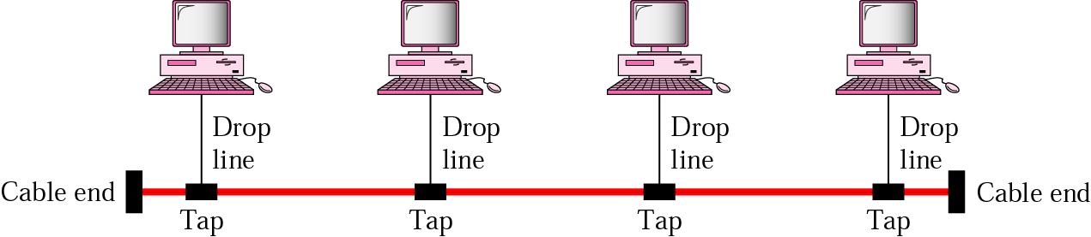
Network topologies
Bus topology

Slide 25
Network topologies
Characteristics:–
Each device is connected to a central cable called as
backbone (or data highway)
Multi-point connection
Advantages –
Easy to add or delete nodes
Easy to install & configure
Less cabling required compared to mesh or star
topology (hence less expensive)
Disadvantages –
Access mechanism is required (to decide which device
gets access to the medium)
Limitations on distance due to interference
Entire network is affected if backbone cable is broken

Slide 26
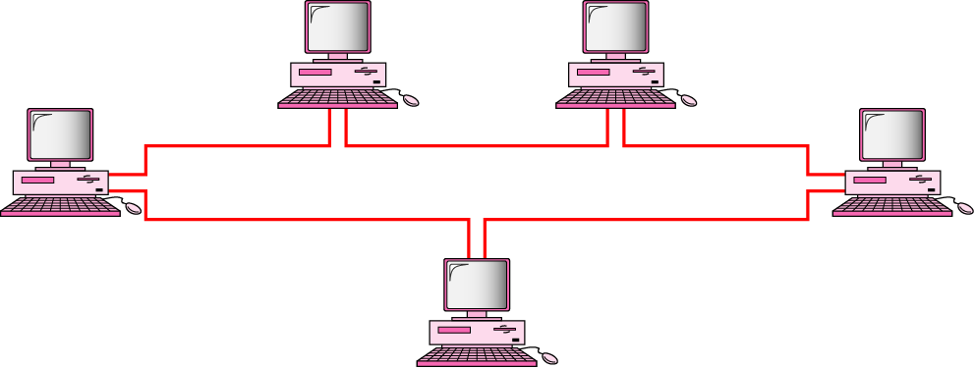
Network topologies
Ring topology

Slide 27
Network topologies
Characteristics:–
Each device has dedicated point-to-point connection
only with two devices, on either side of it
Signal is passed from one device to another until it
reaches the destination and is regenerated at each node
Advantages –
Easy to add or delete nodes
Easy to install & configure
Less cabling required compared to mesh or star
topology (hence less expensive)
Disadvantages –
Access mechanism is required (to decide which device
gets access to the medium)
Entire network is affected if ring cable is broken

Slide 28
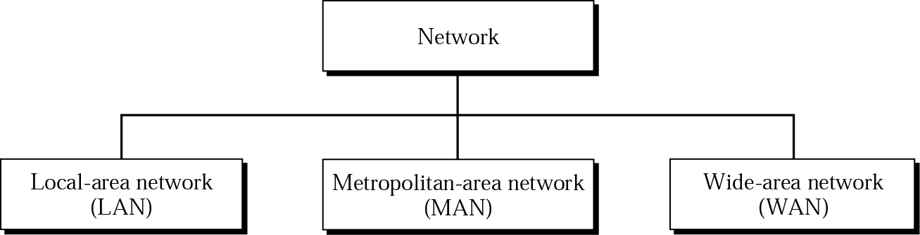
Categories of Networks

Slide 29
Categories of Networks
Characteristics of Local Area Network (LAN):
Covers limited geographic area: office, building or a
campus (10 m to 1 Km)
Usually owned by private companies or institutions
Data rates are high (10 to 100 Mbps or higher)
Data transmission through twisted pair cable, or Fiber
optic cable
Less delay, very few errors, no switching elements
required
Main purpose to share resources in an organization
Protocols used: Ethernet, Token ring, Token bus

Slide 30
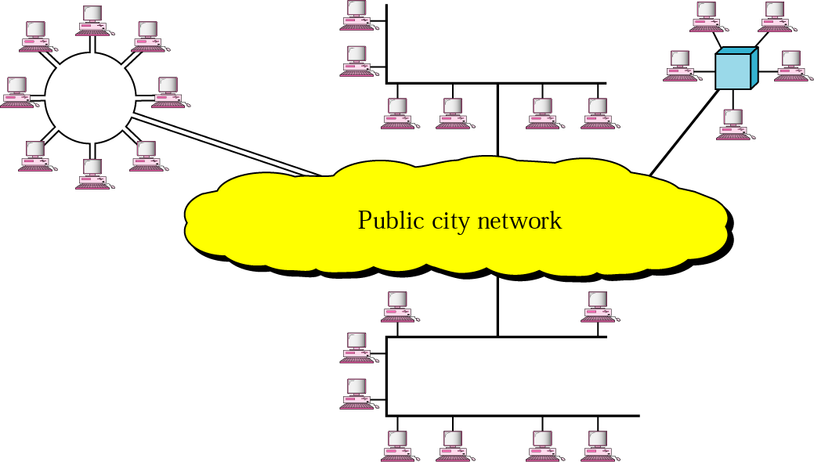
Categories of Networks
Metropolitan Area Network (MAN):

Slide 31
Categories of Networks
Characteristics of Metropolitan Area Network (MAN):
Covers geographic area of a typical metropolitan city
(5 to 50 Km)
Owned by private or public companies (such as banks)
or telephone companies
Data rates are high (10 to 100 Mbps)
Data transmission through coaxial cable or Fiber
optic cable
Main purpose to connect various LANs in a city
Technologies used: SMDS, FDDI, ATM
Links between LANs could also be wireless (e.g. microwave
or radio)

Slide 32
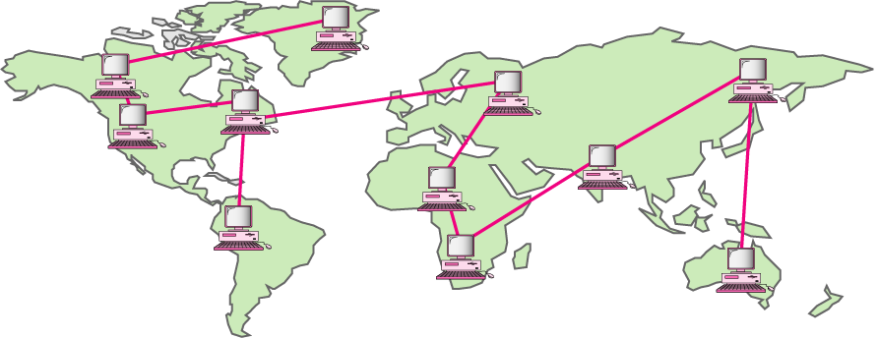
Categories of Networks
Wide Area Network (WAN):

Slide 33
Categories of Networks
Characteristics of Wide Area Network (WAN):
Covers very large geographic area: country or even
different continents (100 to 1000 Km or more)
Utilize public, leased communication lines from
telephone companies or carrier providers (e.g. AT&T,
USsprint, MCI, SingTel etc.)
Transmission rates up to 625Mbps but will be limited by
the end infrastructure
Data transmission through Fiber optic cable or Satellite
wireless links
Main purpose is to connect networks across different
countries
Technologies used: ATM, SONET
Internetworking devices such as routers are used

Slide 34
Internet
Internet is a network of networks (or interconnection of
various networks)
It was an outcome of research work done at Advanced
Research Project Agency (ARPA) in early 1970’s.
Protocol used: TCP/IP
It’s a collection of transmission control protocol and
Internet protocol
International Service Providers
National Service Providers
Regional internet service providers
Local internet service providers

Slide 35
Internet

Slide 36
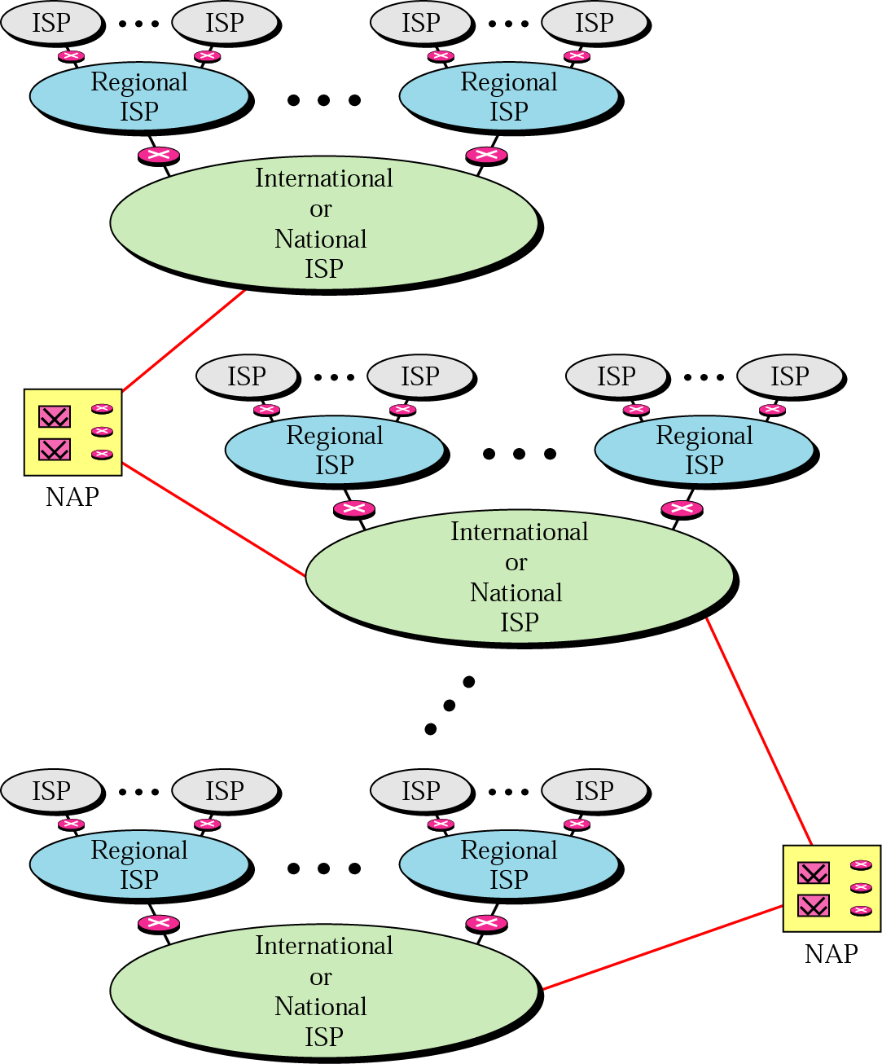
Internet Today

Slide 37
For further queries,
Kindly contact:
Prof. Ravindra Joshi
Associate Professor, Dept. of Engineering Sciences
International Institute of Information Technology (I²IT), Pune
Email: ravindraj@isquareit.edu.in
Cell: 9822021594

