Slide 1
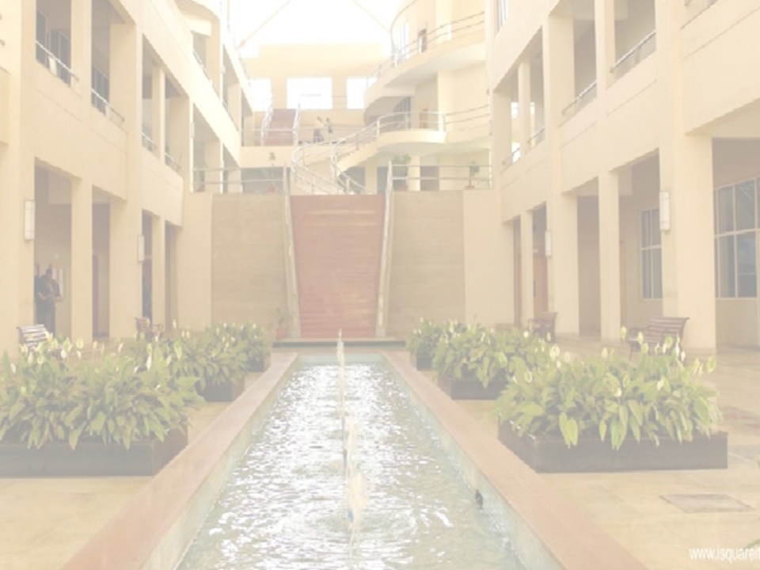

Orthographic Projections
Prof.Yogiraj Deshmukh
Department of Engineering Sciences
International Institute of Information Technology, I²IT
www.isquareit.edu.in

Slide 2

ORTHOGRAPHIC PROJECTIONS
IT IS TECHNICAL DRAWING IN WHICH DIFFERENT VIEWS OF AN OBJECT
ARE PROJECTED ON DIFFERENT REFERENCE PLANES
Different Reference planes are
Horizontal Plane (HP)
Vertical Frontal Plane (VP)
Side Or Profile Plane ( PP)
And
Different Views are Front View (FV), Top View (TV) and Side View (SV)
FV is projected on VP.
TV is projected on HP.
SV is projected on PP.
IMPORTANT TERMS :
Planes.
Pattern of planes & Pattern of views
Methods of drawing Orthographic Projections

Slide 3
PLANES
PRINCIPAL PLANES
HP AND VP
AUXILIARY PLANES
Auxiliary Vertical Plane
(A.V.P.)
Auxiliary Inclined Plane
(A.I.P.)
Profile Plane
( P.P.)

A.V.P.
A.I.P.
⊥ to Hp & ∠ to Vp
⊥ to Vp
&
∠ to Hp


Slide 4
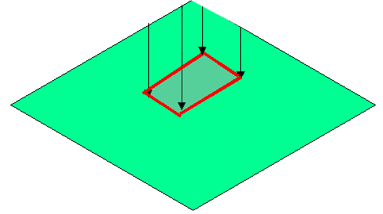
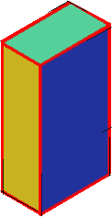
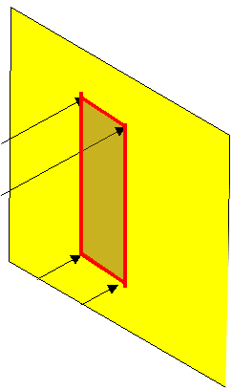
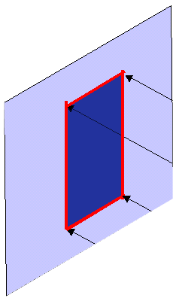
FIRST ANGLE
PROJECTION
FOR T.V.
IN THIS METHOD,
THE OBJECT IS ASSUMED TO BE
SITUATED IN FIRST QUADRANT
MEANS
ABOVE HP & INFRONT OF VP.
V.P.
P.P.
F.V.
S.V.
OBJECT
VP
PP
FV
LSV
X
Y
FOR S.V.
FOR F.V.
TV
HP

Slide 5
PATTERN OF PLANES & VIEWS
THIS IS A PICTORIAL SET-UP OF ALL THREE PLANES.
ARROW DIRECTION IS A NORMAL WAY OF OBSERVING THE OBJECT.
BUT IN THIS DIRECTION ONLY VP AND A VIEW ON IT (FV) CAN BE SEEN.
THE OTHER PLANES AND VIEWS ON THOSE CAN NOT BE SEEN.
Y
X
Y
VP
PP
FV
LSV
X
Y
X
TV
HP

Slide 6
Methods of Drawing Orthographic Projections
First Angle Projections Method
Here views are drawn
by placing object
in 1st Quadrant
Third Angle Projections Method
Here views are drawn
by placing object
in 3rd Quadrant.
FV
TV
X
Y
X
Y
TV
FV
G
L

Slide 7




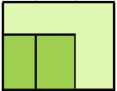
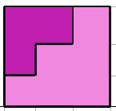

FOR T.V.
S.V.
F.V.
ORTHOGRAPHIC PROJECTIONS
FRONT VIEW
L.H.SIDE VIEW
FOR F.V.
FOR S.V.
x
y
TOP VIEW

Slide 8




FOR T.V.
S.V.
F.V.
ORTHOGRAPHIC PROJECTIONS
FRONT VIEW
L.H.SIDE VIEW
X
Y
FOR S.V.
FOR F.V.
TOP VIEW

Slide 9
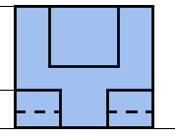

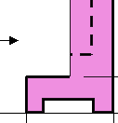
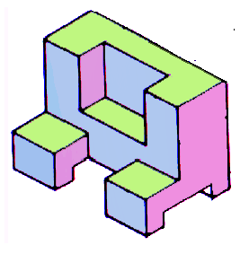
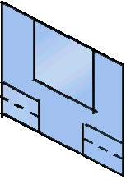
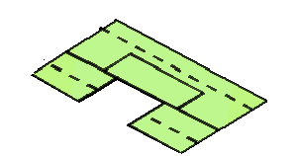

FOR T.V.
S.V.
F.V.
ORTHOGRAPHIC PROJECTIONS
FRONT VIEW
L.H.SIDE VIEW
FOR S.V.
FOR F.V.
X
Y
TOP VIEW

Slide 10
Thanks
Wish you all the Best

