Slide 1
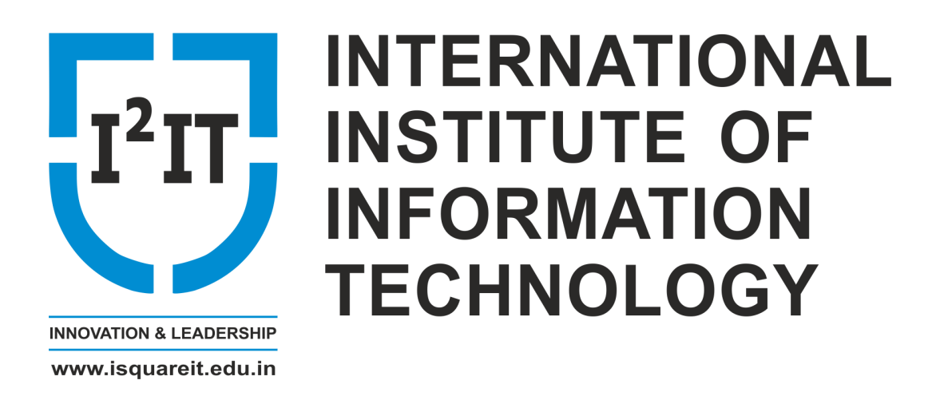
Industrial Internet of Things (IIoT)
Mr. Pradip Ashok Chougule
Department of Computer Engineering
International Institute of Information Technology, I²IT
www.isquareit.edu.in

Slide 2
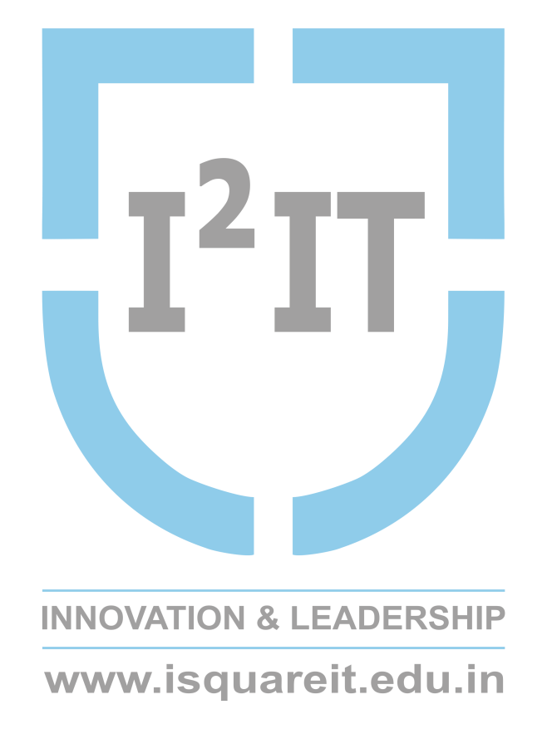
Contents
What is IIoT?
What’s the difference between IoT and IIoT?
Why Industrial IoT?
IIoT infrastructure
IIoT deployment architecture
Drivers of IIoT
IIoT technologies
IIoT applications
Vendors in IIoT
Summary

Slide 3
What is IIoT?
The industrial internet of things (IIoT) is the use of smart sensors and actuators to enhance manufacturing and industrial processes. - (Defined By: Margaret Rouse)
The IIoT consists of internet-connected machinery and the advanced analytics platforms that process the data they produce. - (Reference from: www.hpe.com)

Slide 4
Difference between IoT and IIoT?
The IIoT is a subcategory of the IoT, which also includes consumer-facing applications such as wearable devices, smart home technology and self-driving cars.
Sensor-embedded devices, machines and infrastructure that transmit data via the Internet and are managed by software are the hallmark of both concepts.

Slide 5
Why Industrial IoT?
For any business that deals with the production and/or transportation of physical goods, IIoT can create game-changing operational efficiencies and present entirely new business models.

Slide 6
The following are examples of ways in which IIoT technology could be applied in diverse industries.
Production
Supply Chain
Building Management
Healthcare
Retail

Slide 7
IIoT infrastructure
Source: TechTarget

Slide 8
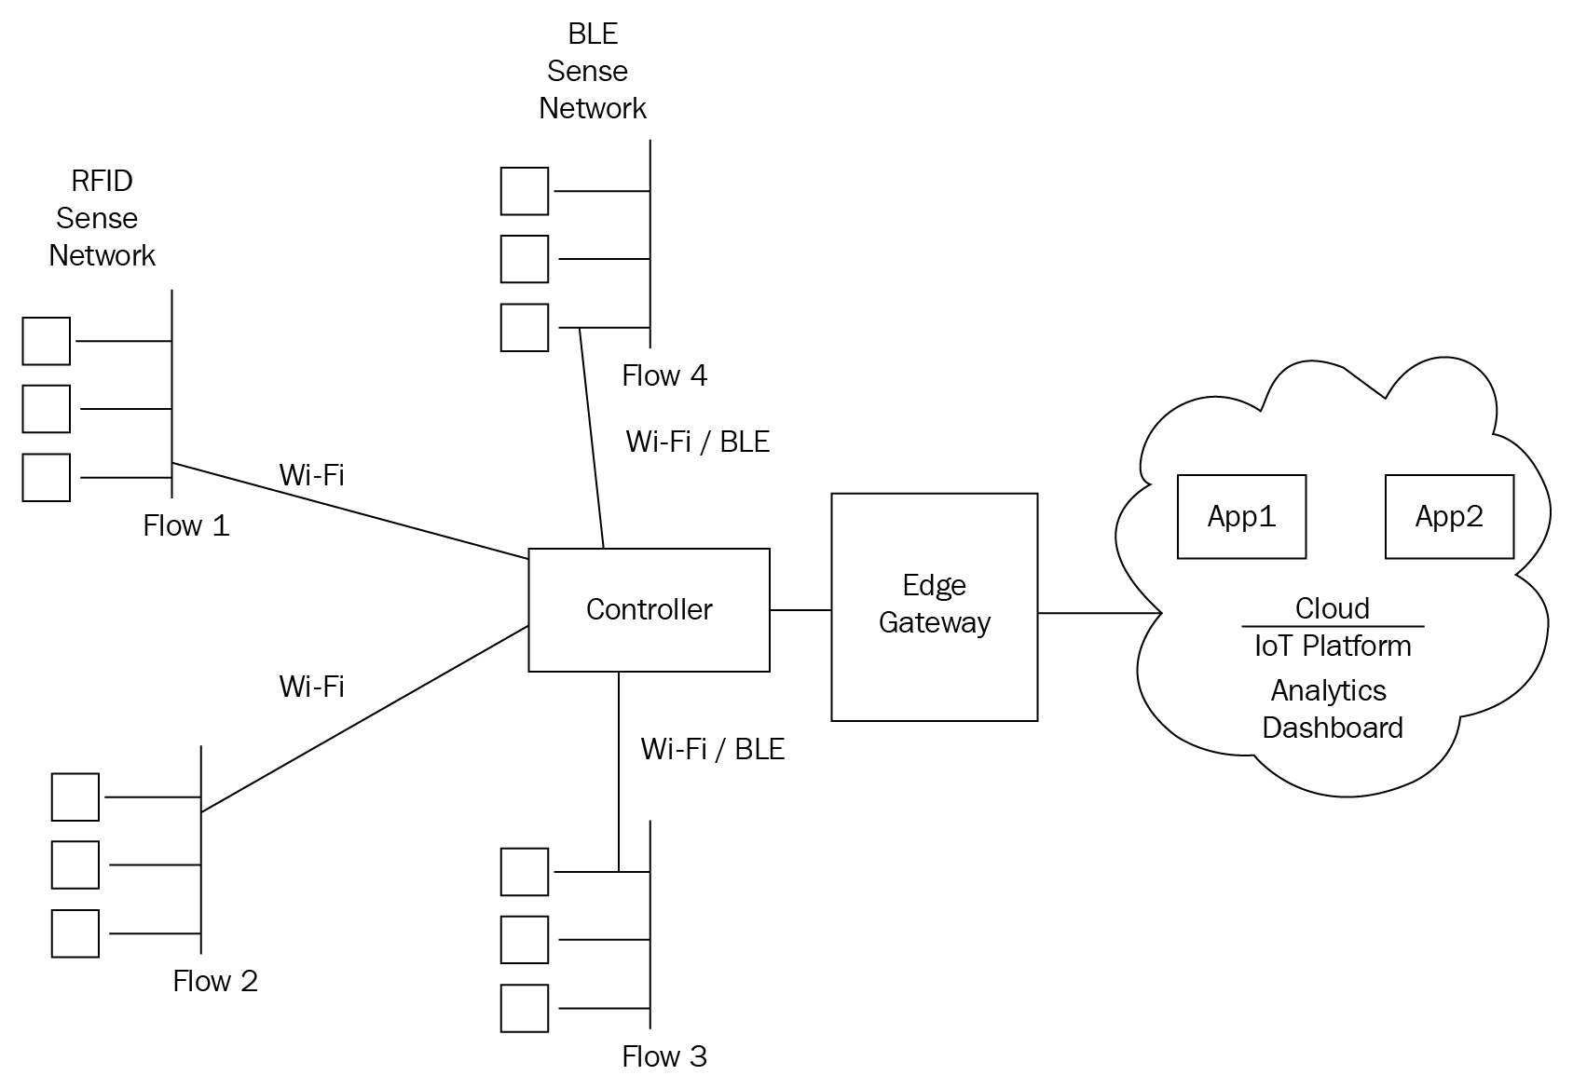
IIoT deployment architecture
Source: https://subscription.packtpub.com/book/business/9781788832687/1/ch01lvl1sec15/industrial-iot-deployment-architecture

Slide 9
Drivers of IIoT
Technology:
Smart Sensors, Robotics & Automation, Augmented/Virtual reality, Big Data Analytics, Cloud Integration, Software applications, Mobile, Low power Hardware devices and Scalability of IP address, etc. is a major driver for the Industrial Internet.

Slide 10
Customer Behavior:
The edge that IIoT gives to enterprises over their competitor helps them achieve better customer satisfaction and retention through value addition.

Slide 11
Macro-Economic Drivers:
Government policies like Industry 4.0, Smart Factories, Make In India, Make In China 2025 & Smart Cities, Japan’s Industrial Value Chain Initiative Foum, Support of Green initiatives, Rising Energy & crude oil prices, Favorable FDI policies, Policies by regulatory bodies, etc. works totally in favour of the IIoT evolution.

Slide 12
IIoT technologies
Current and upcoming IIoT technologies are:
Digital twins
Electronic logging device (ELD)
Radio-frequency identification (RFID)
Intelligent Edge
Predictive maintenance

Slide 13
IIoT applications
Autonomous vehicles: Free-roaming robots move across factory floors
Machine utilisation: Making the most of industrial assets
Operator productivity: Connected tools eliminate human error
Power management: Building automation lowers energy costs
Quality control: Vision systems deliver perfect products, time and again
Smart logistics: Keeping track of assets in real-time
Wearables: Ensuring worker safety at all times

Slide 14
Vendors in IIoT
There are a number of vendors with IIoT platforms, including:
ABB: a power and robotics company.
IoT System by Cisco: a networking company.
Fanuc: a supplier of industrial automation equipment.
Predix by GE Digital: an energy management company.
Connected Performance Services by Honeywell: a software-industrial company.
Connyun by Kuka: a manufacturer of industrial robots (created in partnership with Infosys, an IT consulting firm).
Wonderware by Schneider Electric: an energy management company.
MindSphere by Siemens: an industrial manufacturing company.

Slide 15
Summary
The endless unfolding of new technologies have added up to a huge list of the “Next Big Thing”. However not every evolving technology has the potential to break through the business and social landscape.
McKinsey Global Institute has estimated that IoT will have a potential economic impact of up to $6.2 trillion by 2025.
It also has the potential to drive productivity across $36 trillion and operating costs across multiple industries, including manufacturing, health care, and mining.

Slide 16
Thank You
For Further details, Please contact
Mr. Pradip Ashok Chougule
pradipc@isquareit.edu.in
Department of Computer Engineering
Hope Foundation’s
International Institute of Information Technology, I²IT Pune
P-14, Rajiv Gandhi Infotech Park, Hinjawadi Phase 1,
Pune - 411 057
Phone - +91 20 22933441/2/3
Website - www.isquareit.edu.in | Email - info@isquareit.edu.in

