Slide 1
Smart Closet Organizer
Prof. Prashant Gadakh
Department of Computer Engineering
International Institute of Information Technology, I²IT
www.isquareit.edu.in

Slide 2
Smart Closet Organizer
The smart closet would provide a user with suggestions of outfits from the user’s closet.
Recommending clothes considering the weather and occasion.
The styles recommended will be based on recent trends.
The clothes will be recommended according to users’ clothing style.
Adding and deleting closet items.

Slide 3
Smart Closet Organizer Introduction
Recommendations considering repetitions and unavailability due to reasons like laundry.
By using our application, the user will also be able to see how a particular item from a shop will look on an actual person.
The user will get suggestions of other items along with the one user has selected and where they can locate it.
The user will also get suggestions of items that go along with the items in closet.

Slide 4
Motivations
The basic motivation behind this application is to reduce everyday stress of finding the appropriate attire for an occasion by taking into consideration the current weather. It is difficult to keep track of the laundry in our daily routine. Keeping track of when and how many times a particular clothing item was used is a tedious task. Difficulties in managing a large closet. Confusions while buying from a variety of choices and if they go with existing closet items. Helping shops compete with ecommerce.

Slide 5
Objectives
Adding and deleting closet items to manage closet.
Giving recommendations based on occasion, weather, recent fashion trends and personal choice.
Keeping track of the laundry, when and how many times an item is worn.
Recommendations in buying new items.
Recommendations to pair new items with other items from the shop and also with existing items from closet.

Slide 6
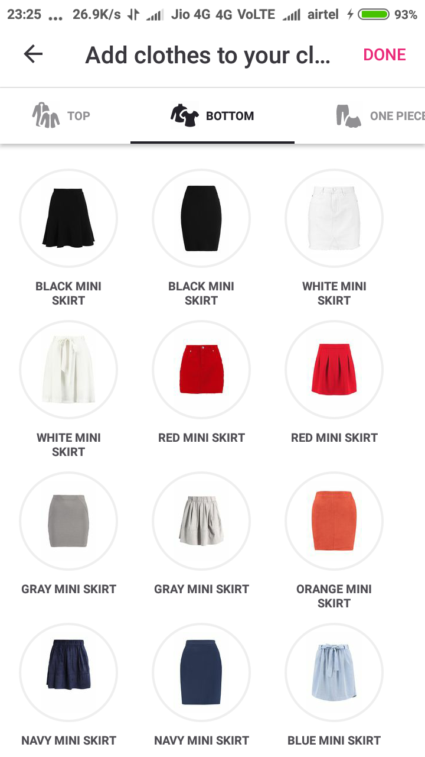
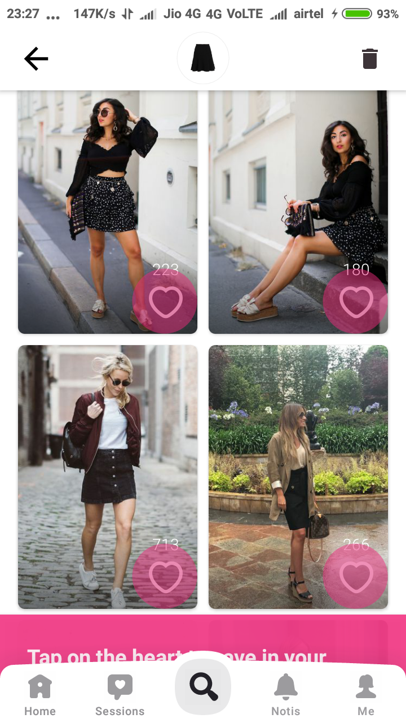
Existing System
Chicisimo –
It is a styling application that gives you outfit ideas for your clothes.
The basic problem with the application is its recommendations.
The clothes for which it recommends the outfit are not the exact clothes user has.
The recommendations are not on according to the occasion and weather.

Slide 7
Existing System-ClosetSpace
This Application is also a styling app which is under development.
Add existing items by taking pictures, details like brand, date of purchase, place of purchase, etc.
Also the user needs to select type of item.
Problems :
- The user is not necessarily aware of the type of item he is
entering
- The clothes may not have a renowned brand if bought from
any local retail store.
- Recommends outfits from outfit ideas created by us which
is to be done manually.

Slide 8
Proposed System
Mobile Application for individual customer as virtual private closet.
Existing apparel entry to the virtual closet.
Addition and Deletion of apparel.
Ease of addition of new clothes using custom available QR Codes.
Outfit recommendation catering to individual user.
Also taking into consideration various factors like availability, trends, occasion, weather, etc.
Website to help manufacturers create custom QR codes.

Slide 9
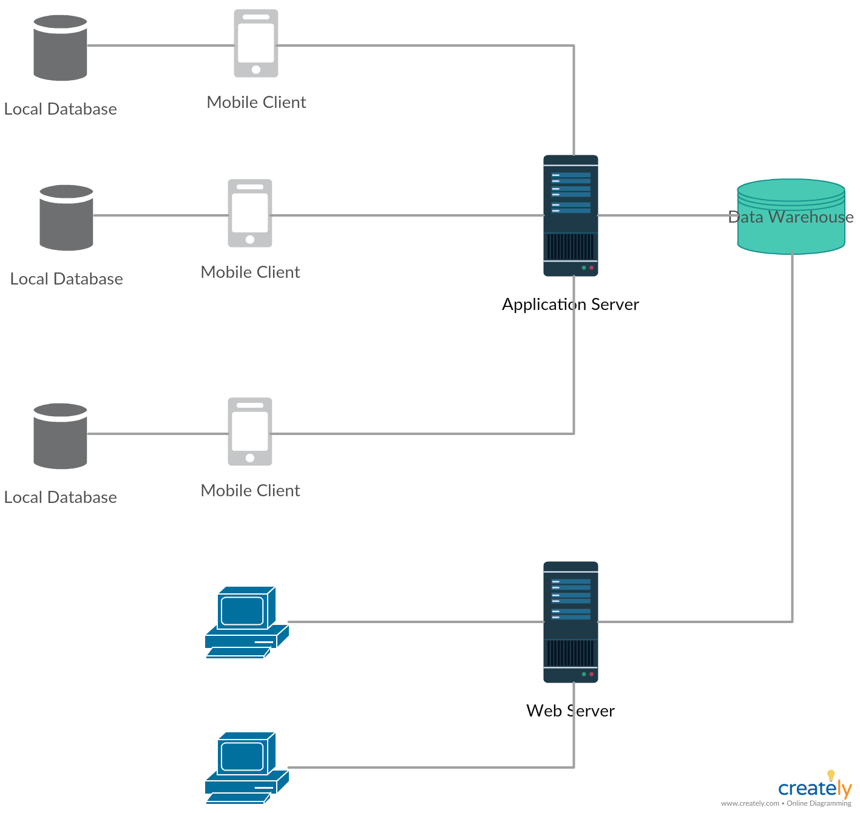
Architecture Diagram

Slide 10
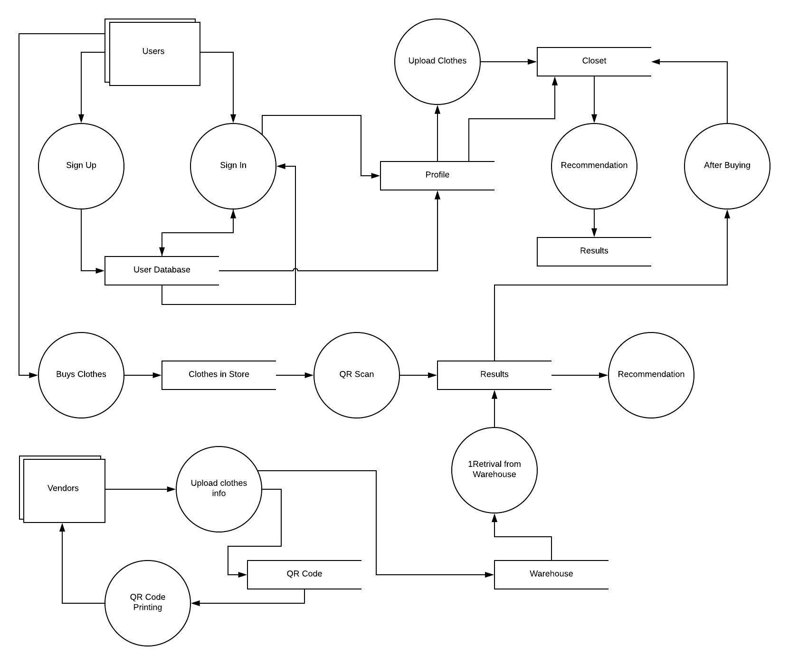
Work Flow

Slide 11
References
[1] Dmitry Ignatov and Andrey Ignatov, “Decision Stream:Cultivating Deep Decision Trees” 2017 International Conference on Tools with Artificial Intelligence.
[2] Jing-Rong Chen Yu-Heng Lin and Yih-Guang leu , “Predictive Model Based on Decision Tree Combined Multiple Regressions” 2017 13th International Conference on Natural Computation, Fuzzy Systems and Knowledge Discovery (ICNC-FSKD 2017).
[3] Sumit Tiwari , “An Introduction To QR Code Technology” 2016 International Conference on Information Technology.
[4] Qingqing. Tu and Le.Dong , “An Intelligent Personalized Fashion Recommendation System” 2010 International Conference on Communications, Circuits and Systems (ICCCAS).

