Slide 1
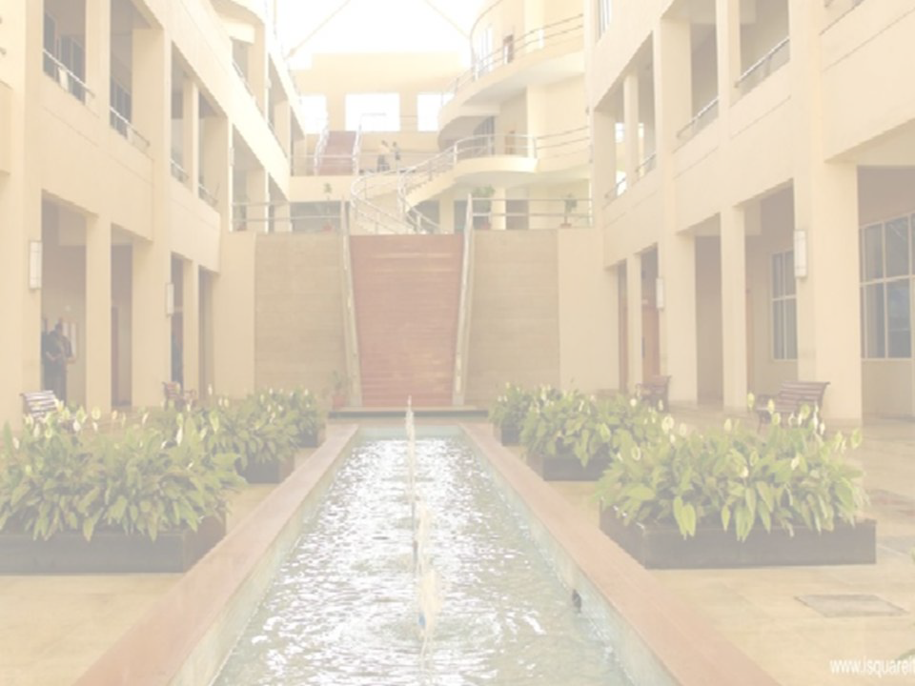
Sampling Theorem and
Band Limited Signals
Smita R Kadam
Department of Electronics and Telecommunication
International Institute of Information Technology, I²IT
www.isquareit.edu.in

Slide 2
BAND LIMITED SIGNALS AND SAMLING
OBJECTIVE : To discuss
Band limited and Time limited signals
Narrowband signals and Narrowband systems
What is Sampling?

Slide 3
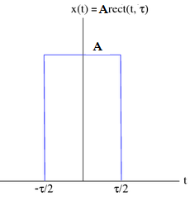
Time limited signal –
A signal which has non zero value only over a certain interval of time and zero value outside this time interval is called Time limited signal
In the signal below
x (t)= A rect (t, τ)
‘A’ is amplitude of Rectangular pulse for the interval
– τ/2 to + τ/2
outside this time interval of ‘ τ ’ amplitude
value is zero

Slide 4
Examples of time limited signals
X₁(t)
X (t)
X (-t)
-1 1
-1 1
-1 1
X₂(t)
X _{e}(t)
X_{o}(t)
-1
-1
-1 1
-1
-1

Slide 5
Band Limited Signal -
A band limited signal is one whose Fourier transform (frequency spectrum) is non zero over a finite interval on frequency axis
Suppose x(t) is a signal whose Fourier transform is X(W)
There exist a positive number ‘W’ such that X (f) is non zero in the interval (-W to W) on frequency axis
‘W’ is also called the bandwidth of the signal which is also highest frequency component in x (t)
X(w)
Band limited signal
-w 0 w

Slide 6
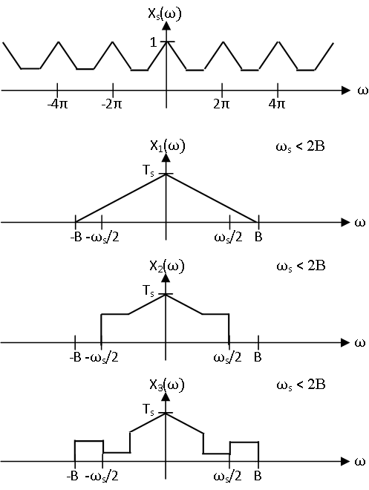
Examples of Band limited signals
G(f)
-B B

Slide 7
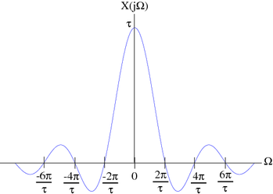
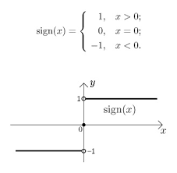
Band unlimited signal
-∞
∞
-∞
∞
Time unlimited signal
∞
-∞

Slide 8
Why band limited signal?
If a Continuous Time (C.T.) signal is to be uniquely represented and recovered from its samples, then the signal must be band-limited.
Time limited functions are not band limited and
Band limited functions are not time limited
Important property of band limited signals is that they slowly change in time
Fourier transform of a time limited rectangular function shown here is not a band limited signal as it has non zero values over infinite range on frequency axis
Sinc (f)
rect(t)
A/f
A
Fourier Transform pair
T
-f
-f
-t
t

Slide 9
Narrow band signals
A signals whose frequency spectrum is limited to narrow band
Modulating and modulated signals are band limited signals
Their spectral width cannot be infinite in practice
Frequency contents of Speech signal 300-3 KHz
Music signals 20-20 KHz
Television information 0-5 MHz
When such a signal modulate a carrier signal of very high frequency then spectrum of this modulated signal becomes Narrow band signal
Examples of narrowband signals found in wireless applications such as Communication, Radars, Positioning, Sensing and Remote control

Slide 10
Narrow band systems
Systems that has small bandwidth is known as a narrowband system
Examples of narrowband systems are SSBSC,DSBSC,DSBFC
Systems that has large bandwidth is known as a wideband system
Examples of wideband systems are FM,PCM,TDM etc
The narrowband systems have higher bandwidth efficiency whereas
Wideband systems are less bandwidth efficient

Slide 11
What is Sampling? Sampling is the process of converting continuous time signal into discrete time signal by sensing analog signal value at discrete instants of time To convert this discrete time signal back to continuous time signal without error, there is a condition related to rate at which these samples should be taken and this condition is given by sampling theorem

Slide 12
What is need of sampling?
All real life signals are continuous time signals which carries message signal
Digital systems can not process continuous time signals so continuous time signal need to be converted into digital form
Analog to digital conversion sets foundation for modern digital communication systems
Extensive use of Digital technology

Slide 13
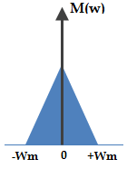
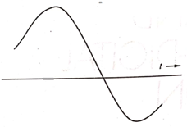
Sampling theorem proof
Consider a message signal m(t) whose spectrum M(w) is band limited to Wm Hz
M(f) = 0 , w >
Non zero, -B to B
Band limited signal m(t) has its Fourier transform M(w) limited within interval (– Wm to Wm)
‘Wm’ is the maximum frequency component in message signal m(t)
If m(t) has multiple frequency components then maximum frequency component value is considered as Wm
m(t)
BW

Slide 14
Consider a periodic impulse train c(t) as a carrier with fundamental time period Ts which is also called as sampling period or sampling interval
Ws is angular frequency given as
Ws =
This impulse train c(t) is written as
c(t) =
Consider a sampler circuit that multiplies two continuous time signals m(t) and c(t)
Generates a sampled signal s(t) as shown in diagram
S(t) has many impulses and strength of every impulse is equal to instantaneous value of signal m(t) given time
Samples are spaced at Ts intervals

Slide 15
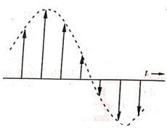
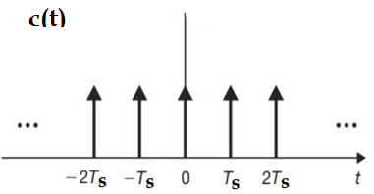
Sampling
m(t)
S(t)
Sampler

Slide 16
S(w) is spectrum of signal s(t) given by
s(t) = m(t) δ_{Ts}(t)
As per the property of Fourier transform multiplication of two signals in time domain is equal to convolution in frequency domain which can be written as
S(w)= [ M(w)* C(w) ]
Fourier transform of periodic pulse train c(t) is written as
S(w) = [ M(w) * ]
=
=

Slide 17
Using property of impulse function
x (t)
S(w) =
=
when, n= 0
s(w) =
Band gap
Ws > 2Wm

Slide 18
Sampling theorem
From the diagram above we see that
(Ws - Wm) > Wm
Ws > 2Wm
This difference between Wm and (Ws -Wm) is called Guard band
When there is no overlapping between triangles of high frequency components and low frequency components of message signal then
original message signal can be reconstructed (Ws - Wm) > Wm
Sampling Theorem statement:
A signal can be represented in samples and recovered back when sampling frequency is greater or equal to twice of maximum frequency component present in the signal
Nyquist criterion:
Minimum possible value of sampling frequency
when the sampling frequency Fs is equal to twice of maximum frequency component in message signal
Fs = 2Fm or Ws = 2Wm

Slide 19
Nyquist criterion and Aliasing
Ws = 2Wm
w
-3ws -2ws -ws ws 2ws 3ws
0
Ws < 2Wm
w
-3ws -2ws - ws ws 2ws 3ws
0
overlapping

Slide 20
Aliasing:
If high frequency components in the DSBSC spectrum such as
(Ws - Wm) to (Ws + Wm) or (-Ws - Wm) to (-Ws + Wm)
appears in the low frequency part of spectrum (-Wm to +Wm) due to overlapping then this effect is called aliasing
To avoid aliasing anti aliasing filters are used
Anti aliasing filter first allows m(t) and cuts the signal spectrum at Wm
For digital telephony anti aliasing filter with a cut off frequency of 4 KHz is used with a sampling frequency of 8 KHz

Slide 21
Why band limited signals for sampling?
If message signal is not band limited then its spectrum is not confined within finite intervals rather extended till infinity
After sampling the repeated spectrum will be with overlapping
Band limited signals can be reconstructed exactly from its discrete time samples without error

Slide 22
References
R Taub, D Schilling and G Saha, Principles of Communication Systems, 3rd edition. Mc Graw Hill, 2012
D Roddy, J Coolen, Electronic Communication, 4th edition,Pearson, 2011
B P Lathi, Zhi Ding, Modern Digital and Analog Communication systems,4th edition

Slide 23
Thank You!
For any queries
Contact: smitak@isquareit.edu.in

