Slide 1
TYPES OF SAMPLING IN ANALOG COMMUNICATION
Smita R Kadam
Department of Electronics and Telecommunication
International Institute of Information Technology, I²IT
www.isquareit.edu.in

Slide 2
What is Sampling? Sampling is the process of converting continuous time signal into discrete time signal by sensing analog signal value at discrete instants of time To convert this discrete time signal back to continuous time signal without error, there is a condition related to rate at which these samples should be taken and this condition is given by sampling theorem

Slide 3
What is need of sampling?
All real life signals are continuous time signals which carries message signal
Digital systems can not process continuous time signals so continuous time signal need to be converted into digital form
Analog to digital conversion sets foundation for modern digital communication systems
Extensive use of Digital technology

Slide 4
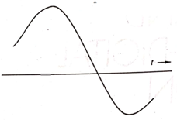
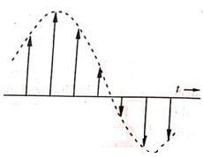
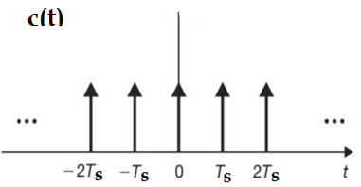
Process of Sampling
m(t)
S(t)
Sampler

Slide 5
Types of sampling
Ideal sampling / Impulse sampling/ Instantaneous sampling
Natural sampling
Flat top sampling

Slide 6
Ideal sampling
A message signal m(t) is multiplied with a periodic pulse train
c(t), using a switching sampler
Pulse train is given by equation
c(t) =
Width of impulse ‘τ’ is very small reaching to zero appearing at ‘Ts’ intervals
Short pulse means less energy per sample
‘Ts’ is sampling interval
Samples represents modulating signal at the instant of sampling

Slide 7
Ideal sampling
Message signal, m(t)
t
Periodic Pulse train, c(t)
-6Ts -4Ts -2Ts -Ts 0 Ts 2Ts 4Ts 6Ts
t
t
Ideally sampled signal ,s(t)

Slide 8
Limitations of Ideal sampling
Practically not possible to generate pulse train with very small width that tends to Zero (0)
Very small pulse width, so sampled signal has very less energy at every sample, so largely affected by noise interference
Very high noise interference

Slide 9
Natural sampling/PAM
Periodic pulse train c(t) is, with finite pulse width and
every sample is with sufficient energy, where impulse sampling has almost zero energy
Amplitude of pulses vary in proportion with modulating signal
‘Ts’ is periodic time of pulse train acting as a periodic switching signal to the modulator
Natural sampling is also referred as natural PAM where top of the pulse follow the shape of modulating signal
Sampling frequency Fs =1/Ts

Slide 10
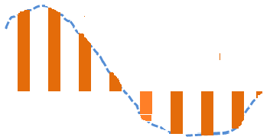
Natural sampling
Message signal, m(t)
t
τ
Periodic Pulse train, c(t)
t
-6Ts -4Ts -2T -Ts 0 Ts 2Ts 4Ts
Naturally sampled signal ,s(t)
t

Slide 11
Natural sampling Equation
Fourier series of an un modulated pulse train c(t) is given as
C(t) = a₀ +
= a₀ + a₁ cos + a₂ cos +.....
We have,
S(t) = m(t) . C(t)
S(t) = a₀ .m(t)+ a₁ m(t). cos + a₂ m(t). cos +.....
above equation shows that sampled signal consist of modulating signal m(t) multiplied by a DC term a₀
And series of DSBSC type components

Slide 12
Natural sampling
Modulating signal spectrum is indicated by M(f) and Wm is the highest frequency component
From the spectrum of sampled signal M’(f) , it is obvious that all the modulating signal spectrum is contained in the baseband part of the spectrum
Original baseband signal m(t) and spectrum M(f) lies in almost same band (then why to use natural PAM ?)
Pulse modulation allows pulses carrying different modulating signals to be interleaved in time, known as time division multiplexed (TDM) signal
To prevent lower edge of the DSBSC spectrum( fs -Wm) from overlapping with low-frequency spectrum (0 - Wm), the separation Δ between these two must not be less than zero

Slide 13
Spectrum-Natural sampling
M(f)
spectrum
density
Aw
a) Spectrum for the modulating signal
0
W
Wm
M’(f)
a₀ Aw
a₁ Aw
a₂ Aw
0
Wm
fs -Wm
fs
fs +Wm
2fs-Wm
2fs
2fs +Wm
b) Spectrum for the natural PAM wave

Slide 14
Natural sampling
This condition imposed on the sampling frequency states that the sampling frequency must be at least twice the highest frequency in modulating signal- sampling theorem
If sampling condition is not met then, parts of the spectra may overlap and once such overlap is allowed to occur then spectra can not be separated by filtering
High frequency component in DSBSC spectrum (fs -w) appear in the low frequency part of the spectrum, effect is termed as aliasing

Slide 15
Aliasing effect - Natural sampling
M’(f)
Part of the Spectrum for the natural PAM Showing the required separation
a₀ Aw
a₁ Aw
0
Wm
fs -Wm
fs
fs +Wm
Δ
M’(f)
Spectrum for the natural
PAM wave
a₀ Aw
a₁ Aw
0
fs -Wm
Wm
fs
2fs-Wm

Slide 16
Natural sampling
To avoid aliasing, the modulating signal is first passed through an ant aliasing filter which cuts the signal spectrum off at some value Wm
If the pulse width of the carrier pulse train used in natural sampling is made very short compared to the pulse period ,the natural PAM becomes Instantaneous PAM
Short pulse means less energy per sample and magnitudes of the coefficients a₀,a₁… are directly proportional to the pulse width
Therefore to maintain reasonable pulse energy a sample and hold circuit is used in flat top sampling

Slide 17
Natural sampling
Due to its wideband nature PAM has very restricted range of applications for direct transmission of signals
Minimum noise interference with sampled signals
Applications
In instrumentation systems for computer interfacing
In analog to digital converters (A/D)

Slide 18
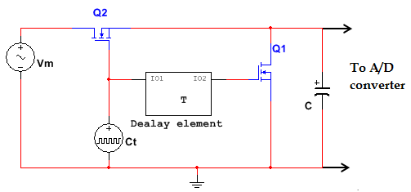
Flat top sampling
Tops of the samples are flat and constant so these are called Flat top sampling or Practical sampling
Sample and hold circuit is used for flat top sampling
Vm is a message signal
Ct is a periodic pulse train of pulse width ‘τ’ and interval Ts
A periodic train of clocking pulse Ct controls switching of transistor Q1

Slide 19
Sample and Hold circuit
Instantaneous samples from message signal are passed to the capacitor ‘C’ whenever ‘Q₁’ is ON
Each sample is held in the capacitor for time period ‘T’
A delayed clock pulse c(t) operate the transistor switch Q₂ to discharge the capacitor before the next sample arrives
In this way flat topped samples are formed that provide the input to A/D converter

Slide 20
Flat-top sampling
Message signal, m(t)
τ
Periodic Pulse train, c(t)
-6Ts -4Ts -2T -Ts 0 Ts 2Ts 4Ts
Flat top sampled signal, s(t)

Slide 21
Flat-top sampling
Frequency spectrum of this flat topped samples M(f) is denoted
M(f) = A. M(f) e^{-jπft} . Sinc fT
A is constant
Exponential term indicates effect of time delay ‘T’ which does not distort the message signal
sinc fT represents a amplitude distortion which must be corrected
Also called as Pulse amplitude sampling (PAM)
High noise interference
Wide band in nature so restricted range of applications for direct transmission of signal
Used as a intermediate stage in Pulse code modulation
Used in instrumentation system and in analog to digital conversion for computer interfacing

Slide 22
Aperture effect
The effect that flat topped samples have on the spectrum is termed as Aperture effect
Sinc fT =
Here, sampling of baseband signal cannot be recovered exactly by passing the samples through an ideal low pass filter
Distortion is due to flat top sampling (not large)
If pulse width ‘τ’ is very small aperture distortion will be small and as τ 0 (instantaneous sampling) distortion approaches ‘0’
This distortion coming from the aperture effect is compensated in the receiver by using equalizer filter
Equalizer filter has reverse characteristics to that of Sinc function
Flat top sampling has the merit that it simplifies the design of the electronic circuitry used to perform sampling operation

Slide 23
References
R Taub, D Schilling and G Saha, Principles of Communication Systems, 3rd edition, Mc Graw Hill, 2012
D Roddy, J Coolen, Electronic Communication, 4th edition, Pearson, 2011
B P Lathi, Zhi Ding, Modern Digital and Analog Communication systems, 4th edition

Slide 24
Thank You!!
For any queries
Contact: smitak@isquareit.edu.in

