Slide 1
Strings in Python
Dr. Varsha Degaonkar
Department of Electronics and Telecommunication
Hope Foundation’s
International Institute of Information Technology, I²IT
www.isquareit.edu.in

Slide 2
Contents:
String traversal using indexing
Concatenating String
Appending String
Multiplying String
Escape Character
Strings are Immutable
String formatting operator

Slide 3
Strings in Python:
String is made by 1 or more characters
Character can be a letter, digit, whitespace, or any other symbol.
Strings are enclosed in a single, double or triple quotes.
Python has a built-in string class “str” that has many useful features.

Slide 4
Strings in Python:
Ex.:
name=“India”
country=name
graduate=‘N’
nationality=str(“Indian”)

Slide 5
Strings in Python:
# Ex.:
str1 = 'I2IT'
print(str1)
str2 = "I2IT"
print(str2)
str3 = '''I2IT'''
print(str3)
# triple quotes- for multiple lines
str4 = """Hello, welcome to
the world of Python"""
print(str4)

Slide 6
String traversal using indexing:
If a string has total n number of characters, then
Index of 1st character in string is 0 and
last character is n-1.
Single character is a string with length 1.
Square bracket [ ] is used to access elements of string.
Example to get a character at position 4:
ch = "Hello, World!" print(ch[4])

Slide 7
String traversal using indexing:
#Ex.:
str = "I2IT!"
index = 0
for i in str:
print("str[", index, "] = ", i)
index+=1
#Output:
str[ 0 ] = I
str[ 1 ] = 2
str[ 2 ] = I
str[ 3 ] = T
str[ 4 ] = !

Slide 8
String traversal using indexing:
#Ex.:
str = "Hello, Welcome to world of Python!"
index = 2
print(str[index])
print(str[index * 3 + 1 ])
Output:
l
W

Slide 9
String traversal using indexing:
Negative Index:
To display the string from end, negative indexing is used.
Ex.:
To get the 6th character from end of the string.
ch = "Hello, World!" print(ch[-6])
Output:
W

Slide 10
String traversal using indexing:
Index from last
-12 | -11 | -10 | -9 | -8 | -7 | -6 | -5 | -4 | -3 | -2 | -1
H | e | l | l | o |  | W | o | r | l | d | !
0 | 1 | 2 | 3 | 4 | 5 | 6 | 7 | 8 | 9 | 10 | 11
String
Index from start

Slide 11
Concatenating, appending, multiplying String:
Concatenating String:
Concatenate means combining or joining two strings.
This is done using + operator.
Ex.
str1 = "Hello" str2 = "World" str3 = str1 + str2 print(str3)
Output:
HelloWorld

Slide 12
Concatenating, appending, multiplying String:
Concatenating String:
Ex.
By adding space in-between:
str1 = "Hello" str2 = "World" str3 = str1 + “ " + str2 print(str3)
Output:
Hello World

Slide 13
Concatenating, appending, multiplying String:
Appending String:
Append means, add something at the end of same string.
We can add one string at the end of another string using the += operator.
Example:
str='Hello! '
name=input('Enter your name: ')
str+=name
print(str)
str+=', Welcome to the Python programming.'
print(str)
Output:
Enter your name: Pune
Hello! Pune
Hello! Pune, Welcome to the Python programming.

Slide 14
Concatenating, appending, multiplying String:
Multiplying String:
Multiply means to repeat the string.
This can be done by using the * operator.
Example:
ch ='Hello! '
print(ch)
Output:
Hello!
Example:
ch ='Hello! '
print(ch * 4)
Output:
Hello! Hello! Hello! Hello!

Slide 15
Concatenating, appending, multiplying String:
Example:
str1='Hello! '
var=7
str2=str1+ var
print(str2)
Output:
TypeError: must be str, not int
Example:
str1='Hello! '
var=7
str2=str1+ str(var)
print(str2)
Output:
Hello! 7

Slide 16
Escape Character:
Escape Character is used in string to insert illegal characters.
Escape character: backslash ‘\’
Ex. We want to print following string.
We are the “Punekars" from Maharashtra.
If We will write:
print(“We are the “Punekars" from Maharashtra.”)
It will give us syntax error. So we have to use escape character.
print(“We are the \“Punekars\" from Maharashtra.”)

Slide 17
Raw String:
Raw string literal which is prefixed by ‘r’ passes all the characters as it is.
They are not processed in any special way, not even the escape sequences.
Example:
print('\n Hello!')
print(r'\n Hello!')
Output:
Hello!
\n Hello!

Slide 18
Strings are Immutable:
An immutable object is an object that is not changeable and its state cannot be modified after it is created.
In Python, a string is immutable.
We cannot overwrite the values of immutable objects.
Whenever we try to modify the existing string variable, a new string is created. i.e. it is stored at new memory location.
id() function displays the memory address.

Slide 19
Strings are Immutable:
str1="Hello "
print("str1 is: ", str1)
print("ID of str1 is:", id(str1))
str2="World!"
print("\nstr2 is: ", str2)
print("ID of str2 is:", id(str2))
str1+=str2 # appending the string
print("\nstr1 after appending is:", str1)
print("ID of str1 is:", id(str1))
str3=str1
print("\nstr3 is: ", str3)
print("ID of str3 is:", id(str3))
str1 is: Hello
ID of str1 is: 139957016469944
str2 is: World!
ID of str2 is: 139957016469888
str1 after appending is: Hello World!
ID of str1 is: 139957016500528
str3 is: Hello World!
ID of str3 is: 139957016500528

Slide 20
Strings are Immutable:
str1="Hello "
print("str1 is: ", str1)
print("ID of str1 is:", id(str1))
str2="World!"
print("\nstr2 is: ", str2)
print("ID of str2 is:", id(str2))
str1+=str2 # appending the string
print("\nstr1 after appending is:", str1)
print("ID of str1 is:", id(str1))
str3=str1
print("\nstr3 is: ", str3)
print("ID of str3 is:", id(str3))
str1 is: Hello
ID of str1 is: 139957016469944
str2 is: World!
ID of str2 is: 139957016469888
str1 after appending is: Hello World!
ID of str1 is: 139957016500528
str3 is: Hello World!
ID of str3 is: 139957016500528
Since str1 and str3 both point to the same value, their address is exactly same

Slide 21
String formatting operator:
To format variables in tuple "%" operator is used.
Ex:
We have a “name” variable with city name stored in it, and we would like to display it.
# This displays out "Hello, Pune!”
name = “Pune”
print("Hello, %s!" % name)
Output:
Hello, Pune!

Slide 22
String formatting operator:
Example:
# This displays “Kumar is 21 years old."
str = “Kumar”
var = 21
print("%s is %d years old." % (str, var)

Slide 23
String formatting operator:
Argument specifiers in Python:
%c - character
%s - String
%d or %i – Signed decimal Integers
%u - Unsigned decimal Integers
%o – octal integer
%x or %X - Integers in hex representation (lowercase/uppercase)
%e or %E – Exponential notaion
%f – Numbers in Floating point
%.<number of digits>f – number of digits to right of dot in in Floating point number.

Slide 24
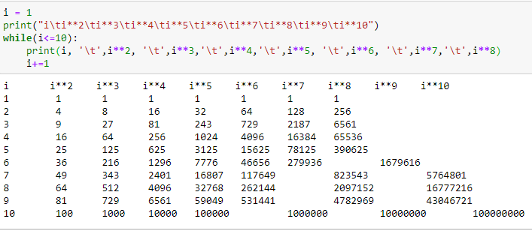
String formatting operator:
# check following code:

Slide 25
String formatting operator:
# check following code:
Columns are misaligned

Slide 26
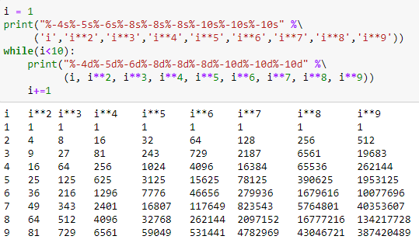
String formatting operator:
# check following code:

Slide 27
String formatting operator:
# check following code:
The – after % indicates left justification
%–10d means left justified 10 character number

Slide 28
References:
“Python Programming using Problem Solving Approach”, by Reema Thareja, Oxford University Pres.

Slide 29
Thank you!!

