Slide 1


ON-Line and OFF-Line UPS
Dr. Varsha Degaonkar
Department of Electronics and Telecommunication
Hope Foundation’s
International Institute of Information Technology, I²IT
www.isquareit.edu.in

Slide 2
Contents
ON-Line UPS
OFF-Line UPS
Battery AH
Back Up Time
Battery Charger Rating

Slide 3
Uninterruptable Power Supplies (UPS)
Need and Objectives:
1) Provide uninterruptible AC power
2) Pure sinusoidal O/P with low distortion
3) Regulation
4) Transient suppression
5) Frequency stability
6) Isolation of load from mains
Types:
1) On line UPS system (inverter preferred or continuous)
2) Off line UPS system (line preferred)
3) Line inter-active system

Slide 4
On-Line UPS System
(Inverter preferred or continuous)
Block diagram

Slide 5
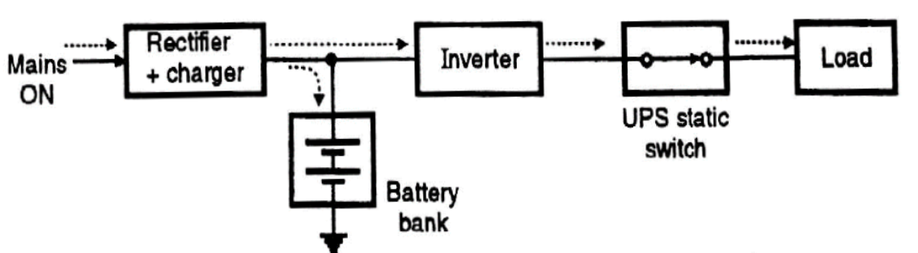
Operation of On-Line UPS System
(Inverter preferred or continuous)
Mode I: Mains ON

Slide 6
Operation of On-Line UPS System
(Inverter preferred or continuous)
Mode I: Mains ON
In On-line UPS, Regardless of the mains supply ON or OFF, the inverter operated on battery works.
As mains power is present, charging of batteries takes place.
The switching time is considered as zero for these supplies.
Batteries used are sealed maintenance free
Low running time (~ 10 to 30 min).

Slide 7
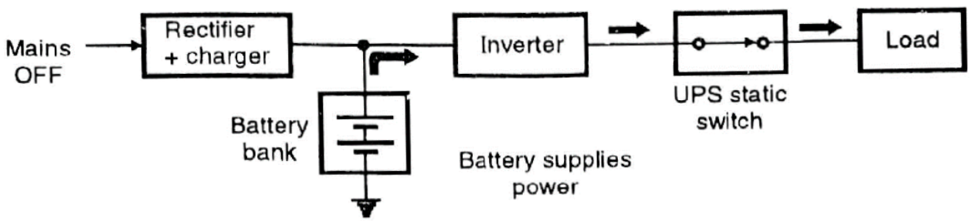
Operation of On-Line UPS System
(Inverter preferred or continuous)
Mode II: Mains OFF

Slide 8
Operation of On-Line UPS System
(Inverter preferred or continuous)
Mode II: Mains OFF
The UPS supplies power to load, when the mains is OFF, till the batteries become discharged.
The batteries will start charging once again when the mains supply start again.

Slide 9
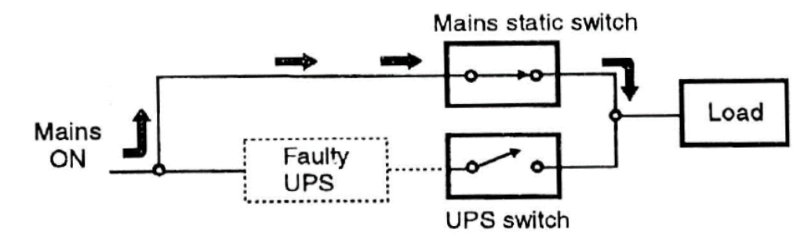
Operation of On-Line UPS System
(Inverter preferred or continuous)
Mode III: UPS Fail / Standby

Slide 10
Operation of On-Line UPS System
(Inverter preferred or continuous)
Mode III: UPS Fail / Standby
If any fault occurs, UPS inverter is bypassed using a Triac.

Slide 11
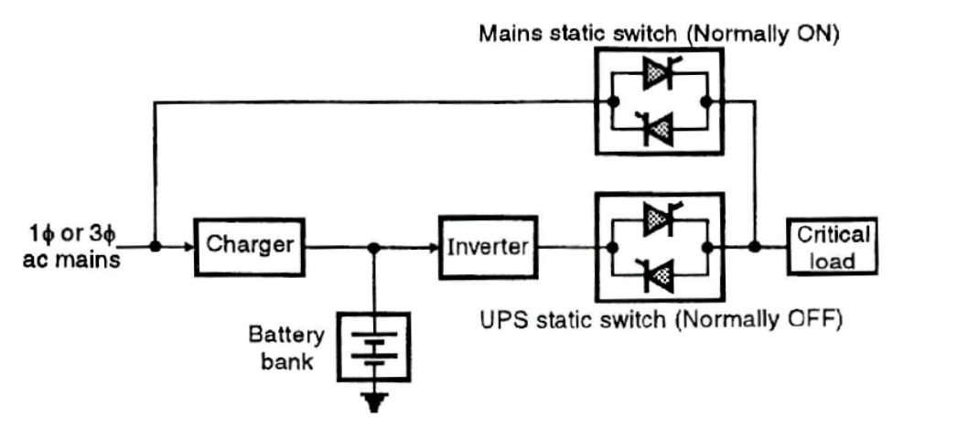
OFF-Line UPS System (Line preferred)
Block Diagram:

Slide 12
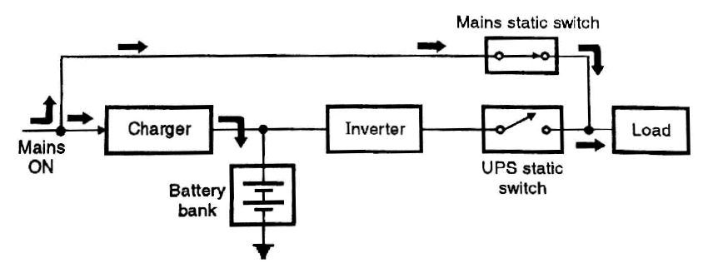
Operation of OFF-Line UPS System
(Line preferred)
Mode I: Mains ON

Slide 13
Operation of OFF-Line UPS System
(Line preferred)
Mode I: Mains ON
When the mains is ON, the inverter circuit is OFF.
Load gets coupled straight to the Mains supply.

Slide 14
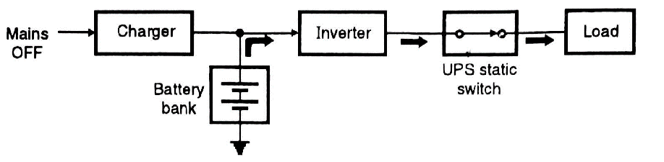
Operation of OFF-Line UPS System
(Line preferred)
Mode II: Mains OFF

Slide 15
Operation of OFF-Line UPS System
(Line preferred)
Mode II: Mains OFF
When the mains supply is OFF, then only inverter is switched ON.
Switching time < 5 ms
The applications where small interruption is tolerated, these are used.
Sealed or lead-acid batteries are used.
Running time ~ 10 to 30 min.

Slide 16
Line Interactive UPS System
Mode I: Mains ON
Mode II: Mains OFF

Slide 17
Batteries Used in UPS System
1) Lead acid batteries.
2) Nickel-Cadmium (Ni Cd) batteries
3) Sealed maintenance free batteries (SMF)
Lead acid batteries are most commonly used in UPS.

Slide 18
Batteries Used in UPS System
Battery Capacity: Ampere Hour (AH)-
𝐴𝑚𝑝𝑒𝑟𝑒 𝐻𝑜𝑢𝑟 = 𝐴𝐻 = 𝐼 × Δ𝑇 | 𝑚𝑖𝑛
I = Constant Discharge current
Δ𝑇 = Time period beyond which voltage of battery decreases below the voltage level (final discharge voltage)

Slide 19
Batteries Used in UPS System
Battery Charging:
The battery Charging profile dependent on the type of the battery chemistry.
Following figure shows the profile for Lead Acid Batteries:

Slide 20
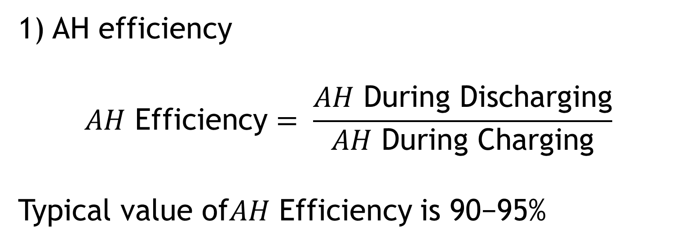
Battery Efficiency

Slide 21
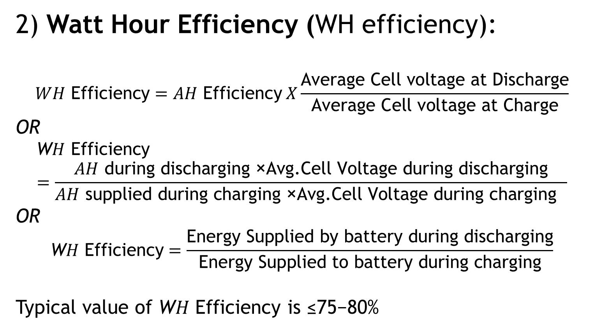
Battery Efficiency

Slide 22
References:
Source: http://www.circuitstoday.com/ups-uninterruptable-power-supplies

Slide 23
Thank you

